Slide 1
The Effect of Perceived Quality and
Satisfaction on Customer Churn
Hee Jeong
Meng Xu Zhao (Elaine)
Kyung Ahn (Sarah)
Jae Yong Lee (Francisco)

Slide 2


Churn?
Notes:
metric : recall on True instances, accuracy

Slide 3
Data Preparation

Slide 4
Attributes | Type
Churn | Nominal
State | Nominal
Account Length | Quantitative
Area Code | Nominal
Phone Number | Nominal
International Plan | Nominal
Voicemail Plan | Nominal
No. of Voicemail Messages | Quantitative
No. of Call Customer Service | Quantitative
Total Day Min. | Quantitative
Total Day Calls | Quantitative
Attributes | Type
Total Day Charge | Quantitative
Total Evening Min. | Quantitative
Total Evening Calls | Quantitative
Total Evening Charge | Quantitative
Total Night Min. | Quantitative
Total Night Calls | Quantitative
Total Night Charge | Quantitative
Total International Min. | Quantitative
Total International Calls | Quantitative
Total International Charge | Quantitative

Slide 5
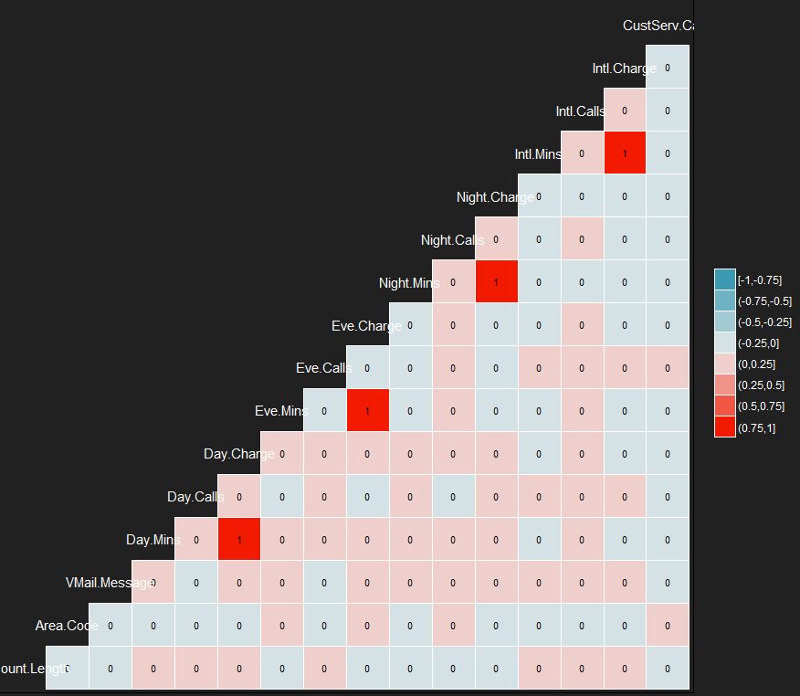
Eliminate attributes
Area Code
Phone Number
State
Voicemail Plan
Correlation Plot
Day Charge
Evening Charge
Night Charge
International Charge

Slide 6
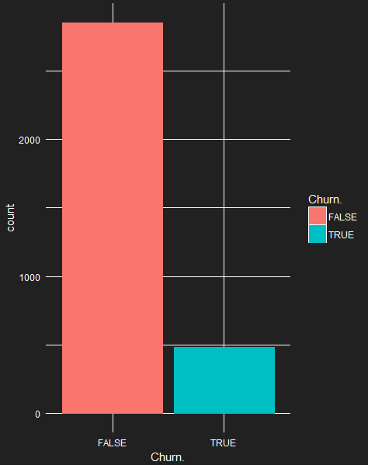
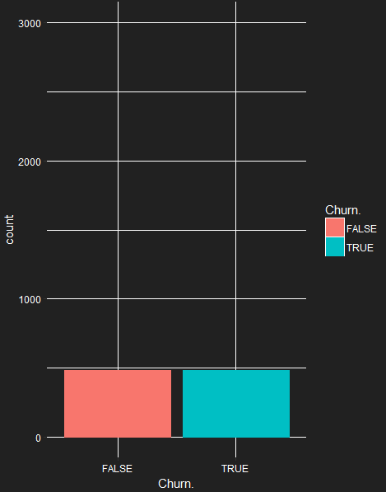
Imbalanced Class
Downsampling

Slide 7
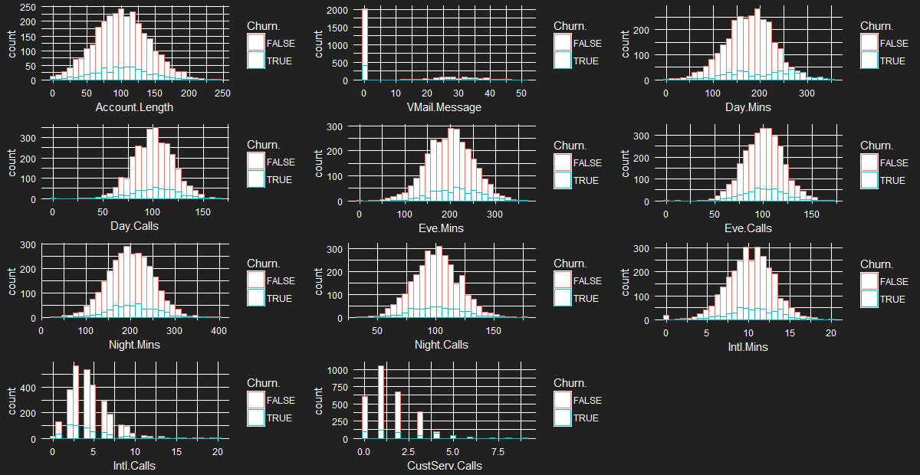
Normal distribution
No missing values
Remove outliers
Notes:
par(mfrow=c(3,3), bg = rgb(33/255,33/255,33/255), fg = "white", col.axis = "White", col.lab = "White", col.main = "white")
col = "#b4a7d6", col = "#e06666", col = "#9fc5e8"

Slide 8
Predictive Modeling/Classification

Slide 9
International Plan
False
True
Customer Service Calls
True
Decision Tree
<= 3
> 3
Day Minutes
True
<= 221.8
> 221.8
False
True

Slide 10
Naive Bayes
Not suitable
Limitations
Treatment
Discretize numeric variables
Probability Density Function
Loss of Information

Slide 11
Analysis of Deviance Table
Df Deviance Resid. Df Resid. Dev Pr(>Chi)
NULL 2302 1867.4
Account.Length 1 0.395 2301 1867.0 0.5298190
Int.l.Plan 1 128.485 2300 1738.5 < 2.2e-16 ***
VMail.Plan 1 33.488 2299 1705.0 7.172e-09 ***
VMail.Message 1 1.301 2298 1703.7 0.2539644
Day.Mins 1 130.707 2297 1573.0 < 2.2e-16 ***
Day.Calls 1 0.359 2296 1572.6 0.5492140
Eve.Mins 1 18.681 2295 1554.0 1.545e-05 ***
Eve.Calls 1 0.002 2294 1554.0 0.9686894
Night.Mins 1 5.482 2293 1548.5 0.0192164 *
Night.Calls 1 2.222 2292 1546.2 0.1360864
Intl.Mins 1 11.874 2291 1534.4 0.0005692 ***
Intl.Calls 1 14.783 2290 1519.6 0.0001206 ***
CustServ.Calls 1 94.003 2289 1425.6 < 2.2e-16 ***
---
Signif. codes: 0 ‘***’ 0.001 ‘**’ 0.01 ‘*’ 0.05 ‘.’ 0.1 ‘ ’ 1
Logistic Regression
TOP 3 most-relevant features:
Intl.Plans(Yes)
Day.Mins
CustServ.Calls
Remove non-significant (large p-values) attributes for final model
Notes:
Higher the # -> lower deviance -> better
(change/drop in deviance)
Add each 1 at a time -> large drop, lowers ambiguity in data

Slide 12
Final Model Summary
Coefficients:
Estimate Std. Error z value Pr(>|z|)
(Intercept) -8.644025 0.634054 -13.633 < 2e-16 ***
Int.l.Planyes 1.969735 0.176672 11.149 < 2e-16 ***
VMail.Planyes -1.142282 0.189063 -6.042 1.52e-09 ***
Day.Mins 0.014999 0.001340 11.193 < 2e-16 ***
Eve.Mins 0.007695 0.001415 5.438 5.39e-08 ***
Night.Mins 0.004730 0.001350 3.503 0.000461 ***
Intl.Mins 0.091873 0.025035 3.670 0.000243 ***
Intl.Calls -0.116794 0.032231 -3.624 0.000291 ***
CustServ.Calls 0.471927 0.052752 8.946 < 2e-16 ***
---
Signif. codes: 0 ‘***’ 0.001 ‘**’ 0.01 ‘*’ 0.05 ‘.’ 0.1 ‘ ’ 1
(Dispersion parameter for binomial family taken to be 1)
Null deviance: 1867.4 on 2302 degrees of freedom
Residual deviance: 1426.6 on 2294 degrees of freedom
AIC: 1444.6
Logistic Regression
International plan subscriber ↑ probability of churn
More Day, Evening, Night, International Minutes or more Customer service calls ↑ probability of churn
Notes:
Being an international plan subscriber increases the probability of churn
More day, evening, night or international minutes or more customer service calls increases probability of churn
log(prob of churn)
Positively related

Slide 13
Post-Prediction Analysis

Slide 14
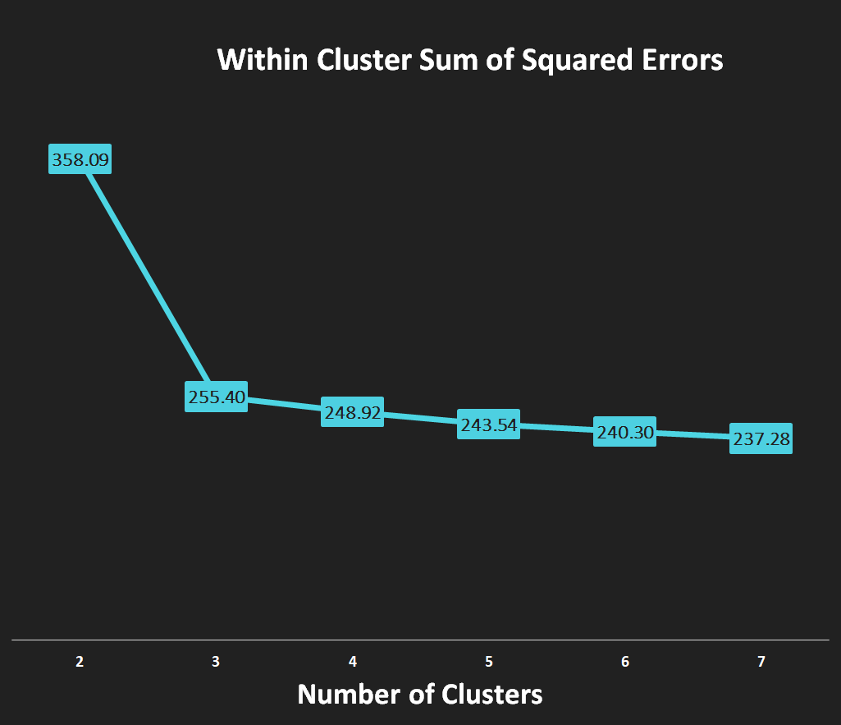
K = 3
K-Means Clustering

Slide 15
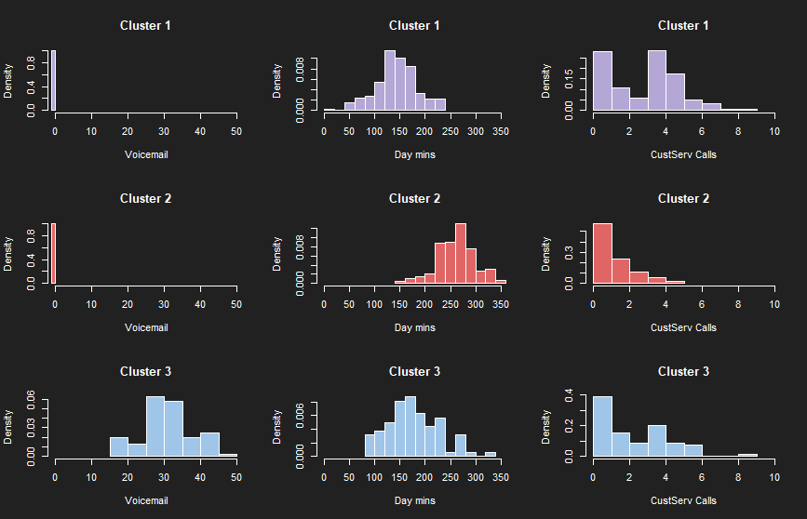
Customer Service Callers
↑ Customer service Calls
↓ Calling minutes
Heavy Users
↑ Calling minutes
Voicemail Users
↑ Voicemail Usage

Slide 16
Conclusions and Recommendations

Slide 17
 | Accuracy | Precision (True) | Recall (True) | ROC Area
Decision Tree | 81.24% | 80.13% | 83.08%
Logistic Regression (on full dataset with classification threshold = 0.5) | 86.6% | 61.2% | 21.9% | 0.814
Logistic Regression (on down-sampling dataset) | 78.1% | 79.4% | 75.9% | 0.832
Decision Tree | 81.24% | 80.13% | 83.08%
Notes:
Prediction = attributes of customers who will churn
Post prediction = attributes of customers who churned

Slide 18
Customer Service Callers | Heavy Users | Voicemail Users
● Problems on Calling | ● High bill | ● Expensive voicemail plan ● Lack of functionality & quality
→ Technical Analysis
→ Surveys
→ Discount Plans
→ Audit current
voicemail plan

Slide 19
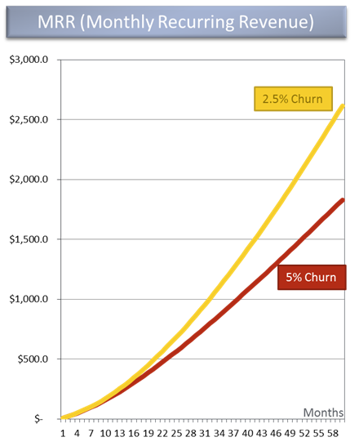
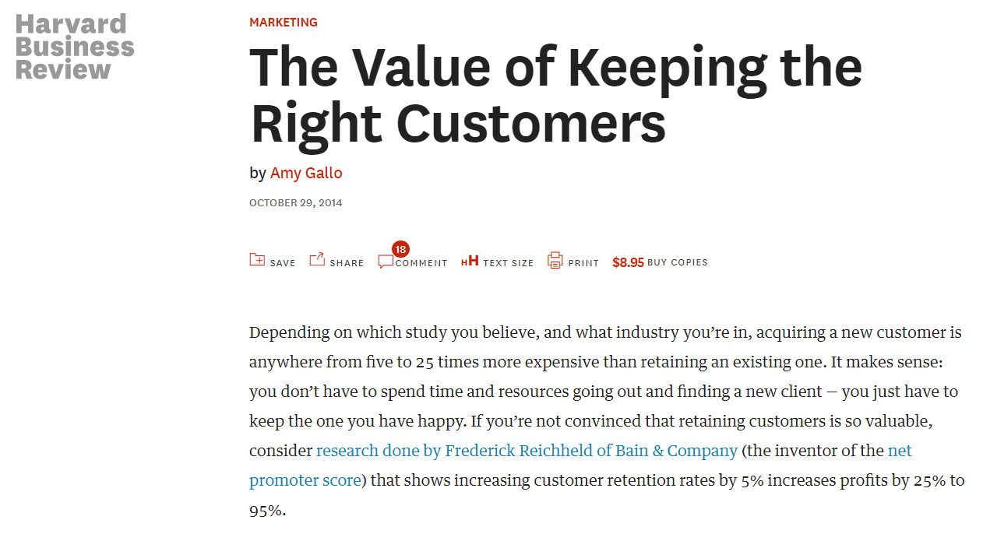
Importance of Churn Prediction Model
Notes:
Acquiring a new customer is anywhere from five to 25 times more expensive than retaining an existing one.
Increasing customer retention rates by 5% increases profits by 25% to 95%
https://www.forentrepreneurs.com/why-churn-is-critical-in-saas/
https://hbr.org/2014/10/the-value-of-keeping-the-right-customers
https://www.quora.com/Why-is-churn-so-important

Slide 20
Questions?

