Slide 1
ListAgg function Applied Use
by Bryan Mack

Slide 2
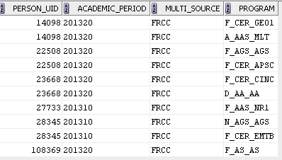
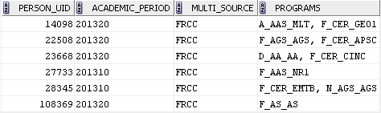
We all know what Pivot tables are, right?

Slide 3
ListAgg Function description
Oracle 11g has introduced a new string aggregation function which is useful in reporting.
Using this method is an excellent way to simplify code while pivoting your columnar data into a single row.

Slide 4
Pivot Methods
There are several Pivot methods:
SYS_CONNECT_BY_PATH
PIVOT keyword
MAX(DECODE( with sequence#
Can generate a sequence by using a statement, such as ROW_NUMBER() OVER (PARTITION BY…)
Custom functions
ListAgg
So why choose ListAgg?

Slide 5
Why choose ListAgg?
Dynamic
It knows how many rows could exist per group
Most simplistic code (my opinion)
Can use concatenated fields
Listagg(program||’:’||mif_value, ‘,’) WITHIN GROUP…
The semi-colon is dynamic
Because it’s new! And new is ALWAYS better, right?

Slide 6
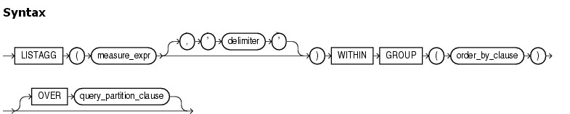
ListAgg Syntax
Source: http://docs.oracle.com

Slide 7
ListAgg Syntax
Required Components
Column(s) to be aggregated
The WITHIIN GROUP keywords
The ORDER BY clause within the grouping
GROUP BY must be used for the entire block

Slide 8
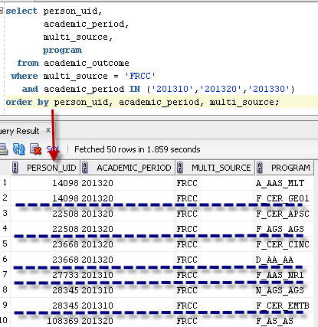
Sample Flat Data

Slide 9
Applied Syntax
select person_uid,
academic_period,
multi_source,
listagg(program, ', ') within group (order by person_uid, academic_period, multi_source) programs
from academic_outcome
where multi_source = 'FRCC'
and academic_period IN ('201310','201320','201330')
group by person_uid, academic_period, multi_source;

Slide 10
Alternative Pivot Method
select person_uid,
academic_period_graduation,
mif_value,
max(decode(programs,1,program,null))||', '||
max(decode(programs,2,program,null)) programs_text
from
(select person_uid, academic_period_graduation, mif_value, program,
row_number() over (partition by person_uid, academic_period_graduation, mif_value ORDER BY person_uid) programs
from mst_academic_outcome)
group by person_uid, academic_period_graduation, mif_value;

Slide 11
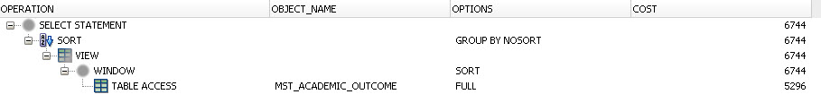
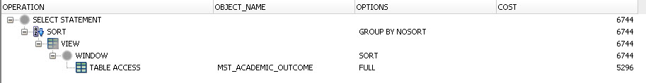
Explain Plans have same cost
Listagg:
Other Method:

Slide 12
Questions????
Bryan.Mack@cccs.edu

