Slide 1
ListAgg Function
Yes, I demonstrated this in 2013 at Coder’s Corner, but I’ve learned more
Bryan L. Mack 04/15/2016

Slide 2


Pivoting Data

Slide 3
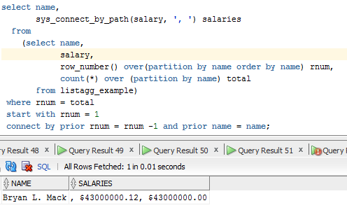
Pivot Options – sys_connect_by_path
Cumbersome, but it works with no sequence number. Still – too lengthy for my taste.

Slide 4
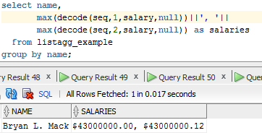
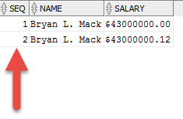
Pivot Options – max(decode(
When you have a sequence number
If no sequence exists, you can create one in-line
You need to know how many entries exist
May need to rtrim the final delimiter or do a REPLACE on extra delimiters

Slide 5
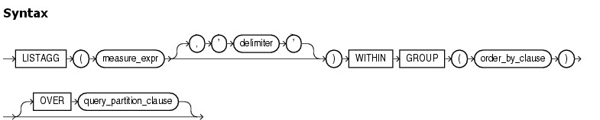
ListAgg
Source: http://docs.oracle.com

Slide 6
Why use ListAgg?
Dyanmic (knows how many rows exist in a group, so is superior to using MAX(DECODE(<seq#
Can use any delimiter you’d like
Can concatenate multiple fields
Simplistic code

Slide 7
ListAgg Syntax – Required Components
Required Components
Column(s) to be aggregated
The WITHIIN GROUP keywords
The ORDER BY clause within the grouping
GROUP BY must be used for the entire block

Slide 8
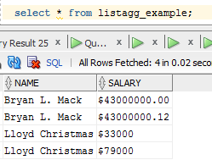
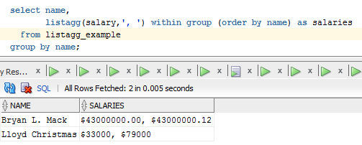
Example #1

Slide 9
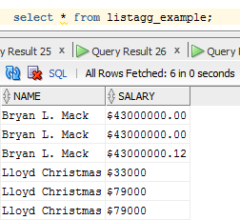
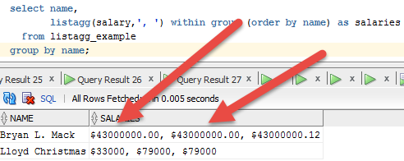
Example #2 – Repeated Values

Slide 10
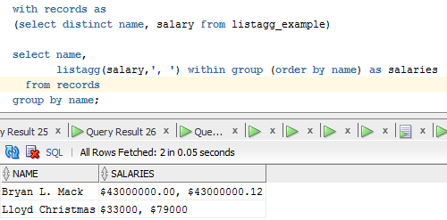
Example #2 – 2 ways to get rid of duplicates
Option #1 – create distinct data set and pull from it:

Slide 11
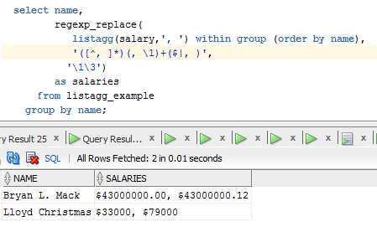
Example #2 – 2 ways to get rid of duplicates
Option #2 – Use Regular Expressions

Slide 12

Sorry – had to find an excuse to show off my daughter

Slide 13
Questions?
Bryan.Mack@cccs.edu

