Slide 1
METEOHACK 2019
- - - -
Team GEOHACK

Slide 2
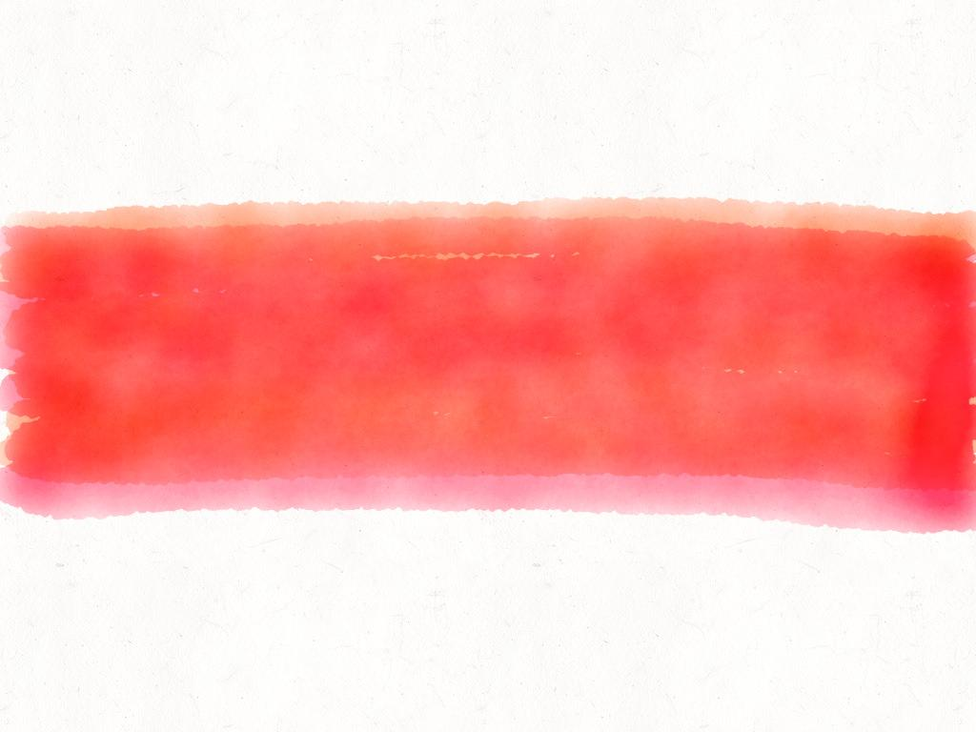
The problem
Currently in Canada there is no system in place to detect flash flood!

Slide 3

730,000,000$
This is the cost of floods in canada since 1970!
Source: https://www.squareoneinsurance.com/water-flood-damage-in-canada

Slide 4
The solution
Use historical watershed flow and current water level plus forecasted rainfall, to generate warnings!

Slide 5


How does it work?
Qo
We check actual current watershed flow
ΔQt
We determine expected water incoming for the next 48h
Qmax
We determine the maximum flow of the past 20 years
If we are near the 20 years limit, we can say this is a dangerous conditions!

Slide 6

A bit more details for ΔQt
We use the following formula:
Previous rain already on the soil (Pp)
Incoming rain (Pf)
Minus soil absorption value, we use (S)
This constant could be improved by using this dataset:
Global Hydrologic Soil Groups (HYSOGs250m) for Curve Number-Based Runoff Modeling
S = 5.38 mm/h

Slide 7

DEMO
https://github.com/flegare/MeteoHackFlashFloodDetection/

Slide 8
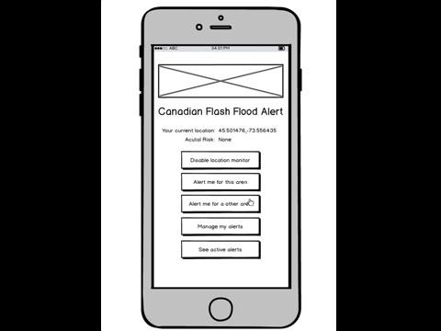
UI MOCKUPS

