Slide 1
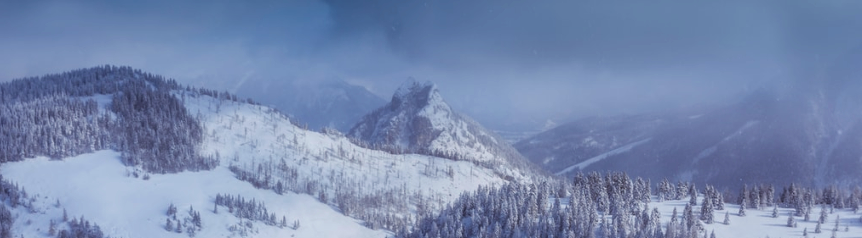






Analysis Report
Team Snowflake
By Ethan, Hong Shun, Fleming

Slide 2
1
Data Exploration
What’s in the dataset?

Slide 3
Shape of dataset
In:
df.shape
Out:
(354288, 38)
From the analysis we can tell that there are 354,288 observations and 38 features.
This is not a relatively large dataset but may require some computational time.

Slide 4
Preview dataset
 | DDate | UserNumber | UserName | Target (Is_gz)
1 | 2015-05-11 | T00_58 | Name_1 | 0
8872 | 2015-11-24 | T00_71 | Name_1 | 1
First looking at the Target variable, it consists of the values 0 and 1. Luckily for us, there are already in their binary form so we can keep it the way it is.
Interestingly, they also provided us the DDate recorded. Normally, time series is used for regression and forecasting, but time series classification can be a possibility.
There are also several irrelevant features such as UserNumber and UserName. The objective is to find whether a transformer has overloaded based on its own features and not if a specific user is more likely to overload a transformer. It is also not practical to base the model on external features due to its inflexibility.

Slide 5
Summary of dataset
 | DType
DDate | datetime64[ns]
DType | object
CT | int64
A0 | float64
The dataset contains a mix of categorical, numerical and date variables.
Most models don't work too well with categorical variables so some data cleansing might be required.

Slide 6
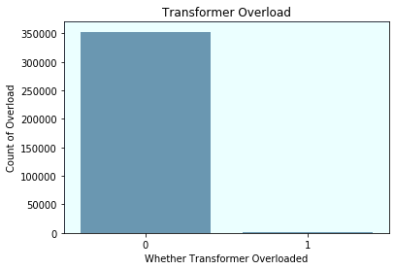
Check for imbalanced data
We can tell that there's a clear imbalance between the two classes. From our experience, if there's a class below 50% of the others, it is considered imbalanced.
 | Count
0 | 352844
1 | 1444

Slide 7
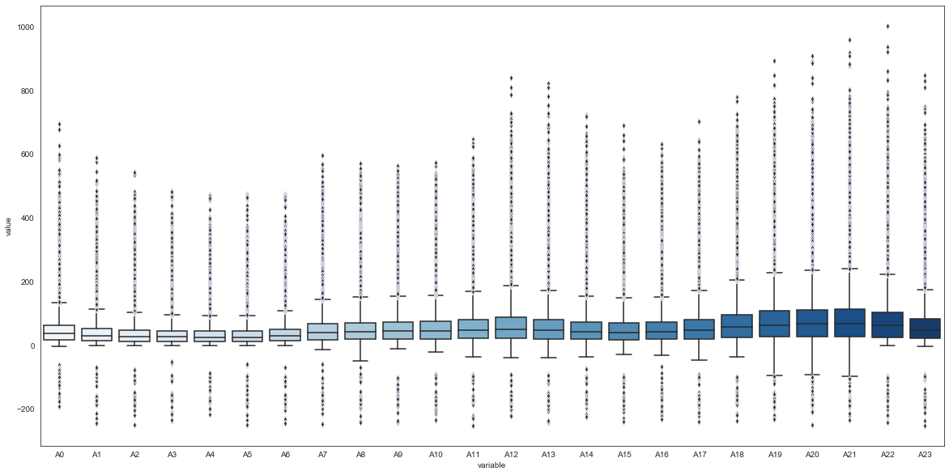
Check for outliers (Plotting)
With box plotting, we can straight away tell the high number of outliers the operating load value variables have.

Slide 8
Check for outliers (Tabular)
 | A0 | A1 | … | A23
Observations | 354288 | 354288 | … | 354288
(%)Above | 5.08% | 5.70% | … | 4.00%
Upper Fence | 135.274 | 113.64 |  | 176.46
Count | 18015 | 20191 | … | 14212
Pandas allows us to view it in a tabular form.
Those are rather high percentages, should be taken note off.

Slide 9
Check for missing values
Looks like there are missing values in the dataset but only from the MaxTemp and MinTemp variables.
The percentage of missing values is far too low to drop it off. Those non-missing data could be valuable to training our model.
 | MaxTemp | MinTemp
Observations | 354288 | 354288
(%)Missing | 0.37% | 0.37%
Count | 1311 | 1311

Slide 10
2
Feature Engineering
Creating meaningful features

Slide 11
Feature Construction
 | DDate
1 | 11/5/2015
2 | 12/5/2015
 | Day | Month
1 | 11 | 5
2 | 12 | 5
Here are some interesting features we could consider.
Every time we see a date column, always remember to extract its individual components.
Finding the ranges between variables can prove useful too
 | MaxTemp | MinTemp
1 | 21.6 | 8
2 | 29.7 | 15.1
 | Temp Range
1 | 13.6
2 | 14.6

Slide 12
3
Dimensionality Reduction
Removing redundant features

Slide 13
Removing Unrelated Features
Our focus is on TRANSFORMERS, are these needed?:
UserNumber
User ID
UserName
User name
EMANumber
Energy meter asset number
Remember, our objective is to determine whether a transformer is overloaded or not based on its state.
Even if a certain user has a higher likelihood of resulting in an overloaded transformer (someone's getting fired! ), including them in the training would serve no practical use.
If we were to change users, or perhaps the user learnt how to better operate it, there’s no way for our model to determine that which leads to inaccurate predictions!
Terminal
Terminal address

Slide 14
4
Data Cleansing
Cleaning our dataset

Slide 15

Handling Outliers
 | A0 | A1 | … | A23
Upper Fence | 135.27 | 113.64 |  | 174.46
1 | 21.6 | 8 | …
8876 | 253.23 | 212.52 | … | 269.71
A0 | A1 | … | A23
135.27 | 113.64 |  | 174.46
21.6 | 8 | …
135.27 | 113.64 | … | 174.46
RobustScaler
Scikit Learn's RobustScaler allows us to easily aggregate outliers based on the entire feature's quantile.

Slide 16
Handling Missing Values
 | MaxTemp | MinTemp
Median | 21.7 | 11.5
1 | 21.6 | 8
635 | |||||||||‎‎‎‎‎‎ | |||||||||
MaxTemp | MinTemp
21.7 | 11.5
21.6 | 8
21.7 | 11.5
SimpleImputer
Scikit Learn's SimpleImputer ensures all missing values are filled up based on the variable's mean, median etc. (based on user selection).

Slide 17
One Hot Encoding
 | Dtype
1 | Column Transformer
7032 | Distribution Transformer
ColT | DitT
1 | 0
0 | 1
OneHotEncoder
One-hot encoding maps a categorical feature, represented as a label index, to a binary vector with at most a single one-value indicating the presence of a specific feature value from among the set of all feature values.

Slide 18
Under sampling
Tomek Links are ambiguous points on the class boundary and are identified and removed in the majority class.
TomekLinks
imblearn
OneSidedSelection
The CNN method is then used to remove redundant examples from the majority class that are far from the decision boundary.
CNN
One-Sided Selection, or OSS for short, is an undersampling technique that combines Tomek Links and the Condensed Nearest Neighbor (CNN) Rule.

Slide 19
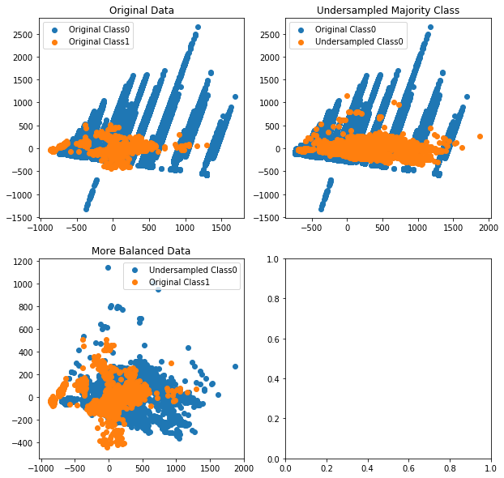
Under sampling
Unlike other undersampling methods, this one clears a lot of data at once (as seen from the graph) since it combines 2 under sampling techniques.
Of course, this could lead to underfitting so try it on your own risk! But generally, the points it picks seem to be as impactful and meaningful.
 | Count (Train)
0 | 13428
1 | 1227

Slide 20
3
Training the Model
Time to build the model!

Slide 21
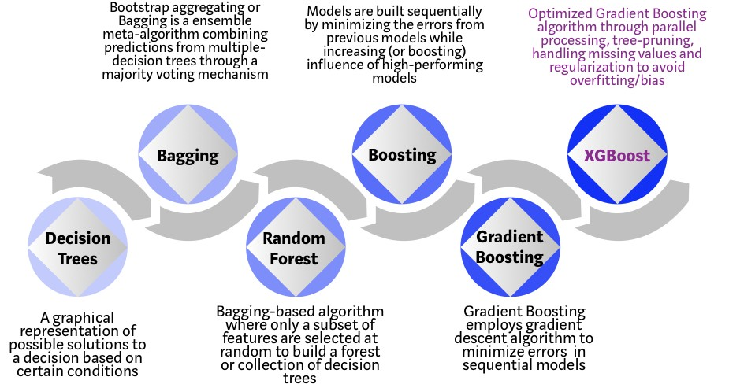

Gradient Boosting
Most Kaggle competitions winners’ won by using XGBoost. And here is why they won:

Slide 22
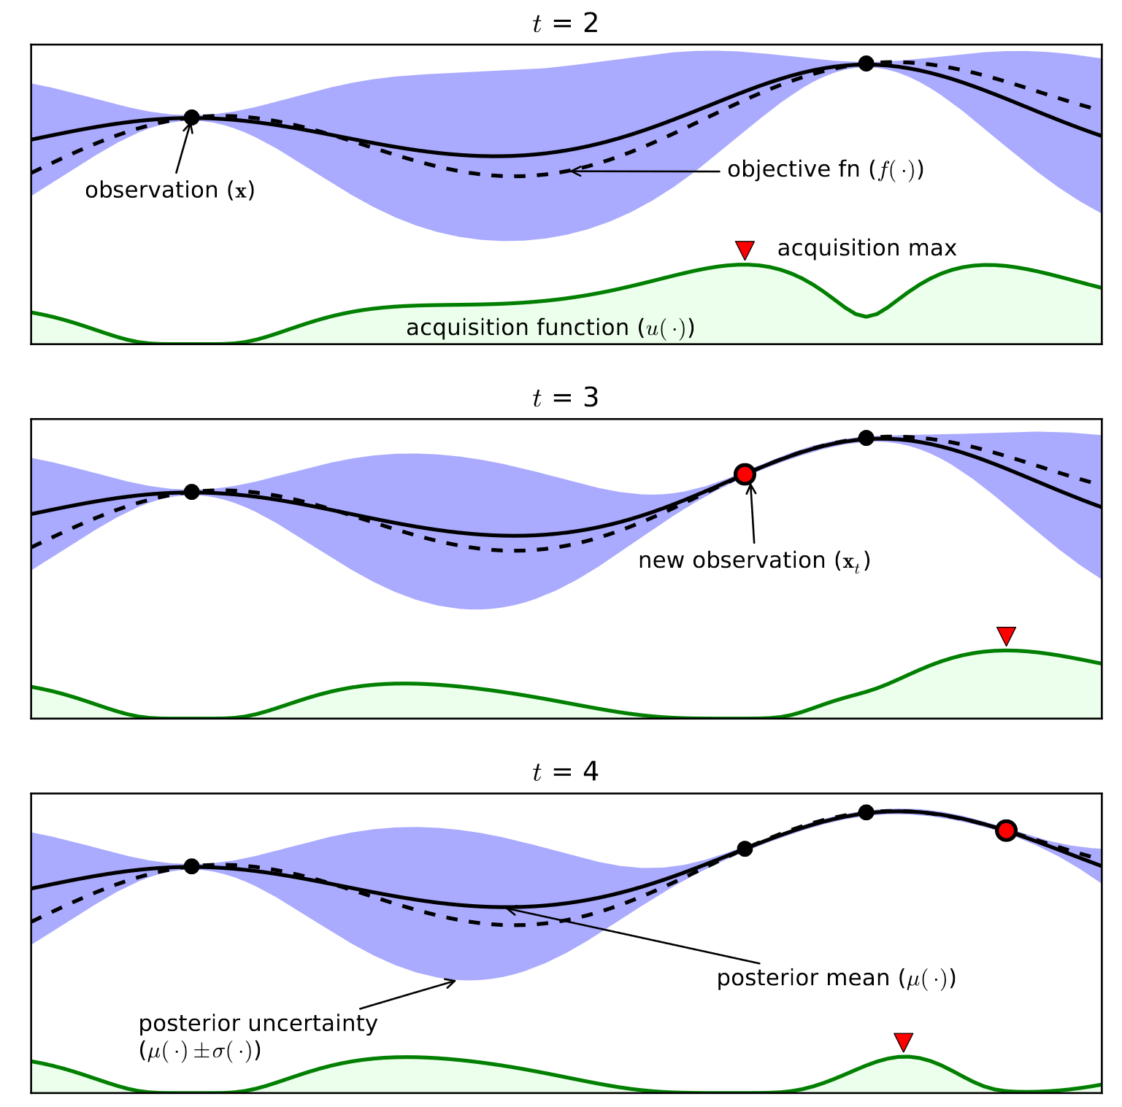
Hyperparameter Tuning
XGBoost has a lot of hyperparamters and manually checking for the best combination can take forever.
Hyperparameter tuning by means of Bayesian Optimisation, can bring down the time spent to get to the optimal set of parameters — and bring better generalisation performance.
bayes opt

Slide 23
4
Evaluation
Checking the predictions

Slide 24
Evaluation (Confusion Matrix)
 | Predicted category
Actual categories |  | Positives | Negatives | Total
 | Positives | 204 | 13 | Precision = 0.94
 | Negatives | 13 | 52914 | 0.99
 | Total | Recall = 0.94 | 0.99 | Total = 0.99

Slide 25
Thanks!
Any questions?

