Slide 1
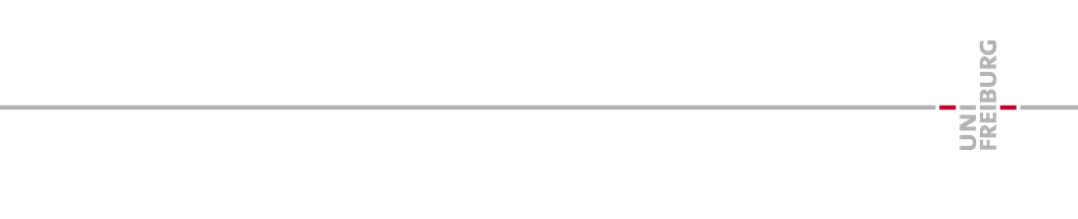
Model-Reconstruction
Retrieving system dynamics from it’s time series.

Slide 2
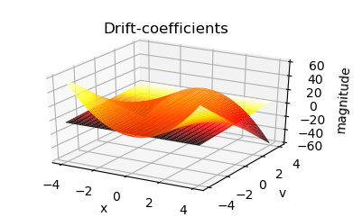
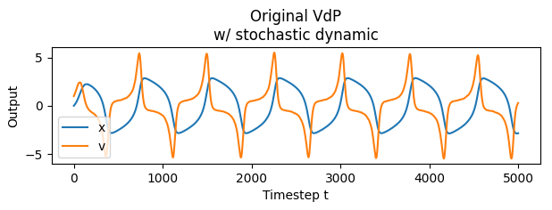
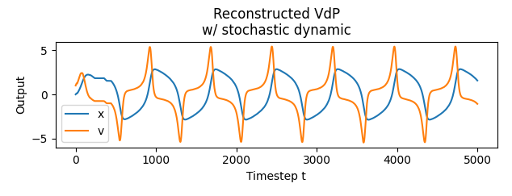
Overview
1. Gathering time-series eg. the Van-der-Pol oscillator
2. Retrieve estimated drift- & diffusion coefficients
3. Reconstruct the systems time-series from the dynamics

Slide 3
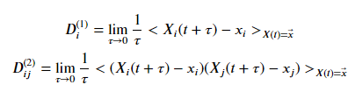
Method used
The method used was proposed by J.Gradisek, S.Riegert, R.Freidrich, I.Grabec in „Analysis of time series from stochastic processes”, year 2000 [1]
Drift- and diffusion-coefficients can be directly derived from the time-series by using their statistical definition: [2]
Drift-coefficient
Diffusion-coefficient
$<⋅>$ → arithmetic mean
For „good“ results the process should be exposed to gaussian noise.

Slide 4
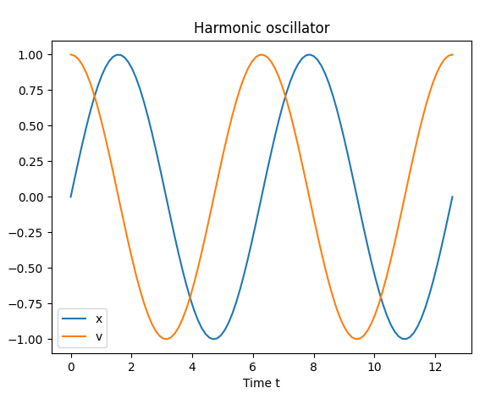
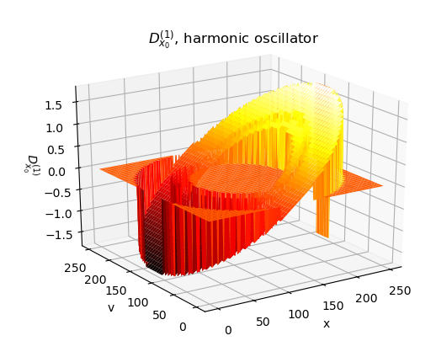
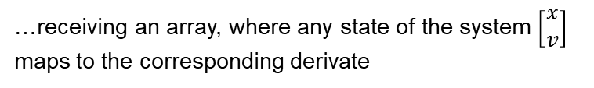
Method used
For any point in the series, where all dimensions have the same value, we calculate the time-derivate for all dimensions.
Same value in x, but not in v!
…receiving an array, where any state of the system $\left[\begin{matrix}x \\ v\end{matrix}\right]$ maps to the corresponding derivate

Slide 5
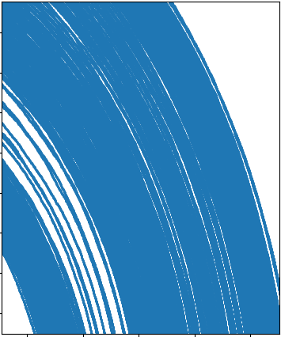
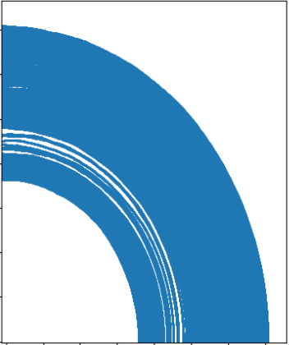
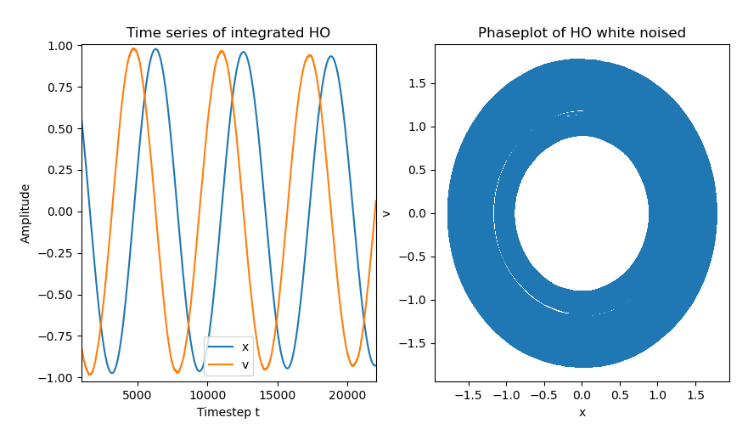
Method used
For any point in the series, where all dimensions have the same value, we calculate the time-derivate for all dimensions.
Same value in x, but not in v!

Slide 6

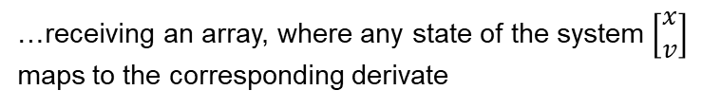
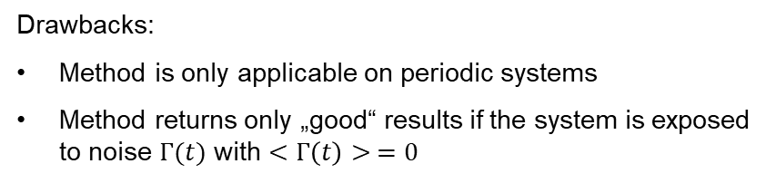
Method used
…receiving an array, where any state of the system $\left[\begin{matrix}x \\ v\end{matrix}\right]$ maps to the corresponding derivate
Drawbacks:
Method is only applicable on periodic systems
Method returns only „good“ results if the system is exposed to noise $Γ(t)$ with $<Γ\left(t\right)> =0$

Slide 7
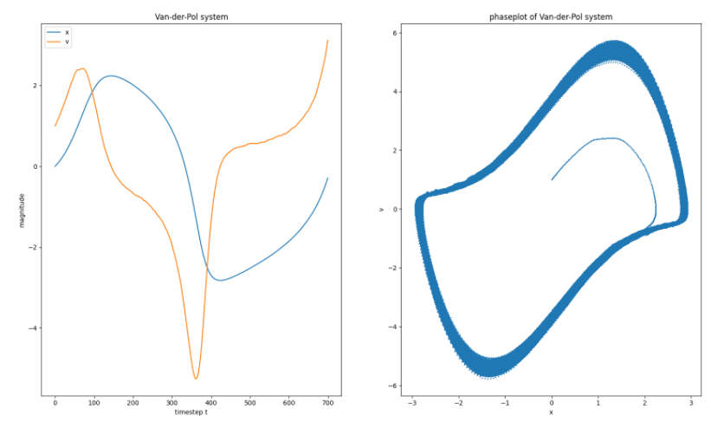



Application
Practically applied to a simulated Van-der-Pol Oscillator.
Simulated over ${100}^{′}000$ periods with $Δt=0.01$ So ${10}^{′}{000}^{′}000$ timesteps.

Slide 8
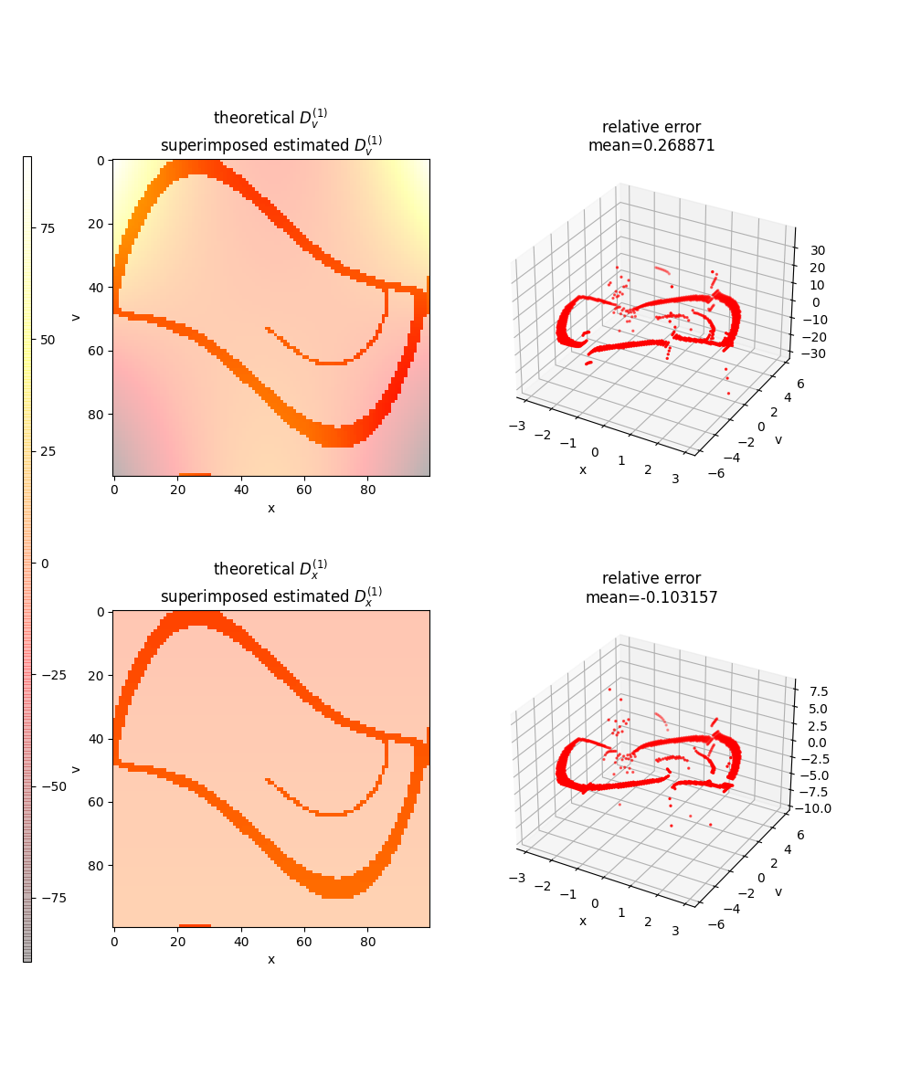
Application

Slide 9
Reconstruction

Slide 10
Fokker-Planck-Analysis

Slide 11
Outlook
Wie ich da mit der BA weitermache

