Slide 1
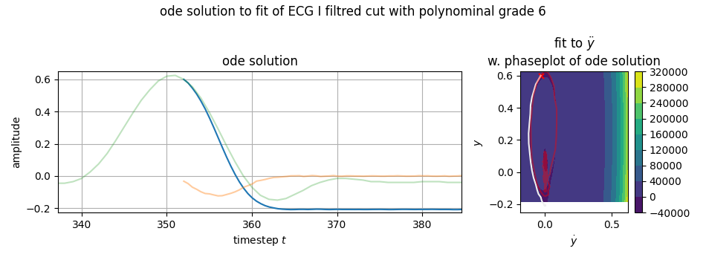
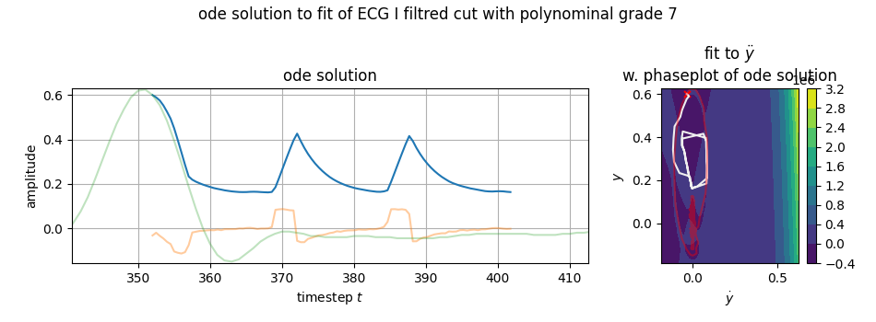
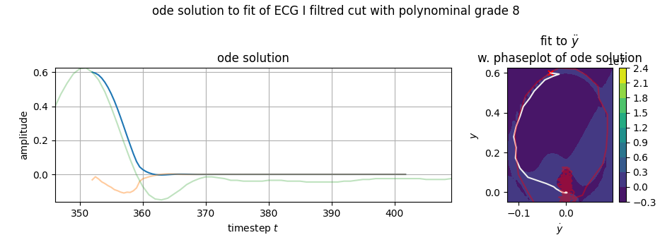
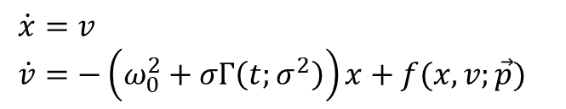



before trying that pinpoint-specific-noise,
recall all parameters:
same parameters but different results:
$$ω=1.1 Hz \\ σ=\sqrt{2γ} \\ \tilde{σ}=σ^{2} \\ N_{f}=?$$
correct!
but this one?
$$\dot{x}=v \\ \dot{v}=−\left(ω_{0}^{2}+σΓ\left(t;σ^{2}\right)\right)x+f(x,v;\vec{p})$$
$$f\left(x,v;\vec{p}\right)=p_{0}v+p_{1}x^{2}+p_{2}xv+p_{3}v^{2}+…$$
$$N_{f}$$

Slide 2
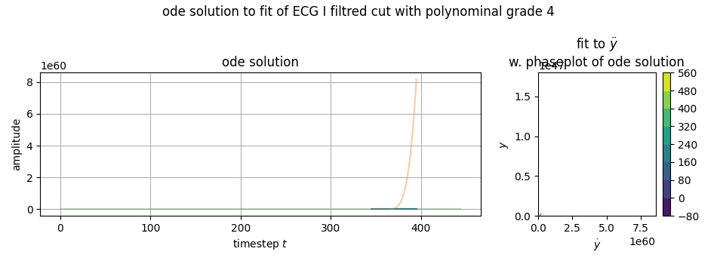
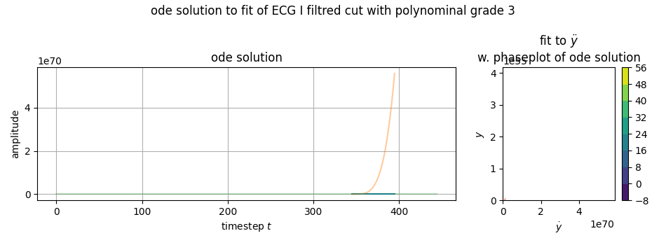
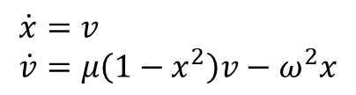
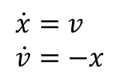

some $N_{f}$ won‘t work.
looking at HO and VdP
$$\dot{x}=v \\ \dot{v}=−x$$
grade 1
$$\dot{x}=v \\ \dot{v}=μ\left(1−x^{2}\right)v−ω^{2}x$$
grade 3
for $N_{f}≤4$ the ODE solution would diverge.
using grades 2, 3 the ODE solution would run into infinity

Slide 3
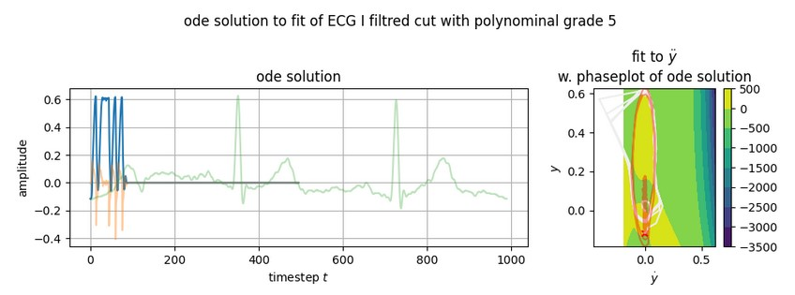
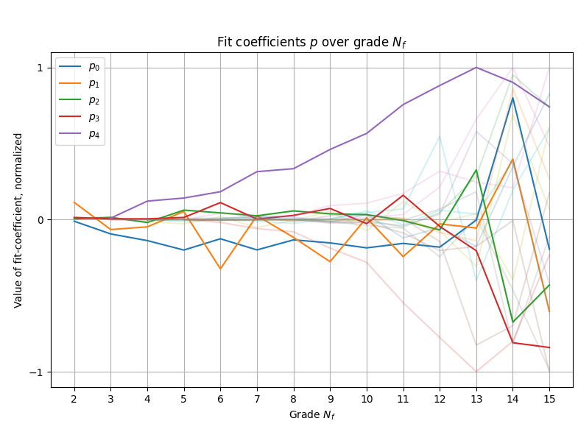
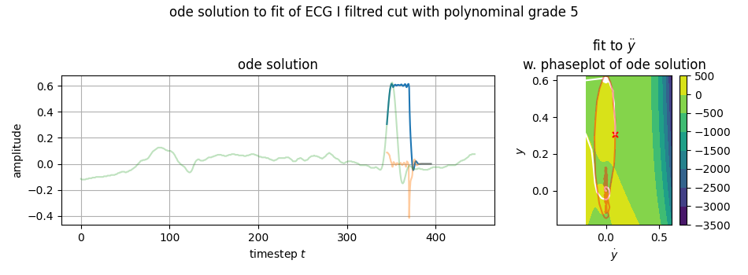
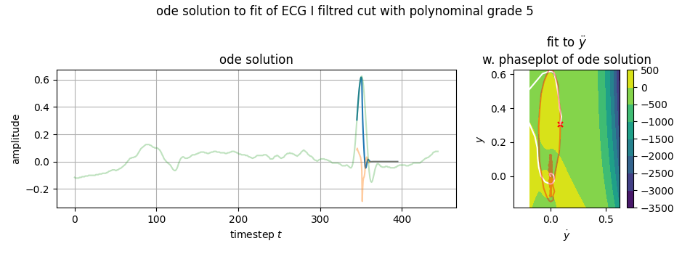



for $N_{f}≥5$ it works:
lets view the fit-coefficients $\vec{p}$
and how they change with changing grade
$$f\left(x,v;\vec{p}\right)=p_{0}v+p_{1}x^{2}+p_{2}xv+p_{3}v^{2}+…$$
they get really large

Slide 4
what grade?

Slide 5


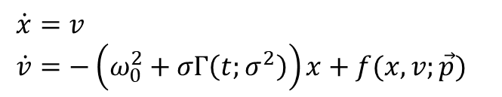
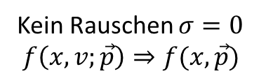

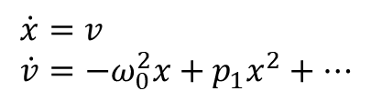
$$\dot{x}=v \\ \dot{v}=−\left(ω_{0}^{2}+σΓ\left(t;σ^{2}\right)\right)x+f(x,v;\vec{p})$$
AfterTalk
$$f\left(x,v;\vec{p}\right)=p_{0}v+p_{1}x^{2}+p_{2}xv+p_{3}v^{2}+…$$
Kein Rauschen $σ=0$
$$f\left(x,v;\vec{p}\right)⇒f(x,\vec{p})$$
$$\dot{x}=v \\ \dot{v}=−ω_{0}^{2}x+p_{1}x^{2}+…$$
$$f\left(x,v;\vec{p}\right)=p_{0}v+p_{1}x^{2}+p_{2}xv+p_{3}v^{2}+…$$
Neuer fit an $f\left(x;\vec{p}\right)$
oder Koeffizienten auslassen?

