Slide 1
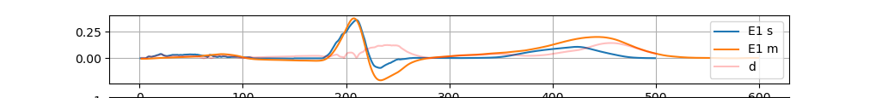
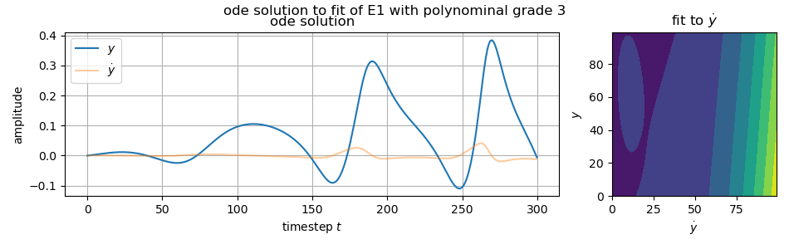
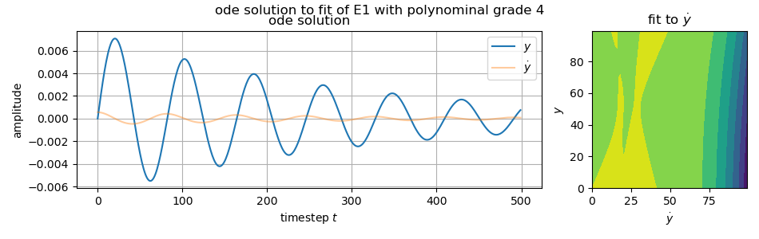
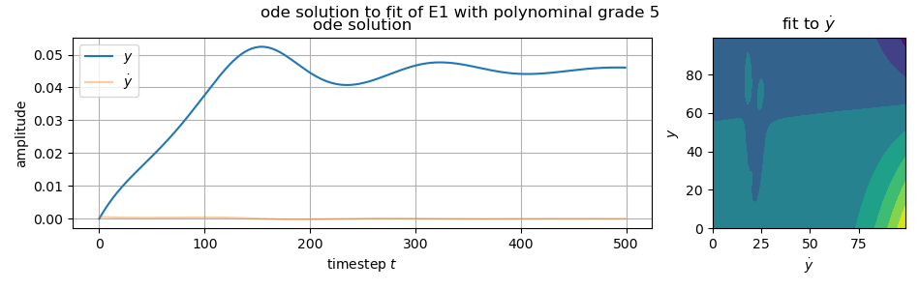
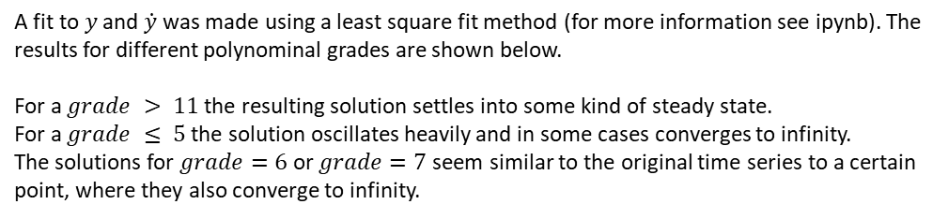
Time series $y$ of channel E1 is shown in figure 1. This particular series was analyzed.
A fit to $y$ and $\dot{y}$ was made using a least square fit method (for more information see ipynb). The results for different polynominal grades are shown below.
For a $grade > 11$ the resulting solution settles into some kind of steady state.
For a $grade ≤ 5$ the solution oscillates heavily and in some cases converges to infinity.
The solutions for $grade=6$ or $grade=7$ seem similar to the original time series to a certain point, where they also converge to infinity.
In figures below y and ydot were swapped unintentionally!
cut!
ydot
y

Slide 2
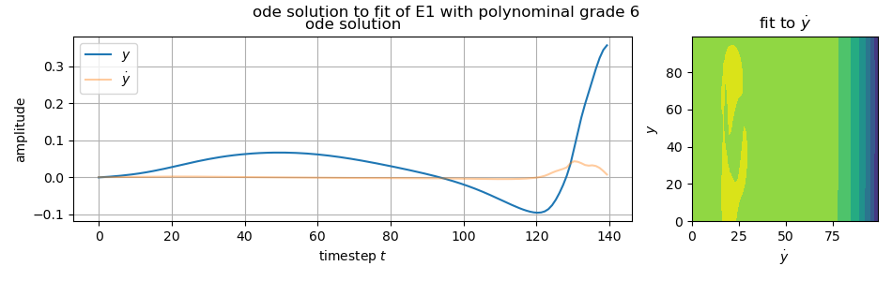
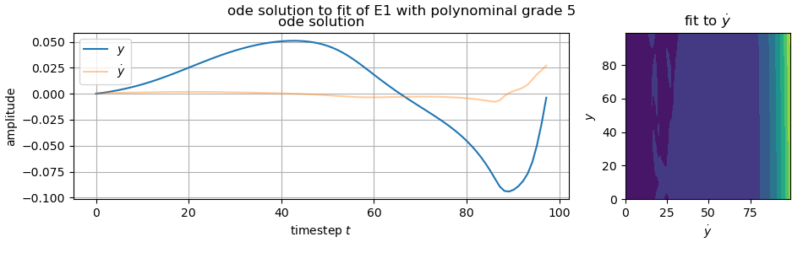
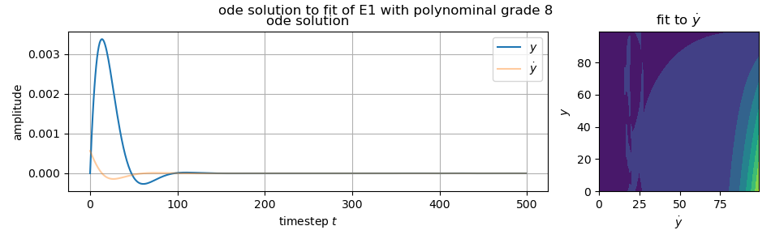
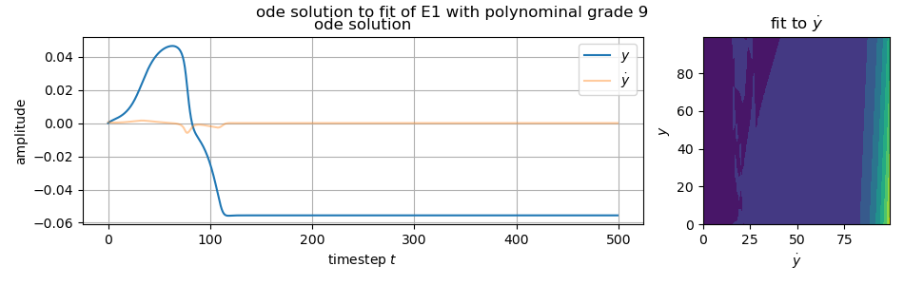
cut!
cut!
7

Slide 3
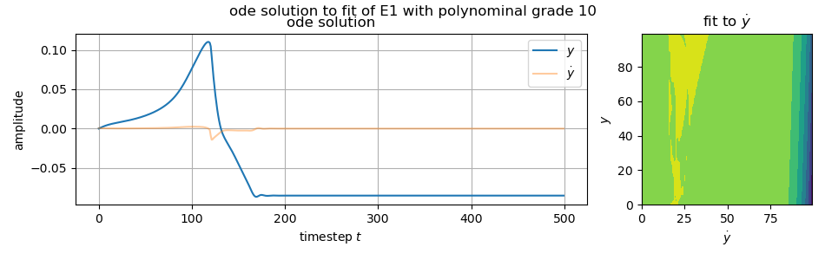
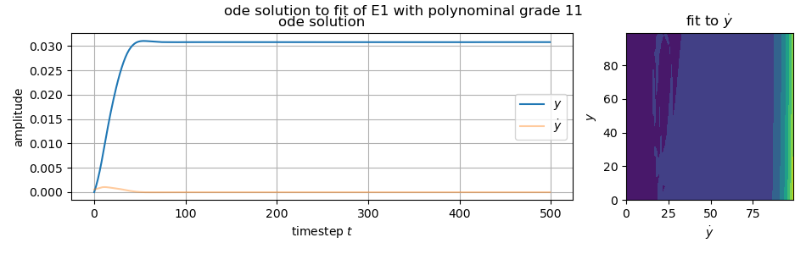
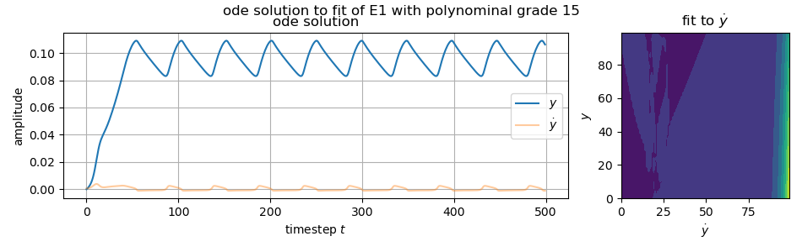
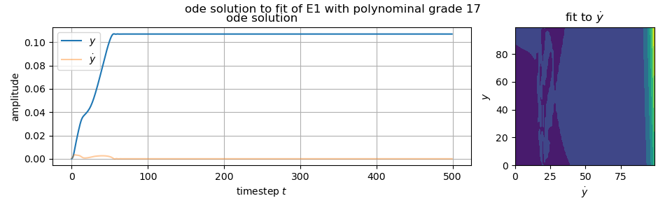

Slide 4
