Slide 1
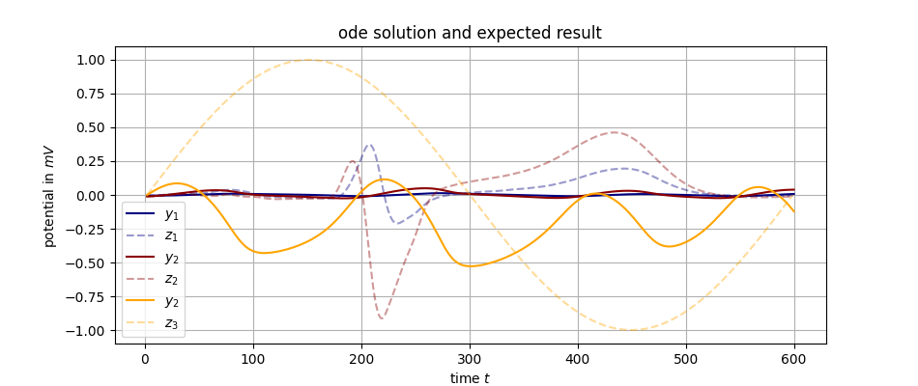
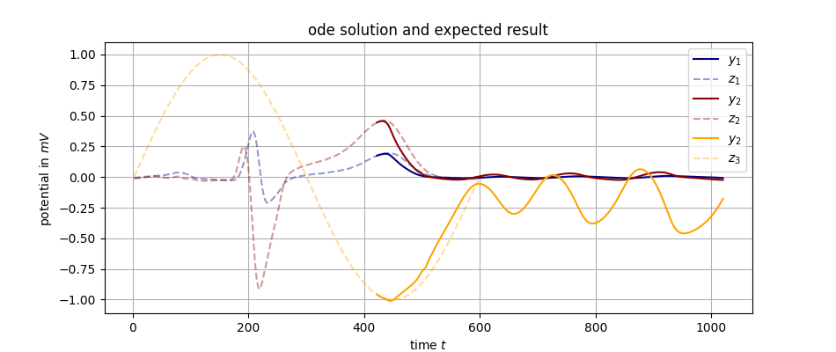
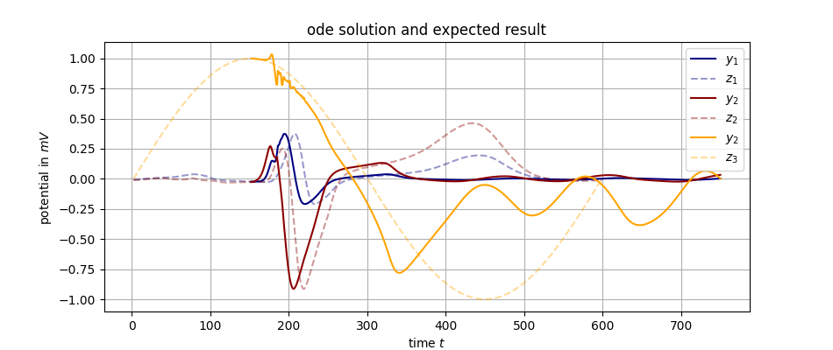
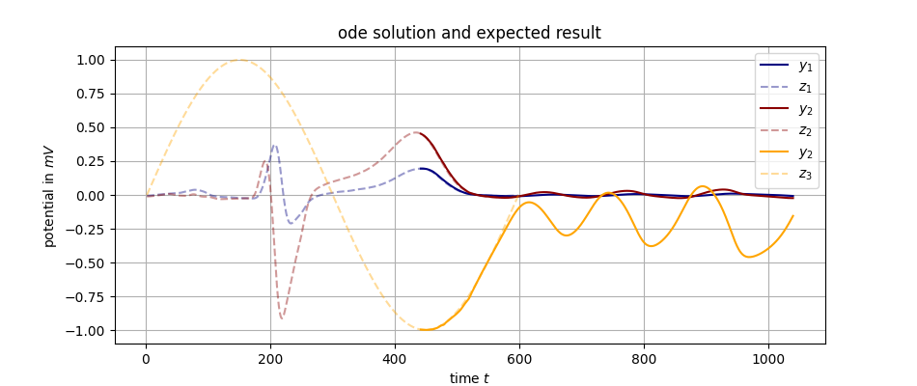
Sinusoid experiment – no lowpass filter

Slide 2
Sinusoid experiment – no lowpass filter

Slide 3
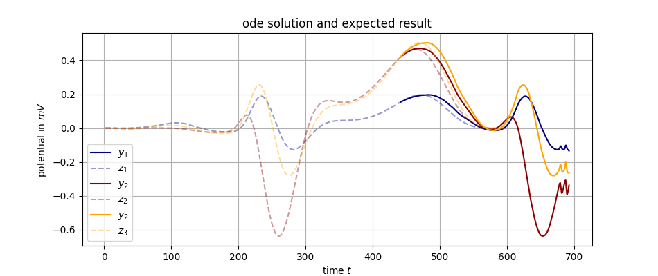
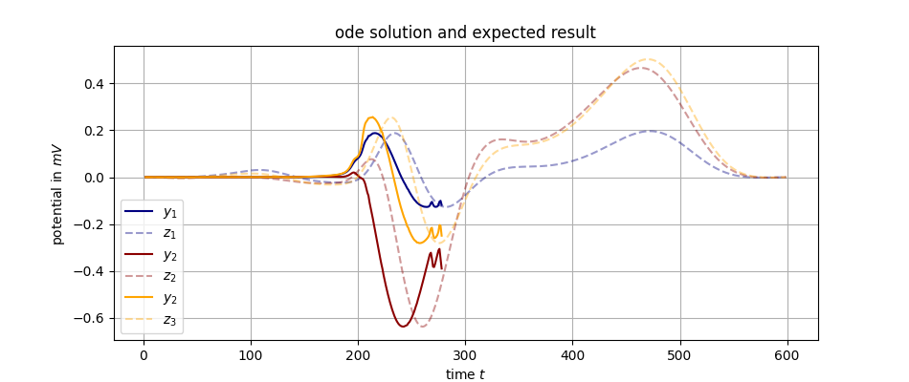
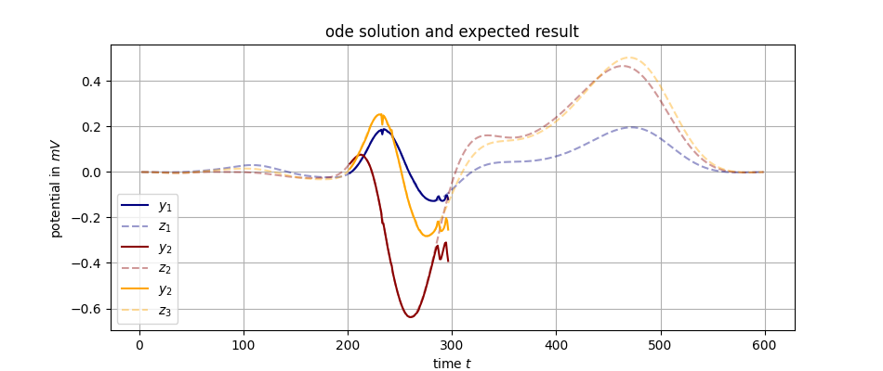
Some reconstruction using 1. filter
2. Tilt
3. reconstruct

Slide 4
Some reconstruction using 1. filter
2. Tilt
3. reconstrcut

Slide 5
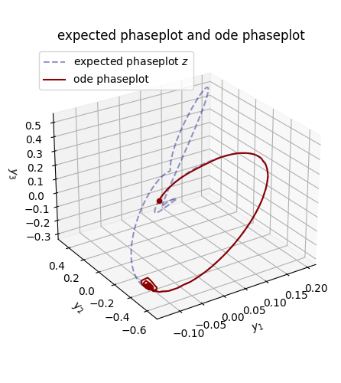
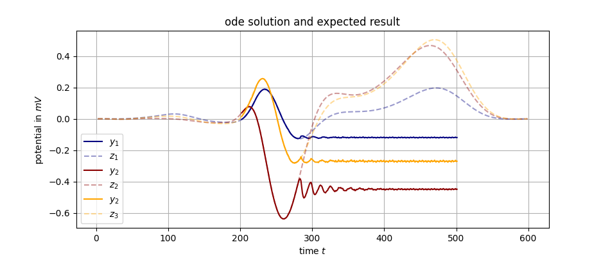
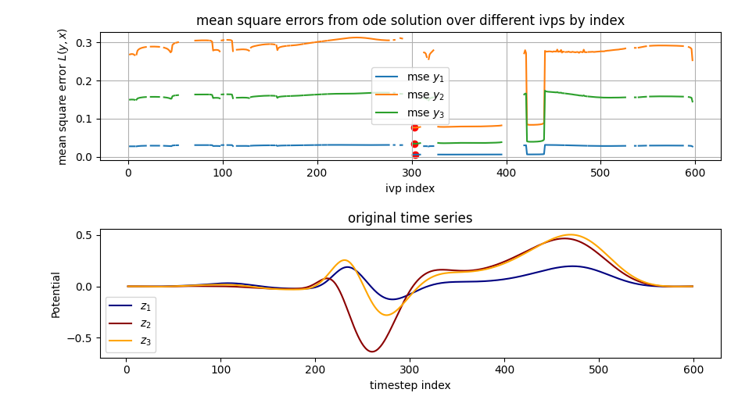
Some reconstruction using
tilt
filter
tilt
reconstcuct

Slide 6
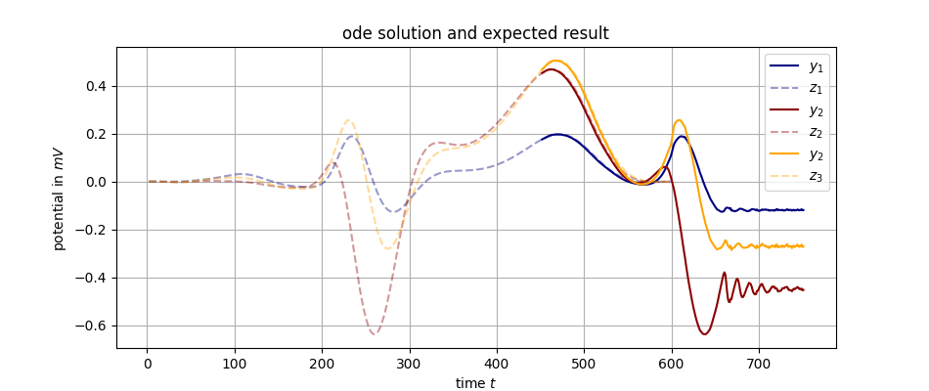

Slide 7
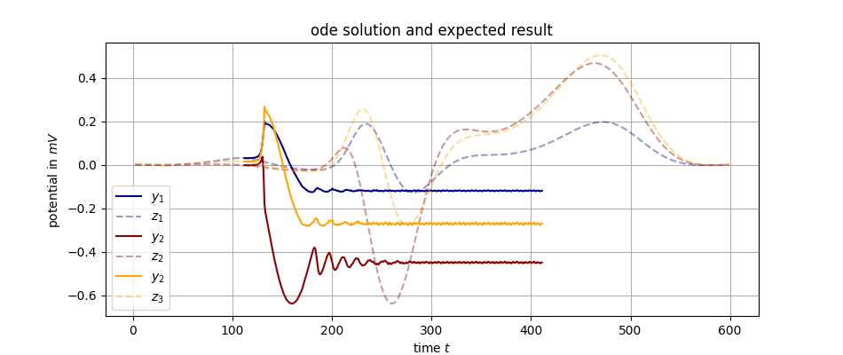
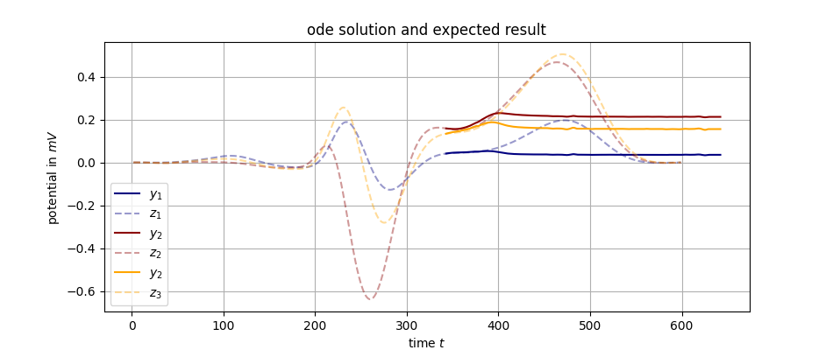
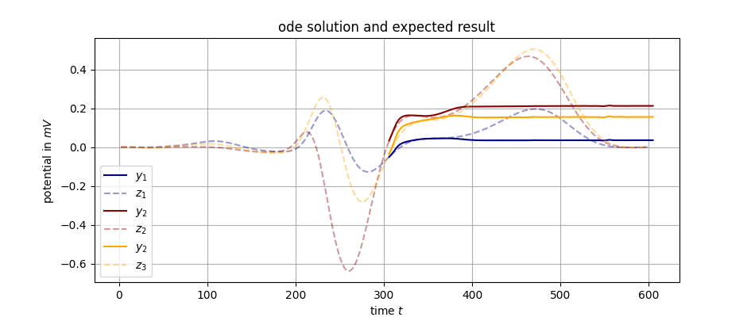
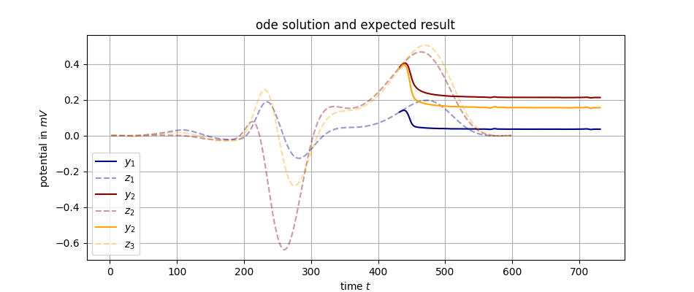
Different initial values!
Fit-Koeffizienten ändern sich ja gar nicht…
t = 110
t = 200
t = 341
t = 303
t = 430
t = 450

Slide 8

→ $∞$

Slide 9
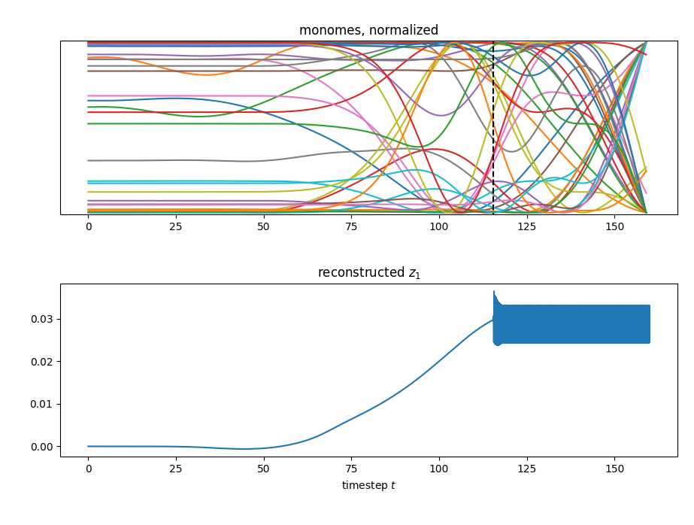

Slide 10
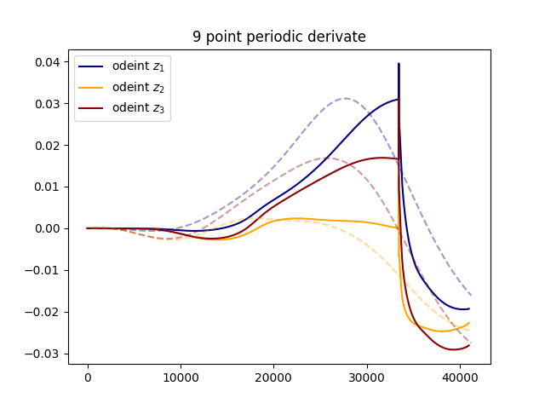
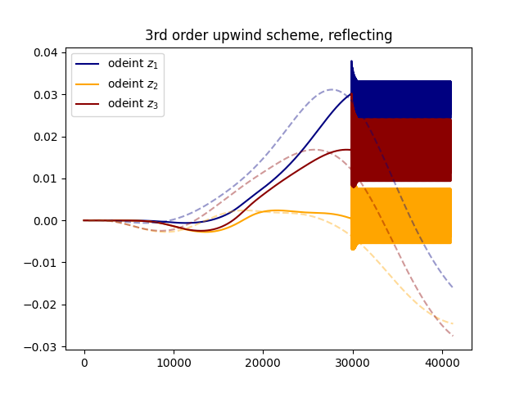
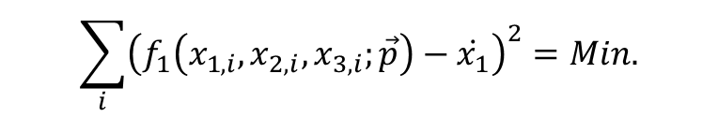
Different derivates, different solutions:
$$\sum_{i}{{\left(f_{1}\left(x_{1,i}, x_{2,i},x_{3,i};\vec{p}\right)−\dot{x_{1}}\right)}^{2}}=Min.$$

Slide 11
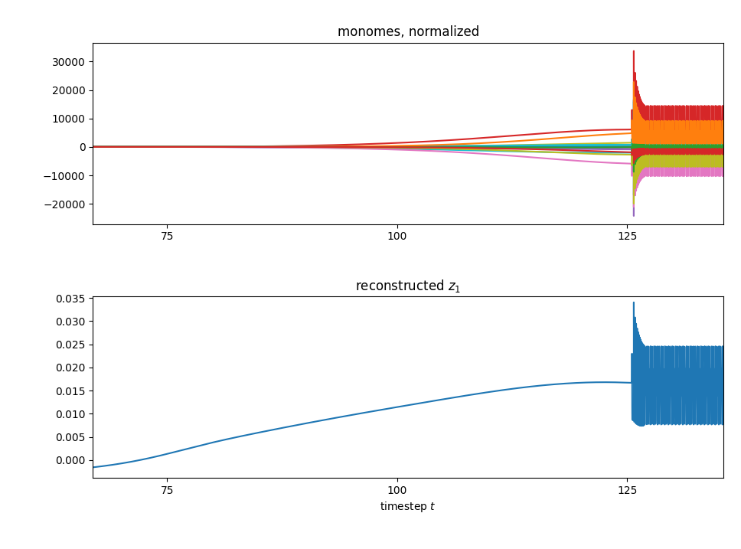
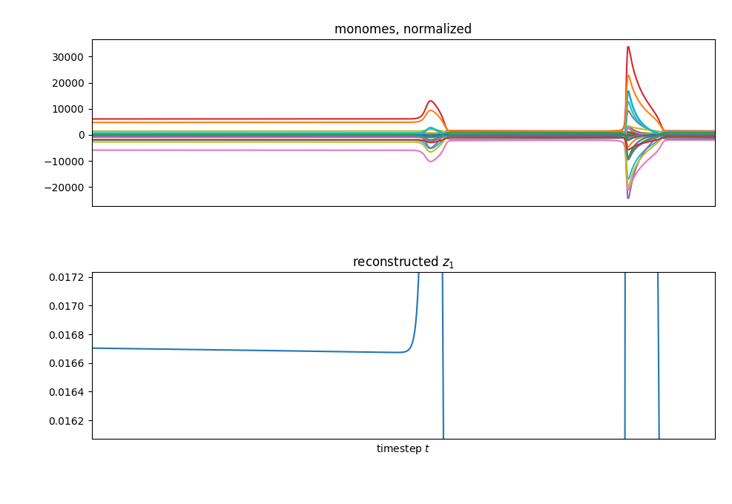

Influence of the monomes
Polynominal function $f(\vec{x})$ grade 4.

Slide 12
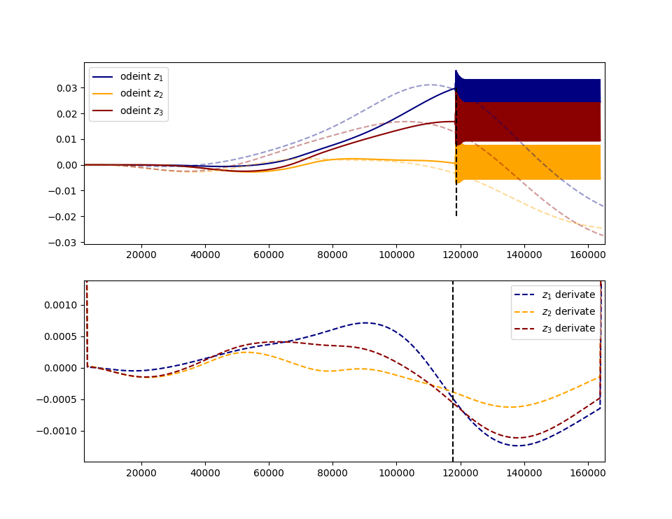
How do the derivates look at this special point?

Slide 13
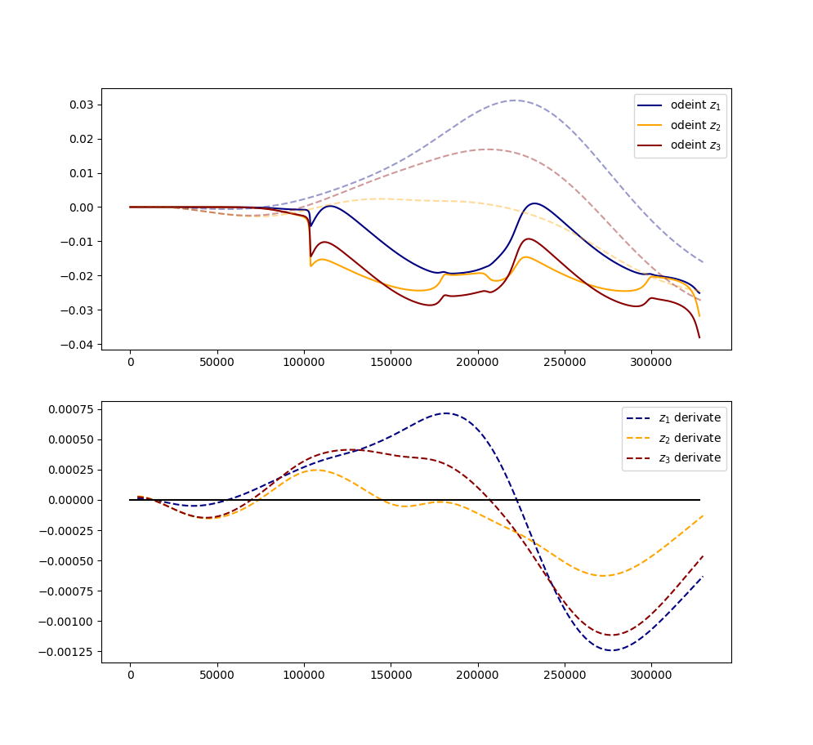
After „correction“

