Slide 1
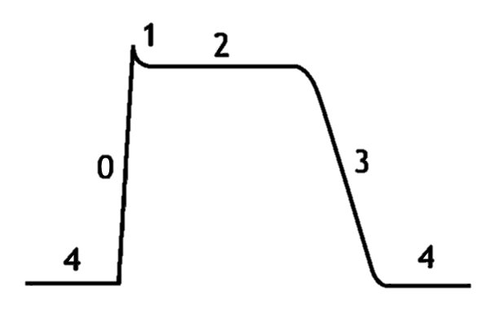
mV
4
0
1
2
3
4
20
0
-90

Slide 2
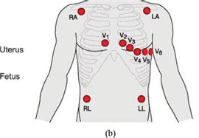
RA
LA
V₁
V₂
V₃
V₆
V₄
V₅
RL
LL

Slide 3
