Slide 1
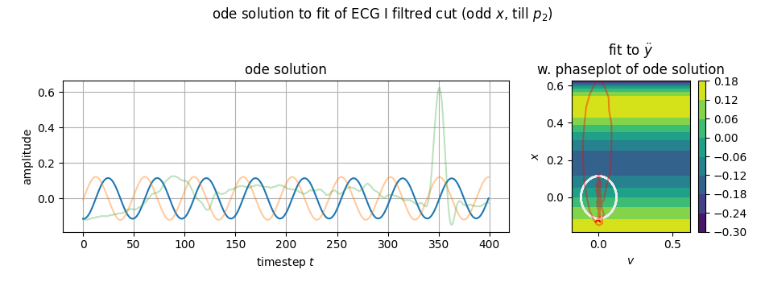

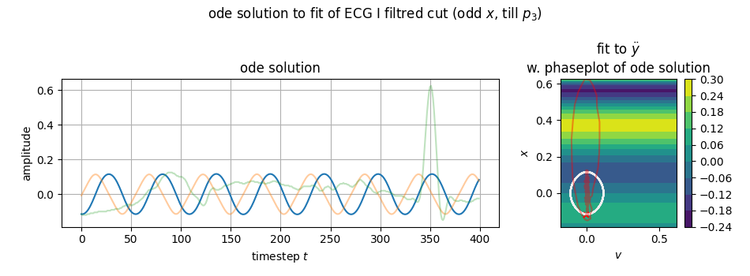
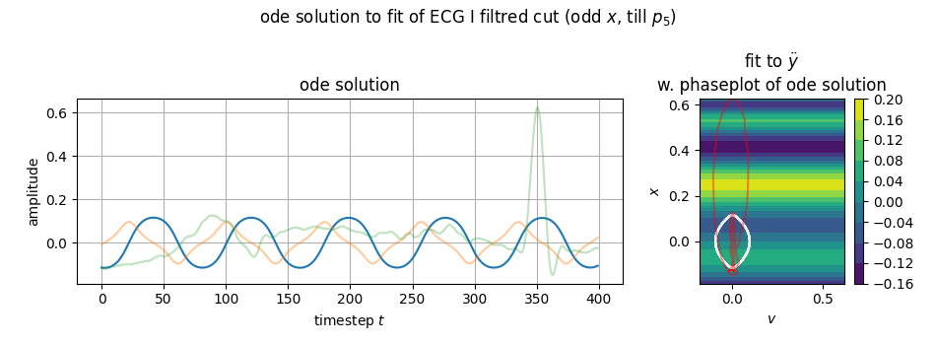
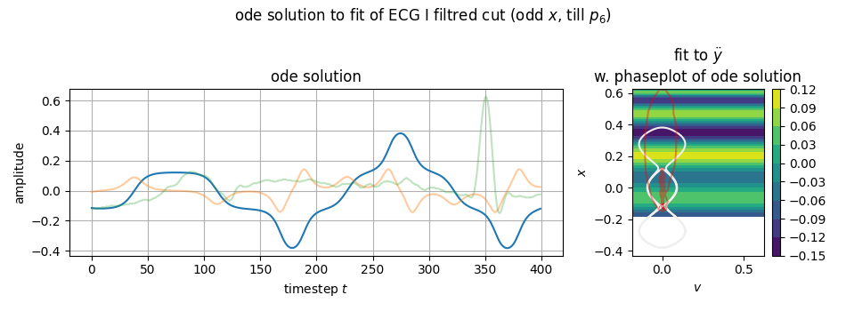
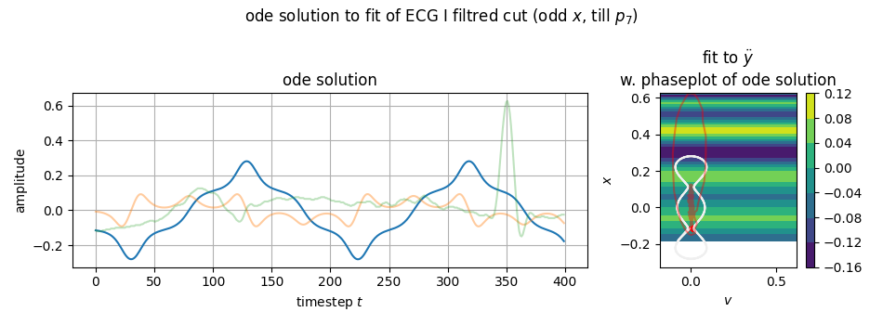
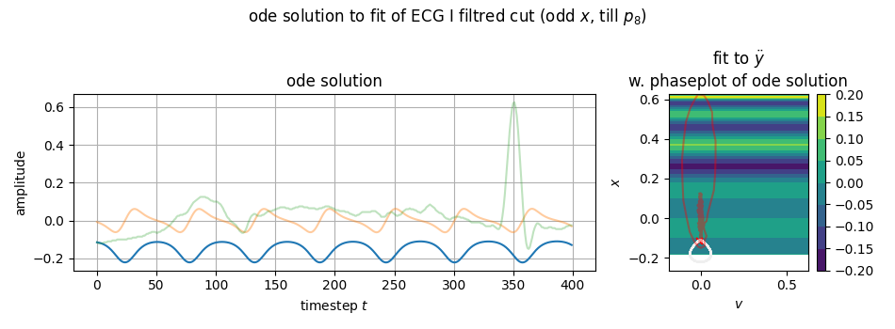
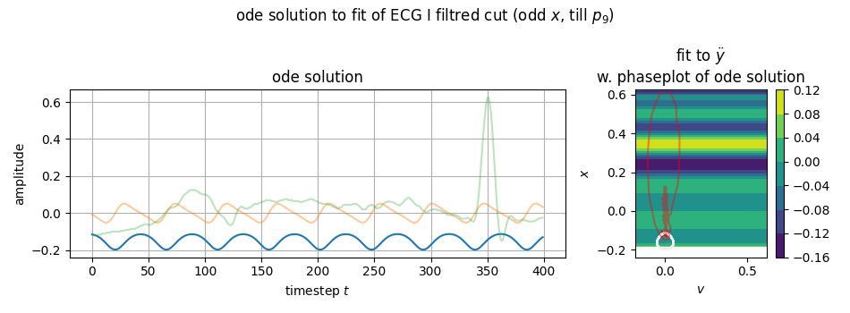
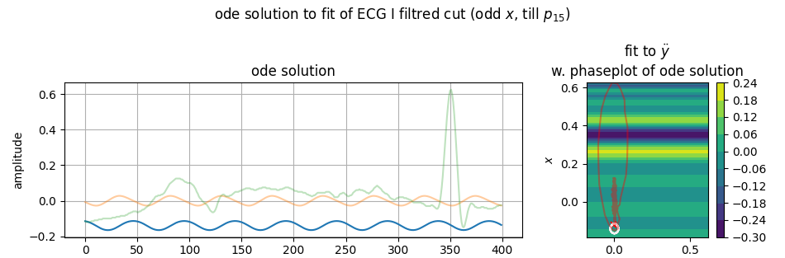
$$\dot{v}=…+q_{15}x^{15}$$
$$\dot{v}=…+q_{27}x^{27}$$

Slide 2
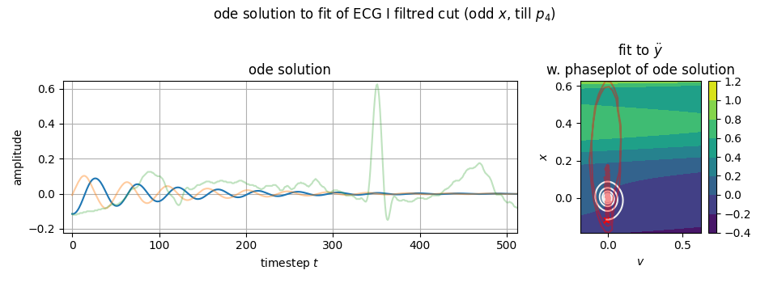
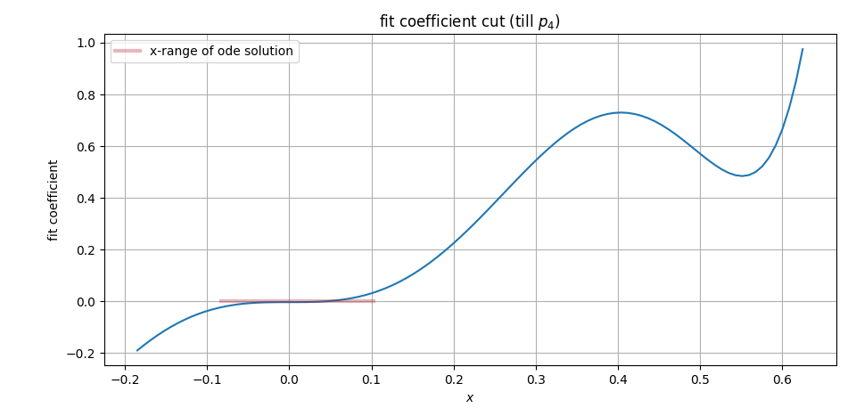

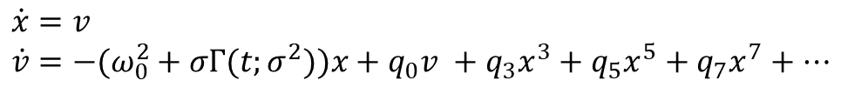
On the search for the right fit function…
$$\dot{x}=v \\ \dot{v}=−(ω_{0}^{2}+σΓ(t;σ^{2}))x+q_{0}v +q_{3}x^{3}+q_{5}x^{5}+q_{7}x^{7}+…$$
$$=−0.1291$$
negative damping

