Slide 1

Estimating Obesity Levels
Name: Flemy Roy
UID: 209011
Roll No:10

Slide 2
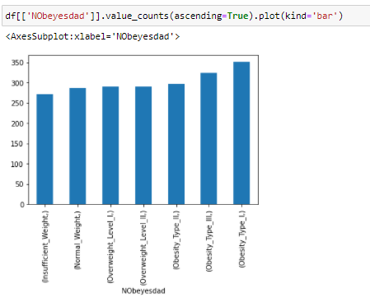
Overview
The dataset comprises of obesity levels various individuals from the countries of Mexico, Peru and Colombia, based on their eating habits and physical condition. The data contains 17 attributes and 2111 records, the records are labeled with the independent variable NObesity (Obesity Level), that allows classification of the data using the following independent variables :
Insufficient Weight
Normal Weight
Overweight Level I
Overweight Level II
Obesity Type I
Obesity Type II
Obesity Type III

Slide 3
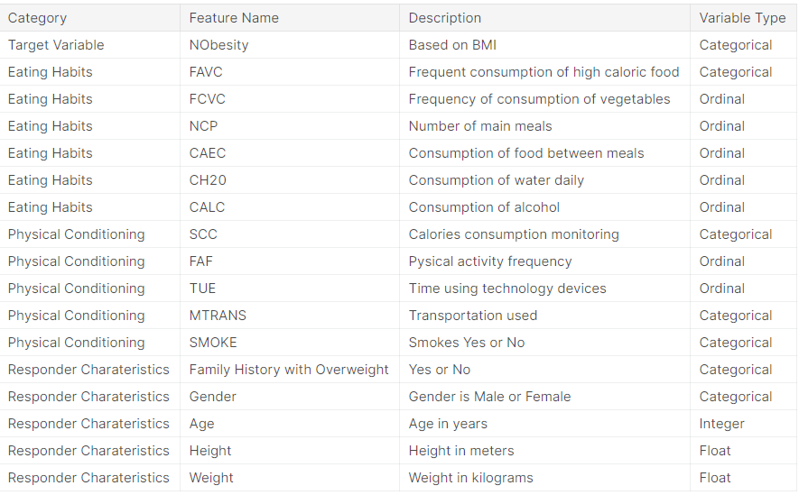
About the Attributes

Slide 4
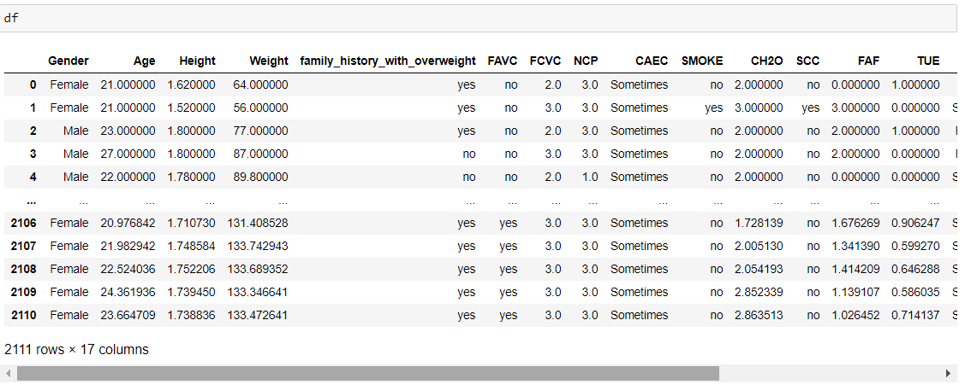
The Dataset

Slide 5
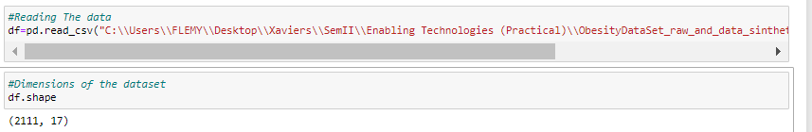
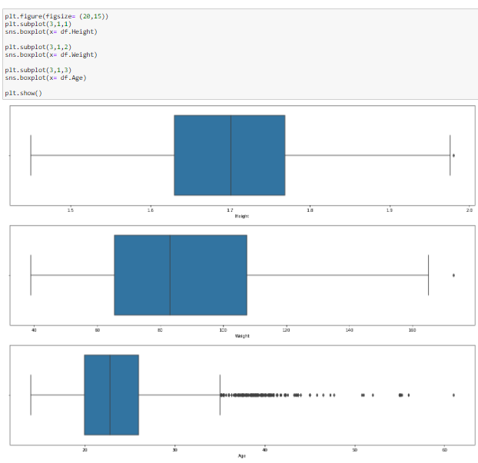
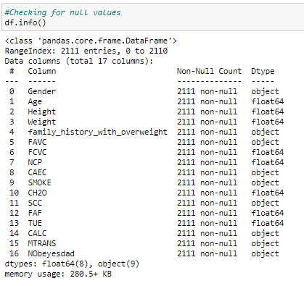
Data Processing
Data Extraction: Data was read and stored in a dataframe named ‘df’
The data was read and stored in a variable ‘df’.
Data Cleaning:
The data was examined for null values and outliers and steps were taken to rectify the same.

Slide 6
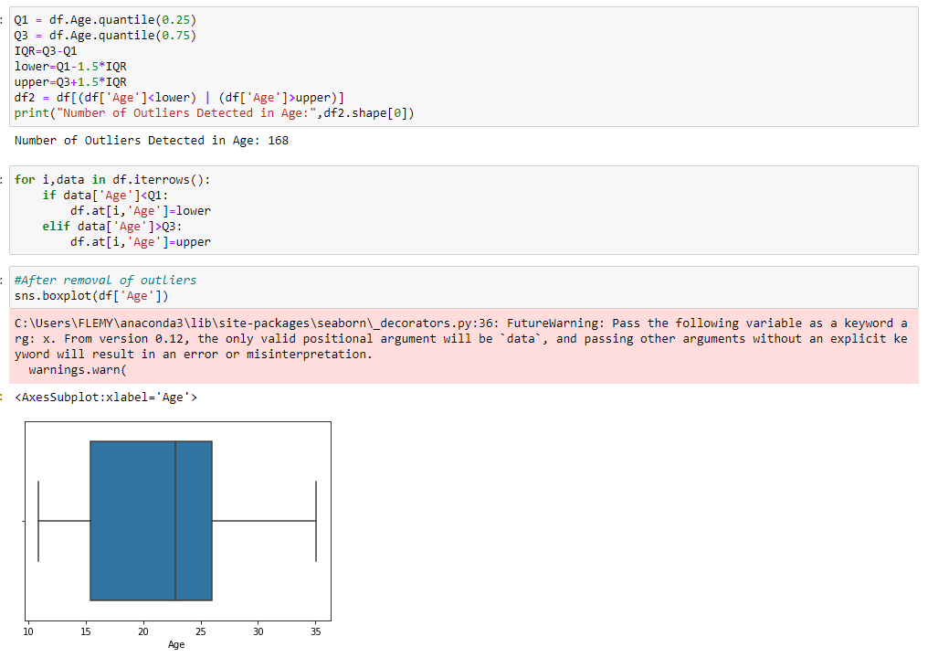
Data Cleaning:

Slide 7

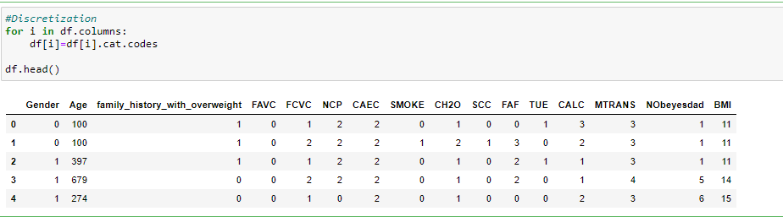
Data Transformation:
It refers to mapping of an entire set of values of a given attribute to a new set of replacement values such that old values can be identified with one of the new values. Normalization and discretization were applied.

Slide 8
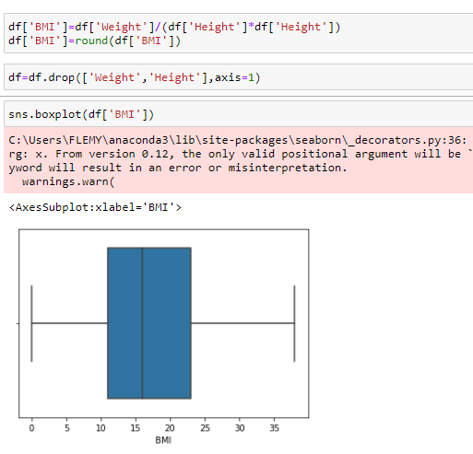
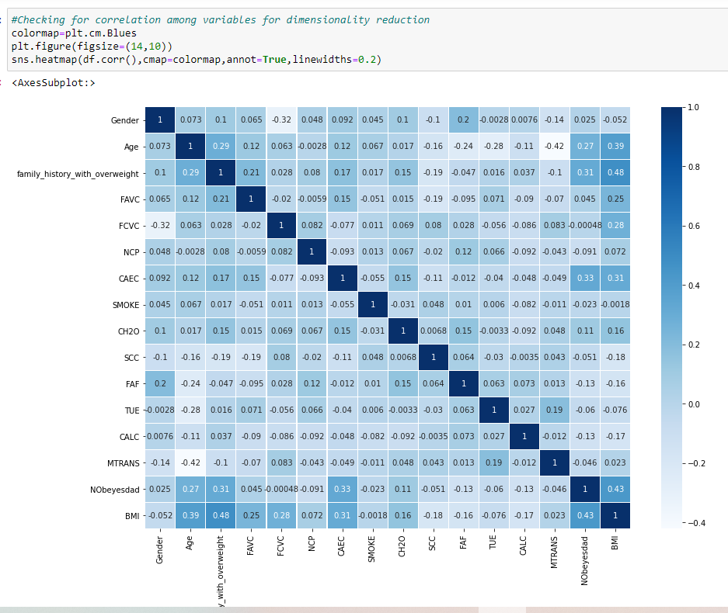
Dimensionality Reduction:
The data was examined for highly correlated variables to perform dimensionality reduction but the it was not required.
A new attribute was constructed named ‘BMI’ which combined the columns ‘Height’ and ‘Weight’.

Slide 9
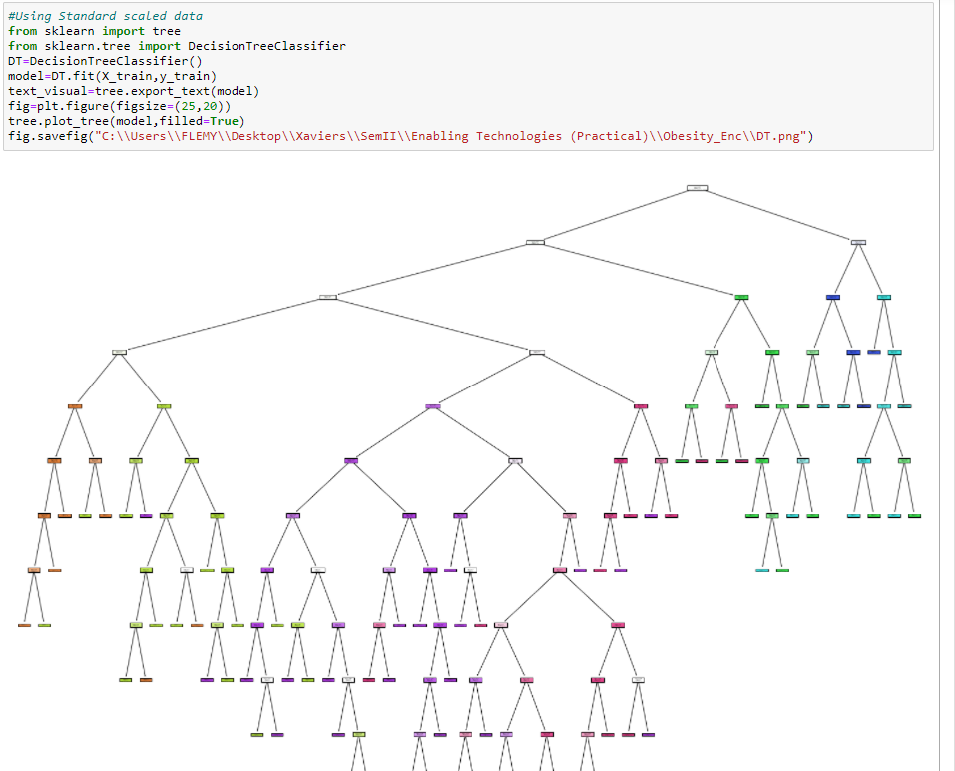
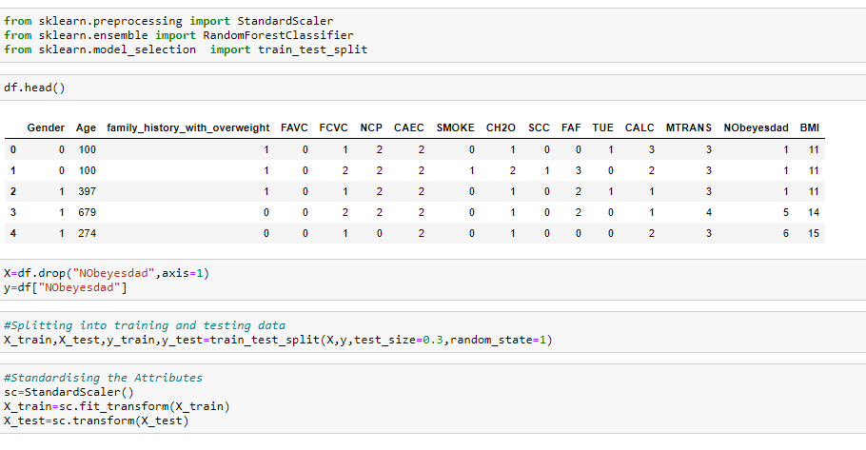
DATA Modelling
Model Selection: Decision Tree

Slide 10
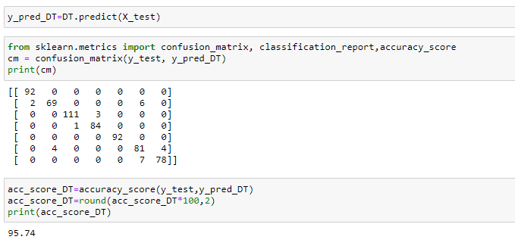
Prediction
The dataset after splitting into training and testing data, the predicted values were stored in a variable named ‘y_pred_DT’ which was then compared to the actual values stored in variable ‘y_test’ to print the confusion matrix.

Slide 11
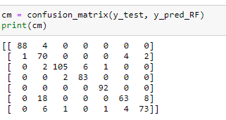
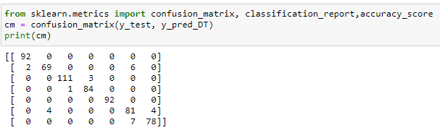
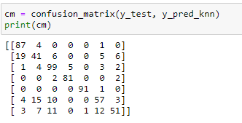
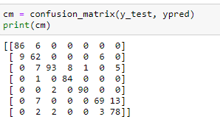
Confusion Matrix
Decision Tree:
Random Forest Classifier:
K Nearest Neighbour:
Naïve Bayes Classifier:

Slide 12
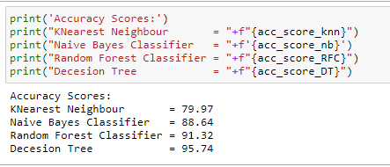
Accuracy of the Models
Reason for selecting Decision Tree:
The dataset has target variable so it is supervised learning. The dataset is imbalanced i.e. the labels are not equally distributed.
So, for this multiclass classification is the best methodology. After comparing these models Decision Tree is most accurate, thus it is the best fit

Slide 13
Thank YOU

