Slide 1
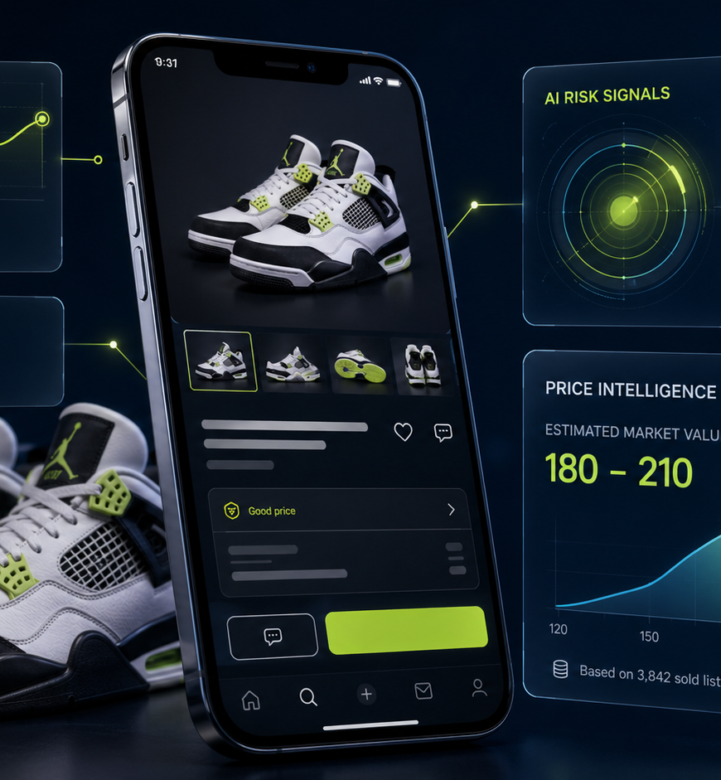
COMPETITOR ANALYSIS
ListLens
Competitive landscape & POC positioning
AI resale intelligence for eBay + Vinted: seller listings, buyer risk checks, and specialist category lenses.
Prepared for POC decision-making
ListLens competitor analysis
01

Slide 2
Executive readout
The market is already busy. ListLens should win by going trust-first, not listing-generator-first.
1
The category is commoditising
Photo → title/description is now table stakes across marketplace-native tools and indie AI listers.
2
The wedge is trust
ListLens has a stronger lane as a portable buyer/seller risk layer across eBay and Vinted.
3
SoleLens is the best POC
Trainers have high volume, replica anxiety, photo-based evidence, and clear buyer willingness to pay.
4
Do not chase crosslisting yet
Inventory sync and bulk listing are a trap for the POC; prove category insight and Guard monetisation first.
ListLens competitor analysis
02

Slide 3
Where ListLens sits
ListLens is between listing productivity, marketplace-native AI, and buyer-side trust.
Seller workflow
Buyer trust
Platform-native
eBay AI
Vinted verification
StockX
White space
Portable resale intelligence
+ specialist risk checks
Vinting
ListLens target
CheckCheck
SellerAider
Vendoo / Crosslist
Portable tools
ListLens competitor analysis
03

Slide 4
Competitive threat stack
The most dangerous rivals own either the marketplace flow or the reseller workflow.
Threat
Competitor
Why it matters
ListLens response
Very high
eBay AI + Product Research
Native workflow, marketplace data, trust badge
Differentiate
Very high
Vinting
UK-first eBay/Vinted/Gumtree AI listing angle
Differentiate
High
SellerAider
AI listing + crosslisting + automation + inventory
Out-focus
High
Snap2List / 3Dsellers
Strong eBay listing creation and pricing flow
Out-focus
High
CheckCheck
Human-led sneaker/luxury authentication credibility
Out-focus
Medium–High
Vendoo / Crosslist
Crosslisting and inventory infrastructure
Defer
Medium
Vinted Item Verification
Important price anchor and platform-native trust
Defer
ListLens competitor analysis
04

Slide 5
Feature comparison: ListLens versus the field
The core gap is buyer risk + missing evidence + seller questions, not plain listing copy.
Capability
ListLens
eBay AI
Vinting
SellerAider
Crosslist
CheckCheck
Photo-to-listing
●
●
●
●
◐
—
Vinted + eBay focus
●
—
●
●
●
—
Buyer listing risk check
●
◐
—
—
—
●
Specialist sneaker lens
●
◐
—
—
—
●
Missing-photo warnings
●
◐
—
—
—
◐
Seller questions
●
—
—
—
—
—
Inventory sync / bulk
—
◐
—
●
●
—
Legend: ● strong support ◐ partial/selected support — not core
ListLens competitor analysis
05

Slide 6
Marketplace-native threats
eBay and Vinted can bundle AI/trust into the purchase flow. ListLens needs portability and depth.
eBay
Vinted
• Photo-to-listing and AI seller assistance are already native • Product Research/Terapeak gives strong pricing evidence • Authenticity Guarantee reduces risk for eligible categories
• Item Verification creates a clear buyer-trust benchmark • Purchase-stage checks leave room for earlier AI risk screens • Category restrictions leave a gap for broader listing analysis
Implication: ListLens should not be “AI for eBay.” It should be the portable trust layer across marketplaces, especially where platform protection is missing or incomplete.
ListLens competitor analysis
06

Slide 7
Seller-side AI listing competitors
Most rivals promise speed. ListLens must demonstrate judgement.
Vinting
UK-first; Vinted/eBay/Gumtree; sold-data pricing claim
Beat on SoleLens depth + Guard
Snap2List
Fast eBay listing creation, pricing, bulk tools
Avoid bulk race; win on Vinted + trust
3Dsellers
Mature eBay seller suite with AI image-to-listing
Win on simplicity + buyer-side wedge
List Perfectly
Established reseller ecosystem and crosslisting AI
Win with UK/Vinted + category-specific insight
Message to land in demos
Not just “Here is a title and description.” Show missing photos, price anomalies, risk confidence, and seller questions.
ListLens competitor analysis
07

Slide 8
Crosslisting workflow competitors
Vendoo, Crosslist, and SellerAider become dangerous if ListLens drifts into operational tooling too early.
What they own
What ListLens should own first
• Marketplace breadth • Inventory management • Delisting / sold detection • Templates and imports • Reseller ops maturity
• Category-specific analysis • Buyer-side risk reports • Missing evidence detection • Vinted/eBay listing quality • Clear confidence language
POC principle: build the data model for inventory later, but do not spend the £75k POC proving another crosslisting dashboard.
ListLens competitor analysis
08

Slide 9
Buyer-side trust competitors
Authentication services are credible. ListLens Guard should sit earlier, cheaper, and wider.
CheckCheck
Human expert authentication; stronger confidence, higher friction
StockX
Marketplace + physical verification; not portable to eBay/Vinted listings
eBay / Vinted protections
Native trust mechanisms; only selected items/categories
ListLens Guard position
Fast AI risk screen before you buy — not formal authentication
ListLens competitor analysis
09

Slide 10
White space: resale intelligence, not copywriting
ListLens can combine seller utility and buyer protection in one portable layer.
Generic AI writes descriptions. Specialist lenses understand resale categories.
1
2
3
4
Photos
Specialist Lens
Marketplace Output
Risk / Trust Report
Seller uploads item photos or buyer submits URL/screenshot
SoleLens extracts model, size, style code, condition and evidence gaps
Vinted/eBay listing draft, price range and confidence warnings
Buyer risk level, missing photos, price flags and seller questions
ListLens competitor analysis
10

Slide 11
Competitor-by-competitor battle plan
The plan is not to mirror every feature. It is to make ListLens clearly different.
Against Vinting
Against Snap2List / 3Dsellers
Win on depth: SoleLens, missing evidence, buyer Guard
Win by avoiding eBay-only and seller-suite complexity
Against SellerAider
Against Vendoo / Crosslist
Win with trust intelligence, not automation breadth
Do not enter the crosslisting arms race in POC
Against CheckCheck
Against eBay / Vinted
Position Guard before formal authentication
Bridge platforms and make risk transparent
ListLens competitor analysis
11

Slide 12
POC priorities and proof points
A successful POC proves buyers and sellers pay for intelligence, not just text generation.
Build / prove now
Avoid / defer
Seller photo-to-listing
Inventory sync
Vinted export
Bulk crosslisting
eBay sandbox draft flow
WatchLens / MotorLens
SoleLens trainer analysis
Formal authentication claims
Buyer risk report
Missing-photo warnings
“This is fake” language
Seller-question generator
Stripe payment
Competitive verdict: ListLens should be the AI trust layer for resale — starting with eBay, Vinted, and SoleLens sneaker checks.
ListLens competitor analysis
12

Slide 13
Appendix: source notes
Competitor statements use public product pages plus the supplied ListLens project specification.
• Supplied ListLens materials: Project Specification and One-Page Offering Summary. • Public competitor/product references reviewed: eBay AI tools, Vinted Item Verification, Vinting, Snap2List, 3Dsellers, List Perfectly, SellerAider, Vendoo, Crosslist, CheckCheck, StockX. • Positioning synthesis: ListLens should not be presented as an AI description writer; it should be the AI trust layer for eBay and Vinted resale.
Note: Guard should remain framed as an AI-assisted risk screen, not formal authentication.
ListLens competitor analysis
13

