Slide 1
THP Search Engine
My final project at CS50

Slide 2



How this API works
POST https://thp-search.herokuapp.com/search
{
"token": "aMaZiNgToKeN",
"query": "awesome+query"
}
1
2
JSON {
"query":"awesome query",
"results":[
{
"title":"most significant result’s title",
"url":"most significant result’s url"
},
……………
{
"title":"less significant result’s title",
"url":"less significant result’s url"
}
]
}

Slide 3
How this Backend works
Based on Ruby on Rails 7
1. The « Scraper » class :
Based on Selenium, this class contains all the methods to
log in to "The Hacking Project" platform
retrieve all available course urls for the registered account
retrieve course content separated into "title", "subheadings" and "contents"
2. The « Db » class :
Automates the database population process.
3. The « Search » controller :
Process the POST request sent to /search and send the response in JSON format.

Slide 4
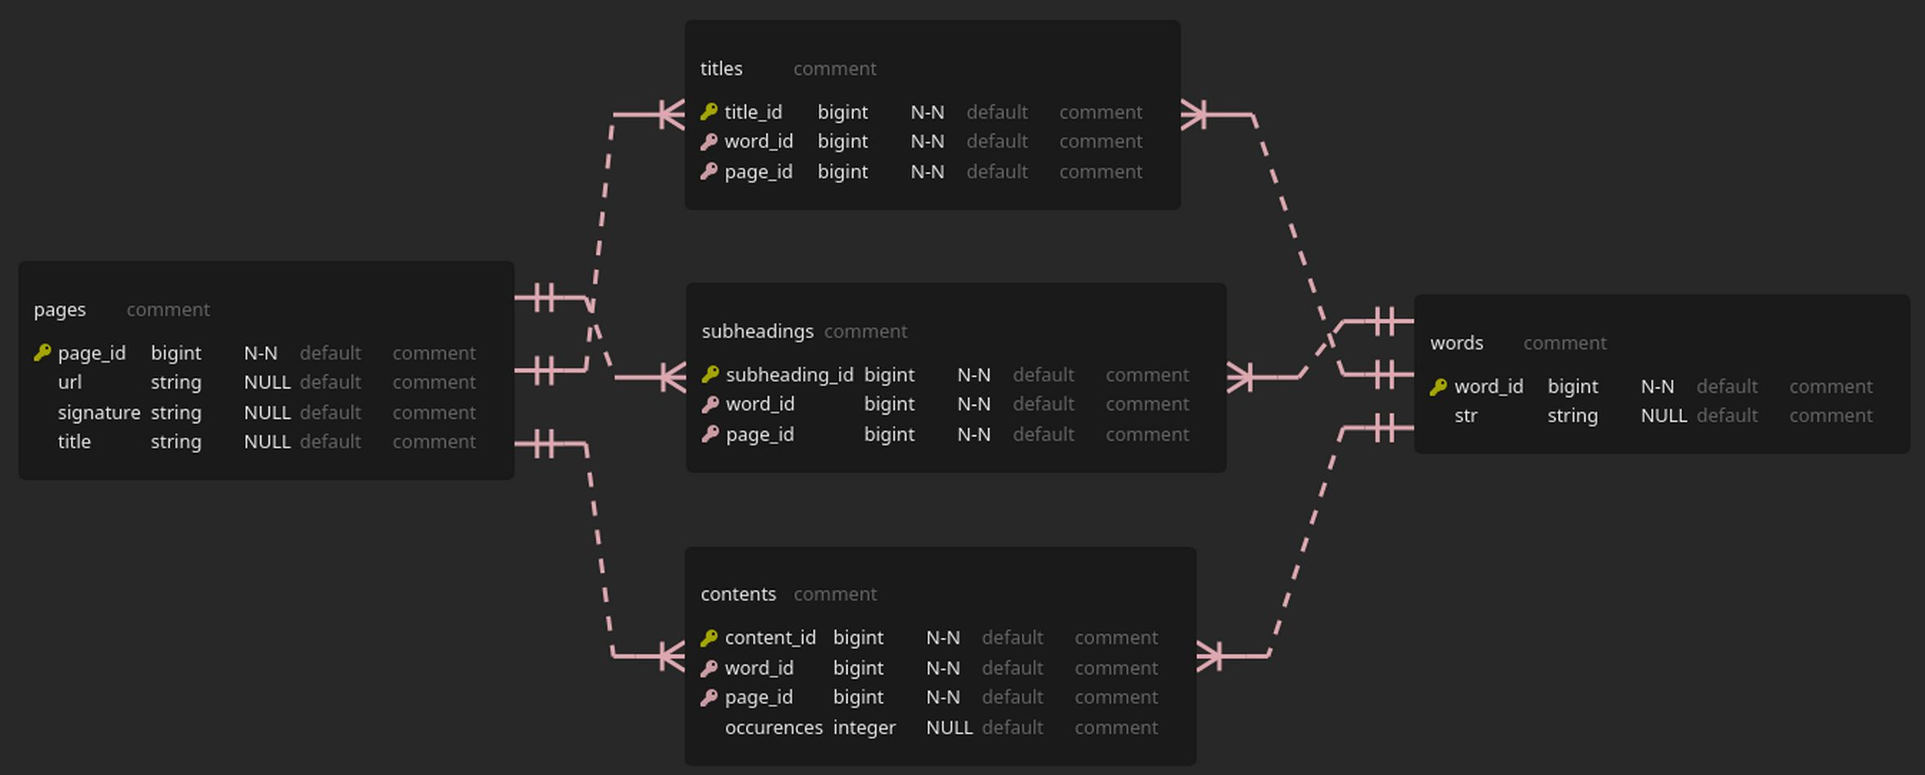
How this database works
Table pages :
Stores « url », « title » and the « signature » which is the digest of the article, this for all pages founded.
Table words :
Stores each word founded in articles. Each word is uniq.
Tables titles, subheadings and contents :
Are join tables for the Many-to-Many relationship between « pages » and « words ».

Slide 5
This work is licensed under a Creative Commons Attribution-ShareAlike 3.0 Unported License.
It makes use of the works of Mateus Machado Luna.

