Slide 1

CHAPTER - XIII MySQL REVISION TOUR

Slide 2
INTRODUCTION
What is Database?
A relational database is, simply, a database that stores related information across multiple tables and allows you to query information in more than one table at the same time

Slide 3
ADVANTAGES OF DATABASE

Slide 4
ADVANTAGES OF DATABASE
1. REDUCING DATA REDUNDANCY
Data redundancy is the repetition or superfluity of data. Data redundancy data is an common issue in computer data storage and database systems. Data redundancy definition. Data redundancy in database means that some data fields are repeated in the database.

Slide 5
ADVANTAGES OF DATABASE
2. CONTROLING DATA INCONSISTENCY
Data inconsistency is a condition that occurs between files when similar data is kept in different formats in two different files, or when matching of data must be done between files. As a result of the data inconsistency, these files duplicate some data such as addresses and names, compromising data integrity.

Slide 6
ADVANTAGES OF DATABASE
3. ENFORCING STANDARDS
DBAs can enforce standards depending on the company’s IT policy. For e.g. standards for names, reports, data elements etc.

Slide 7
ADVANTAGES OF DATABASE
4. DATA SECURITY
Database security refers to the collective measures used to protect and secure a database or database management software from illegitimate use and malicious threats and attacks.

Slide 8
ADVANTAGES OF DATABASE
5. DATA SHARING
Company with several locations has important data distributed over a valid geographically area sharing.
A centralized database is physically contained to a single location controlled by a single computer that is Personal computer most function for which databases are created and accomplished more easily
Continued…

Slide 9
ADVANTAGES OF DATABASE
5. DATA SHARING
If the database is centralized and it is easily to update and back up , recovery and control access to a database . If we know database exactly where it is and what’s software control it and identify the remote place where it is located.

Slide 10
ADVANTAGES OF DATABASE
6. DATA INTEGRITY
Data integrity is the overall completeness, accuracy and consistency of data. This can be indicated by the absence of alteration between two instances or between two updates of a data record, meaning data is intact and unchanged.

Slide 11
DISADVANTAGES OF DATABASE

Slide 12
DISADVANTAGES OF DATABASE
1. DATABASE COMPLEXITY
The design of the database system is complex, difficult and is very time consuming task to perform.

Slide 13
DISADVANTAGES OF DATABASE
2. H/w AND S/w START-UP COSTS
Huge amount of investment is needed to setup the required hardware and the softwares needed to run those applications.

Slide 14
DISADVANTAGES OF DATABASE
3. DAMAGE TO DATABASE AFFECTS VIRTUALLY ALL APPLICATIONS PROGRAMS .
If one part of the database is corrupted or damaged because of the hardware or software failure, since we don’t have many versions of the file, all the application programs which are dependent on this database are implicitly affected.

Slide 15
DISADVANTAGES OF DATABASE
4. EXTENSIVE CONVERSION COSTS
In moving form a file-based system to a database system If you are currently working on file based system and need to upgrade it to database system, then large amount of cost is incurred in purchasing different tools, adopting different techniques as per the requirement.

Slide 16
DISADVANTAGES OF DATABASE
5. INITIAL TRAINING REQUIRED
Initial training required for all programmers and user. Large amount of human efforts, the time and cost is needed to train the end users and application programmers in order to get used to the database systems.

Slide 17
DATA MODELS

Slide 18
DATA MODEL
What is Data Model?
Data models define how the logical structure of a database is modelled. Data Models are fundamental entities to introduce abstraction in a DBMS. Data models define how data is connected to each other and how they are processed and stored inside the system.

Slide 19
TYPES OF DATA MODEL

Slide 20
TYPES OF DATA MODEL
1
2
3
1
2
3
RELATIONAL DATA MODEL
NETWORK DATA MODEL
HIERARCHICAL DATA
MODEL

Slide 21
1. RELATIONAL MODEL
Relational data model is the primary data model, which is used widely around the world for data storage and processing. This model is simple and have all the properties and capabilities required to process data with storage efficiency.

Slide 22
RELATIONAL MODEL

Slide 23
RELATIONAL MODEL
Edgar F. Codd. (19 August 1923 – 18 April 2003) was an English computer scientist who, while working for IBM
He invented the relational model for database management, the theoretical basis for relational databases and relational database management systems.

Slide 24
RELATIONAL MODEL
In the relational model, all data must be stored in relations (tables).
Each relation consists of rows and columns. Each relation must have a header and body.
The header is simply the list of columns in the relation. The body is the set of data that actually populates the relation, organized into rows.
1
2
3

Slide 25
RELATIONAL MODEL
The second major characteristic of the relational
model is the usage of keys.
These are specially designated columns within a
relation, used to order data or relate data to other
relations.
One of the most important keys is the primary key,
which is used to uniquely identify each row of data
Foreign keys relate data in one relation to the
primary key of another relation
4
5
6
7

Slide 26
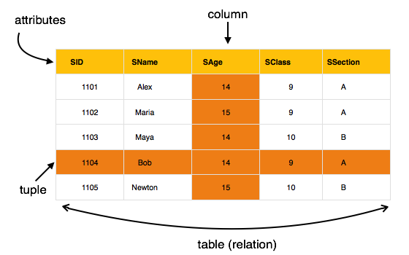
RELATIONAL MODEL

Slide 27
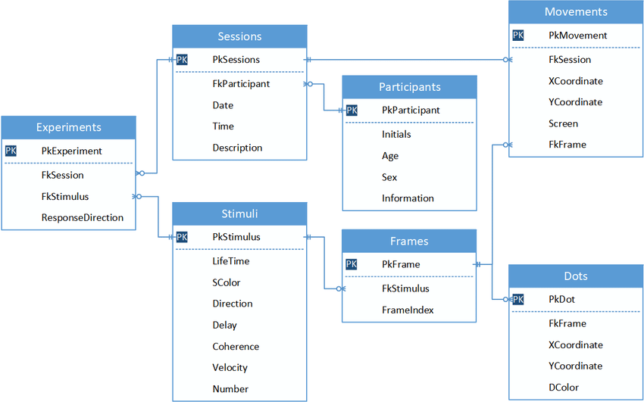
RELATIONAL MODEL

Slide 28
RELATIONAL MODEL SOFTWARES IN MARKET
Microsoft SQL Server
Microsoft SQL Server Express
SQL Azure (Cloud SQL Server)
Microsoft Visual FoxPro
Mimer SQL
MonetDB
mSQL
MySQL
OpenOffice.org Base
Netezza
NexusDB
NonStop SQL
NuoDB
Omnis Studio
Openbase
OpenLink Virtuoso (Open Source Edition)
OpenLink Virtuoso Universal Server
Wikipedia

Slide 29
RELATIONAL MODEL SOFTWARES IN MARKET
Oracle
Oracle Rdb for OpenVMS
Panorama
Paradox
Percona Server for MySQL
Percona XtraDB Cluster
Pervasive PSQL
Polyhedra
PostgreSQL
Postgres Plus Advanced Server
Progress Software
Raima Database Manager (RDM)
RDM Server
R:Base
SAND CDBMS
SAP HANA
SAP Adaptive Server Enterprise
Wikipedia

Slide 30
RELATIONAL MODEL TERMINOLOGIES

Slide 31
RELATIONAL MODEL TERMINOLOGIES
06
CARDINALITY
05
DEGREE
04
ENTITY
03
ATTRIBUTE
02
TUPLE
01
RELATION

Slide 32
RELATION
01
Relation is sometimes used to refer to a table in a relational database but is more commonly used to describe the relationships that can be created between those tables in a relational database.

Slide 33
TUPLE
02
A table has rows and columns, where rows represents records and columns represent the attributes. Tuple − A single row of a table, which contains a single record for that relation is called a tuple. Relation instance − A finite set of tuples in the relational database system represents relation instance.

Slide 34
ATTRIBUTE
03
The columns of table are known as attributes.

Slide 35
ENTITY
04
An entity is a real-world object that are represented in database. It can be any object, place, person or class. Data are stored about such entities. In DBMS we store data in the form of table containing information about entity type like students, teachers, employees etc..

Slide 36
DEGREE
05
The degree of relation is the total number of columns or attributes

Slide 37
CARDINALITY
06
Cardinality of a relation is the total number of rows or records or tuples in the relation

Slide 38

KEYS
KEYS

Slide 39
KEYS
A key is a field, or combination of fields, in a database table used to retrieve and sort rows in the table based on certain requirements. Keys are defined to speed up access to data and, in many cases, to create links between different tables.

Slide 40
KEYS
TYPES OF KEYS
KEYS

Slide 41
1
Primary Key
KEYS
3
4
2
Alternate Key
Foreign Key
Candidate Key

Slide 42

KEYS
1
Primary Key

Slide 43
1
Primary Key
KEYS
A column or group of columns in a table which helps us to uniquely identifies every row in that table is called a primary key. This DBMS can't be a duplicate. The same value can't appear more than once in the table
StudID | Roll No | First Name | LastName
1 | 11 | Rajesh | M
2 | 12 | Mohan | P
Student ID is the Primary Key

Slide 44
KEYS
2
Candidate Key

Slide 45
2
Candidate Key
KEYS
A key with no repeated attribute is called candidate key. The Primary key should be selected from the candidate keys. Every table must have at least a single candidate key.
For Example:
Continued…

Slide 46
2
Candidate Key
KEYS
StudID | Roll No | First Name | LastName
1 | 11 | Krishna | M
2 | 12 | James | W
3 | 13 | Bolt | N
Stud ID, Roll No, are candidate keys which help us to uniquely identify the student record in the table

Slide 47
KEYS
3
Alternate Key

Slide 48
3
Alternate Key
KEYS
All the candidate keys which are not primary key are called an alternate key. It is a candidate key which is currently not the primary key. However, A table may have single or multiple choices for the primary key.
For Example:
Continued…

Slide 49
3
Alternate Key
KEYS
StudID | Roll No | FName | LName | Email
1 | 11 | Ram | Price | abc@gmail.com
2 | 12 | Azar | Wright | xyz@gmail.com
StudID, Roll No, Email are qualified to become a primary key. But since StudID is the primary key, Roll No, Email becomes the alternative key.

Slide 50
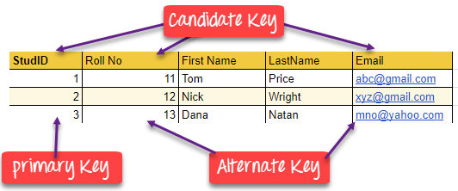
EXAMPLES
KEYS

Slide 51
KEYS
4
Foreign Key

Slide 52
45
Foreign Key
KEYS
A foreign key is a column which is added to create a relationship with another table and which acts as a primary key in the other table. Foreign keys help us to maintain data integrity and also allows navigation between two different instances of an entity. Every relationship in the model needs to be supported by a foreign key.

Slide 53
4
KEYS
Foreign Key
DEPT TABLE
TEACHER TABLE
DeptCode | DeptName
001 | Science
002 | English
005 | Computer
Teacher ID | Fname | Lname
B002 | David | Warner
B017 | Sara | Joseph
B009 | Mike | Brunton

Slide 54
4
Foreign Key
KEYS
In this example, we have two table, teach and department in a school. However, there is no way to see which search work in which department.
In this table, adding the foreign key in Deptcode to the Teacher name, we can create a relationship between the two tables.

Slide 55
4
Foreign Key
KEYS
In this table, adding the foreign key in Deptcode to the Teacher name, we can create a relationship between the two tables.
TEACHER TABLE
Teacher ID | DeptCode | Fname | Lname
B002 | 002 | David | Warner
B017 | 002 | Sara | Joseph
B009 | 001 | Mike | Brunton

Slide 56
KEYS
4
1
Foreign Key
Vs.
Primary Key

Slide 57
4
12
Foreign Key
Vs.
Primary Key
KEYS
Primary Key | Foreign Key
Helps you to uniquely identify a record in the table. | It is a field in the table that is the primary key of another table.
Primary Key never accept null values. | A foreign key may accept multiple null values.
Continued…

Slide 58
4
1
KEYS
Foreign Key
Vs.
Primary Key
Primary Key | Foreign Key
Primary key is a clustered index and data in the DBMS table are physically organized in the sequence of the clustered index. | A foreign key cannot automatically create an index, clustered or non-clustered. However, you can manually create an index on the foreign key.
You can have the single Primary key in a table. | You can have multiple foreign keys in a table.

Slide 59
REFERENTIAL INTEGRITY
RI

Slide 60
REFERENTIAL INTEGRITY
RI
The data in a table that is not linked is probably of no value to other tables. To maintain referential integrity of data that is linked across tables.
Referential integrity (RI) is a relational database concept, which states that table relationships must always be consistent. In other words, any foreign key field must agree with the primary key that is referenced by the foreign key.

Slide 61

REFERENTIAL INTEGRITY
RI
You can set referential integrity when following conditions are met:-
The matching field from the primary table is the primary key
The related fields have the same data type
Both the tables belongs to the same database.

Slide 62
REFERENTIAL INTEGRITY
RI
You can set referential integrity when following conditions are met:-
The matching field from the primary table is the primary key
The related fields have the same data type
Both the tables belongs to the same database.

Slide 63
REFERENTIAL INTEGRITY
RI
After enforcing referential integrity you can observe the following rules:-
Not possible to enter value in the foreign key field of the related table that doesn’t exists in the primary key of the primary table.
You can’t delete a record from primary table if matching records exists in the related table.

Slide 64
REFERENTIAL INTEGRITY
RI
After enforcing referential integrity you can observe the following rules:-
you can’t change primary key value in primary table, if that record has related records

Slide 65


Slide 66

MYSQL INTRODUCTION
MySQL is an world’s most popular open source relational database.
MySQL is cross platform which means it runs on a number of different platforms such as Windows, Linux, and Mac OS etc.
MySQL is written in C and C++.
It was released under the name of co-founder Michael Widenius daughter, ‘My‘.

Slide 67
MYSQL HISTORY
MySQL was created by a Swedish company, MySQL AB, founded by David Axmark, Allan Larsson and Michael "Monty" Widenius.
Original development of MySQL by Widenius and Axmark began in 1994. The first version of MySQL appeared on 23 May 1995.
In 2010 Oracle acquired MYSQL.

Slide 68
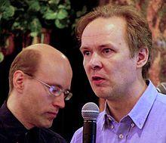
MYSQL HISTORY
Michael “Monty” Widenius
and
David Axmark
It was released under the name of co-founder Michael Widenius daughter, ‘My‘.

Slide 69
WHAT IS SQL?

Slide 70

SQL
SQL stands for Structured Query Language. It is designed for managing data in a relational database management system (RDBMS).
It is pronounced as S-Q-L or sometime See-Qwell. SQL is a database language.
it is used for database creation, deletion, fetching rows, and modifying rows, etc

Slide 71
SQL STATEMENTS

Slide 72
SQL STATEMENTS
SQL statements can be classified in to following categories:-
1. DATA DEFINITION LANGUAGE (DDL) COMMANDS
2. DATA MANIPULATION LANGUAGE (DML) COMMANDS
3. DATA CONTROL LANGUAGE (DCL) COMMANDS
4. TRANSACTION CONTROL LANGUAGE (TCL) COMMANDS

Slide 73

1. DATA DEFINITION LANGUAGE (DDL) COMMANDS
Data Definition Language actually consists of the SQL commands that can be used to define the database schema. Followings are the commands which fall under DDL category :-
CREATE TABLE
DROP TABLE
ALTER TABLE
TRUNCATE
COMMENT
RENAME

Slide 74
2. DATA MANIPULATION LANGUAGE (DML) COMMANDS
The SQL commands that deals with the manipulation of data are DML Commands. Followings commands fall under the DML Commands category:-
SELECT
INSERT
UPDATE
DELETE
MERGE
CALL

Slide 75

3. DATA CONTROL LANGUAGE (DCL) COMMANDS
DCL is short name of Data Control Language mostly concerned with rights, permissions and other controls of the database system. Followings commands fall under the DML Commands category:-.
GRANT
REVOKE

Slide 76
4. TRANSACTION CONTROL LANGUAGE (TCL) COMMANDS
TCL is short name of Transaction Control Language which deals with a transaction within a database. Followings commands fall under the DML Commands category:-.
COMMIT
ROLLBACK
SAVEPOINT
SET TRANSACTION

Slide 77
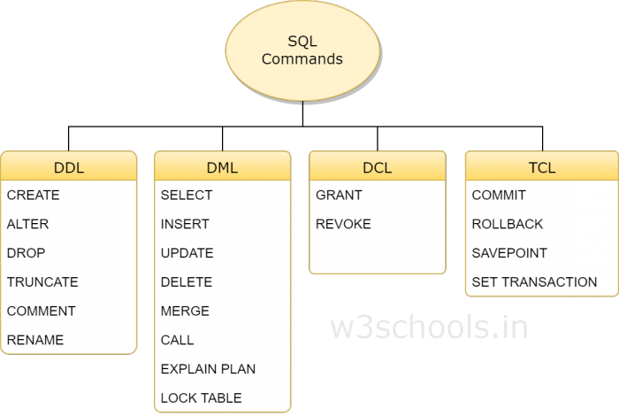
SUMMARY
Reference: w3schools.in

Slide 78
DATA TYPES

Slide 79
DATA TYPES
Ty p e | S i z e | D e s c r i p t i o n
CHAR[Length] | Length bytes | 0 to 255 characters long.
VARCHAR (Length) | String length + 1 bytes | 0 to 255 characters long.
TINYTEXT | String length + 1 bytes | maximum length of 255 characters.

Slide 80
DATA TYPES
Ty p e | S i z e | D e s c r i p t i o n
TEXT | String length + 2 bytes | maximum length of 65,535 characters.
MEDIUMTEXT | String length + 3 bytes | maximum length of 16,777,215 characters.
LONGTEXT | String length + 4 bytes | maximum length of 4,294,967,295 characters.

Slide 81
DATA TYPES
Ty p e | S i z e | D e s c r i p t i o n
TEXT | String length + 2 bytes | maximum length of 65,535 characters.
MEDIUMTEXT | String length + 3 bytes | maximum length of 16,777,215 characters.
LONGTEXT | String length + 4 bytes | maximum length of 4,294,967,295 characters.
TINYINT[Length] | 1 byte | Range of -128 to 127 or 0 to 255 unsigned.

Slide 82
DATA TYPES
Ty p e | S i z e | D e s c r i p t i o n
SMALLINT[Length] | 2 bytes | Range of -32,768 to 32,767 or 0 to 65535 unsigned.
MEDIUMINT[Length] | 3 bytes | Range of -8,388,608 to 8,388,607 or 0 to 16,777,215 unsigned.
INT[Length] | 4 bytes | Range of -2,147,483,648 to 2,147,483,647 or 0 to 4,294,967,295 unsigned.

Slide 83
DATA TYPES
Ty p e | S i z e | D e s c r i p t i o n
BIGINT[Length] | 8 bytes | Range of -9,223,372,036,854,775,808 to 9,223,372,036,854,775,807 or 0 to 18,446,744,073,709,551,615 unsigned.

Slide 84
DATA TYPES
Ty p e | S i z e | D e s c r i p t i o n
FLOAT | 4 bytes | A small number with a floating decimal point.
DOUBLE[Length, Decimals] | 8 bytes | A large number with a floating decimal point.
DECIMAL[Length, Decimals] | Length + 1 or Length + 2 bytes | A DOUBLE stored as a string, allowing for a fixed decimal point.

Slide 85
DATA TYPES
Ty p e | S i z e | D e s c r i p t i o n
TIME | 3 bytes | In the format of HH:MM:SS
ENUM | 1 or 2 bytes | Short for enumeration, which means that each column can haveone of several possible values.
SET | 1, 2, 3, 4, or 8 bytes | Like ENUM except that each column can have more than one of several possible values.

Slide 86
DATA TYPES
Ty p e | S i z e | D e s c r i p t i o n
DATE | 3 bytes | In the format of YYYY-MM-DD.
DATETIME | 8 bytes | In the format of YYYY-MM-DD HH:MM:SS.
TIMESTAMP | 4 bytes | In the format of YYYYMMDDHHMMSS; acceptable range ends inthe year 2037.

Slide 87
CHAR vs. VARCHAR DATA TYPE

Slide 88
CHAR vs. VARCHAR DATA TYPE
CHAR Data Type | VARCHAR Data Type
Its full name is CHARACTER | Its full name is VARIABLE CHARACTER
It stores values in fixed lengths and are padded with space characters to match the specified length | VARCHAR stores values in variable length along with 1-byte or 2-byte length prefix and are not padded with any characters
It can hold a maximum of 255 characters. | It can hold a maximum of 65,535 characters.
It uses static memory allocation.mysql>create table emp(name CHAR(20)); Query OK, 0 rows affected (0.25 | It uses dynamic memory allocation.mysql>create table emp1(name VARCHAR(20)); Query OK, 0 rows affected (0.21

Slide 89
CREATING DATABASE IN MYSQL

Slide 90
CREATING DATABASE IN MYSQL
MySQL implements a database as a directory that contains all files which correspond to tables in the database.
CREATE DATABASE mydb;
Return value:
Query OK, 1 row affected (0.05 sec)

Slide 91
USING OR ACCESSING CREATED DATABASE

Slide 92
USING OR ACCESSING CREATED DATABASE
Using the created database mydb
USE mydb;
Return value:
Database Changed

Slide 93
CREATING TABLES WITH CREATE TABLE
CATEGORY: DDL COMMAND

Slide 94
CREATING TABLES WITH CREATE TABLE
Creating a table in MySQL
CREATE TABLE mytable
(
id int NOT NULL,
username varchar(100) NOT NULL,
email varchar(100) NOT NULL,
PRIMARY KEY (id)
);
Query OK, 0 rows affected (0.10 sec)

Slide 95
TABLE CREATION WITH PRIMARY KEY
CATEGORY: DDL COMMAND

Slide 96
TABLE CREATION WITH PRIMARY KEY
Creating a table in MySQL
CREATE TABLE Person (
PersonID INT UNSIGNED NOT NULL PRIMARY KEY,
LastName VARCHAR(66) NOT NULL,
FirstName VARCHAR(66),
Address VARCHAR(255),
City VARCHAR(66)
);

Slide 97
TABLE CREATION WITH PRIMARY KEY
Creating a table in MySQL
CREATE TABLE Person (
PersonID INT UNSIGNED NOT NULL,
LastName VARCHAR(66) NOT NULL,
FirstName VARCHAR(66),
Address VARCHAR(255),
City VARCHAR(66),
PRIMARY KEY (PersonID)
);

Slide 98
TABLE CREATION WITH FOREIGN KEY
CATEGORY: DDL COMMAND

Slide 99
TABLE CREATION WITH FOREIGN KEY
Creating a table in MySQL
CREATE TABLE Account (
AccountID INT NOT NULL,
AccountNo INT NOT NULL,
PersonID INT,
PRIMARY KEY (AccountID),
FOREIGN KEY (PersonID) REFERENCES Person (PersonID)
);

Slide 100
TABLE CREATION WITH FOREIGN KEY
ON CASCADE DELETE
CATEGORY: DDL COMMAND

Slide 101
ON CASCADE DELETE
If a row or tuple deleted from parent table, all its related tuples or rows in the child table will automatically deleted.
CREATE TABLE Account (
AccountID INT NOT NULL,
AccountNo INT NOT NULL,
PersonID INT,
PRIMARY KEY (AccountID),
FOREIGN KEY (PersonID) REFERENCES Person (PersonID) ON CASCADE DELETE
);

Slide 102
TABLE CREATION WITH FOREIGN KEY
ON CASCADE UPDATE
CATEGORY: DDL COMMAND

Slide 103
ON CASCADE UPDATE
If a row or tuple updated from parent table, all its related tuples or rows in the child table will automatically updated.
CREATE TABLE Account (
AccountID INT NOT NULL,
AccountNo INT NOT NULL,
PersonID INT,
PRIMARY KEY (AccountID),
FOREIGN KEY (PersonID) REFERENCES Person (PersonID) ON CASCADE UPDATE);

Slide 104
TABLE CREATION WITH UNIQUE KEY
CATEGORY: DDL COMMAND

Slide 105
TABLE CREATION WITH UNIQUE KEY
Creating a table in MySQL
CREATE TABLE Account (
AccountID INT NOT NULL,
AccountNo INT NOT NULL UNIQUE,
PersonID INT,
PRIMARY KEY (AccountID),
FOREIGN KEY (PersonID) REFERENCES Person (PersonID)
);

Slide 106
TABLE CREATION WITH DEFAULT CONSTRAINT
CATEGORY: DDL COMMAND

Slide 107
TABLE CREATION WITH DEFAULT CONSTRAINT
DEFAULT CONSTRAINT in MySQL
CREATE TABLE student
(
Rollno int not null primary key,
Studname char(50) not null default ‘sam’,
Marks decimal
);

Slide 108
TABLE CREATION WITH CHECK CONSTRAINT
CATEGORY: DDL COMMAND

Slide 109
TABLE CREATION WITH CHECK CONSTRAINT
CHECK CONSTRAINT in MySQL
CREATE TABLE student
(
Rollno int not null primary key,
Studname char(50) not null.
Marks decimal CHECK(Marks>=0)
);

Slide 110
TABLE LEVEL CONSTRAINT
CATEGORY: DDL COMMAND

Slide 111
TABLE LEVEL CONSTRAINT
When a constraint is applied on group of columns of the table, it is called TABLE LEVEL CONSTRAINT.
CREATE TABLE products(
Icode int not null,
Descrip char(25),
Cost decimal,
Qty int,
Totcost float,
CHECK (QTY>0),
UNIQUE(Icode,Ddescrip) ) ;

Slide 112
COLUMN LEVEL CONSTRAINT
CATEGORY: DDL COMMAND

Slide 113
COLUMN LEVEL CONSTRAINT
When a constraint is applied on specific column of the table, it is called COLUMN LEVEL CONSTRAINT.
CREATE TABLE products(
Icode int not null primary key,
Descrip char(25),
Cost decimal);

Slide 114
INSERTING ROWS OR TUPLES IN TABLE
CATEGORY: DML COMMAND

Slide 115
INSERTING ROWS OR TUPLES IN TABLE
CATEGORY: DML COMMAND
Inserting a row into a MySQL table
INSERT INTO mytable ( username, email )
VALUES ( 'username', 'username@example.com' );
Query OK, 1 row affected (0.06 sec)
NOTE: STRINGS and date are represented in single quotes.

Slide 116
UPDATING ROWS OR TUPLES IN TABLE
CATEGORY: DML COMMAND

Slide 117
UPDATING ROWS OR TUPLES IN TABLE
CATEGORY: DML COMMAND
Updating a row into a MySQL table
UPDATE mytable SET username=‘myuser’ WHERE id=8
Query OK, 1 row affected (0.06 sec)

Slide 118
DELETING A ROW INTO A MYSQL TABLE
CATEGORY: DML COMMAND

Slide 119
DELETING A ROW INTO A MYSQL TABLE
CATEGORY: DML COMMAND
Deleting a row into a MySQL table
DELETE FROM mytable WHERE id=8
Query OK, 1 row affected (0.06 sec)

Slide 120
ALTER TABLE in MySQL
CATEGORY: DML COMMAND

Slide 121
MODIFY COLUMN OF MYSQL TABLE
CATEGORY: DML COMMAND
ALTER TABLE is used to add/modify/rename the column definition of existing table.
For Example:-
Create table UserTable2019(
id_user int NOT NULL,
username varchar(30) NOT NULL,
password varchar(30) NOT NULL
);

Slide 122
MODIFY COLUMN OF MYSQL TABLE
CATEGORY: DML COMMAND
ALTER TABLE UserTable2019
MODIFY (
username varchar(45) NOT NULL,
password varchar(35) NOT NULL
);
Username column size changed from 30 to 45 and password column size is changed from 30 to 35.

Slide 123
ADDING COLUMN in MySQL TABLE
CATEGORY: DML COMMAND

Slide 124
ADDING COLUMN IN MYSQL TABLE
CATEGORY: DML COMMAND
ALTER TABLE is used to add/modify/rename the column definition of existing table.

Slide 125
ADDING COLUMN IN MYSQL TABLE
CATEGORY: DML COMMAND
ALTER TABLE UserTable2019
ADD (
address varchar(45) NOT NULL,
Phone_no varchar(35) NOT NULL
);
address and Phone_no are new columns introduced in UserTable2019.

Slide 126
CHANGING COLUMN NAME OF MySQL TABLE
CATEGORY: DML COMMAND

Slide 127
CHANGING NAME OF COLUMN OF MYSQL TABLE
CATEGORY: DML COMMAND
ALTER TABLE is used to change the column name of existing table.
ALTER TABLE UserTable2019
CHANGE address addr varchar(45));

Slide 128
CREATE TABLE FROM SELECT
CATEGORY: DDL COMMAND

Slide 129
CREATE TABLE FROM SELECT
CATEGORY: DDL COMMAND
You can create a table from SELECT clause.
For Example:
CREATE TABLE Usr_Tab2019
AS SELECT * FROM User_table2019;

Slide 130
DROPPING MYSQL TABLE
CATEGORY: DML COMMAND

Slide 131
DROPPING MYSQL TABLE
CATEGORY: DML COMMAND
DROP TABLE command is used to drop the table.
DROP TABLE Tablename
For Example:
DROP TABLE UserTable2019
NOTE: Dropping table will completely delete the table from the database and all its information, and it will not be recovered.

Slide 132
SELECT QUERY in MySQL
CATEGORY: DML COMMAND

Slide 133
SELECT QUERY in MySQL
CATEGORY: DML COMMAND
SELECTING ALL ROWS WITH ALL COLUMNS

Slide 134
SELECT QUERY in MySQL
CATEGORY: DML COMMAND
Selecting all tuples with all attributes in MySQL
SELECT * FROM mytable;
OUTPUT
+----+----------+---------------------+
| id | username | email |
+----+----------+---------------------+
| 1 | myuser | myuser@example.com |
+----+----------+---------------------+

Slide 135
SELECT QUERY in MySQL
CATEGORY: DML COMMAND
PARTICULAR COLUMNS SELECTION IN MYSQL

Slide 136
SELECT QUERY in MySQL
CATEGORY: DML COMMAND
Selected particular columns in MySQL
SELECT username FROM mytable;
OUTPUT
+----------+
| username |
+----+-----+
| myuser |
|----------+

Slide 137
SELECT QUERY in MySQL
CATEGORY: DML COMMAND
SELECTING ROWS BASED ON CONDITIONS

Slide 138
SELECT QUERY in MySQL
CATEGORY: DML COMMAND
Selecting rows based on conditions in MySQL
SELECT * FROM mytable WHERE username = ‘myuser’;
OUTPUT
+----+----------+---------------------+
| id | username | email |
+----+----------+---------------------+
| 1 | myuser | myuser@example.com |
+----+----------+---------------------+

Slide 139
SELECT QUERY in MySQL
CATEGORY: DML COMMAND
SELECT with DISTINCT

Slide 140
SELECT QUERY in MySQL
CATEGORY: DML COMMAND
SELECT with DISTINCT
The DISTINCT clause after SELECT eliminates duplicate rows from the result set.
CREATE TABLE car
( car_id INT NOT NULL PRIMARY KEY, name VARCHAR(20),
price DECIMAL(8,2)
);

Slide 141
SELECT QUERY in MySQL
CATEGORY: DML COMMAND
SELECT with DISTINCT
INSERT INTO CAR (`car_id`, `name`, `price`) VALUES (1, 'Audi A1', '20000');
INSERT INTO CAR (`car_id`, `name`, `price`) VALUES (2, 'Audi A1', '15000');
INSERT INTO CAR (`car_id`, `name`, `price`) VALUES (3, 'Audi A2', '40000');
INSERT INTO CAR (`car_id`, `name`, `price`) VALUES (4, 'Audi A2', '40000');

Slide 142
SELECT QUERY in MySQL
CATEGORY: DML COMMAND
SELECT with DISTINCT
SELECT DISTINCT name FROM CAR;
+---------+
| name |
+---------+
| Audi A1 |
| Audi A2 |
+---------+

Slide 143
SELECT QUERY in MySQL
CATEGORY: DML COMMAND
SELECT with DISTINCT
SELECT DISTINCT name, price FROM CAR;
+---------+----------+
| name | price |
+---------+----------+
| Audi A1 | 20000.00 |
| Audi A1 | 15000.00 |
| Audi A2 | 40000.00 |
+---------+----------+

Slide 144
SELECT QUERY in MySQL
CATEGORY: DML COMMAND
ALL Keyword

Slide 145
SELECT QUERY in MySQL
CATEGORY: DML COMMAND
ALL Keyword
SELECT ALL name FROM CAR;
+---------+
| name |
+---------+
| Audi A1 |
| Audi A1 |
| Audi A2 |
+---------+

Slide 146
DESCRIBE COMMAND

Slide 147
DESCRIBE COMMAND
Describe command is used to show all the fields of a table
All the details. (structure of the table)
DESCRIBE databaseName.tableName;
Or
DESCRIBE tablename;

Slide 148
DESCRIBE COMMAND
mysql> DESCRIBE orders;
+----------------+-------------+------+-----+---------+-------+-------+
| Field | Type | Null | Key | Default | Extra |
+---------------------+------+------+-----+---------+-------+---------+
| orderNumber | int(11) | NO | PRI | NULL | |
| orderDate | date | NO | | NULL | |
| requiredDate | date | NO | | NULL | |
| shippedDate | date | YES | | NULL | |
| 4 rows in set (0.01 sec)

Slide 149
SHOW LIST OF EXISTING DATABASES

Slide 150
SHOW LIST OF EXISTING DATABASES
SHOW databases;
-------------------------------+
| Databases |
+-----------------------------+
| employeees |
| mydb |
+-----------------------------+

Slide 151
SHOW TABLES IN AN EXISTING DATABASE

Slide 152
SHOW TABLES IN AN EXISTING DATABASE
SHOW tables;
-------------------------------+
| Tables_in_mydb |
+-----------------------------+
|mytable |
+-----------------------------+

Slide 153
CREATING USER

Slide 154
CREATING USER- FROM LOCAL

Slide 155
CREATING USER- FROM LOCAL
CREATE USER 'user'@'localhost' IDENTIFIED BY 'some_password';
Will create a user that can only connect on the local machine where the database is hosted.

Slide 156
CREATING USER - FROM ANYWHERE

Slide 157
CREATING USER - FROM ANYWHERE
CREATE USER 'user'@'%' IDENTIFIED BY 'some_password';
Will create a user that can connect from anywhere (except the local machine).

Slide 158
GRANT OR ADDING PRIVILEGES

Slide 159
GRANT OR ADDING PRIVILEGES
CATEGORY: DCL COMMAND
GRANTING SPECIFIC PRIVILEGES
SELECT
INSERT
UPDATE
DELETE
CREATE
DROP
GRANT SELECT, INSERT, UPDATE ON databaseName.* TO 'userName'@'localhost‘;

Slide 160
GRANT ALL PRIVILEGES

Slide 161
GRANT ALL PRIVILEGES
CATEGORY: DCL COMMAND
GRANTING ALL PRIVILEGES
Grant all privileges to the user for all tables on all databases (attention with this):
GRANT ALL ON *.* TO 'userName'@'localhost' WITH GRANT OPTION;

Slide 162
GRANT ALL PRIVILEGES
CATEGORY: DCL COMMAND
GRANTING ALL PRIVILEGES
Grant all privileges to the user for all tables on all databases (attention with this):
GRANT ALL ON *.* TO 'userName'@'localhost' WITH GRANT OPTION;

Slide 163
PREDICATES

Slide 164
PREDICATES
Predicate operations are operations that can be evaluated to give a condition of true or false and are used in WHERE clause of SELECT statement:
1. "Comparison" Predicates: Compares two values of the same type according to a predefined order. There are 6 comparison operations:
Equal: value = value
Not Equal: value <> value
Less Than: value < value
Greater Than: value > value
Less Than or Equal: value <= value
Greater Than or Equal: value >= value

Slide 165
PREDICATES
"Comparison" Predicates Example:
1. SELECT * FROM EMPLOYEE
WHERE
SAL>=6700
2. SELECT * FROM EMPLOYEE
WHERE
Dept=‘Comp Sci’

Slide 166
PREDICATES
2. "Between" Predicates: Check a given value against a value range. There are 2 "between" operations:
Between: value BETWEEN value AND value
Not Between: value NOT BETWEEN value AND value

Slide 167
PREDICATES
"Between" Predicate Example:
SELECT * FROM stud WHERE id >= 2 and id <= 5;
This query can be written as,
SELECT * FROM stud WHERE id BETWEEN 2 and 5;
NEGATE:
SELECT * FROM stud WHERE id NOT BETWEEN 2 and 5

Slide 168
PREDICATES
3. "In" Predicates: Check a given value against a list of values. There are 2 "in" operations:
In: value IN (value, value, ..., value)
Not In: value NOT IN (value, value, ..., value)

Slide 169
PREDICATES
. "In" Predicates Example:
SELECT * FROM STUD WHERE ROLLO IN (1001, 1002,1003,1010)
NOT IN:
SELECT * FROM STUD WHERE ROLLO NOT IN (1006, 1089,1008,1016)

Slide 170
PREDICATES
4. "Like" Predicates: Check a given character string against a character pattern. By default "Like" operations are not case sensitive. There are 2 "Like" operations:
Like: string LIKE pattern
Not Like: string NOT LIKE pattern
Continued…

Slide 171
PREDICATES
"pattern" is a character string with wildcard characters and escape sequences:
"_": Representing one and only one single character.
"%": Representing zero, one and many characters.
"\_": Representing character "_".
"\%": Representing character "%".
Continued…

Slide 172
PREDICATES
Examples:
'abc' LIKE 'Abc' -- true
'3.14' LIKE '_.__' – true
'3.14159' LIKE '3.%‘ -- true
'herong_yang' LIKE 'herong\_yang‘ – true
'4.75%' LIKE '_.__\%' -- true

Slide 173
PREDICATES
Examples:
SELECT * FROM stud_users WHERE username LIKE ‘adm%’;
SELECT * FROM stud_users WHERE username LIKE ‘%adm%’;
SELECT * FROM stud_users WHERE username LIKE ‘_a___’;

Slide 174
PREDICATES
5. "Null" Predicates: Check a given value against null value. There are 2 "Null" operations:
Null : value IS NULL
Not Null : value IS NOT NULL
Examples:
1 IS NULL -- false
'a' IS NOT NULL -- true
NULL IS NULL -- true
NULL IS NOT NULL -- false

Slide 175
COMMENTS

Slide 176
COMMENTS
Comments are non executable statements and are used to explain the code or commands. MYSQL supports three types of comments and they are:-
1. # This comment continues to the end of line
2. /* This is an in-line comment */
3. /* This is a
multiple-line comment */

Slide 177
SQL Exercises

Slide 178
CREATE WORKER TABLE
WORKER_ID | FIRST_NAME | LAST_NAME | SALARY | JOINING_DATE | DEPARTMENT
001 | Monika | Arora | 100000 | 2014-02-20 09:00:00 | HR
002 | Niharika | Verma | 80000 | 2014-06-11 09:00:00 | Admin
003 | Vishal | Singhal | 300000 | 2014-02-20 09:00:00 | HR
004 | Amitabh | Singh | 500000 | 2014-02-20 09:00:00 | Admin
005 | Vivek | Bhati | 500000 | 2014-06-11 09:00:00 | Admin
006 | Vipul | Diwan | 200000 | 2014-06-11 09:00:00 | Account
007 | Satish | Kumar | 75000 | 2014-01-20 09:00:00 | Account
008 | Geetika | Chauhan | 90000 | 2014-04-11 09:00:00 | Admin

Slide 179
CREATE BONUS TABLE
Build the relationship between Worker table and Bonus table
WORKER_REF_ID | BONUS_DATE | BONUS_AMOUNT
1 | 2016-02-20 00:00:00 | 5000
2 | 2016-06-11 00:00:00 | 3000
3 | 2016-02-20 00:00:00 | 4000
1 | 2016-02-20 00:00:00 | 4500
2 | 2016-06-11 00:00:00 | 3500

Slide 180
Build the relationship between Worker table and Title table
CREATE TITLE TABLE
WORKER_REF_ID | WORKER_TITLE | AFFECTED_FROM
1 | Manager | 2016-02-20 00:00:00
2 | Executive | 2016-06-11 00:00:00
8 | Executive | 2016-06-11 00:00:00
5 | Manager | 2016-06-11 00:00:00
4 | Asst. Manager | 2016-06-11 00:00:00
7 | Executive | 2016-06-11 00:00:00
6 | Lead | 2016-06-11 00:00:00
3 | Lead | 2016-06-11 00:00:00

Slide 181
CLASS WORK / HOMEWORK

Slide 182
CREATE WORLD TABLE
Name | Continent | Area | Population | GDP
Afghanistan | Asia | 652230 | 25500100 | 20343000000
Albania | Europe | 28748 | 2831741 | 12960000000
Algeria | Africa | 2381741 | 37100000 | 188681000000
Andorra | Europe | 468 | 78115 | 3712000000
Angola | Africa | 1246700 | 20609294 | 100990000000

Slide 183
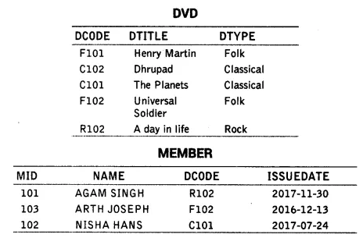
CREATE FOLLOWING TABLES

Slide 184
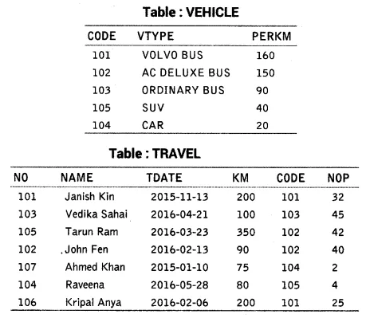
CREATE FOLLOWING TABLES

Slide 185
THANK YOU

