Slide 1
Module 1
Explaining Network Topologies

Slide 2
Module Objectives
Explain network types and characteristics.
Compare and contrast OSI model layers.
Configure SOHO networks.
Explain CompTIA’s troubleshooting methodology.
Notes:
The learning objectives align with the following Exam Objectives for Module 1:
1.1 Explain concepts related to the Open Systems Interconnection (OSI) reference model.
1.2 Compare and contrast networking appliances, applications, and functions.
1.6 Compare and contrast network topologies, architectures, and types.
5.1 Explain the troubleshooting methodology.

Slide 3
Lesson 1.1
Networking Overview
Notes:
Exam Objectives Covered
1.2 Compare and contrast networking appliances, applications, and functions.
1.6 Compare and contrast network topologies, architectures, and types.

Slide 4

Think About It
How would you define your social network?
Notes:
Suggested Discussion - Think About It
Strive to bring attention to the following:
Who is included in a social network?
What is the purpose of this network?
What services or benefits does this network provide?

Slide 5
How are personal and IT networks similar?
Personal Network
People
Relationships
IT Network
Devices
Connections
Communication
Data transfer
Social groups
Influence
Trust
Network segments
Network topology
Security
Notes:
Suggested Instructional Tips - How are personal and IT networks similar?
People and Devices - Individuals in a personal network are equivalent to devices in an IT network. Both are the fundamental units.
Relationships and Connections - The bonds between people in a personal network mirror the connections (cables, wireless signals) between devices in an IT network.
Communication and Data Transfer - How information is exchanged between people (verbal, nonverbal, written) is similar to how data moves between devices (through networks).
Social Groups and Network Segments - Just as people form groups (families, friends, colleagues), devices are organized into networks or segments for efficient communication.
Influence and Network Topology - The way individuals influence others within a social group is comparable to how certain devices or nodes impact data flow within a network.
Trust and Security - Trust is essential for strong personal relationships, while security is paramount for protecting data and devices in IT networks.
Talking points:
Core Components: Both networks consist of entities (people or devices) and connections (relationships or links).
Information Exchange: The primary function of both is to facilitate the exchange of information (ideas or data).
Structure and Organization: Both networks have structures (social groups or network segments) that influence how information flows.
Relationships and Security: Trust and security are critical factors in the success and reliability of both personal and IT networks.

Slide 6
Networks
Servers are powerful computers that share resources like applications and data with client computers
Peer-to-Peer
Each host can both share resources and receive them. A peer-to-peer network is also known as a workgroup
Client-Server
Notes:
Suggested Instructional Tips – Networks
Client-Server model: Servers are powerful computers that share resources like applications and data with client computers.
Peer-to-Peer network: Each hosts can both share resources and receive them. A Peer-to-Peer network is also known as a workgroup.
Key points to emphasize:
Remind (or introduce) learners to the concepts of nodes, clients, and servers.
Differentiate between peer-to-peer and client-server networks.

Slide 7
Local Area Network (LAN)
SOHO
Enterprise LAN
Datacenter
A LAN is confined to a single geographical location.
Notes:
Suggested Instructional Tips – Local Area Networks
Provide a quick overview of the following definitions:
LAN: A local area network (LAN) is confined to a single geographical location.
SOHO: A home or business-oriented network that uses a centralized router or server to network computers, mobile devices, and other devices or appliances.
Enterprise LAN:
Small and medium-sized enterprise (SME) network: A network supporting dozens of users (structured cabling, switches, and routers)
A network supporting hundreds or thousands of users (multiple enterprise-class switches, and routers)
Datacenter: A network that hosts only servers and storage, not end user client devices
WAN: A wide area network (WAN) is a network of networks, connected by long-distance links. A typical enterprise WAN would connect a main office site with multiple branch office sites, possibly in different countries.

Slide 8
Lesson Summary
Network: Computing devices that share data via common protocols and transmission media
Client-Server Network: A server shares data, applications, and resources with client devices
Local Area Network (LAN): Devices connected within a single geographic location such as a home or business
Network Topology: The physical or logical layout of connected devices, typically seen as star, mesh, or point-to-point topologies
Notes:
Lesson Summary
A network is a collection of computers and other devices connected by transmission medium and share one or more protocols that enable them to exchange data. ​
A client-server network is one where some nodes act mostly as clients. Application services and resources are centrally provisioned, managed, and secured by the server.​
Local area networks are confined to a single geographical location and can vary in size from a small home network to an Enterprise LAN. ​
A network’s physical topology describes the placement of nodes and how they are connected. The three basic network topologies are star, mesh, and point-to-point. ​

Slide 9
Activity: Quick Search
Point-to-Point Topology
Star
Topology
Mesh Topology
Instructions
Conduct a quick research on one of the indicated topologies, focusing on understanding the basic structure, advantages, and disadvantages of the topology.
Notes:
Suggested Activity – Quick Search
INSTRUCTIONS FOR INSTRUCTOR: Quick Research (Quick Search) Activity
Whether by instructor assignment or student selection, divide these topologies (Point-to-Point Topology, Star Topology, and Mesh Topology) amongst the learners.
Have learners do a quick research assignment where they learn about the 3 basic topologies.
Have learners compile a short list of notes along with a drawing of the topology.
Once they have compiled their notes, have them return as a group where they can present their findings.
Note: The next three topology slides can be used as handouts to the assigned learners or to refer to when the learners come back to present their findings.
Exam Objectives Covered:
1.6 Compare and contrast network topologies, architectures, and types.
INSTRUCTIONS FOR LEARNERS: Quick Research (Quick Search) Activity
Assignment of Topologies: Your instructor will either assign you one of the following topologies or you may select one yourself: Point-to-Point Topology, Star Topology, and Mesh Topology.
Research: Conduct a quick research on your assigned topology. Focus on understanding the basic structure, advantages, and disadvantages of the topology.
Compile Notes: Create a short list of notes summarizing your findings. Include key points such as: Definition and basic structure; how it works; pros and cons; and common use cases.
Optional: Create a Drawing: If you choose, draw a simple diagram illustrating your assigned topology. Ensure your drawing clearly shows the connections and layout.
Group Presentation: Once you have compiled your notes (and optionally created your drawing), return to the group. Present your findings to the group, explaining the key points and showing your diagram if you created one.
Note: The next three slides provide detailed information about each topology. You can use these slides as handouts or refer to them when presenting your findings.

Slide 10
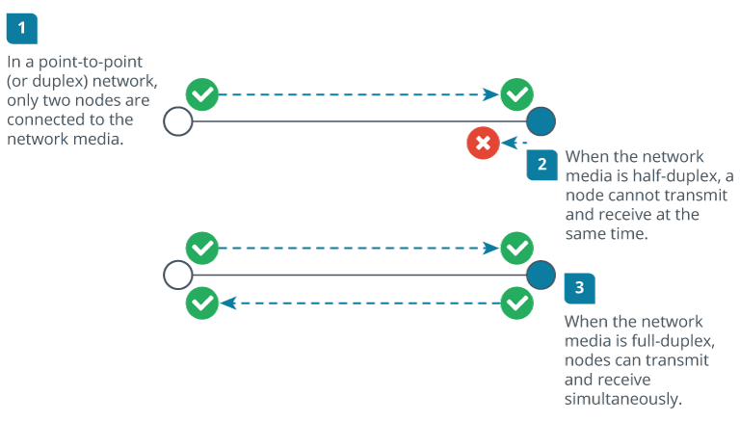
Network Topologies: Point-to-Point
Notes:
Suggested Discussion – Network Topologies: Point-to-Point
Have learners consider usages for a point-to-point network.
What would be the benefits and the downsides of a point-to-point network?
Exam Objectives Covered:
1.6 Compare and contrast network topologies, architectures, and types.
Image Caption:
Physical point-to-point topologies using different media types for half-duplex and duplex communications
Image Description:
The steps are as follows.
In a point-to-point (or duplex) network, only two nodes are connected to the network media.
When the network media is half-duplex, a node cannot transmit and receive at the same time.
When the network media is full-duplex, nodes can transmit and receive simultaneously.

Slide 11
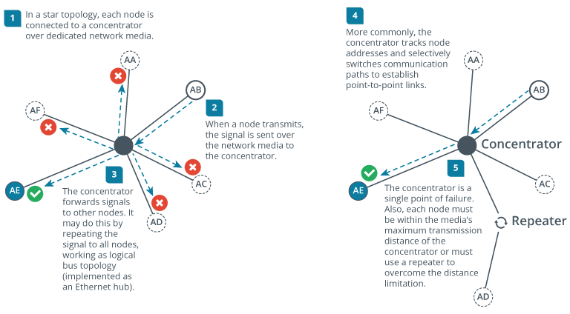
Network Topologies: Star
Notes:
Suggested Discussion – Network Topologies: Star
Have learners consider usages for a star network.
What would be the benefits and the downsides of a star network?
Exam Objectives Covered:
1.6 Compare and contrast network topologies, architectures, and types.
Image Caption:
Star topologies using different types of concentrator.
Image Description:
The steps are as follows.
In a star topology, each node is connected to a concentrator over dedicated network media.
When a node transmits, the signal is sent over the network media to the concentrator.
The concentrator forwards signals to other nodes. It may do this by repeating the signal to all nodes, working as logical bus topology (implemented as an Ethernet hub).
More commonly, the concentrator tracks node addresses and selectively switches communication paths to establish point-to-point links.
The concentrator is a single point of failure. Also, each node must be within the media’s maximum transmission distance of the concentrator or must use a repeater to overcome the distance limitation.

Slide 12
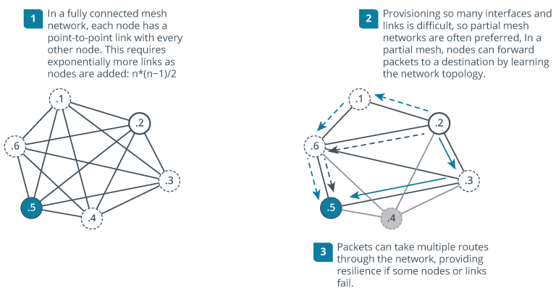
Network Topologies: Mesh
Notes:
Suggested Discussion – Network Topologies: Mesh
Have learners consider usages for a mesh network.
What would be the benefits and the downsides of a mesh network?
Exam Objectives Covered:
1.6 Compare and contrast network topologies, architectures, and types.
Image Caption:
Fully connected and partial mesh topology examples.
Image Description:
The steps are as follows.
In a fully connected mesh network, each node has a point-to-point link with every other node. This requires exponentially more link as nodes are added: n times (n minus 1) over 2.
Provisioning so many interface and link is difficult, so partial mesh networks are often preferred, in a partial mesh, nodes can forward packets to a destination by learning the network topology.
Packets can take multiple routes through the network, providing resilience if some nodes or links fail.

Slide 13
Lesson 1.2
OSI Model Concepts
Notes:
Exam Objectives Covered
1.1 Explain concepts related to the Open Systems Interconnection (OSI) reference model.

Slide 14
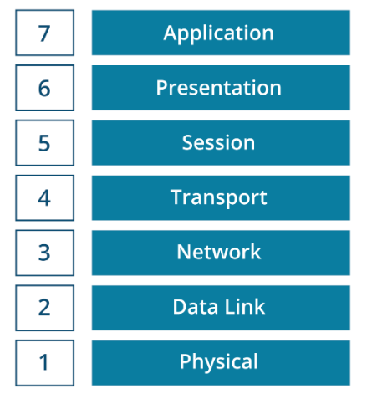
Open Systems Interconnection Model
OSI Model
  A conceptual framework for network communication
  Divides network communication into 7 layers
Why Use It?
  Standardizes network communication
  Simplifies troubleshooting
  Enables interoperability
Notes:
Suggested Instructional Tips – Open Systems Interconnection (OSI) Model
Explain that the OSI (Open Systems Interconnection) Model is a conceptual framework used to understand and implement network protocols in seven distinct layers. Mention that it standardizes networking functions to allow diverse systems to communicate, ensuring interoperability and simplifying troubleshooting.
The Seven Layers of the OSI Model:
Layer 7: Application: Interfaces directly with end-user applications and provides network services.
Layer 6: Presentation: Translates data formats between the application and the network.
Layer 5: Session: Manages sessions and connections between applications.
Layer 4: Transport: Ensures complete data transfer with error checking and flow control (e.g., TCP/UDP).
Layer 3: Network: Manages data routing, forwarding, and addressing (e.g., IP addresses).
Layer 2: Data Link: Handles error detection and correction from the physical layer (e.g., MAC addresses, switches).
Layer 1: Physical: Deals with the physical connection between devices (e.g., cables, switches).
Why Use the OSI Model?:
Standardizes Network Communication: Emphasize that the OSI Model provides a universal set of standards for different network devices and protocols to communicate effectively.
Simplifies Troubleshooting: Explain that the OSI Model helps network professionals isolate and resolve issues by examining each layer independently.
Enables Interoperability: Highlight that the OSI Model ensures different types of hardware and software can work together within a network.

Slide 15
The OSI Model Mnemonic
Please | Do | Not | Throw | Sausage | Pizza | Away
P | D | N | T | S | P | A
Physical | Data Link | Network | Transport | Session | Presentation | Application
Notes:
Suggested Instructional Tips – The OSI Model Mnemonic
Learners should be encouraged to memorize the layers of the OSI model in both ascending and descending order.
To remember the seven layers in ascending order, you can use the mnemonic “Please Do Not Throw Sausage Pizza Away.”
“All People Seem to Need Data Processing” is another mnemonic that can be used to remember the OSI model in descending order.

Slide 16
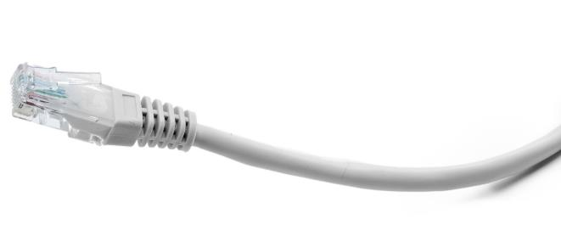
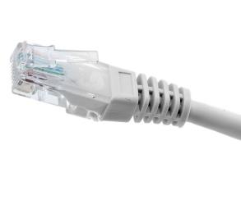
Layer 1 – Physical
7 Application
6 Presentation
5 Session
4 Transport
3 Network
2 Data Link
1 Physical
Functions and Examples
Transmit bits from sending source over network communications to physical layer of receiving device
Data transmitted using cables or wireless media
Examples: Coax and fiber cables, hubs and repeaters, modem, transceiver
10110001110011100000011011001111101
Bit Stream
Sender
Receiver
Notes:
Suggested Instructional Tips – Layer 1: Physical
Point out that these sections contain a brief overview of the technologies that will be covered in detail in the rest of the course.
The physical layer specifies physical topology, physical interface, and signaling.
Remind learners that the transmission media may be cabled or wireless.

Slide 17
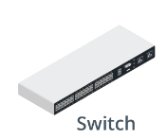
Layer 2 – Data Link
7 Application
6 Presentation
5 Session
4 Transport
3 Network
2 Data Link
1 Physical
Functions and Examples
Transfers data between nodes on the same logical segment using hardware addresses
Encapsulation: organizes stream of bits arriving from the Physical layer into frames
Examples: NIC, bridge, switch, wireless access point
G1
Host AA
G2
Host AB
G3
Host AC
Notes:
Layer 2 – Data Link
Diagram:
At the data link layer, each network interface is identified by a hardware address, represented
as AA, AB, and AC in this diagram.
Let’s say host AA is sending a frame to host AC. The frame travels from host AA along the
cable to switch port G1.
The switch keeps track of which local addresses are connected to its interfaces. To send the
packet to host AC, the switch would forward the frame out of port G3.

Slide 18


Layer 3 – Network
7 Application
6 Presentation
5 Session
4 Transport
3 Network
2 Data Link
1 Physical
Functions and Examples
Packets given a destination IP address and forwarded to the destination network
Examples: Router, IP, ACL, Basic Firewall
Moving data around a network of networks using network and host IDs
Network 9
Router A
1.254
Router B: 2.254
Network 1
(Hosts 1.1, 1.2, 1.3)
Network 2
(Hosts 2.1, 2.2, 2.3)
Notes:
Layer 3 - Network
The general convention is to describe PDUs packaged at the Network layer as packets or datagrams and messages packaged at the Data Link layer as frames. Packet is often used to describe PDUs at any layer, however.
Diagram:
At the network layer, each interface is identified by an address with a network part (1. for this router interface) and a host part (254).
When host 1.2 wants to send to host 2.3, the packet must be delivered to the remote network via routers.
Networks 1 and 2 are connected via an intermediate network (9).
Router B recognizes that Network 2 is directly connected and uses data link protocols to send the packet to host 2.3.

Slide 19
Layer 4 - Transport
7 Application
6 Presentation
5 Session
4 Transport
3 Network
2 Data Link
1 Physical
Functions and Examples
Tracks communication between applications on source and destination hosts
Segments data and manages each data piece
Reassembles segments into application data
Examples: Multilayer switches, advanced firewalls, intrusion detection systems (IDSs)
Notes:
Suggested Instructional Tips – Layer 4: Transport
Mention that a layer 4 PDU is called a segment, and that this usage is not related to the use of segment as part of a physical or logical network topology.

Slide 20
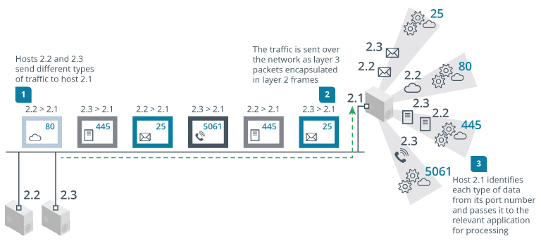
Layer 4 – Transport
Notes:
Suggested Instructional Tips – Layer 4: Transport
Mention that a layer 4 PDU is called a segment, and that this usage is not related to the use of segment as part of a physical or logical network topology.
Image Caption:
Communications at layer 4 (Transport layer) of the OSI model. (Images © 123RF.com.)
Image Description:
The steps are as follows.
Hosts 2.2 and 2.3 send different types of traffic to host 2.1.
The traffic is sent over the network as layer 3 packets encapsulated in layer 2 frames.
Host 2.1 identifies each type of data from its port number and passes it to the relevant application for processing.

Slide 21


Layer 5 - Session
7 Application
6 Presentation
5 Session
4 Transport
3 Network
2 Data Link
1 Physical
Function
Establishes and manages the connections between applications
Authentication
Request
Session Established
Respond
Notes:
Layer 5 - Session
This layer basically provides a mechanism of opening, closing and managing a session between the end-user application processes.
Examples:
AppleTalk Session Protocol (ASP)
AppleTalk Data Stream Protocol (ADSP)
Network Basic Input/Output System (NetBIOS)
Password Authentication Protocol (PAP)

Slide 22
Layer 6 - Presentation
Functions and Examples
Examples: Encryption/Decryption Services
Delivers data across network connections
7 Application
6 Presentation
5 Session
4 Transport
3 Network
2 Data Link
1 Physical
Application Layer Data
Application Layer Data
Presentation Layer
Encrypted, Encoded, Compressed
Presentation Layer
Decrypted, Decoded, and Decompressed
Session Layer Data
Session Layer Data
Notes:
Layer 6 - Presentation
The Presentation layer can also be conceived as supporting data compression and encryption. However, in practical terms, encryption is implemented by devices and protocols running at lower layers of the stack or simply within a homogenous Application layer.
Examples:
MIME (Multipurpose Internet Mail Extensions): This is a common standard used to encode various data formats (text, images, audio, etc.) within email messages. It ensures the receiving email client can understand and display the content correctly.
Encryption/Decryption Services:
While encryption itself can occur at different layers, some Presentation layer protocols might specifically focus on data transformation and encryption/decryption before it reaches the Application layer. This could be seen in specialized security gateways or VPN solutions.

Slide 23



Layer 7 - Application
Functions and Examples
Interacts directly with end-user’s software applications for network service
Examples: SMTP, DNS, FTP
7 Application
6 Presentation
5 Session
4 Transport
3 Network
2 Data Link
1 Physical
Human Readable
Machine Readable
Notes:
Suggested Teaching Tips – Layer 7: Application
The Application layer provides an interface between an application running on the system and the rest of the network. It doesn't refer to the software program running on the computer.
Think User-Facing:
Layer 7 is all about the applications you interact with daily. It's the "top floor" where user interfaces and functionalities reside. Imagine it as the bridge between human users and the technical network world below.
Understanding Protocols:
Layer 7 applications use specific protocols to "speak" to each other and exchange information. Some of the most common Layer 7 protocols include:
HTTP (Hypertext Transfer Protocol): The foundation of the web, used to transfer web pages and data between web browsers and servers.
HTTPS (Secure HTTP): A secure version of HTTP that encrypts communication for added security.
FTP (File Transfer Protocol): Used for transferring files between computers.
SMTP (Simple Mail Transfer Protocol): The protocol behind sending and receiving emails.
DNS (Domain Name System): Translates human-readable website names (like [invalid URL removed]) into machine-readable IP addresses.

Slide 24

The OSI Model Packet Flow
7 Application
6 Presentation
5 Session
4 Transport
3 Network
2 Data Link
1 Physical
7 Application
6 Presentation
5 Session
4 Transport
3 Network
2 Data Link
1 Physical
Sender
Receiver
Notes:
Suggested Instructional Tips – The OSI Model Packet Flow
Provide an overview of what the OSI model is about – separating the functions of hardware and software components to seven layers.
Each layer performs a different group of tasks required for network communication.
Explain how packets flow from the sender to the receiver throughout the model.

Slide 25
Activity: Unscramble the OSI Model
Session
Presentation
Application
Physical
Data Link
Transport
Network
Layer 1
Physical
Layer 1
Layer 2
Data Link
Layer 2
Layer 3
Network
Layer 3
Layer 4
Transport
Layer 4
Layer 5
Session
Layer 5
Layer 6
Presentation
Layer 6
Layer 7
Application
Layer 7
Notes:
Instructor Notes:
The solution is hidden until you advance the slide.
Instructions for Learner
Objective: Your task is to reassemble the scrambled boxes into the correct order of the 7 layers of the OSI Model.
Review the names of the layers provided in the scrambled boxes and determine the appropriate sequence from Layer 1 to Layer 7.
Correct Order:
Layer 1: Physical
Layer 2: Data Link
Layer 3: Network
Layer 4: Transport
Layer 5: Session
Layer 6: Presentation
Layer 7: Application
Tip:
Think about the function of each layer to help you place them in the correct order.

Slide 26
Activity: Unscramble the OSI Model
Session
Presentation
Application
Physical
Data Link
Transport
Network
Layer 1
Physical
Layer 2
Data Link
Layer 3
Network
Layer 4
Transport
Layer 5
Session
Layer 6
Presentation
Layer 7
Application
Notes:
Instructor Notes:
The solution is hidden until you click or advance the slide.
Instructions for Learner
Objective: Your task is to reassemble the scrambled boxes into the correct order of the 7 layers of the OSI Model.
Review the names of the layers provided in the scrambled boxes and determine the appropriate sequence from Layer 1 to Layer 7.
Correct Order:
Layer 1: Physical
Layer 2: Data Link
Layer 3: Network
Layer 4: Transport
Layer 5: Session
Layer 6: Presentation
Layer 7: Application
Tip:
Think about the function of each layer to help you place them in the correct order.

Slide 27
Lesson 1.3
SOHO Networks
Notes:
Exam Objectives Covered
1.1 Explain concepts related to the Open Systems Interconnection (OSI) reference model.
Suggested Instructional Tip
Try to establish a basic understanding of the difference between MAC and IP addresses and private versus public network segments.

Slide 28

Think About It
What is a SOHO router?
What is it used for?
Notes:
Suggested Discussion – Think About It
Recall learner knowledge of SOHO along with their knowledge of routers to determine what a SOHO router is and what function(s) it would serve. This conversation can be brief and more of a conversation starter for the following slides.
The following slides will walk through the physical, data link, network, transport, and application layer functions of the SOHO router
Activity:
Have the learners open the following emulator. Use the emulator to have them follow along with (or after) your lecture: Archer VR900 (tp-link.com)

Slide 29
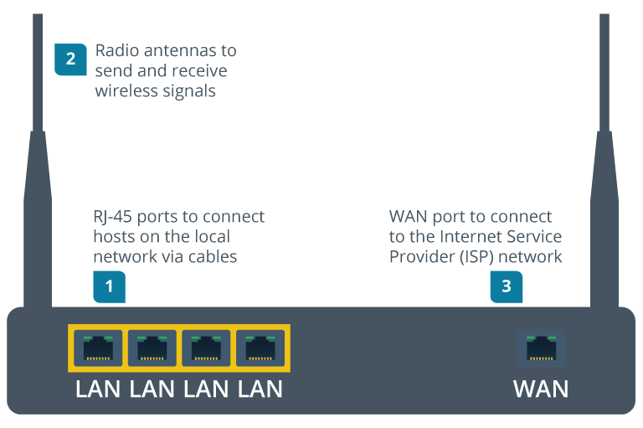
SOHO Router – Physical Layer
A SOHO router functions at several layers of the OSI Model
The Physical Layer Functions are shown in the diagram
Notes:
Suggested Activity – SOHO Router: Physical Layer
Consider doing a short research activity to browse for different modem types. Have learners note the different port types on each.
Suggested Instructional Tips – SOHO Router – Physical Layer
A SOHO router functions at several layers of the OSI Model. The Physical Layer Functions are shown in the diagram.
Starting at layer 1, the SOHO router provides the following physical interfaces:
A few RJ45 ports (usually four) to implement a local cabled network (typically labeled as the LAN ports).
Radio antennae to transmit and receive wireless signals.
A type of modem to connect to the Internet service provider's (ISP's) network (typically labeled as the WAN port).
In the example in the diagram, the WAN interface is another RJ45 port designed to connect to a fiber to the premise's Internet service using the same Ethernet technology as the local network.
On other SOHO routers, there may be a different type of WAN modem, such as an RJ11 port to connect to a digital subscriber line (DSL) service, or a F-connector coax jack to connect to a cable service.
Image Description:
The options are as follows.
R J-45 ports to connect hosts on the local network via cables.
Radio antennas to send and receive wireless signals.
WAN port to connect to the Internet Service Provider (ISP) network.
Image Caption:
Physical layer connectivity options on a SOHO router.

Slide 30
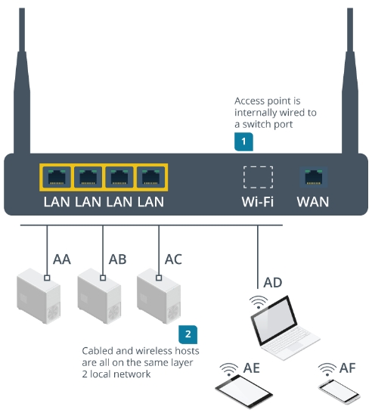
SOHO Router – Data Link Layer
The Data Link Layer functions of a SOHO router include an Ethernet Switch, a Wireless Access Point, and MAC addressing
Notes:
Suggested Instructional Tips – SOHO Router: Data Link Layer
The Data Link Layer functions of a SOHO router include an Ethernet Switch, a Wireless Access Point, and MAC addressing.
Consider showing students an online SOHO router emulator to illustrate the configuration settings and monitoring tools for these different functions.
Ethernet switch—The RJ45 jacks are connected internally by an Ethernet switch.
Wireless access point—The radio antennae implement some version of the Wi-Fi standard. The access point functions as a wireless hub, allowing stations (PCs, tablets, smartphones, and printers) to form a wireless network. The access point is also wired to the Ethernet switch via an internal port. This forms a bridge between the cabled and wireless segments, creating a single logical Data Link network.
At this layer, each host interface is identified by a media access control (MAC) address. For example, each NIC port in the computers and each radio in the mobile devices has a unique MAC address.
Image Description:
The steps are as follows.
Access point is internally wired to a switch port.
Cabled and wireless hosts are all on the same layer 2 local network.
Image Caption:
Data Link layer local network segment. (Images © 123RF.com.)

Slide 31

SOHO Router – Network Layer
Forwards between local private network and public Internet
Router’s WAN interface given a public IP address
Notes:
Suggested Instructional Tips – SOHO Router – Network Layer
The router makes forwarding decisions between the local private network and the public Internet
The SOHO router's WAN interface is allocated a public IP address. When a host on the local network tries to access any valid IP address outside the router’s assigned range, the router forwards that packet over its WAN interface and directs any replies back to the host on the LAN.
Image Description:
The steps are as follows.
Hosts attached to a switch port or connected to the access point are on the same layer 3 network (192.168.1.0 slash 24).
Any communications for other networks must be forwarded via the router.
Image Caption:
Network layer private and public segments. (Images © 123RF.com.)

Slide 32

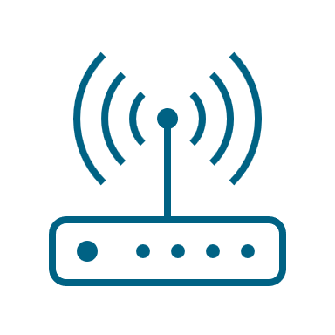
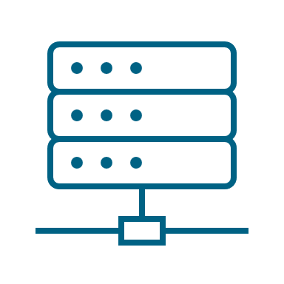

SOHO Router – Transport and Application
Transport layer functions:
Port addressing
  Directs traffic
  to the correct application/service
Application layer functions: Firewall rules
  Protects the network
  by filtering traffic.
  Prevents unauthorized access/potential threats
Application Layer Request and Response
Transport Layer
Segmentation
Transport Layer
Reassembly
Notes:
Suggested Instructional Tips – SOHO Router – Transport and Application
Transport Layer Functions: Port Addressing
Definition: Port addressing involves assigning specific port numbers to different types of network traffic to manage data flow.
Example:
Port 80 for HTTP traffic.
Port 443 for HTTPS traffic.
Function in SOHO Router:
Directs incoming and outgoing traffic to the correct application or service.
Ensures data packets reach the appropriate application on the network.
Application Layer Functions: Firewall Rules
Definition: Firewall rules are security policies that control incoming and outgoing network traffic based on predetermined security rules.
Example:
Allowing or blocking traffic from specific IP addresses.
Permitting or denying traffic on certain ports.
Function in SOHO Router:
Protects the network by filtering traffic.
Prevents unauthorized access and potential threats.
Manages which applications and services can communicate over the network.

Slide 33
SOHO Router – The Internet
WAN: SOHO connection to the Internet
Public Switched Telephone Network (PSTN): Facilitates most SOHO access to Internet
Adherence to established Internet standards
Notes:
Suggested Instructional Tips – SOHO Router – The Internet
The WAN interface of the router connects the SOHO network to the Internet ​
The Public Switched Telephone Network (PSTN) facilitates Internet access for SOHO subscribers
SOHO routers play a crucial role in connecting local networks to the Internet, adhering to Internet standards for IP address allocation, protocols, and security.

Slide 34
The Decimal System – Base 10
Ten-millions | One-millions | Hundred-thousands | Ten-thousands | One-thousands | Hundreds | Tens | Ones
Digit x 10,000,000 | Digit x 1,000,000 | Digit x 100,000 | Digit x 10,000 | Digit x 1,000 | Digit x 100 | Digit x 10 | Digit x 1
Notes:
Suggested Instructional Tips – The Decimal System – Base 10
The decimal system is the familiar numbering system that we use in our daily lives. The decimal system is also called Base 10 because it is built around ten unique digits: 0, 1, 2, 3, 4, 5, 6, 7, 8, and 9.
In base-10, each digit can be 0 to 9.
The values of the places or positions of the numbers are based on powers of 10.
Each number position is 10 times the value to the right of it, thus the term base-10.

Slide 35
The Binary System – Base 2
128 | 64 | 32 | 16 | 8 | 4 | 2 | 1
2⁷ | 2⁶ | 2⁵ | 2⁴ | 2³ | 2² | 2¹ | 2⁰
Notes:
Suggested Instructional Tips – The Binary Numbers – Base 2
The binary system is also called Base 2 because it is built around two unique digits: 0, 1.
In base 2, each digit can only be a 0 to 1 depending on its place.
The values of the places or positions of the numbers are based on powers of 2.
Each number position is 2 times the value to the right of it, thus the term base 2.

Slide 36
Binary Conversion
Let's look at how to convert 205 into binary.
128 | 64 | 32 | 16 | 8 | 4 | 2 | 1
1 | 1 | 0 | 0 | 1 | 1 | 0 | 1
Notes:
Suggested Activity – Binary Conversion
Work on this conversion as a group.
The binary system is also called Base 2 because it is built around two unique digits: 0, and 1.
In base 2, each digit can only be a 0 to 1 depending on its place.
The values of the places or positions of the numbers are based on powers of 2.
Each number position is 2 times the value to the right of it, thus the term base 2.
Instructor Notes:
The answers will be revealed upon clicking or when you advance through the slide.
Simply add all the values where there is a '1' like this: 128+64+8+4+1=205

Slide 37
Activity: Binary Conversion
Convert 132 into binary.
128 | 64 | 32 | 16 | 8 | 4 | 2 | 1
Notes:
Suggested Activity – Binary Conversion
Have learners convert this on their own.
The binary system is also called Base 2 because it is built around two unique digits: 0, 1.
In base 2, each digit can only be a 0 to 1 depending on its place.
The values of the places or positions of the numbers are based on powers of 2.
Each number position is 2 times the value to the right of it, thus the term base 2.
Instructor Notes:
The answers will be revealed upon advancing through the slide.

Slide 38
Activity: Binary Conversion
Convert 132 into binary.
128 | 64 | 32 | 16 | 8 | 4 | 2 | 1
1 | 0 | 0 | 0 | 0 | 1 | 0 | 0
Notes:
Suggested Activity – Binary Conversion
Have learners convert this on their own.
The binary system is also called Base 2 because it is built around two unique digits: 0, 1.
In base 2, each digit can only be a 0 to 1 depending on its place.
The values of the places or positions of the numbers are based on powers of 2.
Each number position is 2 times the value to the right of it, thus the term base 2.
Instructor Notes:
The answers will be revealed upon clicking or when you advance through the slide.
128+4=132, thus those numbers get a '1', all other numbers are not used thus get '0'"

Slide 39
Lesson 1.4
Troubleshooting Methodology
Notes:
Exam Objectives Covered
5.1 Explain the troubleshooting methodology.
Suggested Teaching Tip
Troubleshooting methodology is very important, both to success in the exam and in a career in IT. However, if students are already familiar with the model from A+, there are relatively few differences, so you might be able to move quickly through this topic.

Slide 40
Discussion: Think About It
What is troubleshooting?
What steps should be involved in the troubleshooting process?
Notes:
Suggested Discussion – Think About It
Troubleshooting methodology is very important, both to success in the exam and in a career in IT. However, if students are already familiar with the model from A+, there are relatively few differences, so you might be able to move quickly through this topic.

Slide 41
Troubleshooting Methodology
Identify the problem
Establish a theory of probable cause
Test the theory to determine cause
Establish a plan of action
Implement the solution
Verify the solution
Document findings, actions, and outcomes
Notes:
Suggested Instructional Tips – Troubleshooting Methodology
Note that this slide is just an overview. We will look more closely at each of these steps in the next few slides.
Identify the problem:
Gather information.
Question users.
Identify symptoms.
Determine if anything has changed.
Duplicate the problem, if possible.
Approach multiple problems individually.
Establish a theory of probable cause:
Question the obvious.
Consider multiple approaches:
Top-to-bottom/bottom-to-top OSI model.
Divide and conquer.
Test the theory to determine cause:
If theory is confirmed, determine next steps to resolve problem.
If theory is not confirmed, establish new theory or escalate.
Establish a plan of action to resolve the problem and identify potential effects:
Implement the solution or escalate, as necessary.
Verify full system functionality and implement preventive measures, if applicable.
Document findings, actions, outcomes, and lessons learned throughout the process.

Slide 42

Identify the Problem
Gather information
Question users
System documentation
Installation and maintenance logs
Vendor support sites
Open questions to
uncover information
Closed question to invite a
yes or no or fixed response
Notes:
Suggested Instructional Tips – Identify the Problem
Open questions to seek to uncover information
What is the problem?
What happens when you …. ?
Closed question to invite a yes or no or fixed response
What does the error message say?
Is your computer plugged in?

Slide 43

Identify the Problem
Identify symptoms
Determine if anything has changed
Physical inspection
Did it ever work?
Logs and diagnostic software
Try to duplicate the problem
What has changed since it was last working?
Approach problems individually
Verify symptoms are related before
treating them as one single issue
Notes:
Suggested Instructional Tips – Identify the Problem
This slide outlines the steps to identify a problem in a troubleshooting process. It emphasizes the importance of identifying symptoms, determining changes, and approaching problems individually.
Identify Symptoms:
Physical Inspection: Explain the importance of visually inspecting hardware and connections to identify any obvious issues such as loose cables, damaged components, or error indicators (e.g., LED lights).
Logs and Diagnostic Software: Highlight the use of system logs and diagnostic tools to gather information about the problem. These tools can provide error codes, performance metrics, and other relevant data.
Try to Duplicate the Problem: Stress the importance of replicating the issue to understand its behavior and gather more information. This can help in isolating the cause of the problem.
Determine if Anything Has Changed:
Did it Ever Work?: Ask if the system or component in question has ever functioned correctly. This can help determine if the issue is new or ongoing.
What Has Changed Since it Was Last Working?: Encourage learners to consider recent changes that might have affected the system, such as software updates, hardware modifications, or configuration changes. Identifying these changes can provide clues to the root cause of the problem.
Approach Problems Individually:
Verify Symptoms are Related: Explain the importance of verifying that symptoms are related before treating them as a single issue. Multiple symptoms might indicate multiple problems, and addressing them individually can lead to more effective troubleshooting.
Treating as One Single Issue: Caution against assuming that all symptoms are related to a single cause without proper verification. This can lead to misdiagnosis and ineffective solutions.

Slide 44
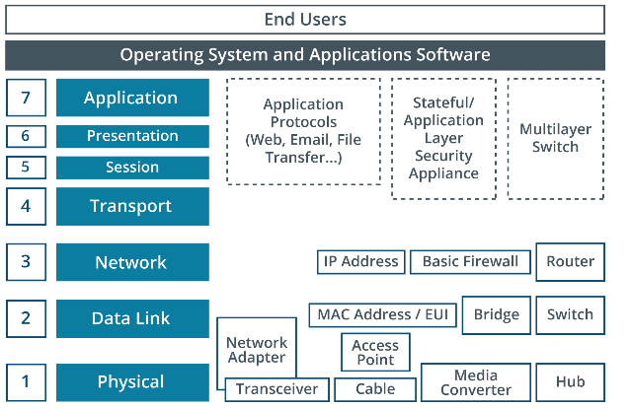
Establish a Theory of Probable Cause
Troubleshooting styles
Question the obvious
Methodically prove the functionality of each component
OSI Model Approach
Top-down approach
Bottom-up approach
Notes:
Suggested Instructional Tips – Establish a Theory of Probable Cause
Troubleshooting styles:
Question the obvious. Step through what should happen and identify the point at which there is a failure or error. This approach can quickly identify obvious oversights, such as a network cable not being plugged in.
Methodically prove the functionality of each component in sequence. This approach is more time consuming but may be necessary for a difficult problem.
OSI Model Approach
Start from either the top or bottom and only move up or down when you have discounted a layer as the source of the problem.
For example, when troubleshooting a client workstation, you might work as follows:
Decide whether the problem is hardware or software related (hardware).
Decide which hardware subsystem is affected (NIC or cable).
Decide whether the problem is in the NIC adapter or connectors and cabling (cabling).
Test your theory (replace the cable with a known good one).
When you have drilled down like this, the problem should become obvious. Of course, you could have made the wrong choice at any point, so you must be prepared to go back and follow a different path.
Image Caption:
Troubleshooting top-to-bottom or bottom-to-top using the OSI model.

Slide 45

Test the Theory to Determine the Cause
Prove or Disprove the Theory
Use one or more method-based approaches
Escalation
Problem is beyond your knowledge or ability
Don’t jump to conclusions
Problem falls under a system warranty
Scope of the problem is very large
Customer is difficult or abusive
Notes:
Suggested Instructional Tips – Test the Theory to Determine the Cause
This slide outlines the steps to test a theory to determine the cause of a problem. It includes guidance on proving or disproving the theory and when to escalate the issue.
Prove or Disprove the Theory:
Use One or More Method-Based Approaches: Explain the importance of using systematic, method-based approaches to test the theory. This could include diagnostic tools, step-by-step procedures, or specific testing methods relevant to the problem. Encourage learners to document their steps and findings to ensure a thorough and repeatable process.
Don't Jump to Conclusions: Stress the importance of not making assumptions or jumping to conclusions without sufficient evidence. Remind learners to rely on data and observations rather than guesses.
Escalation:
Problem is Beyond Your Knowledge or Ability: Discuss scenarios where the problem might be too complex or outside the learner's expertise. Encourage them to recognize their limits and seek help when needed.
Problem Falls Under a System Warranty: Explain that if the problem is covered by a system warranty, it should be escalated to the appropriate support team or vendor to avoid voiding the warranty.
Scope of the Problem is Very Large: Highlight situations where the problem might affect a large number of users or systems, requiring escalation to higher-level support or management.
Customer is Difficult or Abusive: Address the importance of maintaining professionalism and safety. If a customer is difficult or abusive, the issue should be escalated to a supervisor or manager to handle the situation appropriately.

Slide 46
Implement, Verify, and Document
Implement changes
Verify the solution
Document
Implement fixes
Document findings, actions, and outcomes
Logs are useful for future troubleshooting
Make sure the system seems to work for you
Make sure the system seems to work for customer
Escalate if higher authorization is needed
Notes:
Suggested Instructional Tips – Implement, Verify, and Document
Implement the Solution: Virtualization and the cloud provide the means to trial changes before updating the production environment. They allow the rapid creation of sandbox environments that simulate the production one.

Slide 47
Activity: Troubleshooting
Several office employees report that their computers are unable to connect to the Internet, affecting workflow and productivity.
Identify the problem
Establish a theory of probable cause
Test the theory to determine cause
Establish a plan of action
Implement the solution
Verify the solution
Document findings, actions, and outcomes
Notes:
Suggested Activity – Troubleshooting Scenario
In an office setting, several employees begin to report that their computers are unable to connect to the Internet. This sudden loss of connectivity is affecting workflow and productivity. The IT department is tasked with resolving this issue promptly.
Encourage learners to think through each of the steps of the troubleshooting methodology to see what steps they may take to solve the problem.
This is just an example of how this could go:
Identify the problem: The IT support team begins by confirming the issue that multiple computers across various departments are unable to access the internet.
Establish a theory of probable cause: The team theorizes that the problem could be due to a failure in the office's central networking hardware, such as the router or switch, or a possible service disruption from the internet service provider (ISP).
Test the theory to determine cause: To test the theory, the IT support team checks the status of the router and switch, verifies that all cables are securely connected, and then contacts the ISP to confirm if there is an ongoing outage.
Establish a plan of action: After determining that the issue is with the router, which appears to have malfunctioned, the team decides to perform a restart of the router and, if necessary, reset it to its factory settings as a plan of action.
Implement the solution: The router is restarted, and when that doesn't resolve the issue, it's reset to factory settings. Following this action, the network settings are reconfigured.
Verify the solution: Employees are asked to check their internet connectivity. The IT support team also monitors network activity for stability and ensures that all systems can access the internet consistently.
Document findings, actions, and outcomes: The entire troubleshooting process, from the identification of the problem to the resolution, is documented. This includes the initial reports of connectivity issues, the steps taken to diagnose and fix the problem, the resolution of restarting and resetting the router, and the positive outcome of restored internet access. This documentation will be stored in the IT department's knowledge base for future reference.

Slide 48
Summary
Explaining Network Topologies
Notes:
Suggested Instructional Tips
Ask learners to summarize their key takeaways from this module
Conclude by going over main points on the next slide

Slide 49
Main Points
Remember the OSI model’s 7 layers (physical, data link, network, transport, session, presentation, and application).
Plan network structure and troubleshoot issues using OSI model layers.
Implement a methodical approach to troubleshooting (identification, planning, execution, verification, and documentation).
Use strategies like top-to-bottom, bottom-to-top,
and divide-and-conquer.
Notes:
Suggested Instructional Tips – Main Points
Reiterate the relevance of each point:​
The OSI model consists of 7 layers: physical, data link, network, transport, session, presentation, and application​.
Plan network structure and troubleshoot issues by applying OSI model layers, focusing on physical setup, security, performance, and services.​
Implement a methodical approach to troubleshooting, including identification, planning, execution, verification, and documentation.​
Use strategies like top-to-bottom, bottom-to-top, and divide-and-conquer to pinpoint and resolve network issues efficiently.​

