Slide 1
Module 3
Configuring Interfaces and Switches

Slide 2
Module Objectives
Deploy networking devices.
Explain network interfaces.
Deploy common Ethernet switching features.
Troubleshoot transceiver switching issues.
Notes:
Suggested Instructor Notes – Learning Objectives
The learning objectives align with the following Exam Objectives for Module 3:
1.2 Compare and contrast networking appliances, applications, and functions.
1.5 Compare and contrast transmission media and transceivers.
2.2 Given a scenario, configure switching technologies and features.
5.2 Given a scenario, troubleshoot common cabling and physical interface issues.
5.3 Given a scenario, troubleshoot common issues with network services.
5.5 Given a scenario, use the appropriate tool or protocol to solve networking issues.

Slide 3
Lesson 3.1
Network Interfaces
Notes:
Exam Objectives Covered
1.5 Compare and contrast transmission media and transceivers.
5.2 Given a scenario, troubleshoot common cabling and physical interface issues.

Slide 4

Think About It: Network Interfaces
What is a network interface?
Notes:
Suggested Instructor Notes – Think About It: Network Interfaces
Definition: A network interface is the means by which a node is connected to the media and exchanges data with other network hosts. This involves both a physical connection to the network media and the use of a data link protocol such as Ethernet to perform addressing and framing.
Explain to students that understanding the properties of these components is essential for selecting appropriate products and configuring them correctly.

Slide 5
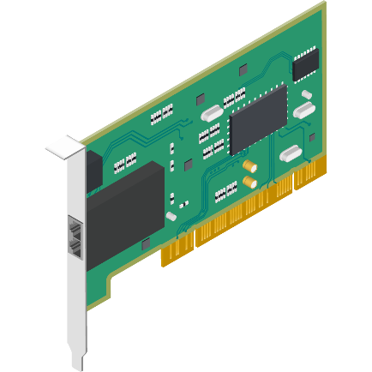
Network Interface Cards
A network interface card (NIC):
Transceiver component
Connects the host to a transmission medium (wired or wireless)
Can have multiple ports on the same card
Has a unique MAC address
Operates at the Data Link layer
Notes:
Suggested Instructional Tips – Network Interface Cards
Encourage students to examine their devices or devices in the room to see what types of ports are on their network interface. If you have some “out of the device” cards that would be even better! Try to provide examples (either in person or online) for the students to compare and contrast (multiport cards, fiber optic ports, etc.)

Slide 6

Symptoms of NIC Issues
Common symptoms of NIC issues include:
Intermittent connectivity
Device manager error messages
Network setting error messages
Slow network speeds
Network connectivity failure
Notes:
Suggested Instructional Tips – Troubleshooting Scenarios
These Scenarios highlight the frustrations caused by common NIC issues. They don't go into technical solutions, but leave the audience with a question to ponder, prompting them to consider the role of the NIC.
Scenario 1: The Frustrated Gamer (Highlights Intermittent Connectivity and Slow Speeds)
Mark was in the middle of an intense online game when his character suddenly froze. He tried moving his character, but nothing happened. Annoyed, he refreshed the game, but it wouldn't connect. He checked his internet connection - full bars! Confused, he ran a speed test. The results? Abysmal download and upload speeds. Mark sighed. This wasn't the first time this had happened. It seemed like his internet connection kept cutting in and out or was just painfully slow. Could it be a problem with his NIC?
Scenario 2: The Puzzled Student (Highlights Device Manager Error Messages)
Sarah was finishing up an important assignment when her laptop suddenly disconnected from the Wi-Fi. She tried reconnecting, but her computer wouldn't detect any available networks. Frantic, she opened her Device Manager and saw a yellow exclamation mark next to her network adapter. Clicking on it, she received an error message she didn't understand. Without internet access, Sarah couldn't submit her assignment. Was this a problem with her network card (NIC)?

Slide 7
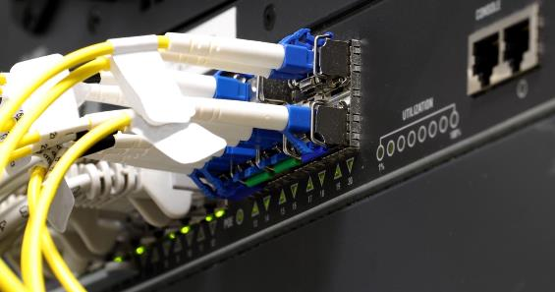
Modular Transceivers
Modular transceivers
Terminate multiple types of cable and connector types
Operate at the Data Link layer
Notes:
Suggested Instructional Tips – Modular Transceivers
Explain to learners that transceivers are designed for use when using multiple types of cabling. Enterprise servers, switches, and routers, are available with modular hot-swappable transceivers for different types of fiber optic and copper connections.
Explain that they operate at the data link layer which is responsible for putting the data onto the wire and pulling it off the wire (send/receive).
Show learners examples of various modular transceivers or have them do an online search to see what they can find. (Examples: SFP/SFP+, GSFP/QSFP+)
Instructor Notes:
Scenario 1: The Upgrading Company (Highlights Adaptability)
A growing company needed to upgrade its network infrastructure to handle increased bandwidth demands. However, they had a mix of different fiber optic cable types across their various buildings. Replacing all the cables would be expensive and time-consuming. The solution? Modular transceivers! By utilizing transceivers compatible with their existing network switches but designed for the specific fiber they needed, the company could easily upgrade their network without ripping out all their existing cabling. The modularity of the transceivers saved them time and money.
Scenario 2: The Connected Conference Center (Highlights Distance and Compatibility)
A conference center was hosting a major event with international participants. They needed to ensure a reliable and high-speed network connection for all attendees, However, some of the conference rooms were located at a significant distance from the main network hub. Traditional copper cables wouldn't suffice for such long distances. The solution? Modular transceivers designed for fiber optic cables. By installing fiber optic cables and compatible transceivers in the remote conference rooms, the center could provide a strong and reliable network connection for all participants no matter their location.

Slide 8
Symptoms of Transceiver Issues
Mismatched ports
No link
Intermittent connection loss
Signal strength
Intermittent connections
Packet loss
Poor network performance
Notes:
Suggested Instructor Notes – Symptoms of Transceiver Issues
Mismatched ports common causes:
Mismatched duplex settings half-duplex (data can only flow in one direction at a time) and full duplex (data can flow in both directions at once)
Mismatched speeds – Two devices operate at different speeds
Signal strength common causes:
Physical obstacles
Radio wave interference
Power levels
Faulty devices
Scenario 1: The Lost Connection (Mismatched Ports)
John, an IT technician, was troubleshooting a network outage in a recently renovated office space. Everything seemed to be connected properly, but no devices in the new section could access the network. John double-checked the cables and switch ports, but everything looked good. Finally, he realized a crucial detail - the new network jacks were designed for a different type of fiber optic connector than the transceivers installed in the switch. This mismatch in port types prevented any signal from passing through, causing the network outage. John quickly replaced the transceivers with ones compatible with the new jacks, and voila! The network in the new office space sprang to life.
Scenario 2: The Grainy Video Call (Signal Strength)
Sarah was video conferencing with a colleague located in a different country. The call started smoothly, but soon the video became choppy and pixelated, making communication difficult. Sarah suspected a network issue. She checked the network monitoring tools and noticed the signal strength coming from the transceiver connected to the video conferencing equipment was dropping significantly. This weak signal resulted in poor video quality. The problem could be due to a faulty transceiver, a damaged fiber optic cable, or even dust on the transceiver connector. By diagnosing the cause of the weak signal and taking corrective action (replacing the transceiver, repairing the cable, or cleaning the connector), Sarah could ensure clear and uninterrupted video calls.

Slide 9
MAC Address Format
Device ID
(based on device model and manufactured date)
Organizationally unique identifier (OUI)
2D:45:19:87:C8:E2
48-bit alphanumeric identifier;
pairs of hexadecimal digits separated by colons or hyphens
Notes:
Suggested Instructional Tips - MAC Address Format
Encourage students to check out their devices to see and compare different MAC addresses.
Remind students that each network port has a unique MAC address. A NIC with four ports has four MAC addresses.
Windows users open a command prompt and type: ipconfig /all
Windows calls the MAC address the "Physical Address"

Slide 10
MAC Broadcast Address
Preamble
Synchronization sequence
SFD
Signals the start of the frame
Destination MAC
Address of the recipient device
Source
MAC
Address of the sending device
Ether Type
Protocol of the payload
Payload
Data being transmitted
FCS
Error-checking code
Broadcast Address
ff:ff:ff:ff:ff:ff
If a MAC address is all 1s, all
hosts on that network will
receive and process the packet
Notes:
Suggested Instructor Notes – MAC Broadcast Address
Imagine an apartment building with many tenants. A regular MAC address is like a personal mailbox – it delivers messages to a specific device. But a broadcast address is like a building-wide announcement. It sends a message to all devices in the building (all devices on the network segment) at once.
Explain when broadcast addresses are used. Examples include:
Sending ARP (Address Resolution Protocol) requests to find the MAC address of a device with a known IP address.
Sending network discovery messages to identify devices on the network.
Sending wake-on-LAN (WoL) packets to turn on devices remotely.
Acknowledge that broadcast messages can slow down the network because all devices receive and need to process them. This is different from a unicast message (sent to a specific device) or multicast message (sent to a specific group of devices).

Slide 11
Lesson 3.2
Ethernet Switches
Notes:
Exam Objectives Covered
1.2 Compare and contrast networking appliances, applications, and functions.
2.2 Given a scenario, configure switching technologies and features.

Slide 12

Hubs
Hub
Hubs send transmissions from one port to every other port.
To: D
From: A
Mine!
Not Mine.
Not Mine.
A
B
C
D
Notes:
Suggested Instructor Notes – Hubs
Diagram:
Operates at the physical layer
With hubs, all interfaces receive all unicast and broadcast transmissions. Hosts are typically configured to ignore unicast transmissions that are not addressed to them. However, setting an interface to promiscuous mode allows a host to capture (or "sniff") all unicast transmissions sent via the hub. This is a major security weakness of hubs.
Process:
The A host sends a frame
The hub receives a weakened and distorted transmission
The hub regenerates the transmission, and floods the frame out of all its other ports
Hosts B and C receives the frame, but ignore it because it doesn’t match their addresses
Host D receives the frame and process it
Suggested Instructional Tips – Hubs
While hubs are pretty much obsolete, explain that it is important for students to grasp the principle of how they operate.
Optionally, note that there were 10/100 dual speed hubs that created two bridged segments.
A broadcast transmission is sent to all hosts in the same logical network area. In Ethernet, this is accomplished by using the broadcast MAC address ff:ff:ff:ff:ff:ff. A unicast transmission is addressed to a single host only, using its MAC address. With hubs, all interfaces receive all unicast and broadcast transmissions. Hosts are typically configured to ignore unicast transmissions that are not addressed to them. However, setting an interface to promiscuous mode allows a host to capture (or "sniff") all unicast transmissions sent via the hub. This is a major security weakness of hubs.

Slide 13
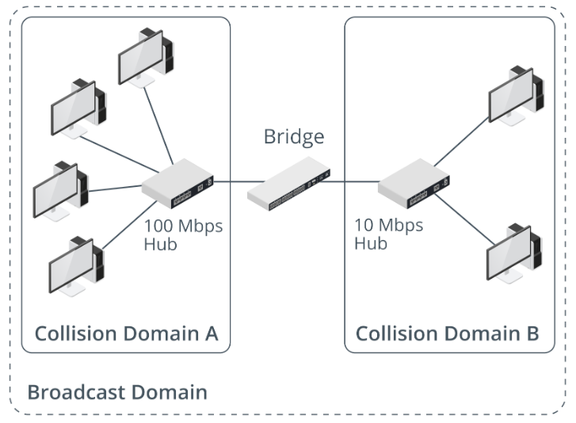
Bridges
Bridges separate physical network segments while keeping all nodes in the same logical network.
Notes:
Suggested Instructor Notes – Bridges
Operates at the data link layer (2); bridges learn the MAC addresses of devices on each connected network segment and build a forwarding table.
Reduces the number of collisions caused by having too many nodes contending for access
Suggested Instructional Tips
Again, you would struggle today to buy an Ethernet bridge appliance (or find anywhere to put it), but it is important that students grasp the principle of how they operate. The bridging function is still widely used. Examples include bridging wireless networks or bridging adapters on a host computer. "Virtual wire" type firewalls also perform bridging. Emphasize the differences between broadcast domains and collision domains. Collision domains are about physically shared media, and collision domain borders are established by bridges and switches (the latter puts each port in its own collision domain, making the concept redundant). Broadcast domains are established by layer 3 logical network devices and protocols (routers), but point out that this requires the concept of a layer 2 broadcast address.
Analogies
Traffic Control: Imagine a busy intersection with multiple lanes of traffic. A bridge is like a traffic controller, separating incoming traffic onto specific lanes (network segments) based on their destination. It prevents unnecessary traffic (data packets) from flooding the entire network.
Apartment Building: Think of a large apartment building with multiple floors. Each floor represents a network segment. A bridge acts like a mail carrier who sorts incoming mail (data packets) based on the apartment number (destination MAC address) and delivers them to the correct floor (network segment).
Interactive Learning
If applicable to your audience, consider a simulation activity where participants act as bridges, receiving and forwarding data packets based on destination addresses.

Slide 14
Switches
Switch
A switch sends transmissions from one port to only a single destination port.
To: D
From: A
A
B
C
D
Notes:
Suggested Instructor Notes – Switches
Data link layer
Process:
A sends frame to D
The switch receives the frame and reads the destination MAC address
The switch uses its MAC address table to find the port connected to the destination MAC address
The switch sends the frame out of port 4 for host D to receive
Suggested Instructional Tips
Emphasize how a switch establishes collision and broadcast domain boundaries. Collision domains are reduced to a single port. By default, all switch ports will be in the same broadcast domain unless VLANs have been configured.
Emphasize that switches are like intelligent traffic directors on a network. They learn the MAC addresses of devices connected to each port and use that information to efficiently direct data packets to their intended destinations.
Dedicated Connections: Unlike hubs that broadcast data to all connected devices, switches create dedicated communication channels between devices, improving network performance and reducing collisions.
Analogy: Think of a waitress in a restaurant who takes orders (data packets) from tables (devices) and delivers them directly to the intended kitchen station (destination device) based on the table number (MAC address

Slide 15
Ethernet Switch Types
Unmanaged vs. Managed
Modular vs. Fixed
Desktop vs. Rack
Managed switches can be configured
Unmanaged switches have no configuration options
Modular can be configured with different numbers and types of ports
Fixed come with a set number of ports
Desktop switches are free standing
Rack-mounted switches are designed fit into networking racks
Stackable
Can be connected together
Can be managed as a single unit
Notes:
Suggested Instructor Notes – Ethernet Switch Types
Unmanaged vs. Managed: Configuration of a managed switch can be performed at a command-line interface (CLI). Once you have established a connection to the switch's management interface, you can configure settings for each of the switch port interfaces. These settings control the network link configured for each client device attaching to the switch.
Suggested Instructional Tip
The term "switch" covers an incredibly wide range of devices and functionality.
This content on switch types isn't specifically called out in the exam objectives, but it goes toward determining appropriate placement of switching devices.

Slide 16
Activity: Matching
Hub
Switch
Bridge
Improves network efficiency by dividing it
into smaller, manageable sections
Notes:
Suggested Activity - Matching
Advance the slide to reveal the answer.

Slide 17

Activity: Matching
Hub
Switch
Bridge
Improves network efficiency by dividing it
into smaller, manageable sections
Notes:
Correct Answer: Bridge

Slide 18
Activity: Matching
Hub
Switch
Bridge
Operates by creating a single shared communication path between multiple devices in a network
Notes:
Suggested Activity - Matching
Advance the slide to reveal the answer.

Slide 19
Activity: Matching
Hub
Switch
Bridge
Operates by creating a single shared communication path between multiple devices in a network
Notes:
Correct Answer: Hub

Slide 20
Activity: Matching
Hub
Switch
Bridge
Intelligently directs data to a specific port based on
MAC addresses, reducing network congestion
Notes:
Suggested Activity - Matching
Advance the slide to reveal the answer.

Slide 21
Activity: Matching
Hub
Switch
Bridge
Intelligently directs data to a specific port based on
MAC addresses, reducing network congestion
Notes:
Correct Answer: Switch

Slide 22
Activity: Matching
Hub
Switch
Bridge
Operates primarily at the physical layer
Notes:
Suggested Activity - Matching
Advance the slide to reveal the answer.

Slide 23
Activity: Matching
Hub
Switch
Bridge
Operates primarily at the physical layer
Notes:
Correct Answer: Hub

Slide 24
Activity: Matching
Hub
Switch
Bridge
Learns the MAC addresses of devices connected to it and uses this information to forward data only to the intended recipient
Notes:
Suggested Activity - Matching
Advance the slide to reveal the answer.

Slide 25
Activity: Matching
Hub
Switch
Bridge
Learns the MAC addresses of devices connected to it and uses this information to forward data only to the intended recipient
Notes:
Correct Answer: Switch

Slide 26
Lesson 3.3
Switch Port Configuration
Notes:
Exam Objectives Covered
2.2 Given a scenario, configure switching technologies and features.
5.3 Given a scenario, troubleshoot common issues with network services.

Slide 27
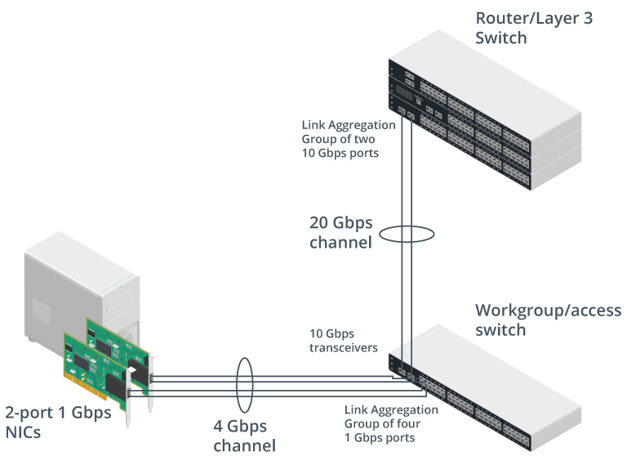
Link Aggregation/NIC Teaming
Link aggregation
Combining
2+ separate
cabled links into a
single logical channel
Provides redundancy
Cost effective
Increases bandwidth
Notes:
Suggested Instructor Notes – Link Aggregation/NIC Teaming
Link aggregation means combining two or more separate cabled links into a single logical channel. From the host end, this can also be called NIC teaming; at the switch end, it can be called port aggregation and is referred to by Cisco as an EtherChannel. The term "bonding" is also widely substituted for "aggregation."
Image Caption
A server node uses NIC teaming to create a 4 Gbps channel link from four 1 Gbps ports to a workgroup switch, while the workgroup switch bonds its uplink transceivers to create a 20 Gbps channel to a router.
Image Description
2-port 1 Gbps NICS connected to workgroup or access switch via 4 Gbpschannel. It is labeled link aggression group of four 1 Gbps ports. Router or layer 3 switch is connected to workgroup or access switch via 20 Gbps channel. It is labeled link aggregation group of two 10 Gbps ports. Text beside workgroup or access switch reads, 10 Gbps transceivers.

Slide 28
Maximum Transmission Unit (MTU)
Standard Ethernet frame
Maximum transmission unit (MTU) is 1,500 bytes
Jumbo frame
Supports payload up to 9,216 bytes
Limited because they break Ethernet standards
Reduces the number of frames transmitted
Notes:
Suggested Instructor Notes – Maximum Transmission Unit
WAN links have different MTUs. WAN technologies are covered later in the course.
Analogy: Imagine sending packages (data) across a network. The MTU is like the maximum size of a box a delivery truck (switch port) can handle. If a package is too big (data exceeds MTU), it won't fit and needs to be broken down (fragmented) into smaller pieces for delivery, causing delays.
Suggested Teaching Tips
Emphasize the concepts of an MTU and fragmentation and reassembly.
Discuss situations where adjusting MTU might be beneficial. For instance, transferring large files across the network might require a higher MTU to avoid excessive fragmentation.

Slide 29
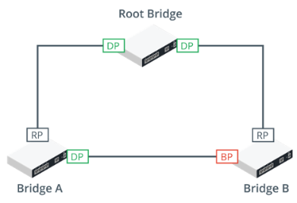
Spanning Tree Protocol
Spanning Tree Protocol (STP)
Prevents bridge/switch loops
Layer 2 protocol
Provides fault tolerance
Notes:
Suggested Instructor Notes – Spanning Tree Protocol
Ethernet has no concept of a "time to live" value for frames, so layer 2 broadcast and flooded traffic could continue to loop through a network with multiple paths indefinitely.
Image Description: Minimum configuration needed to prevent loops in a network with 3 bridges or switches
The root bridge has two designated ports (DP) connected to Bridge A and Bridge B.
Bridges A and B both have root ports (RP) connected back to the interfaces on the root bridge.
Bridges A and B also have a connection directly to one another.
On Bridge A, this interface is active and traffic for Bridge B can be forwarded directly over it.
On Bridge B, the interface is blocked (BP) to prevent a loop, and traffic for Bridge A must be forwarded via the root bridge.
Image Caption: Spanning tree configuration. (Images © 123RF.com.)
Suggested Instruction Notes
The Problem: Bridge Loops and Network Chaos
Imagine a network of bridges connecting different segments. Bridges are great for controlling network traffic, but what happens if there's a loop created by connecting bridges together in a circle?
Data packets would endlessly loop around the circle, never reaching their intended destination. This can lead to network congestion, slowdowns, and even complete outages.
STP: The Loop-Busting Hero
STP (Spanning Tree Protocol) acts like a network traffic cop. It detects bridge loops and intelligently disables unnecessary bridge ports, creating a loop-free path for data to flow efficiently.
Think of it as automatically identifying a redundant path in the circular bridge connection and shutting it down. This ensures data takes a single, defined path, preventing the looping chaos.
Benefits of a Loop-Free Network:
Improved Performance: With STP, data packets reach their destination faster and more reliably, leading to a smoother network experience for everyone.
Reduced Congestion: By eliminating loops that cause endless retransmission of data, STP helps free up network resources and prevents unnecessary traffic jams.
Increased Stability: STP helps maintain a stable network environment by preventing the unpredictable behavior caused by bridge loops.

Slide 30

Power Over Ethernet
Power over Ethernet (PoE)
Allows 1 cable to transmit both data and power to networked devices
Simplifies network installation
and expansion
Notes:
Suggested Instructor Notes – Power Over Ethernet
Benefits of PoE:
Convenience and Cost Savings: PoE simplifies network setup by reducing cable clutter and eliminating the need for additional power outlets. This can save time and money during installation.
Flexibility: PoE allows for device placement in areas where power outlets might be limited, such as ceilings for access points or high walls for security cameras.
Centralized Power Management: With PoE, power delivery can be managed and controlled centrally through the network switch, offering better control and easier troubleshooting.
Suggested Instructional Tip
Emphasize what sort of devices can use PoE: access points (wireless access points, IP cameras, VoIP phones, etc.). You couldn't, for instance, run a laptop or laser printer off PoE.

Slide 31
Activity: Scavenger Hunt
Find devices that use Power over Ethernet (PoE).
Explore to find any devices that might be powered through an Ethernet cable.
Note the device type, device location, and how it benefits from PoE.
Notes:
Suggested Activity – Scavenger Hunt
Find devices that use Power over Ethernet (PoE).
Explore to find any devices that might be powered through an Ethernet cable.
Note the device type, device location, and how it benefits from PoE

Slide 32
Lesson 3.4
Switch Troubleshooting
Notes:
Exam Objectives Covered
5.2 Given a scenario, troubleshoot common cabling and physical interface issues.
5.3 Given a scenario, troubleshoot common issues with network services.
5.5 Given a scenario, use the appropriate tool or protocol to solve networking issues.

Slide 33
Hardware Failure Issues
Hardware Failure Issue | Troubleshooting and Mitigation Steps
Power issues | Verify stable power supply Install UPS and secondary power sources
Network adapters | Check for damaged ports or connectors Test with alternative adapter if possible Update or reinstall drivers
Switches/routers/ modems | Visually inspect for damage Inspect indicator lights Verify power supply and cabling connections Restart the device following proper protocols
Overheating | Check for proper ventilation around the device Clean dust from intake or exhaust vents Ensure cooling systems are operational
Notes:
Instructor Notes – Hardware Failure Issues
Do be aware that restarting a switch, router, or server can be very disruptive to the rest of the network. Identify how to mitigate potential impacts and seek authorization for your plan before proceeding. Also, remember that a restart will apply the startup configuration. Any unsaved changes in the running configuration will be discarded.

Slide 34
Port Status Indicators
 | Solid green | The link is connected, but there is no traffic.
 | Flickering green | The link is operating normally (with traffic). The blink rate indicates the link speed.
 | No light | The link is not working, or the port is shut down.
 | Solid amber | The port is blocked by the spanning tree algorithm.
 | Blinking amber | A fault has been detected.
Notes:
Instructor Notes - Port Status Indicators
When you are troubleshooting a suspected layer 1 or layer 2 problem, check the LED status indicators on the NIC at one end and the switch/router port at the other. You will need the vendor documentation to interpret the LEDs. Note that this table represents typical configurations. Manufacturers specifications may differ.

Slide 35
Switch Show Commands
show config
show startup-config
show running-config
show interface
Device's current configuration
Configuration device will
use upon the next restart
Active configuration currently
used by the device
Detailed information about
the device's network interfaces
Notes:
Switch Show Commands
show config: This command is your go-to for viewing the device's overall current setup. It pulls up the comprehensive settings and configurations that are applied and functioning at the moment.
show startup config: When you're preparing for future operations or maintenance windows, this command is critical. It displays the configuration that has been saved and will be automatically applied the next time the device restarts. This is essential for verifying changes intended for future application.
show running config: Use this command to see the configuration actively being used by the device in real-time. It's particularly useful for troubleshooting or verifying that recent changes have taken effect without needing a restart.
show interface: This command offers a deep dive into each network interface on the device. It covers a variety of details including status (up/down), protocol status, speed, and packet statistics. This is helpful for diagnosing connectivity issues or for regular network health checks.

Slide 36
Switch Show Command Status
Down/down | Both the layer 1 (physical) and layer 2 (data link) connections are inactive.
Administratively down/down | The interface has been manually disabled by an administrator using the shutdown command.
Down/error disabled | The interface has been automatically disabled due to a network error or policy violation.
Up/down (suspended) | The physical layer is operational, but the data link layer is inactive due to administrative settings or errors.
Notes:
Instructor Notes – Switch Show Command Status
Interpreting Status Messages:
Down/down: This indicates the port is currently inoperable and unable to transmit or receive data.
This could be due to a physical cable issue, disabled interface configuration, or a hardware problem on the switch or connected device.
Administratively down/down: The port is intentionally disabled by the administrator, likely through configuration settings.
It remains inoperable even if a cable is connected.
Down/error-disabled: The port has encountered an error and has been automatically disabled by the switch for protection.
This might be due to excessive link errors or detected hardware issues on the port.
Up/down (suspended): The port is currently up and able to transmit/receive data, but it has experienced prior issues and is in a suspended state.
This could be a temporary condition or might require further investigation depending on the switch model and specific details.
Note: Network appliance administration and management console settings are covered later in the course.

Slide 37

Interface Error Counters
Link state
Resets
Discards/drops
Checks if interface is up or down
Immediate alert for downtime
Count of manual and automatic restarts
High frequency of resets should be monitored
Causes by checksum errors, mismatched
MTUs, size anomalies, high load, ACL or
VLAN configuration errors
Used for troubleshooting
Notes:
Instructor Notes – Interface Error Counters
An interface might change rapidly or "flap" between up and down states, making the problem harder to observe and diagnose. Interface counters record the number of events over time. This allows you to diagnose issues with an interface that is up but that is unreliable or performing poorly.
Beyond Basic Status:
While basic port status messages (up/down) offer a starting point, the "show interface status" command provides valuable insights through Interface Error Counters.
Key Error Counters:
Link State: This counter indicates the number of times the physical link between the switch port and the connected device has transitioned from up to down or vice versa.
Frequent link state changes suggest potential cabling issues, device instability, or errors on the connected device.
Resets: This counter reflects the number of times the switch has reset a specific port.
This can be triggered by various factors, including excessive errors, duplex mismatch, or negotiation issues with the connected device. High reset counts could indicate a faulty cable or hardware problem.
Discards/Drops: This counter represents the number of packets the switch has discarded or dropped due to errors.
Reasons for discards/drops can be diverse, such as buffer overflow, invalid packets, or errors detected during transmission. An abnormally high discard/drop rate warrants investigation.
Utilizing Error Counters:
By analyzing these error counters in conjunction with the basic port status, network administrators can gain deeper insights into potential network connectivity problems.
Troubleshooting Strategies:
A high Link State change count suggests verifying cable integrity and ensuring secure connections.
Frequent port resets might indicate a faulty cable, duplex mismatch, or hardware issues on the switch or connected device.
Abnormally high Discards/Drops could point towards switch buffer overload, invalid packet formats, or errors on the connected device.

Slide 38
Common Interface Errors
Cyclic Redundancy Check (CRC) Errors
Indicative of noise, interference, or equipment malfunctions
Runt Frame Errors
Frames are smaller than the minimum frame size.
Results from collisions or damaged hardware.
Giant Frame Errors
Frames exceed the maximum allowed size.
Caused by misconfiguration or malfunctioning network devices
Frame's calculated checksum does not match the transmitted checksum
Notes:
Instructor Notes – Common Interface Errors
CRC (Cyclic Redundancy Check) Errors:
Description: These errors occur when the calculated checksum of a received frame doesn't match the checksum transmitted with the frame.
Possible Causes: Noise, electromagnetic interference, or malfunctioning equipment on the network path can corrupt data during transmission, leading to CRC errors.
Troubleshooting Tips: Verify cable integrity, check for loose connections, and rule out potential sources of interference. Consider replacing malfunctioning devices if necessary.
Runt Frame Errors:
Description: These errors indicate receiving frames that are smaller than the minimum allowable frame size.
Possible Causes: Collisions during transmission or damaged network hardware can cause incomplete frames, resulting in runt errors.
Troubleshooting Tips: Investigate potential causes of collisions, such as excessive network traffic or misconfigured devices. Check for damaged cables or faulty network adapters on connected devices.
Giant Frame Errors:
Description: These errors occur when received frames exceed the maximum permitted size on the network.
Possible Causes: Misconfiguration of network devices or malfunctioning equipment can lead to giant frames being sent.
Troubleshooting Tips: Verify switch and device configuration settings for correct frame size. Consider replacing malfunctioning equipment identified as the source of giant frames.
Additional Points:
Network switches typically keep track of these errors and increment their respective counters within the "show interface status" output.
By monitoring these error counters alongside basic port status and link activity, network administrators can gain valuable insights into potential network performance issues.

Slide 39
Network Loop and Broadcast Storm
Network Loops: Causes
Redundant connections
End-device side
Network Loops: Solutions
Proper redundant connection configuration
Implement spanning tree protocol (STP)
Educate users
Broadcast Storms: Causes
DHCP issues
Very large broadcast domains
Broadcast Storms: Solutions
Monitor DHCP traffic
Segment the network
Notes:
Instructor Notes
Network Loops: A network loop occurs when a single frame of data is endlessly replicated within a network segment due to redundant pathways. This can quickly consume network resources and bring communication to a halt.
Causes:
Redundant connections: Incorrectly configured redundant links between switches can create loops.
End-device side: Certain device configurations or bridging features can also introduce loops on the end-device side.
Solutions:
Proper redundant connection configuration: Ensure redundant links are configured correctly to avoid creating loops (e.g., using Spanning-Tree Protocol – STP).
Implement Spanning-Tree Protocol (STP): STP is a standard protocol that helps prevent loops by electing a single path for data flow while keeping redundant links available for failover.
Educate users: Educate users on potential loop-causing configurations, such as enabling bridging functions on devices that shouldn't act as bridges.
Broadcast Storms: A broadcast storm occurs when a broadcast frame (like a DHCP request) is endlessly replicated and flooded throughout the network, consuming bandwidth and degrading performance.
Causes:
DHCP issues: Malfunctioning DHCP servers or misconfigured clients can continuously broadcast DHCP requests, triggering a storm.
Very large broadcast domains: Large, unsegmented networks can exacerbate broadcast storms as the broadcast traffic reaches a wider range of devices.
Solutions:
Monitor DHCP traffic: Monitoring DHCP activity can help identify malfunctioning servers or rogue clients causing excessive broadcasts.
Segment the network: Segmenting the network into smaller broadcast domains using techniques like VLANs can limit the impact of broadcast storms, preventing them from flooding the entire network.
Additional Points:
Network loops and broadcast storms can have severe consequences, causing network outages and hindering communication.
Understanding their causes and implementing preventive measures is crucial for maintaining network stability and performance.

Slide 40
Power Over Ethernet Issues
Cabling Considerations
Must use Cat 5e or better, recommend
Cat 6A
Importance of conductor thickness (23 AWG > 24 AWG for better performance)
Shielded cabling
helps disperse
heat efficiently
Standard Compatibility
Devices must negotiate the correct PoE mode (Alternative A, B, or Four-pair)
Challenges with devices only supporting the first PoE standard
Power Budget Management
Switches have a limited power budget
(300–400W)
Use "show power inline" command
for monitoring
Notes:
Instructor Notes – Power Over Ethernet Issues
Cabling Considerations
Cat 5e or Better: While Cat 5e cables meet the minimum PoE standard, consider using Cat 6A for futureproofing and potentially better performance over longer distances.
Conductor Thickness: Opt for cables with thicker conductors (23 AWG gauge) compared to thinner ones (24 AWG). Thicker conductors offer less resistance, leading to lower power loss over longer cable runs.
Shielded Cabling: Shielded cabling can be beneficial, especially in environments with electromagnetic interference (EMI). Shielding helps disperse heat more efficiently, further enhancing performance.
Standard Compatibility
Negotiation is Key: PoE devices and switches need to negotiate the correct PoE mode (e.g., 802.3af Alternative A, 802.3at Type B, or Four-Pair PoE) to ensure proper power delivery.
Legacy Device Challenges: Devices that only support the first PoE standard (802.3af with a 15.4W maximum) might not function correctly with newer PoE switches that offer higher power options. Consider upgrading older devices or using PoE injectors to supplement power delivery if necessary.
Power Budget Management
Limited Switch Capacity: PoE switches have a limited overall power budget (typically ranging from 300W to 400W). This budget is shared across all PoE-powered devices connected to the switch.
Monitoring Power Levels: Utilize the "show power inline" command (or equivalent depending on the switch model) to monitor power levels delivered to connected devices. This helps identify potential power limitations or overloading scenarios.
Strategic Power Distribution: Plan your PoE device deployment strategically to ensure the total power draw doesn't exceed the switch's budget. Prioritize devices with higher power requirements (e.g., PTZ cameras) and consider using PoE injectors for specific devices if needed.

Slide 41

Activity: What Would You Do?
The switch won’t power on.
What troubleshooting steps would you take?
Notes:
Suggested Activity - What Would You Do?
Check the Power Source: Ensure the switch is properly plugged into a working electrical outlet. Try plugging something else into the outlet to verify the outlet is functioning.
Inspect the Power Cord: Look for any visible signs of damage or wear on the power cord. If damage is found, the power cord may need to be replaced.
Power Cycle the Device: Unplug the switch from the power source for approximately one minute, then plug it back in to see if it powers on. This can resolve temporary issues that might be preventing it from turning on.
Test with a Different Power Supply (if applicable): If your switch model allows for the power supply to be detached or replaced, try using a different power supply that is known to be working.
Check for Overheating: If the switch was recently powered on and used for an extended period before shutting off, allow it some time to cool down. Overheating can cause the device to shut down automatically as a safety measure.

Slide 42
Summary
Configuring Interfaces and Switches
Notes:
Suggested Instructional Tips
Ask learners to summarize their key takeaways from this module
Conclude by going over main points on the next slide

Slide 43
Main Points
NIC vs. Transceiver: NIC connects host to network (cable), transceiver adapts cable types
Hub vs. Switch: Hub broadcasts to all devices, switch directs traffic to specific devices; bridge connects networks, and keeps them logically unified
STP: Prevents bridge loops and ensures network redundancy (Layer 2 protocol)
Notes:
Reiterate the relevance of each point:​
Network interface cards (NICs) is used to connect a host to a transmission medium, while a transceiver is used to terminate multiple types of cable and connector types.
Hubs send transmissions from one port to every other port; a switch sends transmissions from one port only to the destination port; bridges separate physical network segments while keeping all nodes in the same logical network.
The Spanning Tree Protocol (STP) is a layer 2 protocol that prevents bridge loops and provides fault tolerance.

