Slide 1
Module 4
Configuring Network Addressing

Slide 2
Module Objectives
Explain IPv4 addressing schemes.
Explain IPv4 forwarding.
Configure IP networks and subnets.
Use appropriate tools to test a host’s IP configuration.
Explain IPv6 addressing schemes.
Troubleshoot IP networks and hosts.
Notes:
The learning objectives aligns with the following Exam Objectives for Module 4:
1.4 Explain common networking ports, protocols, services, and traffic types.
1.7 Given a scenario, use appropriate IPv4 network addressing.
1.8 Summarize evolving use cases for modern network environments.
5.3 Given a scenario, troubleshoot common issues with network services.
5.5 Given a scenario, use the appropriate tool or protocol to solve networking issues.

Slide 3
Lesson 4.1
Internet Protocol Basics

Slide 4

Think About It
What is the purpose of a package mailing label?
What information is important to the delivery company?
Notes:
Suggested Discussion – Think About It
Emphasize the following parts of the label
Delivery address
Return address
Method of shipment (overnight, standard, etc.)
Content type (battery, fragile, perishable, etc.)

Slide 5

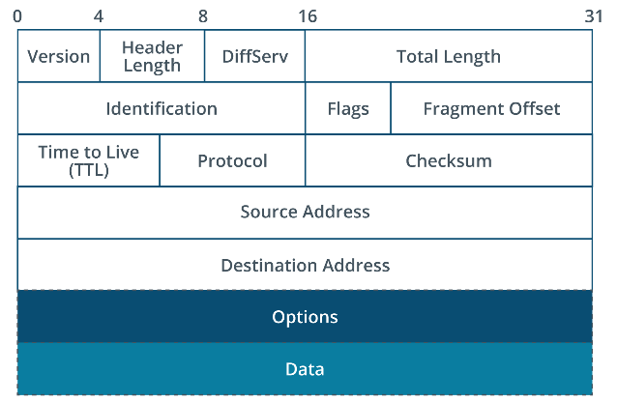
IPv4 Datagram Header
Notes:
Instructor Notes – IPv4 Datagram Header
Compare the datagram header to a package mailing label. Imagine each part of the header as a section of a shipping form; every piece of information is vital to ensure the package (in this case, the data) is handled correctly throughout its journey. For example:
Just as a package label includes the delivery address, return address, and other details to ensure it reaches the correct destination safely, the IPv4 Datagram Header contains specific information to ensure data travels correctly over the Internet. It's divided into several fields, each playing a crucial role.
The "Version" field tells us about the IP protocol version, like knowing whether you're sending a standard package or an overnight one.
The "Source IP Address" and "Destination IP Address" are akin to the sender's and receiver’s addresses on a package, ensuring the data is sent from the right starting point to the correct destination.
Just as knowing whether a package contains perishable goods might dictate how it's handled, the "Protocol" field ensures data packets are processed correctly, based on the requirements of the specified protocol.
The Internet Protocol (IP) header contains fields to manage the logical addressing and forwarding function. In IPv4, the header contains two fields for the 32-bit source and destination addresses, plus several other fields to support forwarding functions.
Version – The IP protocol version (4 or 6)
Header length – The number of 32-bit words in the header (minimum value of 5)
Differentiated Services Code Point (DSCP) – The type of service for differentiated service
Total length – Total size of the datagram including the header and the data segment
Checksum – Provides error detection for the header
Protocol – The type of data encapsulated in the payload

Slide 6
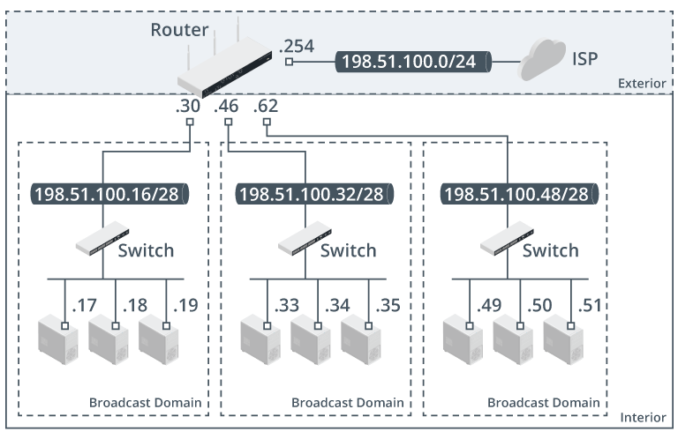
Addressing and Forwarding
Notes:
Instructor Notes – Addressing and Forwarding
Forwarding at layer 3 is referred to as routing, while forwarding at layer 2 is described as switching.
How routing and switching work together on a typical network
Network is connected to the Internet through WAN interface on router
Router’s other interfaces divide the network into 3 logical subnets that are mapped to layer 2 segments, each implemented with a switch.
Nodes within each subnet can address one another directly because they are in the same broadcast domain
Notes within the subnet can only communicate with nodes in other subnets through the router
Image Description:
The diagram shows two regions: exterior and interior. The exterior region shows the port .254 of the router connected to ISP via 198.51.100.0 slash 24.
The port .30 of the router is connected to a switch in the first broadcast domain via 198.51.100.16 slash 28.
The switch is connected to three devices via nodes, .17, .18, and .19.
The port .46 of the router is connected to a switch in the second broadcast domain via 198.51.100.32 slash 28.
The switch is connected to three devices via nodes, .33, .34, and .35.
The port .62 of the router is connected to a switch in the third broadcast domain via 198.51.100.48 slash 28.
The switch is connected to three devices via nodes, .49, .50, and .51. The broadcast domains are in the interior region.
Image Caption:
Network placement of routers and switches. (Images © 123RF.com.)

Slide 7


Address Resolution Protocol (ARP)
I have a delivery for
a Juanita Valdez
Let me find
her for you!
Notes:
Instructor Notes – Address Resolution Protocol (ARP)
Similar to how the Address Resolution Protocol (ARP) functions within a network, envision someone attempting to deliver flowers to an individual’s workplace.
The sender knows who they are delivering to (IP address) but not their exact location within the large office building (the MAC address).
The reception desk acts like ARP in this scenario.
The delivery person approaches with a name, asking, “Can you tell me where I can find this person?”
The receptionist, having access to the internal “directory” of where everyone is located (similar to how ARP knows the physical MAC addresses associated with IP addresses), provides the specific desk location (the MAC address).
This enables the delivery person to complete the delivery directly to the recipient, mirroring how ARP facilitates the direct sending of data packets to the designated device on a network.

Slide 8
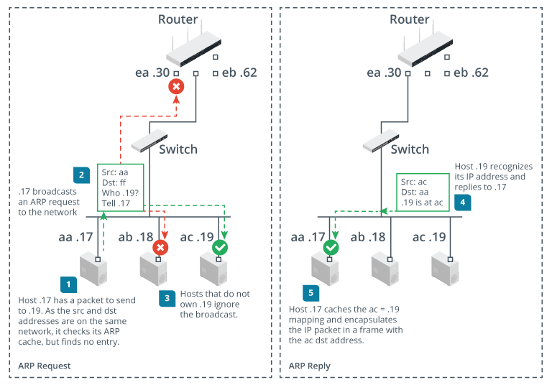
ARP Requests and Replies
Notes:
Instructor Notes - Access Subnet vs. Remote Using ARP
When both sending and receiving hosts are within the same broadcast domain, or subnet, local address resolution takes place using ARP requests and replies.
If the destination address is on another subnet or a remote network, the local host uses ARP to determine the MAC address of the default gateway and forwards the packet.
Image Description:
The steps are as follows.
Host .17 has a packet to send to .19. As the source and destination addresses are on the same network, it checks its ARP cache, but finds no entry.
.17 broadcasts an ARP request to the network.
Hosts that do not own .19 ignore the broadcast.
Host .19 recognizes its I P address and replies to .17.
Host .17 caches the ac.19 mapping and encapsulates the IP packets in a frame with the ac destination address.
Image Caption:
ARP requests and replies. (Images © 123RF.com.)

Slide 9
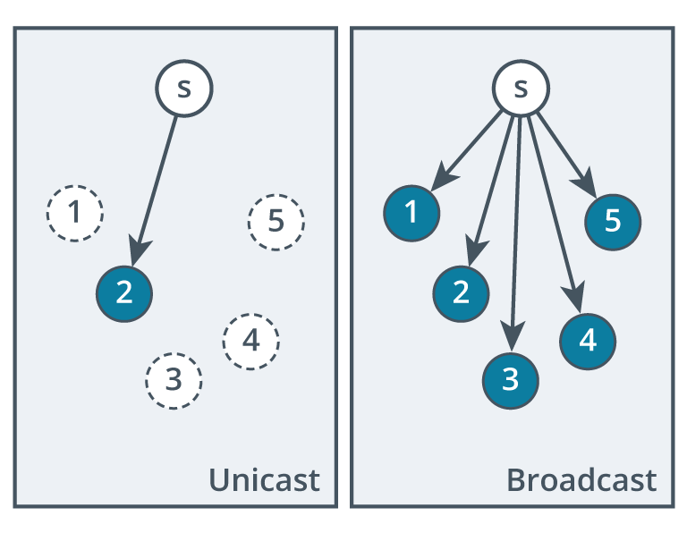
Unicast and Broadcast Addressing
Unicast
Broadcast
Addressed only to the destination IP
Addressed to the last IP address in a network or subnet
Sends only to the destination
Sends to all hosts on a network or subnet
Notes:
Instructor Notes – Unicast and Broadcast Addressing
Unicast can be remembered as a "one-to-one" form of communication, similar to sending a letter directly to a friend; it's designated for a single, specific recipient.
Broadcast communication functions akin to shouting in a crowded room; anyone within earshot can hear the message. It is the digital equivalent of sending out a public announcement over a loudspeaker, targeting everyone in a specific area or network subnet, regardless of whether they need the information. This method ensures that all connected devices are simultaneously informed, suitable for network management tasks like searching for servers or updating multiple systems at once.
Image Description
Unicast addressing shows six nodes labeled s, 1, 2, 3, 4, and 5. 2 is shaded. An arrow from s points to 2. Broadcast addressing shows nodes labeled s, 1, 2, 3, 4, and 5. 1, 2, 3, 4, and 5 are shaded. Arrows from s point to 1, 2, 3, 4, and 5.
Image Caption
Unicast and broadcast addressing.

Slide 10
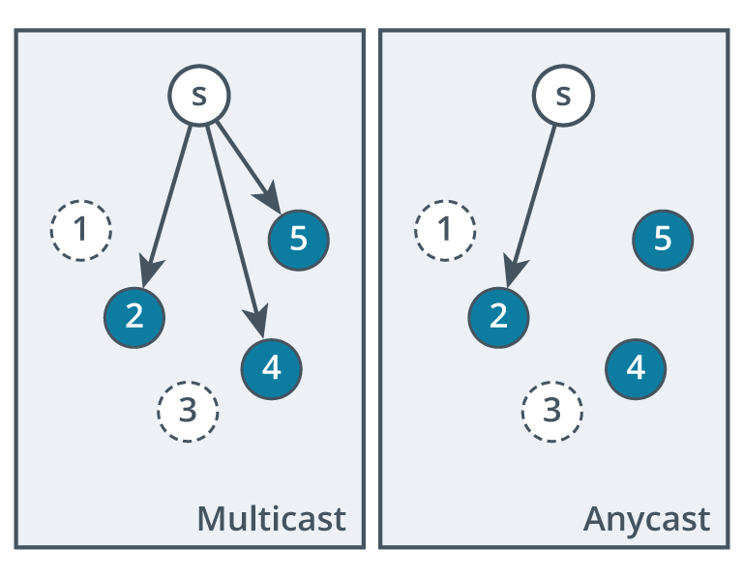
Multicast and Anycast Addressing
Multicast
Anycast
Addressed to a specific group of
host IP addresses
Sends to all hosts on a network
or subnet
Addressed to any one device out
of a group of devices, typically
the closest one
Used for load balancing
and redundancy
Notes:
Instructor Notes – Multicast and Anycast Addressing
Multicast is like a seminar where only registered attendees are privy to the information being disseminated. It targets a select group of interested parties, efficiently distributing data to multiple recipients without cluttering the network. This approach is perfect for applications requiring simultaneous data delivery like live video streaming or financial stock update broadcasts, ensuring that only interested or relevant recipients receive the message.
Anycast can be likened to a chain of retail stores, where despite the presence of multiple locations, a customer only visits the one nearest to them for convenience. In network terms, anycast addresses data requests to the closest or most accessible server among a group of potential servers, prioritizing speed and efficiency. This method is particularly effective in distributed networks for enhancing user experience by reducing latency, improving load distribution, and providing redundancy.
Image Description
Multicast addressing shows six nodes labeled s, 1, 2, 3, 4, and 5. 2, 4, and 5 are shaded. Three arrows from s point to 2, 4, and 5. Anycast addressing shows nodes labeled s, 1, 2, 3, 4, and 5. 2, 4, and 5 are shaded. An arrow from s points to 2.
Image Caption
Multicast and anycast addressing.

Slide 11
Activity: Two Truths and a Lie
IPv4 headers contain a "Destination" field used to route data to the nearest server, regardless of its final destination.
ARP functions like an online phone directory, associating IP addresses with MAC addresses to ensure data reaches the correct device.
Broadcast addressing targets all hosts within a specified local network
Notes:
Suggested Activity – Two Truths and a Lie
LIE: The claim that IPv4 headers contain a "Destination" field used to route data to the nearest server, regardless of its final destination, is false. The "Destination" field is used to direct the data to its final destination IP address, not just the nearest server.

Slide 12
Lesson 4.2
IPv4 Addressing
Notes:
Exam Objectives Covered
1.7 Given a scenario, use appropriate IPv4 network addressing.
Suggested Instructional Tip – IPv4 Addressing
This topic builds on the previous one to deepen students' understanding of how layer 3 routing and layer 2 forwarding work together.

Slide 13
IPv4 Addressing
172 | 17 | 154 | 2
10101100 | 00010001 | 10011010 | 00000010
8 bits | 8 bits | 8 bits | 8 bits
IPv4 addresses are decimal representations of four sets of binary octets.
Each octet is 8 bits, making all IPv4 addresses 32 bits.
Notes:
Instructor Notes – IPv4 Addressing
IPv4 addresses are unique identifiers assigned to devices on a network.
They are represented as a series of four decimal numbers separated by periods (e.g., 192.168.1.1).
Behind the Scenes: Each decimal number actually represents a set of 8 bits (binary digits: 0s and 1s). We call these sets "octets".
Unpacking the Format:
IPv4 addresses consist of four octets, making them a total of 32 bits long (4 octets * 8 bits/octet = 32 bits).
We typically see these addresses written in decimal format for readability, but network devices understand and process them in binary form.
Suggested Instructional Tips
Mention that odd numbers end in a binary 1. Even numbers end in a 0. Encourage students to perform the calculations in their heads or on paper and then use a calculator to check their answers.

Slide 14
Activity: Binary Conversion
Convert 01100001 to decimal form:
0 | 1 | 1 | 0 | 0 | 0 | 0 | 1
Notes:
Suggested Activity – Binary Conversion
This is review from Chapter 2.
Have learners convert this on their own or as a group.
If they need a hint or reminder of the values, fill in the second line by advancing to the next slide.
The final answer appears after advancing through the next two slides.
Suggested Instructional Tips
Mention that odd numbers end in a binary 1. Even numbers end in a 0. Encourage students to perform the calculations in their heads or on paper and then use a calculator to check their answers.

Slide 15
Activity: Binary Conversion
Convert 01100001 to decimal form:
0 | 1 | 1 | 0 | 0 | 0 | 0 | 1
128 | 64 | 32 | 16 | 8 | 4 | 2 | 1
Notes:
Suggested Activity – Binary Conversion
This is review from Chapter 2.
This slide displays the hint/reminder by filling in the second line.
Suggested Instructional Tips
Mention that odd numbers end in a binary 1. Even numbers end in a 0. Encourage students to perform the calculations in their heads or on paper and then use a calculator to check their answers.

Slide 16
Activity: Binary Conversion
Convert 01100001 to decimal form:
0 | 1 | 1 | 0 | 0 | 0 | 0 | 1
128 | 64 | 32 | 16 | 8 | 4 | 2 | 1
Answer: 64 + 32 + 1 = 97
Notes:
Suggested Activity – Binary Conversion
This is review from Chapter 2.
Answer slide
Answer: 64 + 32 + 1 = 97
Suggested Instructional Tips
Mention that odd numbers end in a binary 1. Even numbers end in a 0. Encourage students to perform the calculations in their heads or on paper and then use a calculator to check their answers.

Slide 17
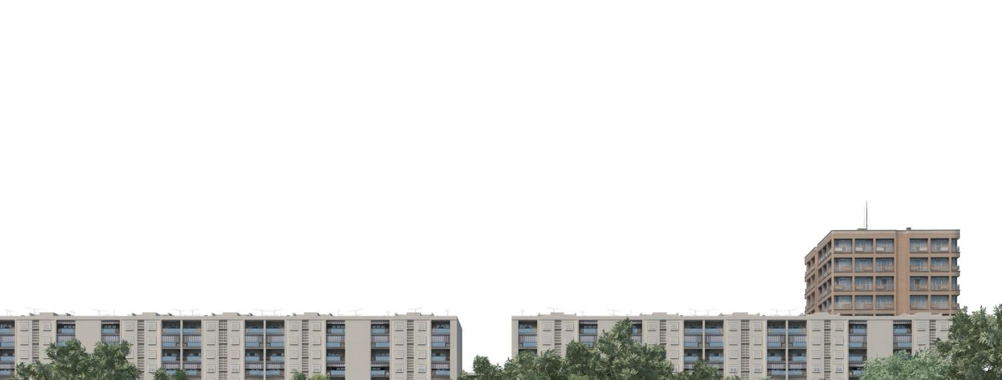
IP Address Formatting
Network ID
Host ID
Common to all hosts on the same IP network
Identifies a host within an IP network
Like an apartment building number
Like an apartment number within a building
Notes:
Instructional Notes – IP Address Formatting
Key Points:
An IPv4 address functions like an address for a device on a network.
It consists of two key parts:
Network ID (NetID): This identifies the specific network to which a device belongs, similar to an apartment building number. All devices on the same network share the same Network ID.
Host ID: This uniquely identifies a specific device within a network, just like an apartment number within a building identifies a particular residence.
Analogy:
Imagine a large apartment complex. The complex itself has a unique address (like a street address), which would be analogous to the Network ID in our IPv4 address.
Each individual apartment within the complex has its own unique number (like an apartment number), which is similar to the Host ID within an IPv4 address.
Understanding the Relationship:
The Network ID portion of the address determines which network a device belongs to.
The Host ID portion differentiates between individual devices sharing that same network.

Slide 18
Subnet Masks
Subnet Masks
Help devices determine which network or
subnet it belongs
Identify the network portion of an IP address
If the network ID matches the local network, the transmission is sent directly to the host. Otherwise,
it is forwarded.
Notes:
Instructor Notes – Subnet Masks
Subnet addressing has three hierarchical levels: a network ID, subnet ID, and host ID.
To further expand on the apartment analogy, you could refer to how the 1 in apartment 101 refers to the floor and the 01 refers to the unit number on that floor. Until you get to the correct floor, the last part of the number isn’t relevant.
To create logical subnets, bits from the host portion of the IP address must be allocated as a subnetwork address, rather than part of the host ID.
It is important to understand that only one mask is ever applied to the IP address on each interface. The mask containing the subnet information is only used within the IP network. External IP networks continue to address the whole network by its network ID.

Slide 19
Default Subnet Mask
Example:
Network: 192.168.1.x
Binary: 11000000.10101000.00000001.00000000
Mask: 255.255.255.0
Binary: 11111111.11111111.11111111.00000000
Notes:
Instructor Notes – Determining Subnet Mask
A subnet mask is 32 bits long (like the IP address)
The number of 1s in the subnet mask identifies which bits in the IP address contain the network ID.
Suggested Instructional Tip
The default masks align with octet boundaries. This means that the values in the dotted decimal mask will be 255 or 0 as shown in the default Class C subnet mask shown above.
This is a 24-bit mask. Notice there are 24 1's in the binary field.
A shortcut to writing masks is known as Classless Interdomain Routing (CIDR), which allows you to simply state the number of 1's. So for this IP address, you could write the subnet mask with a /24 after the IP like this: 192.168.1.0 /24

Slide 20

Host Ranges
192.168.1.x
.2
.3
.4
.5
Think of the “network” part of an IP address as the building’s address, and the “host” part as the apartment number.
Notes:
Instructor Notes – Host Ranges
Understanding IP address ranges can be likened to sorting mail in a large apartment building.
Just as each apartment has a unique number to identify where mail should be delivered, every device on a network has a unique IP address.
Think of the "network" part of an IP address as the building's address, and the "host" part as the specific apartment number.
For instance, in a typical home network (like 192.168.1.x), the "192.168.1" can be seen as the building's address, while the "x" represents the specific apartment (or device) number.
Address ranges (like 192.168.1.1-192.168.1.254) tell us which "apartment numbers" are available for devices in this "building" — what addresses can be assigned to devices so they can communicate within the network.

Slide 21
Host Ranges
192.168.1.x
.2
.3
Default
Gateway
.1
.4
.5
The default gateway is like the main entrance of the lobby of the apartment building.
Notes:
Instructor Notes – Host Ranges
Continuing with our apartment building analogy…
You can think of the default gateway as the main entrance or the lobby of the building.
Just as you need to go through the lobby to reach the outside world, devices in your network use the default gateway to communicate with devices outside their local network — it's the path to the broader Internet.
If the IP addresses are apartment numbers, and the network part is the building address, then the default gateway is essentially the address of the building's lobby, guiding the "mail" (or data packets) to and from the larger world of the Internet efficiently.

Slide 22
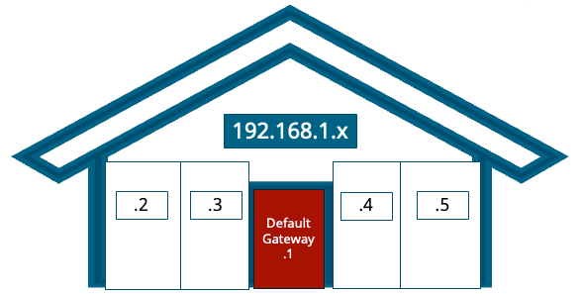

Broadcast Addresses
192.168.1.255
The broadcast address is like a loudspeaker intended to reach all residents in the apartment building.
Notes:
Instructor Notes – Broadcast Addresses
Keeping with our analogy…
Broadcast address allows a message to be sent to all devices on the network simultaneously.
The address is the last address in an IP network – where all the host bits are set to 1.
For the 192.168.1.x network, the broadcast address would be 192.168.1.255.

Slide 23
Activity: Fill in the Blanks
IP Address | Subnet Mask | Host Portion | Broadcast Address
192.168.2.123 | 255.255.255.0 |  | 192.168.2.255
10.1.1.9 | 255.255.0.0 | .1.9
198.51.100.16 | 255.255.255.0
Notes:
Suggested Activity – Fill in the Blanks
This activity can be done as a group or individually or a combination of both! Have learners fill in the cells in white.
Answers:
192.168.2.123 with a subnet mask of 255.255.255.0
The network portion is contained within the first three octets (192.168.2)
The host portion is contained in the last octet (.123)
10.1.1.9 with a subnet mask of 255.255.0.0
The network portion covers the first two octets
The host portion covers the last two octets
To determine the broadcast address, we set all bits in the host portion to 1. This changes the last two octets to 255.255, since in binary form, all host bits set to 1 correspond to the decimal value 255. Therefore, the broadcast address for the network 10.1.0.0 is 10.1.255.255.
198.51.100.16 with a subnet mask of 255.255.255.0
The network portion covers the first three octets
The host portion covers the last octet
The broadcast address is 198.51.100.255

Slide 24
Activity: Fill in the Blanks
IP Address | Subnet Mask | Host Portion | Broadcast Address
192.168.2.123 | 255.255.255.0 | .123 | 192.168.2.255
10.1.1.9 | 255.255.0.0 | .1.9 | 10.1.255.255
198.51.100.16 | 255.255.255.0 | .16 | 198.51.100.255
Notes:
Suggested Activity – Fill in the Blanks
This activity can be done as a group or individually or a combination of both! Have learners fill in the cells in white.
Answers:
192.168.2.123 with a subnet mask of 255.255.255.0
The network portion is contained within the first three octets (192.168.2)
The host portion is contained in the last octet (.123)
10.1.1.9 with a subnet mask of 255.255.0.0
The network portion covers the first two octets
The host portion covers the last two octets
To determine the broadcast address, we set all bits in the host portion to 1. This changes the last two octets to 255.255, since in binary form, all host bits set to 1 correspond to the decimal value 255. Therefore, the broadcast address for the network 10.1.0.0 is 10.1.255.255.
198.51.100.16 with a subnet mask of 255.255.255.0
The network portion covers the first three octets
The host portion covers the last octet
The broadcast address is 198.51.100.255

Slide 25
Lesson 4.3
IPv4 Subnetting
Notes:
Exam Objectives Covered
1.7 Given a scenario, use appropriate IPv4 network addressing.

Slide 26
Public vs. Private Addressing
Public IP Addressing
Private IP Addressing
Assigned by ISPs
Unique identification on the Internet
Devices requiring direct access to the Internet
Assigned by private networks
Devices not directly accessible from the Internet
Unique identification in private network
Notes:
Instructor Notes – Public vs. Private Addressing
A key distinction between public and private IP addressing lies in the fact that public IPs are unique across the entire internet, enabling devices to find and communicate with each other globally, while private IPs are used within local networks and cannot be directly accessed from the outside internet. This separation enhances security and allows for efficient use of IP addresses within private networks.

Slide 27
Private IP Addresses
Class | Range
A | 10.0.0.0 to 10.255.255.255
B | 172.16.0.0 to 172.31.255.255
C | 192.168.0.0 to 192.168.255.255
D | 224.0.0.0 to 239.255.255.255
E | 240.0.0.0 to 255.255.255.255
Notes:
Instructor Notes - Private IP Addresses
A-C can be assigned by private networks without needing to be registered.
Multiple organizations are using the same addresses, but because they are not directly connected to the Internet, there is not a duplication.
D is reserved for multicasting
E is reserved for experimental use and testing
Suggested Instructional Tip
Students need to learn these ranges.

Slide 28

IPv4 Address Scheme Design
When planning a private IPv4 addressing scheme, consider:
number of IP networks and subnetworks required
number of hosts per subnet
Network ID must be from a valid private range
Network and host IDs cannot be all 1s (broadcast)
Each host ID must be unique on subnet
Each network ID must be unique on network
Notes:
Suggested Instructional Tips – IPv4 Address Scheme Design
This section is critical. Allow plenty of time for it and when you feel your students can grasp this, then move on.
Note that CIDR/supernetting and VLSM are covered later (in lesson 7).
Note: When designing an IPv4 address scheme, always start by evaluating the total number of hosts required for each subnet to minimize wastage of IP addresses, and consider future network expansion to ensure scalability.

Slide 29
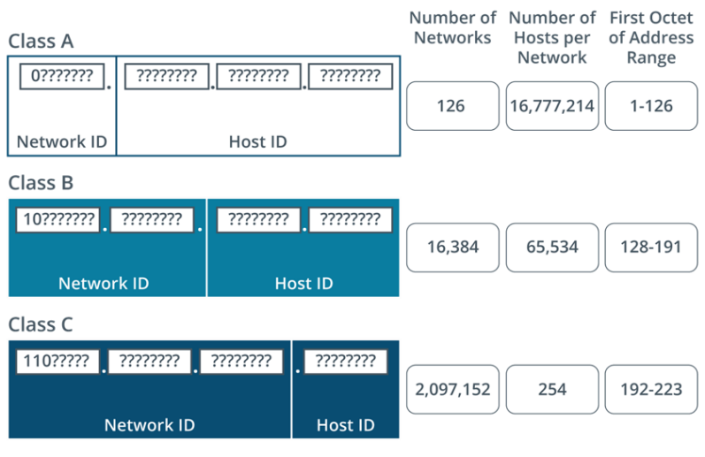
Classful Addressing
Notes:
Instructor Notes – Classful Addressing
Divides the IP address space into fixed classes, each with a different range of IP addresses.
Uses a default subnet mask based on the class of the IP address.
Lacks flexibility as it does not allow for variable length subnetting or efficient IP address usage.
Image Description:
Class A network has 8 bits as the network ID and 24 bits as the host ID.
Number of networks: 126.
Number of hosts per network: 16,777,214.
First octet of address range: 1 to 126.
Class B network has 16 bits as the network ID and 16 bits as the host ID.
Number of networks: 16,384. Number of hosts per network: 65,534.
First octet of address range: 128 to 191.
Class C network has 24 bits as the network ID and 8 bits as the host ID.
Number of networks: 2,097,152.
Number of hosts per network: 254.
First octet of address range: 192 to 223.
Image Caption:
Class A, Class B, and Class C networks.

Slide 30
Classless Addressing
Borrowing Bits
Allows borrowing bits from the host portion of the address to create subnets.
Increase available network addresses
Reduce usable host addresses
in each subnet
Notes:
Instructor Notes – Classless Addressing
Borrowing Bits (Classless Addressing):
A more modern approach known as Classless Inter-Domain Routing (CIDR) that overcomes the limitations of classful addressing.
CIDR allows borrowing bits from the host portion of the address to create subnets.
Subnetting essentially divides a larger network into smaller, more manageable segments.
By borrowing bits, network administrators can create subnets with varying numbers of hosts, catering to specific network size requirements.
Borrowing bits (CIDR) introduced a more flexible approach within classless addressing. It allows for customization of network sizes by creating subnets through the concept of borrowing bits from the host portion of the IP address.
Suggested Analogy
Imagine a large apartment complex (classful addressing) with predefined building sizes (number of apartments per building). Borrowing bits (CIDR) is like having the flexibility to create smaller sub-complexes within the main complex, allowing for more efficient allocation of apartment units based on actual needs.

Slide 31
Classless Addressing Example
Starting Network ID | 192.168.89.0
Starting Subnet mask | 255.255.255.0
Starting Network ID in binary | 11000000.10101000.01011001.00000000
Borrow one bit from the host to give to the network | 11000000.10101000.01011001.00000000
New network ID | 192.168.89.128
Range of IP addresses | 11000000.10101000.01011001.10000000 through 11000000.10101000.01011001.11111111 192.168.89.128 to 192.168.89.255
New subnet mask | 255.255.255.128 or 192.168.89.128/25
Notes:
Instructor Notes – Classless Addressing Example
CIDR is covered on next slide, but the format is introduced on this slide as a transition.
While the range of the new network is 192.168.89.128 - 192.168.89.255, the IP ending in .128 belongs to the network ID, and the IP ending in .255 belongs to the broadcast address, so the IP addresses available for hosts is 192.168.80.129 - 192.168.89.254

Slide 32
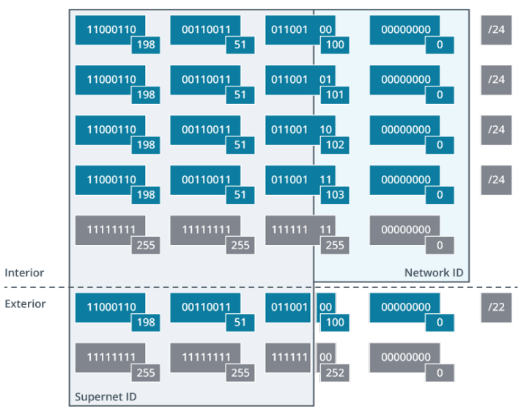
Classless Inter-Domain Routing (CIDR)
CIDR
Allocates IP address space more efficiently
Combines an IP address with a suffix (network portion of address)
Allows for variable-length subnetting
Notes:
Instructor Notes – Classless Inter-Domain Routing (CIDR)
The Internet has shifted toward a hierarchical routing structure by reengineering classful schemes with CIDR in the case of IPv4.
Routers at the top of the hierarchy need to store only the high-level network prefixes, and any given router can conceal the complexity of any networks it owns by advertising a single routing prefix. This means that routing tables are kept at a manageable size.
This is also referred to as route summarization. Note that CIDR/supernetting is the "public" view of a network that is internally more complex.
Emphasize the importance of understanding CIDR (Classless Inter-Domain Routing) notation, as it allows for more efficient use of IP address space by varying the length of the subnet mask according to network size needs.
Image Description:
The illustration shows two regions: interior and exterior.
The interior region has five addresses:
First address: 11000110 (198) 00110011 (51) 01100100 (100) 00000000 (0) slash 24.
Second address: 11000110 (198) 00110011 (51) 01100101 (101) 00000000 (0) slash 24.
Third address: 11000110 (198) 00110011 (51) 01100110 (102) 00000000 (0) slash 24.
Fourth address: 11000110 (198) 00110011 (51) 01100111 (103) 00000000 (0) slash 24.
Fifth address: 11111111 (255) 11111111 (255) 11111111 (255) 00000000.
The exterior region has two addresses:
First address: 11000110 (198) 00110011 (51) 01100100 (100) 00000000 (0) slash 22.
Second address: 11111111 (255) 11111111 (255) 11111100 (252) 00000000 (0).
The first 22 bits represent supernet ID and the next 10 bits represent network ID.
Using CIDR/supernetting to summarize four /24 networks as one /22 network.

Slide 33
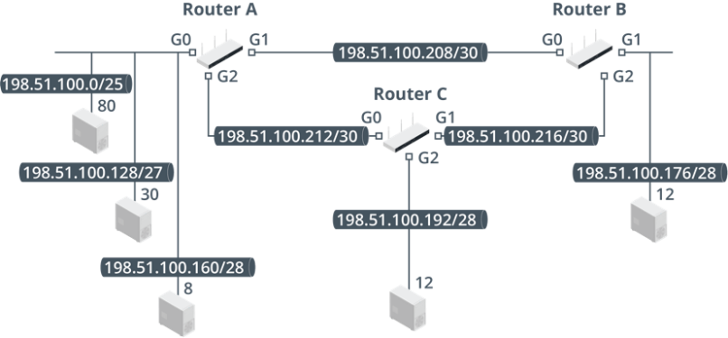
Variable Length Subnetting (VLSM)
VLSM
Creates subnets of different sizes within the same network
Enables efficient allocation of IP addresses
Requires careful planning and management
Notes:
Instructor Notes – Variable Length Subnetting (VLSM)
Where CIDR/supernetting is the public view, VLSM is used to maximize address space usage within a private network (though that private network could be the network by which an ISP allocates public addresses to its customers).
Focus on practical exercises that involve dividing a network into subnets of different sizes to meet specific requirements. Reinforce the concept that subnetting can be tailored to fit various network needs efficiently.
Image Description:
The diagram shows three routers: router A, router B, and router C.
Router A (G1 and G2) is connected to routers B (G0) and C (G0).
G0 is connected to three end systems labeled 80, 30, and 8.
G1 of router B connected to end system, 12.
G2 of router B connected to G1 of router C.
G2 of router C connected to 12.
Image Caption:
VLSM design topology diagram. (Images © 123RF.com.)

Slide 34
Activity: Classless Addressing
Starting Network ID | 192.168.89.0
Starting Subnet mask | 255.255.255.0
Starting Network ID in binary | 11000000.10101000.01011001.00000000
Borrow two bits from the host to give to the network
What is the new network ID for the second Subnet?
What is the range of IP addresses for the second Subnet?
What is the new Subnet mask?
Notes:
Suggested Activity – Classless Addressing
Have learners calculate the cells in white on their own or in groups.

Slide 35
Activity: Classless Addressing
Starting Network ID | 192.168.89.0
Starting Subnet mask | 255.255.255.0
Starting Network ID in binary | 11000000.10101000.01011001.00000000
Borrow two bits from the host to give to the network | 11000000.10101000.01011001.00000000
What is the new network ID for the second Subnet? | 192.168.89.64
What is the range of IP addresses for the second Subnet? | 192.168.89.65 to 192.168.89.126
What is the new Subnet mask? | 255.255.255.192 or 192.168.89.192 /26
Notes:
Suggested Activity – Classless Addressing
Answers:
Borrow two bits from the host to give to the network
11000000.10101000.01011001.00000000
What is the new network ID for the second Subnet?
192.168.89.64
What is the range of IP addresses for the second Subnet?
192.168.89.65 to 192.168.89.126
What is the new Subnet mask?
255.255.255.192 or 192.168.89.192 /26

Slide 36
Lesson 4.4
IP Troubleshooting Tools
Notes:
Exam Objectives Covered
5.5 Given a scenario, use the appropriate tool or protocol to solve networking issues.
Suggested Instructional Tip – IP Troubleshooting Tools
This section should not require too much presentation time. The basic commands should be familiar from A+, so focus on interpreting output.

Slide 37
ipconfig
ipconfig
View IP address, subnet mask, and default gateway for all network interfaces
ipconfig /all
Also includes complete TCP/IP configuration parameters including DHCP and MAC address
ipconfig /renew
Renews the client’s DHCPs leased IP address
ipconfig /release
Releases the client’s DHCPs leased IP address
Notes:
Instructor Notes - ipconfig
Use case: ipconfig is especially effective for quickly obtaining a host's current IP address, subnet mask, and default gateway, which are critical for network troubleshooting and setup.
Suggested Instructional Tips
Encourage students to learn the main switches for ipconfig. Students need to interpret the output to confirm whether a configuration is static or DHCP assigned, whether the correct DHCP server has been used, whether APIPA is in use, and so on.

Slide 38
ifconfig and ip
Reports network interface configuration: ip addr (legacy is ifconfig)
Single interface only: ip addr show dev eth0
Status of interfaces: ip link
Enable or disable an interface:
ip link set eth0 up|down
Modify the IP address configuration:
ip addr add|delete
Notes:
Instructor Notes – ifconfig and ip
Use case: ifconfig is commonly used for configuring, managing, and troubleshooting network interfaces on Unix-like systems, while ip addr is its modern Linux counterpart, offering more detailed information and capabilities for managing IP addresses and network interfaces.
Suggested Instructional Tips
Encourage students to learn the main switches for ipconfig. Students need to interpret the output to confirm whether a configuration is static or DHCP assigned, whether the correct DHCP server has been used, whether APIPA is in use, and so on.

Slide 39
arp
arp –a (or arp –g)
Shows the ARP cache contents
arp –s IPAddress MACAddress
Adds an entry to the ARP cache
arp –d
Deletes all entries in the ARP cache
Notes:
Instructor Notes – arp
Use Case: The arp command command is particularly useful when diagnosing network issues, as it allows you to view and modify the IP-to-MAC address mappings in the ARP cache, for instance, when you need to verify if a device is communicating with the correct hardware on the local network.

Slide 40
ping
ping
ping error messaging
Format: ping IPaddress
Tests connectivity with a given IP address
Destination host unreachable
No reply (request timed out)
Notes:
Instructor Notes – ping
Destination host unreachable—There is no routing information (that is, the local computer does not know how to get to that IP address). This might be caused by some sort of configuration error on the local host, such as an incorrect default gateway, by a loss of connectivity with a router, or by a routing configuration error.
No reply (Request Timed Out.)—The host is unavailable or cannot route a reply to your computer. Requests time out when the TTL is reduced to 0 because the packet is looping (because of a corrupted routing table), when congestion causes delays, or when a host does not respond.
Use case: The ping command is used to verify the accessibility of a device on a network by sending echo requests and measuring response times, making it essential for troubleshooting connectivity issues.
Suggested Instructional Tips
Emphasize that students should be able to interpret the output from ping: that is, determine that the protocol is not installed/corrupt, that a host is offline, or that a router is offline/route wrongly configured.

Slide 41
Lesson 4.5
IP version 6
Notes:
Exam Objectives Covered
1.8 Summarize evolving use cases for modern network environments.
Suggest Instructional Tip
Following the content examples, focus on comparing IPv6 concepts to their IPv4 equivalents.

Slide 42
IPv6 vs IPv4
Comparison | IP Version 4 | IP Version 6
Address format | Dotted decimal format (192.168.1.1) | Hexadecimal format (2001:0db8:85a3:0000:0000:8a2e:0370:7334)
# of addresses | 4.3 billion | 340 undecillion (3.4 x 10^38)
Network and Host Portions | Changes based on subnet mask | First 64 bits are used for network ID. Second 64 bits are used for host ID
Notes:
Instructor Notes - IPv6 vs IPv4
Key Differences:
Address Format: IPv4 uses a decimal format with four octets separated by periods (e.g., 192.168.1.1). IPv6 uses a hexadecimal format with eight groups of four hexadecimal digits separated by colons (e.g., 2001:0db8:0000:0000:0000:ff00:0042:83ff).
Number of Addresses: IPv4 has a limited address space due to its 32-bit format. IPv6 boasts a significantly larger address space, virtually eliminating the possibility of exhaustion in the foreseeable future.
Network and Host Portions: In IPv4, classful addressing or CIDR determines the network portion (NetID). IPv6 relies solely on CIDR notation for subnet masking and defining the network and host portions.
Additional Notes:
IPv4 remains widely used, but IPv6 adoption is steadily increasing to address the limitations of IPv4's address space.
IPv6 offers several advantages besides a larger address space, including improved security features and simplified header structure.

Slide 43
IPv6 Address Format
Contains eight 16-bit numbers, with each double-byte expressed as 4 hex digits
Binary Address | 0010 0000 0000 0001 : 0000 1101 1011 1000 : 0000 0000 0000 0000 : 0000 0000 0000 0000 : 0000 1010 1011 1100 : 0000 0000 0000 0000 : 1101 1110 1111 0000 : 0001 0010 0011 0100
Hex Notation | 2001:0db8:0000:0000:0abc:0000:def0:1234
Canonical Notation | 2001:db8::abc:0:def0:1234
Notes:
Instructor Notes – IPv6 Address Format
Using canonical notation, the hex notation can be compressed further. Where a double byte contains leading 0s, they can be ignored. In addition, one contiguous series of 0s can be replaced by a double colon place marker. You can only use double colon compression once in a given address.

Slide 44
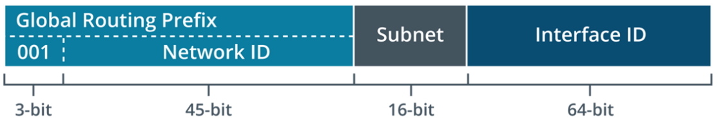
IPv6 Unicast Addressing
Globally scoped unicast addresses are routable
over the Internet and are the equivalent of
public IPv4 addresses.
Notes:
Instructor Notes – IPv6 Unicast Addressing
The parts of a global address are as follows:
The first 3 bits (001) indicate that the address is within the global scope. Most of the IPv6 address space is unused. The scope for globally unique unicast addressing occupies just 1/8th of the total address space. In hex, globally scoped unicast addresses will start with a 2 (0010 in binary) or 3 (0011).
The next 45 bits are allocated in a hierarchical manner to regional registries and from them to ISPs and end users.
The next 16 bits identify site-specific subnet addresses.
The final 64 bits are the interface ID.
Image Description:
Global routing prefix: 0 0 1, 3-bit; network I D, 45-bit. Subnet: 16-bit. Interface I D: 64-bit.
Image Caption:
IPv6 global unicast address format.

Slide 45
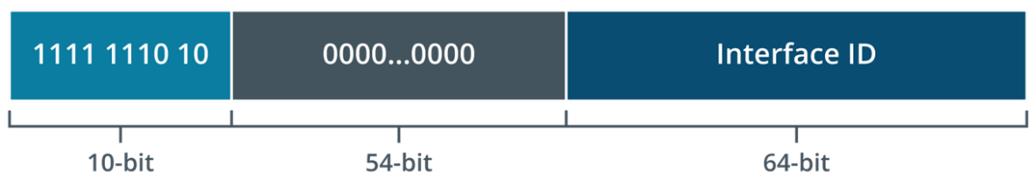
IPv6 Link Local Addressing
Span a single subnet and the equivalent of
IPv4 private addressing
Link local range is fe80::/10
Start with a leading fe80, with the next 54 bits set to 0,
and the last 64 bits are the interface ID
Link Local Addressing
Notes:
Instructor Notes – IPv6 Link Local Addressing
Key Points:
Scope: IPv6 link-local addresses are designed for communication between devices on the same physical link (like a shared switch or network segment).
They are similar to private addressing in IPv4, which is not routable on the public internet.
Address Range: Link-local addresses fall within the specifically reserved range of fe80::/10.
This means the first 10 bits (out of 128) are always fe80 in hexadecimal notation, followed by a colon (::).
Interface Identifier (IID): The remaining 118 bits (128 bits - 10 bits used for prefix) are further divided.
The first 54 bits are typically set to 0.
The last 64 bits represent the Interface Identifier (IID), which is uniquely derived from the device's MAC address using a specific algorithm (usually EUI-64).
Benefits and Use Cases:
Link-local addresses enable automatic address configuration for devices on a network, ensuring basic communication even without a central DHCP server.
They are also used for neighbor discovery protocols, a fundamental function for devices to learn about each other's presence on the same link.
Image Description:
1111111010: 10-bit.
0000 and so on til 0000: 54-bit.
Interface ID: 64-bit.
Image Caption:
IPv6 link local unicast address format.
Suggested Instructional Tips
Stress that IPv6 interfaces are always assigned link local addresses, regardless of whether they also have a global address. You can easily distinguish them because a global unicast address starts with a 2 or 3 (or binary 0010 or 0011), while a link local address starts with fe80.

Slide 46
IPv6 Packets
Version | Traffic Class | Flow Label
Packet Length |  |  | Next Header | Hope Limit
Source Address
Destination Address
Notes:
Instructor Notes – IPv6 Packets
Traffic Class: Describes the packet’s priority.
Flow Label: Used for quality of service (QoS) management, such as for real-time streams. This is set to 0 for packets not part of any delivery sequence or structure.
Payload Length: Indicates the length of the packet payload, up to a maximum of 64 KB; if the payload is bigger than that, this field is 0, and a special Jumbo Payload (4 GB) option is established.
Next Header: Used to describe what the next extension header (if any) is, or where the actual payload begins.
Hop Limit: Replaces the TTL field in IPv4 but performs the same function.
Suggested Activity
Encourage students to compare the fixed header of IPv6 with IPv4s to understand the advancements in protocol design and the benefits for modern networking.

Slide 47
IPv6 Multicast and Anycast Addressing
Multicast
First 8 bits: indicate the address is within
the multicast scope
Next 4 bits: used to flag types of multicast
Next 4 bits: determine the scope
Final 112 bits: define multicast groups
within that scope
Notes:
Instructor Notes – IPv6 Multicast and Anycast Addressing
The parts of a multicast address are subdivided as follows:
The first 8 bits indicate that the address is within the multicast scope (1111 1111 or ff).
The next 4 bits are used to flag types of multicast if necessary; otherwise, they are set to 0.
The next 4 bits determine the scope; for example, 1 is node-local (to all interfaces on the same node), and 2 is link local.
The final 112 bits define multicast groups within that scope.

Slide 48
IPv4 and IPv6 Transition Mechanisms
Dual Stack
Allows IPv4 and IPv6 to run simultaneously
Ideal for transitional periods where both IPv4 and IPv6 networks are operational
Tunneling
Encapsulates IPv6 packets within IPv4 packets to traverse IPv4 networks
Useful for IPv6 islands within an IPv4 network
NAT64
Translates IPv6 into IPv4 and vice versa
Best for environments transitioning to IPv6 but still needing access to IPv4 resources
Notes:
Instructor Notes – IPv4 and IPv6 Transition Mechanisms
A network is likely to have to run both IPv4 and IPv6 in some or all segments and for connectivity with internetworks. This compatibility requirement can be implemented using dual stack hosts, using a tunneling mechanism, or by using a type of address translation.
Highlight that dual stack allows devices to use both IPv4 and IPv6 in parallel without encapsulation, tunneling encapsulates IPv6 packets within IPv4 to traverse IPv4 networks, and NAT64 translates between the protocols, enabling IPv6 devices to communicate with IPv4 networks.
Stress the importance of understanding the context in which each transition mechanism is best applied to facilitate smooth network evolution towards IPv6.
Suggested Instructional Tips
Note that tunneling has a considerable overhead due to the layers of encapsulation required, so dual stack is typically preferred, if supported by the end and intermediate systems.

Slide 49
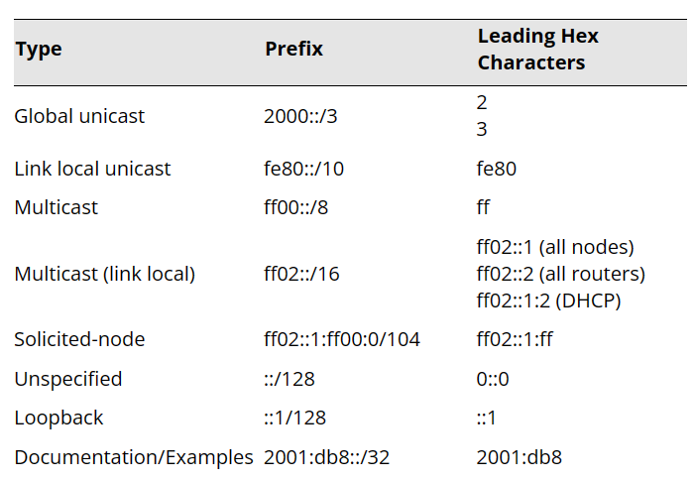
Common IPv6 Address Prefixes
Notes:
Instructor Notes – Common IPv6 Address Prefixes
Understanding Network Types: The table categorizes different IPv6 address types based on their prefix (first part of the address in CIDR notation). This helps identify the network type (e.g., link-local, site-local, public global unicast) a specific address belongs to.
Targeted Addressing: By recognizing the leading hex digits or prefix of an address, you can quickly determine its functionality and scope. For example, addresses starting with fe80:: are likely link-local addresses used for communication on a local network segment.
Routing and Reachability: The table provides insights into how addresses are routed. Public global unicast addresses (likely starting with 2000::/3) are routable across the entire internet, while private address types (like fe80::/10) are not.
Suggested Instructional Tips
Encourage students to learn these prefixes so that they can easily identify different types of IPv6 addresses. It should also be noted that IPv6 is always evolving, and new prefixes are being defined for new features, so this is not a definitive list.

Slide 50
Lesson 4.6
IP Troubleshooting
Notes:
Exam Objectives Covered
5.3 Given a scenario, troubleshoot common issues with network services.

Slide 51
IP Configuration Issues
Network Layer Troubleshooting: Focus on IP configuration after ruling out Physical and Data Link layers.
Neighbor Discovery: Use appropriate tools to verify host configuration.
Incorrect IP Address: Ensure hosts have valid, unique addresses within the same subnet.
Non-Default Masks: Be cautious with subnet boundaries.
Incorrect Subnet Mask: Understand the impact of longer and shorter prefixes on routing.
Notes:
Instructor Notes – IP Configuration Issues
Network Layer Troubleshooting: Focus on IP configuration after ruling out Physical and Data Link layers.
Neighbor Discovery: Use appropriate tools to verify host configuration.
Incorrect IP Address: Ensure hosts have valid, unique addresses within the same subnet.
Non-Default Masks: Be cautious with subnet boundaries.
Incorrect Subnet Mask: Understand the impact of longer and shorter prefixes on routing.

Slide 52
IP Configuration Issues
Incorrect IP Address
 | IP | Mask
Incorrect IP Address - Valid Configuration Example
Host A | 192.168.1.10 | 255.255.255.0
Host B | 192.168.1.11 | 255.255.255.0
Incorrect IP Address - Invalid Configuration Example
Host C | 192.168.0.21 | 255.255.255.0
Issue: Host C is in a different subnet (192.168.0.0 compared to 192.168.1.0).
Non-Default Masks – Example with /28 Subnet
Host A | 198.51.100.10 | 255.255.255.240
Host B | 198.51.100.11 | 255.255.255.240
Host C | 198.51.100.21 | 255.255.255.240
Issue: Host C is in a different subnet due to the network prefix boundary.
Notes:
Instructor Notes – IP Configuration Issues
Network Layer Troubleshooting: Focus on IP configuration after ruling out Physical and Data Link layers.
Neighbor Discovery: Use appropriate tools to verify host configuration.
Incorrect IP Address: Ensure hosts have valid, unique addresses within the same subnet.
Non-Default Masks: Be cautious with subnet boundaries.
Incorrect Subnet Mask: Understand the impact of longer and shorter prefixes on routing.

Slide 53
Duplicate IP and MAC Address Issues
Duplicate IP Address Issues
Identify and resolve using ping, arp -a, and arping -D
Ensure each host has a unique IP address
Duplicate MAC Address Issues
Identify and resolve using arp, ipconfig, ip neigh,
and protocol analyzers
Be aware of potential spoofing attacks
Notes:
Instructor Notes – Duplicate IP and MAC Address Issues
Duplicate IP Address Issues
Causes:
Configuration errors (e.g., both addresses statically assigned).
One address assigned within a DHCP scope.
Symptoms:
Windows: Displays a warning and disables the IP.
Linux: Logs a warning but does not disable the interface.
Impact:
Race condition determines which system receives traffic.
Network instability and communication issues.
Troubleshooting Steps:
Identify Duplicate IPs:
Use ping and arp -a to examine the ARP cache table.
On Linux, use arping -D to report duplicate replies.
Resolve Issue:
Configure each host to use a unique IP address.
Duplicate MAC Address Issues
Causes:
Locally administered addressing.
Potential spoofing attacks.
Symptoms:
Both hosts contend to respond to ARP queries.
Communications may be split or reach only one host.
Impact:
Network instability and communication issues.
Troubleshooting Steps:
Identify Duplicate MACs:
Use arp utility to verify MAC addresses for each host.
Use ipconfig (Windows) or ip neigh (Linux) to check MAC address assignments.
Check MAC address and ARP tables on switches and routers.
Use a protocol analyzer to examine ARP traffic.

Slide 54
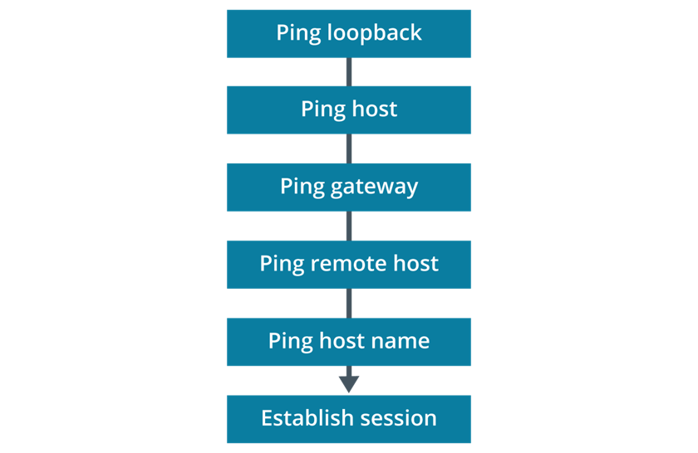
IP Forwarding Issues
Notes:
Instructor Notes – IP Forwarding Issues
Ping the loopback address (ping 127.0.0.1) to verify TCP/IP is installed and loaded correctly. If this fails, reinstall the network protocol stack.
Ping the IP address of the local host to verify it was added correctly and to verify that the network adapter is functioning properly. If you cannot ping the host's own address, there might have been a configuration error, or the network adapter or adapter driver could be faulty.
Ping the IP address of the default gateway to verify it is up and running and that you can communicate with another host on the local network.
Ping the IP address of other hosts on the same subnet to test for local configuration or link problems.
Image Description:
The sequence is as follows: ping loopback, ping host, ping gateway, ping remote host, ping host name, and establish session.
Image Caption:
A general ping sequence for identifying connectivity issues.

Slide 55
Summary
Configuring Network Addressing
Notes:
Instructional Tips
Ask learners to summarize their key takeaways from this module
Conclude by going over main points on the next slide

Slide 56
Main Points
IP: Creates interconnected networks (interwork) using unique addresses.
IPv4 Address: 32-bit address divided into four octets.
Network Segment: Represented by a subnet at
layer 3 (Network.)
TCP/IP Utilities: Command-line tools for network configuration and communication monitoring.
IPv6 Address: Eight 16-bit numbers expressed in hexadecimal format.
Notes:
The core function of IP is to facilitate the creation of a group of logically distinct but interconnected networks, referred to as an internetwork.
An IPv4 address is 32 bits long and is subdivided into four group of 8 bits.
A network segment is represented at the Network layer by a subnet.
TCP/IP command-line utilities enable you to gather information about how your systems are configured and how they communicate over an IP network.
An IPv6 address contains eight 16-bit numbers, with each double-byte expressed as 4 hex digits.

