Slide 1
Module 5
Configuring Routing and Advanced Switching
Notes:
Suggested Instructional Tips
As with IP, the course dedicates quite a substantial block to covering a single objective and a few content examples. This content is relatively complex and critical foundational knowledge, however, so try to allocate a decent amount of time to cover it.

Slide 2
Module Objectives
Compare and contrast routing concepts.
Compare and contrast dynamic routing concepts.
Install and troubleshoot routers.
Explain tiered switching architecture.
Explain virtual LANs.
Notes:
Learning Objectives
The learning objectives align with the following Exam Objectives for Module 5:
1.2 Compare and contrast networking appliances, applications, and functions.
1.6 Compare and contrast network topologies, architectures, and types.
2.1 Explain characteristics of routing technologies.
2.2 Given a scenario, configure switching technologies and features.
5.3 Given a scenario, troubleshoot common issues with network services.
5.5 Given a scenario, use the appropriate tool or protocol to solve networking issues.

Slide 3
Lesson 5.1
Routing Technologies
Notes:
Exam Objectives Covered
1.2 Compare and contrast networking appliances, applications, and functions.
2.1 Explain characteristics of routing technologies.
5.5 Given a scenario, use the appropriate tool or protocol to solve networking issues.
Suggested Teaching Tip
This topic covers the basic process of using routing to determine a path and then forwarding the packet over that path using directly connected and static routes only.

Slide 4
Routing Tables and Path Selection
The following main parameters define a routing entry:
Protocol
Destination
Interface
Gateway/next hop
Notes:
Suggested Instructional Tips – Routing Tables and Path Selection
Explain that information about the location of other IP networks and hosts is stored in the routing table.
Explain that an entry in the routing table should answer two questions:
Where does this packet need to end up? (destination)
Given A, where should it go next? (interface/gateway/next hop)
Protocol—The source of the route. Paths can be configured statically or learned by exchanging information with other routers via a dynamic routing protocol.
Destination—Routes can be defined to specific hosts but are more generally directed to network IDs. The most specific (longest) destination prefix will be selected as the forwarding path if there is more than one match.
Interface—The local interface to use to forward a packet along the chosen route. This might be represented as the IP address of the interface or as a layer 2 interface ID.
Gateway/next hop—The IP address of the next router along the path to the destination.

Slide 5
Routing Table Entries
Directly connected routes
Remote routes
Host routes
Default route
For subnets for which the router has a local interface
For subnets and IP networks that are not directly attached
To a specific IP address
To use when an exact match for a network or host route is not found
Notes:
Suggested Instructional Tips - Static and Default Routes
A static route is manually added to the routing table and only changes if edited by the administrator.
Make sure students can distinguish directly connected routes from those the router has been configured with (static) or learned.
You might also want to add the concept of a local route. A local route is a special type of connected host route to one of the router's own IP addresses (typically the loopback address).

Slide 6
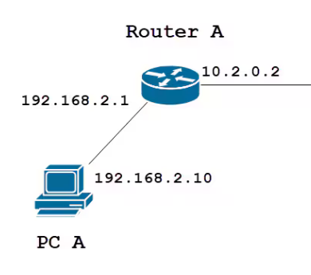
Static Routes
A static route is manually added to the routing table and only changes if edited by the administrator
Notes:
Suggested Instruction Tips – Static Routes
Configuring static routing entries can be useful in some circumstances, but it can be problematic if the routing topology changes often, as each route on each affected router needs to be updated manually.
Image Description:
The diagram shows a simplified representation of a static route entry in a routing table. The network destination and subnet mask together define the target network. The next hop is the address of the router or interface that the packet should be forwarded to. The administrative distance is typically represented numerically (e.g., 1 for directly connected, 100 for static).
Image Caption:
Static route diagram (© Cisco: https://www.cisco.com/c/en/us/support/docs/smb/routers/cisco-rv-series-small-business-routers/kmgmt-2334-Static-Routing-RV160-RV260.html)

Slide 7
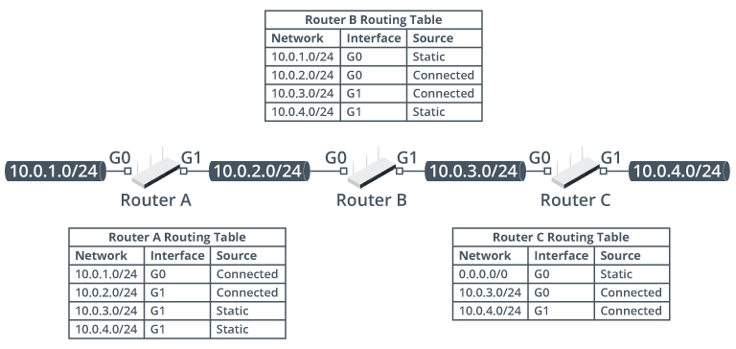
Routing Table Example
Notes:
Suggested Instructional Tips – Routing Table Example
Router A:
The router is directly connected to networks 10.0.1.0/24 (via interface G0) and 10.0.2.0/24 (via interface G1).
The router has been configured with static routes to 10.0.3.0/24 and 10.0.4.0/24, both of which are reachable via interface G1.
Router B:
Configured in the same way as Router A.
The networks 10.0.2.0/24 and 10.0.3.0/24 are directly connected, and the paths to 10.0.1.0/24 and 10.0.4.0/24 are configured as static entries.
Router C:
Configured differently than Routers A and B.
It is directly connected to 10.0.3.0/24 and 10.0.4.0/24, but the only static route configured is for 0.0.0.0/0. This is a default route. While the router has no specific knowledge of networks 10.0.1.0/24 and 10.0.2.0/24, it will forward packets for these destinations over its G0 interface.
Image Description:
The G0 port of router A is connected to the network, 10.0.1.0 slash 24. The G1 port router A is connected to the G0 port of router B via the network, 10.0.2.0 slash 24. The G1 port of router B is connected to the G0 port of router C via 10.0.3.0 slash 24. The G1 port of router C is connected to the network, 10.0.4.0 slash 24.
Three tables are provided. Each table has three columns labeled network, interface, and source.
Router A routing table infers the following data: 10.0.1.0 slash 24: G0 and connected; 10.0.2.0 slash 24: G1 and connected; 10.0.3.0 slash 24: G1 and static; 10.0.4.0 slash 24: G1 and static.
Router B routing table infers the following data: 10.0.1.0 slash 24: G0 and static; 10.0.2.0 slash 24: G0 and connected; 10.0.3.0 slash 24: G1 and connected; 10.0.4.0 slash 24: G1 and static.
Router C routing table infers the following data: 0.0.0.0 slash 0: G0 and static; 10.0.3.0 slash 24: G0 and connected; 10.0.4.0 slash 24: G1 and connected.
Image Caption:
Routing tables for three routers connected in a series. (Images © 123RF.com.)

Slide 8
Packet Forwarding
Receive the packet
Examine the packet
Consult the routing table
Make a forwarding decision
Forward the packet
Notes:
Suggested Instructional Tips – Packet Forwarding
Forwarding decision:
If the packet can be delivered to a directly connected network via an Ethernet interface, the router uses ARP (IPv4) or Neighbor Discovery (ND in IPv6) to determine the Data Link layer address of the destination interface.
If the packet can be forwarded via a gateway over an Ethernet interface, it inserts the next hop router's MAC address as the destination address in a new frame and uses the MAC address of the outgoing interface as the source address.
If the packet can be forwarded via a gateway over another type of interface (leased line or DSL, for instance), the router encapsulates the packet in an appropriate frame type.
If the destination address cannot be matched to a route entry, the packet is either forwarded via the default route or dropped (and the source host is notified that it was undeliverable).
Note that both Data Link and Network layer addresses are used. Data Link addresses in the frame change as the frame is delivered from hop to hop. At any point in the process, the Data Link destination address indicates the physical address of the next hop on the route. The Data Link source address is the physical address of the device sending the frame.

Slide 9
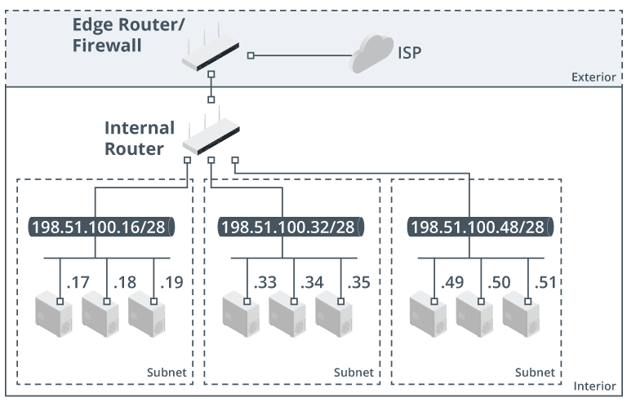
Router Configuration
Router Placement
Same subnet or IP network must not be separated by a router
Different subnets or
IP networks must be separated by a router
Notes:
Suggested Instructional Tips – Router Configuration
Router placement:
Host with addresses in the same subnet or IP network must not be separated by a router.
Hosts with addresses in different subnets or IP networks must be separated by a router.
Make sure students understand the implications of MTU. MTU (Maximum Transmission Unit) is the size of the data packet and is usually 1500 bytes. Anything larger would have to be fragmented across more than one Ethernet frame.
Image - Simplified example of a typical network configuration
An edge router/firewall provides access to the Internet.
Traffic between the local subnets is controlled by a separate internal router.
Image Description
The diagram shows two regions: exterior and interior.
The exterior region shows the second port of the edge router connected to ISP.
The first port of the edge router is connected to the first port of an internal router.
The second port of the internal router is connected to three devices in the first subnet whose ports are labeled .17, .18, and .19 via 198.51.100.1 slash 28.
The third port of the internal router is connected to three devices in the second subnet whose ports are labeled .33, .34, and .35 via 198.51.100.32 slash 28.
The third port of the internal router is connected to three devices in the third subnet whose ports are labeled .49, .50, and .51 via 198.51.100.48 slash 28.
Image Caption
Network placement of edge and internal routers. (Images © 123RF.com.)

Slide 10
Routing Tools
show route
Displays routing table
show arp
Lists current ARP table entries
route
Shows IP routing table of a host
traceroute
Tracks a packet’s path to destination
Notes:
Suggested Instructional Tips – Routing Tools
`show route`: Displays the routing table of a network device, including paths to various network destinations, the specific routes to each destination, and metrics used to select the best route.
`show arp`: Lists the current ARP (Address Resolution Protocol) table entries in a network device, mapping IP addresses to physical hardware addresses on the local network.
`route`: Allows users to view or modify the IP routing table of a host, providing control over how traffic is directed between different networks.
`traceroute`: A network diagnostic tool that tracks the pathway packets take to reach a specified destination across an IP network, showing each hop and the time taken to get from one hop to the next.

Slide 11
Activity: Trivia
What is the function of a routing table?
What are directly connected routes?
What is traceroute used for?
Notes:
Suggested Activity – Trivia
Routing table function: Determines optimal paths for data packets.
Directly connected routes: Paths to networks directly reachable by the router.
Traceroute usage: Identifies the pathway and transit times packets take through a network.

Slide 12
Lesson 5.2
Dynamic Routing Technologies
Notes:
Exam Objectives Covered
2.1 Explain characteristics of routing technologies.

Slide 13
Static vs. Dynamic Routing
Feature | Static Routing | Dynamic Routing
Configuration | Manually configured | Automatically adjusts to network changes
Flexibility | Inflexible - Updates require manual intervention | Flexible - Adapts in real-time
Control | Complete control over routing paths | Less direct control over the routes that data takes
Use Case | Ideal for small, stable networks where routes do not change often | Ideal for larger, more complex networks with frequent changes
Notes:
Suggested Instructional Tips – Static vs. Dynamic Routing
Routing Overview: In networks, routing protocols determine how data packets find their way to their destination across interconnected networks.
Choosing the Right Approach:
Static routing offers simplicity and control for small, stable networks where routes rarely change.
Dynamic routing provides greater flexibility and scalability for larger, complex networks where automatic adaptation to topology changes is crucial.
Additional Points:
Briefly mention the concept of hop count, a factor considered by some routing protocols to choose the most efficient path for data packets.
You can touch upon the existence of various dynamic routing protocols (e.g., RIP, OSPF, EIGRP) with varying levels of complexity and features.
However, the focus of this slide might be on the core differences between static and dynamic approaches rather than specific protocols.
Remember:
Understanding static and dynamic routing is essential for network design and configuration.
Choosing the appropriate approach depends on your network size, complexity, and desired level of control.

Slide 14
Dynamic Routing Protocols
Definition
Dynamic routing protocols are algorithms that automatically update
route information and adjust the paths between network nodes by
distributing network topology information
Advantages
Scalability, adaptivity to network changes, and reduced network
administration overhead
Considerations
Requires more processing power and memory
Proper configuration is critical for security and efficiency
Notes:
Suggested Instructional Tips – Dynamic Routing Protocols
Emphasize the importance of understanding the protocols' operational concepts, such as how they make decisions and interact with other network devices, to effectively manage and troubleshoot networks. Encourage hands-on experience with simulation tools or lab setups to solidify these concepts.

Slide 15
RIP Protocol
Definition
Features
A legacy dynamic routing protocol that finds the best path between
the source and destination networks
Uses hop count as the metric for path selection
15 maximum allowed hops
Considerations
Not ideal for large networks because of the hop count limit
Slow to converge in response to network changes
Notes:
Suggested Instructional Tip – RIP Protocol
Use hands-on lab exercises where students can observe how RIP’s hop count limit affects routing decisions and network performance.

Slide 16
Enhanced IGRP (EIGRP)
Features
Definition
An advanced distance-vector protocol that is used on a computer network for automating routing decisions and configurations
Uses metrics such as bandwidth, delay, load, and reliability for path selection
Supports both IPv4 and IPv6 without needing separate configurations
Considerations
More complex to configure
Cisco Systems proprietary protocol
Notes:
Suggested Instructional Tips – Enhanced IGRP (EIGRP)
Consider using simulated software and/or real network equipment to demonstrate the protocol’s dynamic adjustment capabilities and its fast convergence.

Slide 17
Open Shortest Path First (OSPF)
Definition
Features
A dynamic link-state protocol that efficiently exchanges routing information
within an autonomous system using the Shortest Path First algorithm
Computes the shortest path first
Supports complex network topologies
Considerations
Can be complex planning and configuration
Requires more bandwidth than distance-vector protocols

Slide 18
Border Gateway Protocol (BGP)
Definition
Features
Gateway protocol that enables the Internet to exchange
routing information between autonomous systems
Scalable to the Internet’s size, handling thousands of routes
Uses path vector protocol for establishing routing decisions
Supports CIDR, allowing for efficient IP address management and route aggregation
Notes:
Suggested Instructional Tips – Border Gateway Protocol (BGP)
Use hands-on labs to simulate inter-AS routing scenarios.

Slide 19
Activity: Fill in the Blank
____________________ are algorithms that automatically update
route information and adjust the paths between network
nodes by distributing network topology information.
____________________ is a protocol that enables the Internet to exchange routing information between autonomous systems.
____________________ is a legacy dynamic routing protocol that
finds the best path between the source and destination networks.
____________________ is a dynamic link-state protocol that efficiently exchanges routing information within an autonomous system using the Shortest Path First algorithm.
Notes:
Suggested Activity - Fill in the Blank
Have students jot down their answers and then review as a class.
Dynamic routing protocols
BGP
RIP
Open Shortest Path First (OSPF)

Slide 20
Lesson 5.3
Network Address Translation
Notes:
Exam Objectives Covered
2.1 Explain characteristics of routing technologies.

Slide 21
Network Address Translation (NAT)
What it does
Why it is needed
Modifies the network address information in packet
headers while in transit
Increases network security by hiding internal IP
addresses from external networks
Enables multiple devices on a local network to share a
single public IP address
Conserves public IP addresses

Slide 22
NAT Types
Dynamic
Static
Translates one internal IP address to one external IP address
Allows inbound connections initiated from outside the network
Maps internal addresses to a pool of
external addresses dynamically
Allows a larger number of devices to share
the same external IP address

Slide 23
Edge Routers
An edge router…
Is located at the boundary of a network that connects to external networks (e.g., the Internet).
Manages the flow of data between the internal
and external networks.
Routes data to its destination, performs NAT,
and applies security measures.
Notes:
Suggested Instructional Tips – Edge Routers
Discuss the different ways a router can be deployed and where they should be placed on a network to implement different topologies.

Slide 24
Types of Edge Routers
Customer Edge (CE)
Located at the edge of a customer’s network
Connects customer’s internal network to provider’s network, acting as a security barrier for the customer’s network
Provider’s Edge (PE)
Located at the edge of a provider’s network
Focuses on maintaining the integrity and confidentiality of customer data as it travels across the provider’s network

Slide 25
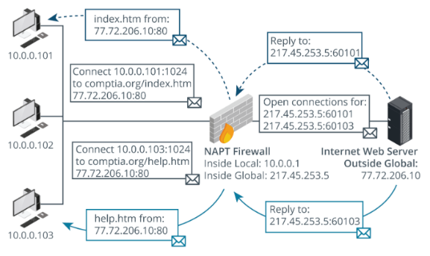
Port Address Translation
Notes:
Suggested Instructional Tips – Port Address Translation
Port Address Translation (PAT) is the technique of mapping multiple private IP addresses to a single public IP address using different port numbers.
Image Description:
Two hosts (10.0.0.101 and 10.0.0.102) initiate a web connection at the same time.
The PAT service creates two new port mappings for these requests (10.0.0.101:61101 and 10.0.0.102:61102) in its state table.
It then substitutes the private IP for the public IP and forwards the requests to the public Internet.
It performs a reverse mapping on any traffic returned using those ports, inserting the original IP address and port number, and forwarding the packets to the internal hosts.
Image Caption:
Port Address Translation (PAT). (Images ©123RF.com.)

Slide 26
Activity: Multiple Choice
For each definition, choose the correct option.
Conserves public IP addresses
Maps internal addresses to a pool of external addresses
Maintains the confidentiality of a customer’s data as it travels across the provider’s network
NAT
PAT
Dynamic NAT
Static NAT
CE
PE
Notes:
Suggested Activity – Multiple Choice
For each definition, choose the correct option from the multiple-choice answers provided.
Only one option is correct for each definition.
Answers
Conserves public IP addresses
NAT
Maps internal addresses to a pool of external addresses
Dynamic NAT
Maintains the confidentiality of a customer’s data as it travels across the provider’s network
PE

Slide 27
Lesson 5.4
Firewalls
Notes:
Exam Objectives Covered
1.2 Compare and contrast networking appliances, applications, and functions.

Slide 28
Firewall Types
Hardware
Software
Cloud-based
Standalone appliances
Integrated within routers
Next-Generation (NGFW)
Operating system-based
Third-party software-based
Firewall as a service (FAAS)
Unified Threat Management (UTM)
All-in-one security appliances
Notes:
Suggested Instructional Tips – Firewall Types
Hardware Firewalls:
Standalone appliances specifically designed for network security, often found in corporate environments.
Integrated within broadband routers providing basic home and small office protection.
Next-Generation Firewalls (NGFW) combining traditional firewall protection with additional security features.
Software Firewalls:
Operating System-based firewalls such as Windows Defender Firewall or Linux’s iptables.
Third-party software applications offering advanced features and customization options.
Cloud-based Firewalls:
Firewall as a Service (FaaS), providing scalable and flexible security measures, managed over the cloud.
Unified Threat Management (UTM) Devices:
All-in-one security appliances that include firewall capabilities along with anti-virus, anti-spam, and intrusion detection systems.
As the firewall functionality moves up the network stack, it becomes more sophisticated but correspondingly slower and harder to configure.

Slide 29
Stateless vs. Stateful
Stateless inspection (Packet Filtering)
Stateful inspection (Circuit Level Gateway)
Filters based on IP addresses, protocol, and port numbers
Inspects packets and tracks the state of active connections
Acts at the network layer
Acts at the session layer
Suitable for smaller networks or less complex security requirements
Ideal for corporate networks where it is critical to protect sensitive data
Notes:
Suggested Instructional Tips – Stateless vs. Stateful
Comparison
Basic functionality:
Packet Filtering: Analyzes incoming and outgoing packets based on a set of predefined rules, such as IP addresses, protocol, and port numbers. Acts at the network layer.
Stateful Inspection: Not only inspects packets like packet filtering does but also tracks the state of active connections and makes decisions based on the context of the traffic, offering more nuanced security.
Security
Packet Filtering: Offers a basic level of security by blocking or allowing data packets based on the administrator’s rules. It does not understand the state or context of the traffic.
Stateful Inspection: Provides a higher level of security by monitoring the state of active connections and inspecting the payload of packets. Capable of detecting and blocking threats based on the state and context of the traffic.
Use cases
Packet Filtering: Effective for basic security measures, such as creating a demilitarized zone (DMZ) or restricting access to certain IP addresses, protocols, or ports.
Stateful Inspection: Ideal for environments requiring higher security, such as corporate networks, where monitoring the state and behavior of traffic is crucial for protecting sensitive data.
Primary Difference: Packet filtering examines individual packets based on predefined rules, whereas circuit level gateway focuses on establishing a secure session through TCP handshake verification.
Focus on usage and placement rather than configuration detail.

Slide 30
Activity: Firewall Shopping
Research 3 different types of firewalls, noting the different types, the volume of traffic supported, where it should be placed on a network, and any other notable features.
Barracuda.com
Checkpoint.com
Fortinet.com
Notes:
Suggested Activity – Firewall Shopping
Divide learners into groups or assign them a manufacturer
Have them research different types of routers
Note the different types
Note the different volume of traffic supported
Note the type of router (where it should be placed on the network)

Slide 31
Lesson 5.5
Enterprise Networking Topologies
Notes:
Exam Objectives Covered
1.6 Compare and contrast network topologies, architecture, and types.

Slide 32
Activity: Think About It
What are the three basic network topologies?
Notes:
Suggested Activity – Think About It
Encourage learners to recall the three types of basic network topologies and how they function. Possibly drawing a picture of each.
Point to point is a one-to-one link between two hosts only.
Star is many-to-many links where each node relies on a central forwarding device to establish paths to other nodes.
Mesh is many-to-many links that depend on each node having multiple interfaces and cable paths to other nodes.

Slide 33
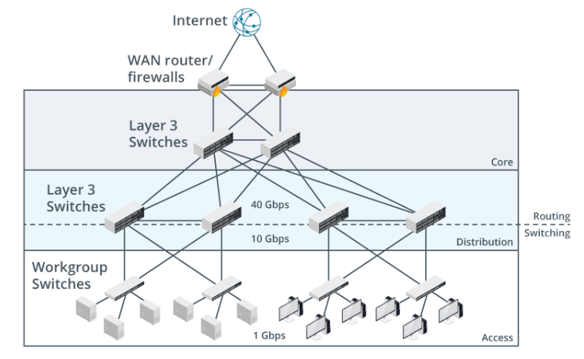
Three-Tiered Network Hierarchy
Notes:
Suggested Instruction Tips – Three-Tiered Network Hierarchy
Access/Edge Layer:
Function: Explain that the access or edge layer allows end-user devices to connect to the network.
Implementation: Mention that it is implemented using structured cabling, wall ports for wired access, and access points for wireless access.
Topology: Highlight that end systems connect to switches in the access/edge layer in a star topology with no direct links between the access switches.
Distribution/Aggregation Layer:
Function: Explain that the distribution or aggregation layer provides fault-tolerant interconnections between different access blocks and either the core or other distribution blocks.
Capabilities: Mention that layer 3 capable switches in the distribution layer have different capabilities compared to layer 2 workgroup switches in the access tier. Highlight the "route once, switch many" principle and the use of application-specific integrated circuits (ASICs) in layer 3 switches.
Core Layer:
Function: Describe the core layer as providing a highly available network backbone.
Purpose: Emphasize that its purpose should be kept simple: provide redundant traffic paths for data to continue to flow around the access and distribution layers of the network.
Suggested Instructor Tips
Mention that many corporate office networks follow Cisco's design principles for a three-tiered hierarchy: access, distribution, and core.
Image Caption:
Core, distribution, and access layers in three-tiered network architecture. (Images © 123RF.com.)

Slide 34
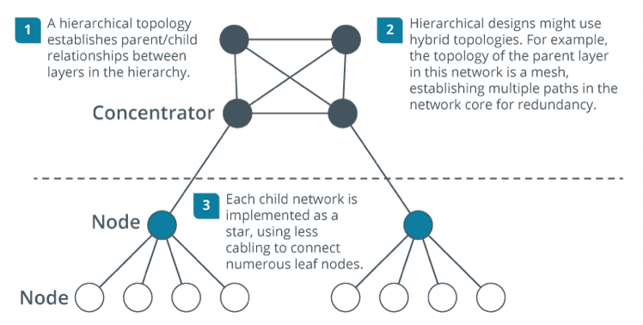
Hybrid Topologies
Used when a basic topology isn’t enough
Use a mixture of the basic topologies
Used to implement redundancy and
fault tolerance
Notes:
Suggested Instructional Tips – Hybrid Topologies
Used When Basic Topologies Aren't Enough:
Basic network topologies (bus, star, mesh) offer advantages in simplicity and ease of implementation for smaller networks.
However, as network size and complexity grow, the limitations of basic topologies become apparent.
Hybrid topologies bridge this gap by combining the strengths of different basic structures to create a network that caters to specific needs.
For example: A large office building might have a star topology for individual floors (star within a floor) connected by a bus or mesh backbone (bus/mesh between floors) to provide a scalable and fault-tolerant network.
Mixture of Basic Topologies:
Hybrid topologies don't adhere to a single, rigid structure.
They leverage the flexibility of combining elements from different basic topologies (star, bus, mesh) to create a customized network design.
This allows network designers to address specific requirements within different network segments.
For example: A network might utilize a star topology for connecting desktop computers within a department (star for workstations) while employing a mesh topology to connect critical servers for increased redundancy and reliability (mesh for servers).
Implementing Redundancy and Fault Tolerance:
Network redundancy refers to having backup paths or components to maintain functionality in case of failures.
Hybrid topologies excel at implementing redundancy and fault tolerance.
By incorporating elements like redundant links or multiple pathways, hybrid networks can ensure continued operation even if a single component fails.
For example: A hybrid network might have redundant connections between switches (redundant links) using elements of both star and mesh topologies. This ensures data can still flow even if a switch or cable fails.
Image Caption
Hierarchical hybrid topology example where a mesh network distributes traffic between multiple star networks.

Slide 35
Activity: Quick Search
Hierarchical star
Hierarchical star-mesh
Star of stars
3-Tiered network hierarchy
Research these hybrid topologies and note
the following:
What do they look like?
How and when are they used?
Notes:
Suggested Activity - Quick Search
Have students research hybrid topologies noting what they look like and how and when they are used.

Slide 36
Lesson 5.6
Virtual LANS
Notes:
Exam Objectives Covered
2.1 Explain characteristics of routing technologies.
2.2 Given a scenario, configure switching technologies and features.
5.5 Given a scenario, use the appropriate tool or protocol to solve networking issues.

Slide 37
Virtual LANs and Subnets
Creates separate networks within a single physical network infrastructure
Segmentation
Flexibility
Simplified Administration
Divides a network into small, isolated segments
Requires a managed switch
Users and devices are grouped by function, department
or team
Network changes or moves can be easily managed without altering physical setup
Notes:
Suggested Instructional Tips – Hybrid Topologies
Explain that VLANs (Virtual LANs) and subnets are used to logically segment a network into smaller, isolated sections.
Highlight that VLANs and subnets improve network performance, security, and manageability.
Segmentation:
Divides a Network into Small, Isolated Segments: Explain that VLANs and subnets divide a larger network into smaller, isolated segments, reducing broadcast domains and improving network performance. Mention that segmentation helps contain network issues within a specific segment, preventing them from affecting the entire network.
Requires a Managed Switch: Highlight that implementing VLANs requires a managed switch, which allows for the configuration and management of VLANs. Explain that managed switches provide the necessary features to create and manage VLANs, such as VLAN tagging and trunking.
Flexibility:
Users and Devices are Grouped by Function, Department, or Team: Explain that VLANs and subnets allow for grouping users and devices based on their function, department, or team, rather than their physical location. Highlight that this logical grouping improves network organization and simplifies access control and policy enforcement. Mention that VLANs can span multiple switches, allowing devices in different physical locations to be part of the same VLAN.
Simplified Administration:
Network Changes or Moves can be Easily Managed without Altering Physical Setup: Explain that VLANs and subnets simplify network administration by allowing network changes or moves to be managed without altering the physical setup. Highlight that administrators can reassign devices to different VLANs or subnets through software configuration, reducing the need for physical re-cabling. Mention that this flexibility makes it easier to adapt to organizational changes, such as department relocations or team restructuring.

Slide 38
VLAN IDs and Membership
VLAN IDs
Each VLAN is assigned a unique ID
Each device is a member of a VLAN
Devices use VLAN IDs to manage traffic
Inter-VLAN routing is needed for devices to communicate between VLANs
Notes:
Suggested Instructional Tips – VLAN IDs and Membership
Each VLAN is assigned a unique VLAN ID, which acts as a digital identifier distinguishing one VLAN from another within the same network.
When a device connects to the network, it must be identified as a member of a specific VLAN. This can be done manually by configuring the network switch port to which the device is connected or dynamically based on criteria such as user credentials or the type of device connecting.
Network devices use VLAN IDs to manage traffic. Data packets are tagged with the VLAN ID, ensuring they are routed only within that VLAN.
For devices in different VLANs to communicate, inter-VLAN routing must be set up. This is typically done through a Layer 3 switch or a router
Make sure students understand that VLAN ID configuration takes place on the switch interface, not on the end system.

Slide 39
Tagged and Untagged Ports
Port tagging: method of marking data packets
with a VLAN ID
Tagged ports: configured to receive and
understand packets that have a VLAN identifier
Untagged ports: set to receive data without
a VLAN identifier
Notes:
Suggested Instructional Tips – Tagged and Untagged Ports
Port tagging is a method of marking data packets with a VLAN ID
Tagged ports are configured to receive and understand packets that have a VLAN identifier
Untagged ports are set to receive data without a VLAN identifier
Note that the configuration determines the way the switch will treat forwarding.

Slide 40
VLAN Types
Default VLAN
Native VLAN
Management VLAN
Receives all untagged frames
Separate Native and Default VLANs
Voice VLAN
Handles VoIP system traffic
Manages network devices and services
Isolate from user data traffic
Separate from Default VLAN
VLAN with ID1
Should remain unused
Change unused ports from ID1
Prioritizes
voice traffic
Ensures voice communication quality
Match Native VLAN IDs
on switches
Notes:
Suggested Instructional Tips – VLAN Types
Default VLAN vs. Native VLAN Analogy
Imagine the default VLAN as a public park. Anyone can enter freely (untagged devices).
The native VLAN is like a designated drop-off zone within the park. Untagged packages (data) are left there by default.
If the park and the drop-off zone have the same name, it can get confusing and potentially lead to security issues (anyone can access anything left in the drop-off zone).
Voice VLAN Analogy
Imagine a highway system with dedicated lanes for high-priority vehicles like ambulances (Voice VLAN).
These lanes have fewer traffic lights and stop signs (prioritization) to ensure smooth and uninterrupted travel (low latency calls).
Regular traffic lanes (data VLAN) coexist but might experience occasional delays at intersections.
Management VLAN Analogy
Imagine a large office building with separate access controls for different areas.
Tenants (regular users) have keycards for their office floors (data VLAN), while security personnel and maintenance staff (network administrators) have master keycards granting access to all areas, including security control rooms (management VLAN).
This separation ensures only authorized personnel can access critical systems.

Slide 41
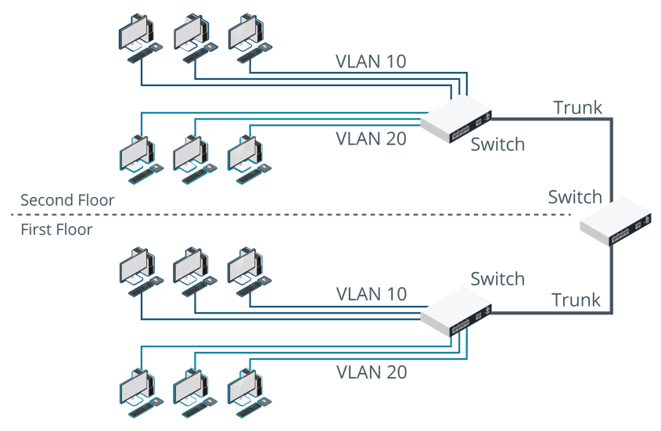
Trunking and IEEE 802.1Q
Trunking bundles physical links into one logical link
Notes:
Suggested Instructional Tips – Trunking and IEEE
On a large network, a single switch will not provide enough ports for all the hosts that need to be connected to the network.
Multiple switches must be interconnected.
The interconnections between switches are referred to as trunks.
One of the ports on each switch would be configured as a trunk port for this purpose.
When frames designated for different VLANs are transported across a trunk, the VLAN ID (VID) of each frame must be preserved for the receiving switch to forward it correctly.
VIDs are normally defined by the IEEE 802.1Q standard.
Image Caption
VLAN trunk link. (Images © 123RF.com.)

Slide 42
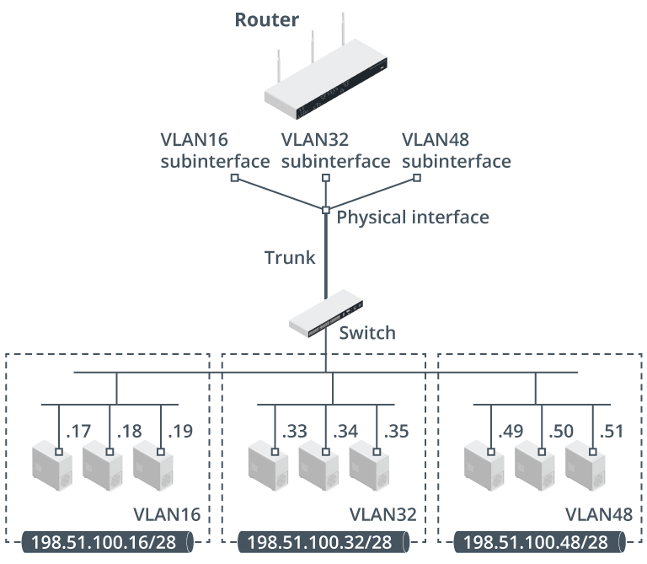
VLAN Routing
One method to route between VLANS with only a switch is to deploy a router with a single interface (a router on a stick) which is connected to a trunk port on the switch
Notes:
Suggested Instructional Tips – VLAN Routing
Point out that switches and VLANs work at layer 2. Traffic cannot be routed between VLANS based on MAC addresses, so it needs to be done at layer 3.
A router on a stick is a router with only a single interface.
This can be connected to a trunk port on the switch.
The trunk port carries all the VLAN-to-VLAN traffic that must be routed.
The router’s physical interface is configured with multiple subinterfaces.
Each subinterface acts as the default gateway for its VLAN/subnet
The router forwards inter-VLAN traffic between the subinterfaces.
Image: Router-on-a-stick topology with subinterfaces serving each VLAN/subnet (Images © 123RF.com.)

Slide 43

Activity: Two Truths and a Lie
Each device in a VLAN is assigned a unique VLAN ID.
Untagged ports are set to receive data without a VLAN identifier.
A Native VLAN receives all untagged frames.
Notes:
Suggested Activity – Two Truths and a Lie
Answer:
Lie: Each device in a VLAN is assigned a unique VLAN ID.
VLAN IDs are assigned to VLANs.
Devices are provided membership to the VLAN.

Slide 44
Lesson 5.7
Routing and VLAN Troubleshooting
Notes:
Exam Objectives Covered
5.3 Given a scenario, troubleshoot common issues with network services.

Slide 45
Routing Table Issues
Verify connectivity
Review routing table entries
Check subnet masks
Examine static and dynamic routes
Use traceroute
Suspect a routing issue if you ping a host’s default
gateway but not some or all hosts on remote network.
Notes:
Suggested Instructional Tips – Routing Table Issues
Basic Steps:
Verify Connectivity: Verify that the device you're troubleshooting is plugged, in, powered on, cabling is secure, and that it can successfully ping devices within its own network and the gateway.
Review Routing Table Entries: Use commands like `route` (Linux) or `netstat -r` (Windows) to display the current routing table. Look for any incorrect or missing routes that might be causing the issue.
Check for Correct Subnet Masks: Incorrect subnet masks in the routing table can lead to misrouted traffic.
Examine Static and Dynamic Routes: Identify if the problem lies with static routes (manually configured) or dynamic routes (learned via routing protocols). If static, ensure they point to the correct next-hop IP addresses. If dynamic, verify that routing protocols are correctly configured and operational.
Use Traceroute: Tools like `traceroute` (Linux) or `tracert` (Windows) can help identify the path traffic takes through the network. This can help you see where it might be getting dropped or misrouted.

Slide 46
Default Route and Routing Loop Issues
Verify host configuration
Ping default gateway
Check router settings
Review physical connections
Identify routing loops
Misconfigured default routes or distributing default
routes to other routers can lead to routing loops.
Notes:
Suggested Instructional Tips – Default Route and Routing Loop Issues
Clarify that a routing loop occurs when two routers use one another as the path to a network.
Verify Host Configuration: Ensure each host's network configuration is correct, especially the default gateway setting. Use commands such as `ipconfig` (Windows) or `ifconfig`/`ip addr` (Linux/Unix) to check the assigned IP address and default gateway.
Ping Default Gateway: Test connectivity to the default gateway through a ping test. If the ping to the default gateway fails, the issue might be local to the host or a physical connectivity problem.
Check Router Settings: Inspect the router's configuration, ensuring that it has a correct and active default route set up. Use router commands like `show ip route` to view the routing table and verify the default route (0.0.0.0/0) is correctly pointing to the next hop towards the intended external network.
Review Physical Connections: Verify all physical connections, including cables and interfaces, are secure and operational.
Identify Routing Loops: If routing loops are suspected, due to misconfiguration or improper propagation of routes, use traceroute or tracert to trace the path packets take. Repeated hops may indicate a loop. If a loop is detected, review and adjust routing configurations and route advertisements.

Slide 47
VLAN Assignment Issues
Devices on a VLAN need a matching IP configuration
(address, subnet mask, gateway, DNS).
Check physical connectivity
Ping the loopback address
Ping the default gateway
Ping a remote host or server
Notes:
Suggested Instructional Tips – VLAN Assignment Issues
Any device connecting to a port in the VLAN must have an appropriate IP configuration for that subnet in terms of IP address, subnet mask, default gateway, and DNS servers.
Check physical connectivity – Verify that the cable from the patch panel is connected to the correct switch port. If there are continuing problems, verify that the patch panel labeling correctly identifies the wall jack that the computer is connected to.
Perform ping tests
Ping the loopback address, then the host's own IP address to verify that TCP/IP is working, and that the host's IP is correctly configured.
Ping the default gateway to verify that it is contactable.
Ping a remote host or server to verify that routing is available.

Slide 48
Summary
Configuring Routing
and Advanced Switching
Notes:
Suggested Instructional Tips
Ask learners to summarize their key takeaways from this module
Conclude by going over main points on the next slide

Slide 49
Main Points
Routing Tables: Routers' internal maps guide data packets to their destinations
Dynamic Routing: Protocols automate routing information exchange between routers
NAT: Translates between private and public IP addresses for internet access
VLANs: Create logical network segments
within a physical network​
Notes:
Reiterate the relevance of each point:​
Information about the location of other IP networks and hosts is stored in the routing table.
Dynamic routing protocols are needed to enable networks to exchange routing information quickly and efficiently.
Network address translation (NAT) is used to manage communications between public and private IP address schemes
A Virtual Local Area Network (VLAN) is a technology that creates separate networks within a single physical network infrastructure.

