Slide 1
Module 7
Explaining Application Services

Slide 2
Module Objectives
Explain the importance of time
synchronization and the role of NTP.
Explain the use of web, file/print,
and database services.
Explain the use of email and voice services.
Explain how high availability services are provisioned using redundancy and load balancing.
Notes:
The learning objectives aligns with the following Exam Objectives for Module 7:
1.2 Compare and contrast networking appliances, applications, and functions.
1.4 Explain common networking ports, protocols, services, and traffic types.
2.1 Explain characteristics of routing technologies.
3.3 Explain disaster recovery (DR) concepts.
3.4 Given a scenario, implement IPv4 and IPv6 network services.

Slide 3
Lesson 7.1
Application Security and Time Synchronization
Notes:
Exam Objectives Covered
1.4 Explain common networking ports, protocols, services, and traffic types.
3.4 Given a scenario, implement IPv4 and IPv6 network services.

Slide 4

Transport Layer Security (TLS)
Encryption
Authentication
Integrity
Encrypts the data
Confirm server identity with certificates
Ensures data
is unchanged
Notes:
Suggested Instructional Tips – Transport Layer Security (TLS)
TLS is like a protective envelope for data sent over the Internet.
Here’s how TLS works in simple terms:
Encryption: Just like sealing your letter in an envelope, TLS encrypts the data to hide it from anyone who might intercept it. This ensures that only the sender and the recipient, who have the “key” to the “envelope”, can access the contents.
Authentication: Before you send your letter, you want to be sure that the person you’re sending it to is who they say they are. TLS uses certificates, which are like digital IDs, to confirm that the server you’re communicating with is legitimate.
Integrity: You also want to make sure that your letter hasn’t been tampered with during transit. TLS includes checks to ensure that the data remains unchanged from when it was sent to when it’s received.

Slide 5


TLS Handshake
Client Hello
Server Hello
Client Key Exchange
Session Key Established
Server Finished
Notes:
Suggested Instructional Tips – TLS Handshake
Client Hello: The client initiates the handshake by sending a “hello” message to the server. This message includes:
Supported TLS version
List of cipher suites
A random byte string called the “client random”
Server Hello: In response, the server sends:
Its SSL certificate
Chosen cipher suite
Another random byte string (“server random”)
Authentication: The client verifies the server’s SSL certificate to authenticate its identity.
Key Exchange: Both sides agree on a pre-master secret for the session using the chosen cipher suite.
Session Keys: Session keys are generated from the pre-master secret and random strings exchanged earlier.
Finished: Both client and server send a “finished” message, encrypted with the session keys, confirming the handshake is complete.

Slide 6
Network Time Protocol (NTP)
Purpose
Operation
Hierarchy
Synchronizes system clocks to Coordinated Universal Time (UTC)
Operates over networks using the UDP protocol on port 123
Organizes devices in a hierarchical manner, indicating distance from the clock
Synchronization
Synchronizes devices by sending timestamped messages to/ from network peers
Algorithms
Uses complex algorithms to account for network delay and jitter
Notes:
Suggested Instructional Tip – Network Time Protocol (NTP)
Explain NTP as the Internet’s “timekeeper”, making sure that all networked devices have the same, precise time. This is important for logging events, security protocols, and scheduling operations.

Slide 7
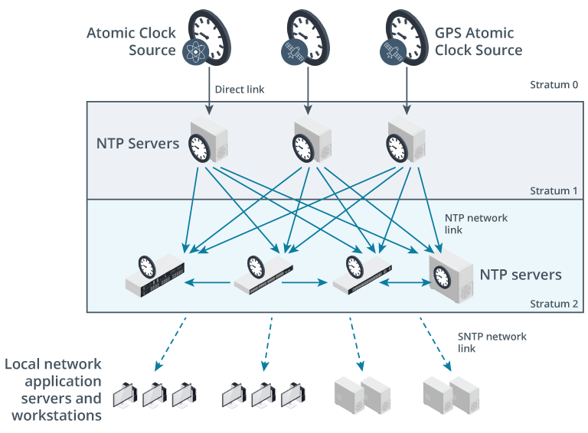
NTP Diagram
Notes:
NTP Diagram
Image Caption
Stratum 1 NTP servers are directly connected to an accurate clock source. Each stratum level below one represents a network hop away from that accurate time source.
Image Description
The illustration shows three atomic clock sources (GPS atomic clock sources) in stratum 0 connected to each NTP server via direct links in stratum 1. Each NTP server is connected to same four NTP servers in stratum 2 via NTP network links. The NTP servers are connected to local network application servers and workstations via SNTP network links.

Slide 8
Precision Time Protocol (PTP)
Applications
Industrial processes
5G cellular data
Medical devices
Financial services
Broadcasting
Clock types
Grandmaster clock
Boundary clock
Ordinary clock
Roles
TimeTransmitter
TimeReceiver
Grandmaster
Boundary
Notes:
Suggested Instructional Tips – Precision Time Protocol
Explain that while NTP can accomplish millisecond precision, PTP is capable of nanosecond precision.
Applications: It’s used in networks for industrial processes, 5G cellular data, medical devices, market trading, financial services, and broadcasting.
Clock Types:
Grandmaster Clock: The main time source in a PTP domain.
Boundary Clock: Has interfaces in multiple PTP segments, acting as a bridge.
Ordinary Clock: A clock with a single PTP interface, typically a time receiver.
Roles:
TimeTransmitter: The role of an interface sending the time.
TimeReceiver: The role of an interface receiving the time.
The grandmaster clock always transmits time
Boundary clocks can both receive and transmit time.

Slide 9
Activity: Fill in the Blank
TLS __________ the data to hide it from anyone who might intercept it.
__________ is used to synchronize clocks to Coordinated Universal Time.
The __________ clock is the main time source in the
PTP domain.
Notes:
Suggested Activity - Fill in the Blank
Answers:
Encrypts
NTP
Grandmaster

Slide 10
Lesson 7.2
Web, File/Print, and Database Services
Notes:
Exam Objectives Covered
1.2 Compare and contrast networking appliances, applications, and functions.
1.4 Explain common networking ports, protocols, services, and traffic types.

Slide 11
Hyper Text Transfer Protocol (HTTP)
Purpose
Foundation
Protocol for fetching resources (HTML documents, images, and videos) from the web
Basis of any data exchange on the web
Notes:
Suggested Instructional Tips – Hyper Text Transfer Protocol (HTTP)
When teaching about HTTP, focus on its role as the foundation of data communication for the web. Use everyday scenarios, like ordering at a restaurant, to explain how HTTP functions as a request-response protocol between clients and servers.

Slide 12



Hyper Text Transfer Protocol (HTTP)
3. Translates URL into HTTP request
5. Interprets request and retrieves requested data files
1. User enters URL
2. URL
4. HTTP Request
User
Browser
Web Server
7. Webpage
5. HTTP Response
8. Displays webpage on user screen
6. Renders data into a webpage
6. Sends status code and webpage data

Slide 13
HTTP Secure (HTTPS)
non-secure
HTTP
HTTPS
Foundational protocol for the Internet
Secure version of HTTP
Does not encrypt data
Uses TLS (SSL) encryption
Uses port 80
Uses port 443
URL begins with http://
URL begins with https://
Notes:
Suggested Instructional Tips – HTTP Secure (HTTPS)
Protocol Definition:
HTTP (Hypertext Transfer Protocol) is the foundational protocol used for transmitting data over the web, particularly from web servers to browsers.
HTTPS (Hypertext Transfer Protocol Secure) is the secure version of HTTP, where communications are encrypted.
Security:
HTTP does not encrypt data, which means information can be intercepted and read by others.
HTTPS uses TLS (SSL) encryption to protect data, making it secure from eavesdroppers and man-in-the-middle attacks.
Port Numbers:
HTTP typically uses port 80 for communication.
HTTPS uses port 443 to handle secure communications.
URL Format:
An HTTP URL begins with http://
An HTTPS URL starts with https://
Use Cases:
HTTP is suitable for browsing websites that do not require data security.
HTTPS is essential for websites that handle sensitive information like e-commerce sites, banking, and any form of login pages.
Performance:
HTTP has less data overhead because it doesn’t involve encryption, potentially leading to faster load times.
HTTPS may introduce a slight performance overhead due to encryption, but modern optimization techniques have minimized this impact.

Slide 14

File Transfer Protocol (FTP) vs. Secure File Transfer Protocol (SFTP)
FTP
Unencrypted data
Uses two channels
Uses ports 20 and 21
SFTP
Encrypted data
Uses one channel
Uses port 22
Notes:
Suggested Instructional Tips – Secure File Transfer Protocol (SFTP)
When teaching about SFTP, emphasize its security features and practical applications. Explain that SFTP uses SSH (Secure Shell) to provide a secure channel, making it ideal for transferring sensitive data like financial or medical records.

Slide 15
Server Message Block Protocol (SMB)
SMB Purpose
SMB Usage
Allows computers in the same ​network to share resources​ like files and printers
Windows
Linux using Samba
Notes:
Suggested Instructional Tips - Server Message Block Protocol (SMB)
When teaching SMB, focus on its role in network file sharing. Explain SMB as the protocol that allows computers within the same network to access files, printers, and other shared resources, much like sharing tools in an office.

Slide 16

SMB Diagram
🖨
Client requests access to SMB shared resource
Client
Server grants or denies access to SMB shared resource
Server

Slide 17
Network Attached Storage (NAS)
NAS Purpose
NAS Components
Provides remote file access
Processor, memory, and hard drives
Bespoke OS, usually Linux
Concurrent resource access for multiple devices
Notes:
Suggested Instructional Tips – Network Attached Storage (NAS)
When teaching about NAS, focus on its convenience and efficiency for centralized data storage. Compare NAS to a library where users can easily store, access, and share a wide variety of books (data) from any device connected to the network.
NAS Purpose
Allows devices to store and access files as if they were on their own system
Multiple devices can access resources concurrently
NAS Components
Includes a processor, memory, and hard drives
Runs on its own OS, usually Linux

Slide 18
NAS Diagram
NAS
Notes:
Suggested Instructional Tips – NAS Diagram
NAS: Think of a NAS as a personal cloud storage device for your home network.
Files: Your digital files are like documents and photos you store in a cloud service like Dropbox or Google Drive.
Multiple Users: Authorized devices on your network can access and share the files on the NAS, similar to how you can share folders with others in a cloud service.
Local Control: Unlike cloud storage, a NAS gives you more control over your data since it's physically located on your network.
Scalability (optional): You can expand the storage capacity of your NAS by adding additional drives, similar to upgrading your storage plan on a cloud service.

Slide 19
RDBMS Database Service
Relational Database
Management Systems
Structured storage (tables store data)
SQL queries to retrieve/update data
Connected tables link data via unique IDs
Encryption via TLS
Notes:
Suggested Instructional Tips – RDMS Database Service
Uses tables with rows and columns to store data
Operates using SQL for tasks like retrieving and updating data
Establishes relationships between tables using unique identifiers
Ports can be secured with TLS encryption

Slide 20
NoSQL Database Service
NoSQL Databases
Stores data in different formats
(key-value pairs/wide columns)
Simple Access through APIs over HTTPS
Scalable Growth (Horizontal scaling)
Supports wide range of data models
Notes:
Suggested Instructional Tips – NoSQL Database Service
When teaching about NoSQL databases, emphasize their flexibility and scalability.
NoSQL Databases
Stores data in formats like key-value pairs or wide columns
Accessed through an API over HTTPS
Designed for horizontal scaling across distributed systems
Supports a wide range of data models

Slide 21
RDBMS vs NoSQL
RDBMS
NoSQL
Requires predefined schema
Vertically scalable
Handles complex queries
Schema-less or
dynamic schemas
Horizontally scalable
Simplicity/speed for specific types of queries
Notes:
Suggested Instructional Tips - RDBMS vs NoSQL
Highlight how NoSQL databases differ from traditional relational databases by allowing for varied data models and accommodating large volumes of unstructured data, making them ideal for big data applications and real-time web apps

Slide 22
Activity: Matching
HTTP
FTP
SMB
NAS
RDBMS
Protocol for web communication
Network protocol for file transfer
Protocol for network file sharing
Storage accessible over a network
System for managing relational databases
Notes:
Suggested Activity - Matching
Answers:
HTTP: Protocol for web communication
FTP: Network protocol for file transfer
SMB: Protocol for network file sharing
NAS: Storage accessible over a network
RDBMS: System for managing relational databases

Slide 23
Lesson 7.3
Email and Voice Services

Slide 24
Simple Mail Transfer Protocol (SMTP)
Purpose
Used to send emails from one server to another
Routes emails from sender’s email client to recipient’s email server
Process
Security
Combinable with TLS to encrypt emails during transmission
Ports
Port 25, port 465 with implicit TLS, port 587 with explicit TLS

Slide 25
Internet Message Access Protocol (IMAP)
Purpose
Access and manage email remotely
Stores emails on server
Function
Connecting to the mail server
Synchronization
Reading emails
Managing emails
Notes:
Suggested Instructional Tips – Internet Message Access Protocol (IMAP)
Purpose
IMAP is an email protocol that allows you to access and manage your email messages stored on a remote mail server.
Unlike downloading messages locally, IMAP keeps your emails on the server, making them accessible from multiple devices.
Function
Connecting to the mail server: When you sign in to your email client (e.g., Gmail, Outlook), it connects to the mail server hosting your email account.
Synchronization: The server sends an updated list of emails (headers, subjects, senders) to your mailbox.
Reading emails: Clicking on an email requests the server to deliver its full content (including attachments) for display.
Managing emails: IMAP allows actions like deleting, moving, and flagging messages, ensuring synchronization across all devices.

Slide 26

SMTP and IMAP Diagram
Sender
Receiver
Internet
SMTP
IMAP
SMTP
Sender’s
Email Server
Receiver’s Email Server
Notes:
Suggested Instructional Tips – SMTP and IMAP Diagram
User composes an email and sends it through their email client (Outlook, Gmail etc.).
The email client connects to the sender's email server (port 587).
The sender's server transmits the email content and recipient information to the recipient's server using SMTP (often on port 25).
IMAP allows users to access and manage emails stored on the email server.

Slide 27
Voice and Video Services
VOIP
Combines PBX functions with VoIP
PBX
VoIP-Enabled PBX
Transmits voice calls over IP networks
Supports voice, video, and multimedia sessions
Private Branch Exchange
Supports various devices
Manages incoming/ outgoing calls, voicemail, and call forwarding
Connects internal phone lines within an organization
Operates over LAN or WAN
Reduces reliance on physical infrastructure
Notes:
Suggested Instructional Tips – Voice and Video Services
PBX is not an exam content example, but you will need to introduce the term to discuss telephony and gateways.
VoIP is the underlying technology that allows voice calls to be transmitted over the internet.
PBX is a traditional phone system managing calls within an organization, often using dedicated phone lines.
VoIP-Enabled PBX combines VoIP and PBX functionalities, offering internet-based call management with features like call forwarding, voicemail, and potentially more.

Slide 28
VoIP Protocols
Real-Time Protocol
Real-Time Transport Control Protocol (TRCP)
Session Initiation
Protocol (SIP)
Transports audio/video over the Internet in real time
Uses even numbered UDP ports for streaming media
Focuses on the delivery of data
Provides out-of-band statistics and control information for an RTP session
Uses the next higher odd-numbered port from RTP port
Offers feedback on packet delivery, loss, and jitter
Initiates, maintains, and terminates real-time communication sessions
Uses TCP/UDP ports 5060 (non-encrypted) and 5061 (TLS-encrypted)
Manages call setup and teardown, user location, and messaging.
Notes:
Suggested Instructional Tips – VoIP Protocols
These protocols work together in VoIP and other real-time communication systems to deliver and manage multimedia over the internet. RTP and RTCP focus on the transport and quality control of media streams, while SIP handles the overall session management.
Emphasize the different requirements of real-time data applications compared to "bursty" data applications, and the basic function of SIP and RTP. Mention that many of these protocols use UDP for transport, rather than TCP, to reduce overhead.

Slide 29
Activity: Trivia
Which protocol allows you to access and manage emails remotely?
Which protocol is used to send emails from one server to another?
Notes:
Suggested Activity – Trivia
IMAP (Internet Message Access Protocol)
SMTP (Simple Mail Transfer Protocol)

Slide 30
Lesson 7.4
Disaster Recovery and High Availability

Slide 31
Disaster Recovery Concepts
Disaster Recovery Plan (BRP)
Tabletop Exercises
Validation Tests
Business Continuity Plan (BCP)
Guidelines and procedures
Preparation and prevention
Simulation
Constrictive learning
Functional testing
Scenario testing
Full-scale testing
BCP team
Business impact analysis (BIA)
Crisis communication plan
Notes:
Suggested Instructional Tips – Disaster Recovery Concepts
Disaster Recovery Plan (DRP):
Guidelines and Procedures: A DRP provides a structured approach to resume operations after an incident, focusing on data and critical system availability.
Preparation and Prevention: It includes risk analysis, data backups, and contingency planning to minimize damage and recover quickly.
Tabletop Exercises:
Simulation: These are discussion-based sessions where teams role-play through disaster scenarios to evaluate response plans.
Constructive Learning: The exercises are designed to identify gaps in plans and improve emergency response in a low-stress environment.
Validation Tests:
Purpose: Validation tests ensure that disaster recovery and business continuity plans are effective and reliable.
Types:
Functional Testing: Verifies that individual components (e.g., servers, backups) work as expected.
Scenario Testing: Simulates specific disaster scenarios (e.g., fire, cyberattack) to assess the plan’s response.
Full-Scale Testing: Comprehensive end-to-end testing involving all stakeholders.
Importance: Identifies weaknesses, validates procedures, and builds confidence in the plan.
Business Continuity Plan: A BCP outlines procedures to maintain essential functions during disruptions (e.g., natural disasters, cyber incidents).
Components:
BCP Team: Responsible for planning and testing continuity strategies.
Business Impact Analysis (BIA): Identifies risks and potential disruptions.
Crisis Communication Plan: Ensures effective communication during crises.
Importance: Protects reputation, minimizes financial losses, and empowers employees to handle disruptions.

Slide 32
Disaster Recovery Metrics
High availability (HA)
Maximum tolerable downtime (MTD)
Recovery time
objective (RTO)
Work recovery
time (WRT)
Recovery point
objective (RPO)
Ensures consistent system uptime
Longest disruption without severe impact
Time to restore services after disruption
Time to confirm system/data integrity post-recovery
Maximum acceptable loss after an event
Notes:
Suggested Instructional Tips – Disaster Recovery Metrics
Note that RTO and RPO are objectives, not measures of elapsed time. If there is an outage, these objectives set an upper limit on the time you have to restore a system or the minimum frequency with which secure backups need to be made.
Recovery Point Objective (RPO) is how much data can be lost, measured over time. For example if a server and it's data crashes on Thursday, and the RPO is 48 hours, that means the company is OK with loosing 2 days of data, but no more.

Slide 33
Disaster Recovery Sites
Cold Site
Warm Site
Hot Site
Notes:
Suggested Instructional Tips – Disaster Recovery Sites
Cold site: No equipment is set up, data is not present, staff is not present. Failover time is slow.
Warm site: Equipment is set up, some data may be present (but not current), some staff may be present. Failover time is quick but not immediate.
Hot site: All equipment and data are available, and a qualified staff is present on location. Failover is immediate.

Slide 34
Fault Tolerance and Redundancy
Fault Tolerance
Redundancy
Maintains operation despite component failure
Operates at reduced capacity instead of shutting down
Uses replication, error checking, and failover
Duplicates key components for higher reliability
Offers backup paths/capacity for failed components
Prevents system collapse from any single failure
Notes:
Suggested Instructional Tips – Fault Tolerance and Redundancy
Fault tolerance prevents downtime during failures.
Redundancy provides a way to recover after a complete system outage.
Suggested Analogy
Think of fault tolerance as a car with two spare tires. Even if one tire gets a flat, the car can keep running on the spares.
Redundancy is like having a second car parked nearby. If your primary car breaks down completely, you can still get where you need to go with the backup car.

Slide 35
Key Performance Indicators (KPIs)
Mean time between failures (MTBF)
Average time between system failure
Total operational time divided by # of failures
Mean time to failure (MTTF)
Expected lifespan before a non-repairable
system fails
Total operational time until failure divided by # of units
Mean time to
repair (MTTR)
Average time to fix and restore a failed system
Total time spent on repairs divided by the number of repairs
Notes:
Suggested Instructional Tips – Key Performance Indicators (KPIs)
Metrics for System Reliability:
MTBF (Mean Time Between Failures): This metric represents the average time a system operates without failure. A higher MTBF indicates a more reliable system with fewer breakdowns.
MTTF (Mean Time To Failure): Similar to MTBF, MTTF signifies the average lifespan of a component or system before it fails for the first time. It's often used for non-repairable items like lightbulbs.
MTTR (Mean Time To Repair): This metric focuses on how long it typically takes to repair a failed system and restore functionality. A lower MTTR indicates a faster recovery time and minimizes downtime.
Key Differences:
Focus: MTBF and MTTF look at the time before failures, while MTTR deals with the time after a failure to get the system back up.
Application: MTBF is generally used for repairable systems, while MTTF is often used for non-repairable ones.

Slide 36
Load Balancers
Purpose
Types
Distributes network traffic across multiple servers
Improves application performance
and reliability
Functionality
Acts as a “traffic cop” to route client requests
Ensures no single server is overworked
Benefits
Reduces downtime and increases scalability
Provides redundancy/
efficiency in handling requests
Can be hardware-based or software-based
Uses various algorithms like Round Robin, Least Connections, etc.
Notes:
Suggested Instructional Tips – Load Balancers
Ensure students understand the uses and placement of load balancers.
Load Balancers: Traffic Directors for Your Network
Function: Distribute incoming network traffic (requests) across multiple servers in a network. This prevents any single server from becoming overloaded and ensures smooth performance for users.
Benefits:
Improved Scalability: Easily handle increased traffic by distributing it across multiple servers.
Enhanced Availability: If one server fails, the load balancer redirects traffic to functioning servers, minimizing downtime.
Increased Performance: Users experience faster response times due to efficient traffic distribution.
Types:
Hardware Load Balancers: Dedicated physical devices specifically designed for high-performance traffic management.
Software Load Balancers: Software programs installed on existing servers, offering a more cost-effective solution for moderate traffic loads.
Considerations:
Load Balancing Algorithm: Different algorithms exist (e.g., round robin, least connections) to determine how traffic is distributed among servers.
Session Management: Certain applications require maintaining user sessions on a specific server. Load balancers with session persistence ensure users stay connected to the same server during their session.
Analogy: Think of a load balancer as a traffic director at a busy intersection. It receives client requests and routes them to available servers.

Slide 37
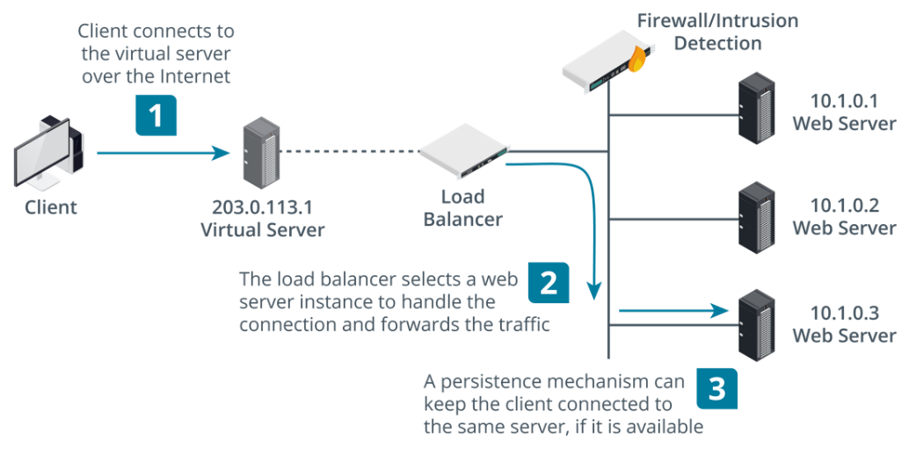
Load Balancer Diagram
Notes:
Suggested Instructional Tips – Load Balancer Diagram
Ensure students understand the uses and placement of load balancers.
Image Description
Client connects to the virtual server over the Internet.
The load balancer selects a web server instance to handle the connection and forwards the traffic.
A persistence mechanism can keep the client connected to the same server, if it is available.
Image Caption
Topology of basic load balancing architecture. (Images © 123RF.com.)

Slide 38
High Availability Clusters
High Availability Clusters Function
Ensure continuous service/minimal downtime
for critical applications
Automatically manage failovers to maintain operations
Monitor system health and provide redundancy
Ideal where uptime is crucial (e.g., databases, business services)
High Availability Clusters Definition
Systems that ensure continuous operation and minimize downtime via redundant components and failover mechanisms
Notes:
Suggested Instructional Tips – High Availability Clusters
Where basic load balancing just directs traffic between nodes, failover clusters share information so that if one node fails, another can take over.
High Availability Clusters Definition
Systems that ensure continuous operational performance and minimize downtime via redundant components and failover mechanisms
High Availability Clusters Function
Ensure continuous service and minimal downtime for critical applications
Automatically manage failovers to maintain operations.
Monitor system health and provide redundancy
Ideal for environments where uptime is crucial, like databases and business services

Slide 39
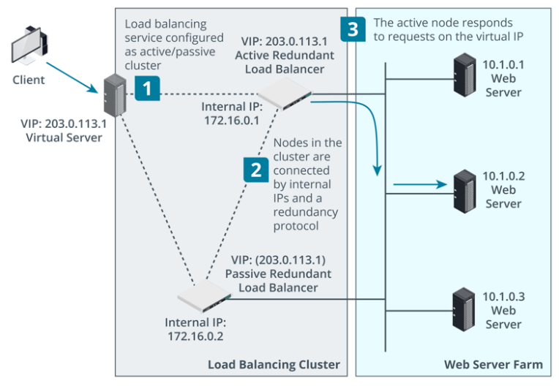
High Availability Clusters Diagram
Notes:
Image Description
Load balancing service configured as active or passive cluster.
Nodes in the cluster are connected by internal IPs and a redundancy protocol.
The active nodes responds to requests on the virtual IP.
Image Caption
Topology of clustered load balancing architecture. (Images © 123RF.com.)

Slide 40
First Hop Redundancy
Functions
Multiple routers prevent single points of failure
Quick failover with protocols like HSRP/VRRP
Maintains network access and reliability
Ensures uninterrupted gateway availability
First Hop Redundancy Definition
Ensures uninterrupted network service by automatically switching to a backup gateway if the primary one fails
Notes:
Suggested Instructional Tips – First Hop Redundancy
Always on the Right Path: First Hop Redundancy
Function: Ensures uninterrupted network access by providing a backup for the default gateway (router) on a subnet.
How it Works:
Uses a virtual IP (VIP) and virtual MAC address shared by multiple routers.
One router acts as the active gateway, forwarding traffic.
Standby routers monitor the active one.
If the active gateway fails, a standby router seamlessly takes over-using the VIP and MAC, minimizing downtime for connected devices.
Benefits:
High Availability: Prevents network disruptions caused by a single router failure.
Improved Fault Tolerance: The network remains operational even if the primary gateway goes down.
Transparent Failover: Devices automatically connect to the available router without needing manual intervention.
Analogy: Think of FHR as having a designated backup driver on a road trip. If the main driver gets tired or encounters an issue, the backup driver can take the wheel seamlessly, ensuring you reach your destination without delay.

Slide 41
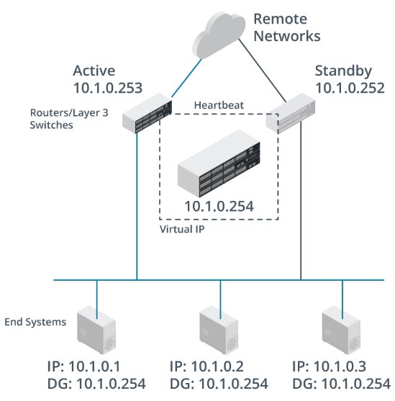
First Hop Redundancy Diagram
Notes:
Image Description - First Hop Redundancy
The diagram shows remote networks connected to two routers or layer 3 switches labeled active 10.1.0.253 and standby 10.1.0.252.
The two switches are connected via a dashed line labeled heartbeat.
The switches are connected to a router or layer 3 switch labeled virtual IP 10.1.0.254.
The first two routers or layer 3 switches are connected to 3 end systems.
First end system: IP: 10.1.0.1; DG: 10.1.0.254.
Second end system: IP: 10.1.0.2; DG: 10.1.0.254.
Third end system: IP: 10.1.0.3. DG: 10.1.0.254.
Image Caption
Hot Standby Router Protocol (HSRP) topology. (Image © 123RF.com.)

Slide 42
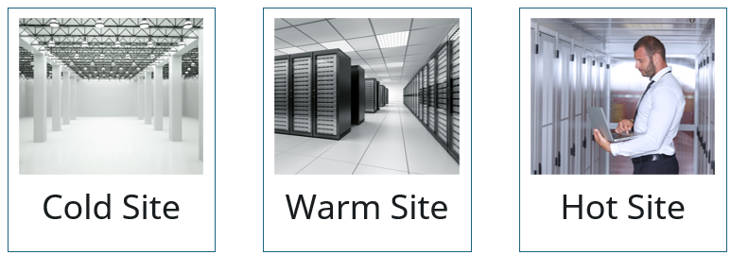
Activity: Hot, Warm, or Cold?
A financial services company that processes high-volume transactions cannot afford more than a few minutes of downtime. Any downtime can result in significant financial loss and erosion of customer confidence.
Which type of recovery site would be best for their situation?
Notes:
Suggested Activity – Hot, Warm, or Cold?
Scenario Expansion:
The company operates in a competitive market where even a few minutes of downtime can lead to customers switching to competitors. They handle sensitive financial data requiring strict compliance with regulatory standards, making data integrity and security paramount. The IT infrastructure is complex, with interdependent systems that need to be fully synchronized for operations.
Solution
**Hot site**
A hot site is the optimal choice because it offers a near-instantaneous transition with minimal service interruption.
It mirrors the primary site with real-time data replication, ensuring that all transactions are up-to-date.
The hot site is fully equipped with the necessary hardware and software, making it ready to take over immediately in the event of a disaster.
Cold site:
A cold site would be too slow to bring online, risking significant financial and reputational damage.
Warm site:
A warm site might be quicker to activate but could still lead to unacceptable delays in restoring full service.

Slide 43
Summary
Explaining Application Services
Notes:
Suggested Instructional Tips
Ask learners to summarize their key takeaways from this module
Conclude by going over main points on the next slide

Slide 44
Main Points
HTTPS everywhere: Implement HTTPS (TLS/443) on web servers for secure communication
Secure file transfer: Utilize secure protocols like SFTP/FTPS (SSL/TLS) for file transfers
Limit unencrypted sharing: Restrict unencrypted services (SMB) to trusted internal networks
Plan for disruptions: Develop DR/HA plans with dedicated resources for business continuity
Notes:
Reiterate the relevance of each point:​
Configure web servers with a valid certificate to enable HTTPS over TCP/443.
Enable secure FTP on web servers, file servers, and appliances as a means of transferring files securely. FTP can be secured using SSL or TLS.
Ensure unencrypted local file and printer sharing services such as SMB are used only on trusted local networks.
Develop disaster recovery and high availability plans and provision supporting resources.

