Slide 1
HOTEL DATABASE MANAGMET SYSTEM
Name: Falastin Bawaqna.
Department: Computer Engineering .
Course:Intr. to Database Management Systems.
Instructor: Dr. Ayşe Yasemin Seydim.

Slide 2
Specifications
a Hotel has:HotelID,name, address, phone,email,stars.
a Room has: RoomNumber,HotelID,RoomType,status.
a Guest has : GuestID,Fname,Lname, Address, Phone, Email.
a Booking has:BookingID,GuestID, check-in date, check-out date.
A BookingRoom has: BookingID,RoomNumber,HotelID

Slide 3
Specifications
a RoomType has: RoomType,PricePerNight,capacity.
A staff has :staffID,HotelID,Fname,Lname,salary,phone,position,HireDate.
Hourly_staff has :staffID, hourly_wages, hours_worked.
A Contract_staff has:staffID, contract File.
a payment has :paymentID , BookingID,Price,Date, Method.

Slide 4
Schema
Entities:
Hotel(HotelID,name, address, phone,email,stars)
Room:(RoomNumber,HotelID,RoomType,status)
Guest(GuestID,Fname,Lname, Address, Phone, Email)
Booking(BookingID,GuestID, check-in date, check-out date)
BookingRoom (BookingID,RoomNumber,HotelID )

Slide 5
Schema
Entities:
RoomType(: RoomType,PricePerNight,capacity)
Payment(:paymentID , BookingID,Price,Date, Method)
Staff(staffID,HotelID,Fname,Lname,salary,phone,position,StartDate)
Hourly_staff(staffID, hourly_wages, hours_worked)
Contract_staff(staffID, contract File)

Slide 6
Relationships:
(Hotel-Room)A Hotel can have more than one room (1-M).(room in Hotel is weak-entity set)
(Guest-Booking)A guest can make more than one bookings and each booking linked to just one guest(1-M).
(Booking-Room)The single booking can include more than one room and every room can be booked from multiple booking(M-M).
(RoomType-Room)Every room has just one room type and the same room type can be for more than one room(1-M).
(Hotel-Staff)The Hotel has many staffs and every employee works in one hotel(1-M).
(Booking-Payment)The single booking can have many payment transactions and every transaction related just to single booking(1-M).
(Staff-Staff)a staff can be either Hourly_Emps or Contract_Emps (is a- hierarchy)

Slide 7
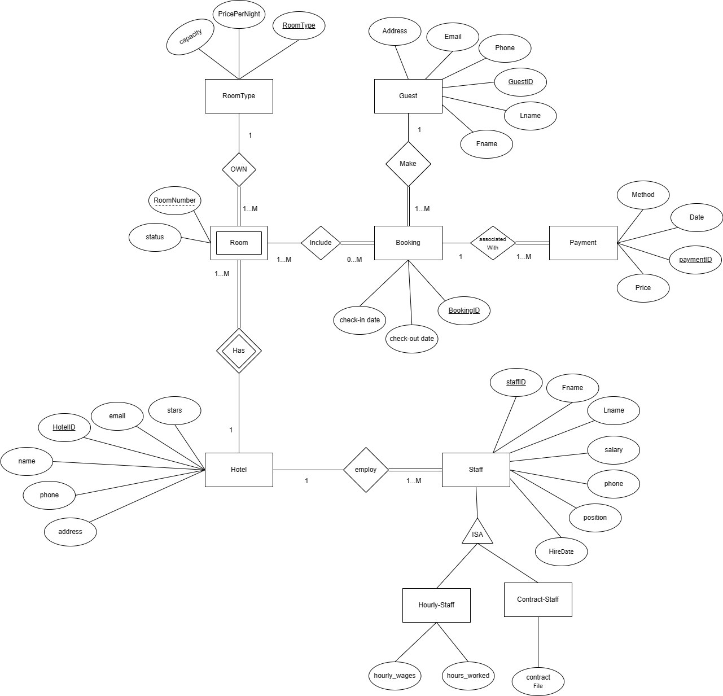

Slide 8
Normalization
1NF applied on all the relations for example :
The Payment relation is the result of apply the 1NF on Booking-Payment relationship because if there is no payment relation the booking relation will contain multiple values for payment column.

Slide 9
Normalization
2NF applied on all the relations for example :
Before applying the 2NF the Room relation had a hotelName field and this filed partial dependent on the primary key (HotelID), as a result hotel relation constructed with hotelID , hotel Name fields and etc.
- Every non prime key full dependent on the primary key.

Slide 10
Normalization
3NF applied on all the relations.
- There is no non prime key depends on another non prime key (no non prime key depends transitivly on the primary key).

Slide 11
Teşekkürler!

