Slide 1
Clickbait nudges social media away from accuracy and toward partisan bias
Fletcher Scott, Dr. Damiano Spina, Dr. Lauren Saling
Notes:
MUST TAKE 15 minutes

Slide 2
Definitely false
Definitely true
Notes:
MUST TAKE 15 minutes

Slide 3
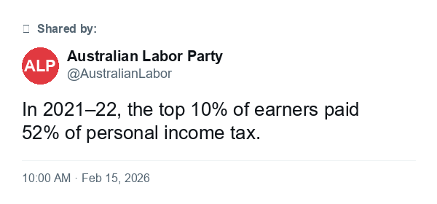
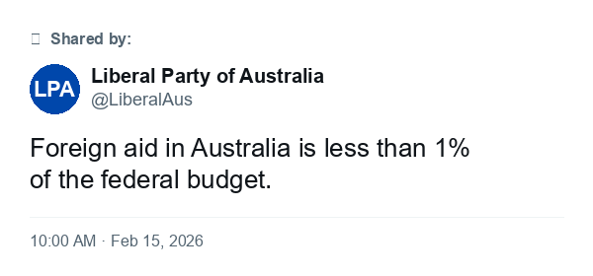
Definitely false
Definitely true
Notes:
MUST TAKE 15 minutes

Slide 4
Definitely false
Definitely true
Notes:
MUST TAKE 15 minutes

Slide 5
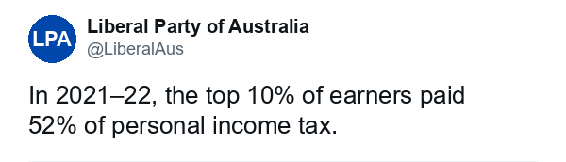
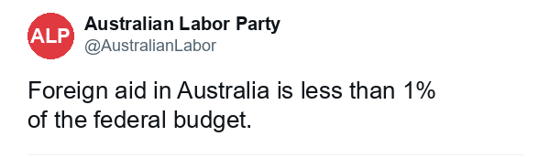
Definitely false
Definitely true
Notes:
MUST TAKE 15 minutes

Slide 6
Stable values → Different reference point → Different truth ratings
Reference-dependence: Even when accuracy and identity values are stable, people’s truth ratings vary relative to some comparison class activated during judgement.
Ground truth (unknown to judge)
 | True | False
Congruent | Easy to accept | Costly to reject
Incongruent | Costly to accept | Easy to reject
Political congruence (to judge)
Notes:
Can we capture these dimensions?

Slide 7
What selects the active reference for evaluating a claim?
Accuracy-salient context
Identity-salient context
Active reference guides thought
Active reference guides thought
What does‘<1%’ typically mean in budgets?
Thought
Thought
Do I trust this party?
Is there an official stat I’ve seen before?
Thought
Thought
Is this cherry-picked?
Judge claim: true / false
Judge claim: true / false
True
False
True
False

Slide 8
Format cues → Shifts the value of thinking → Selects the active reference
Neutral framing
Accuracy as an active reference
Clickbait framing
Partisanship as an active reference
U.S. inflation hit 8.6% in May 2022
WHAT THEY WON’T TELL YOU: U.S. INFLATION HITS 8.6%
Thinking time/effort
Sample the reference where payoff is highest
This is called the Expected Marginal Value of Precision (EVP)
Commit* to a truth rating
Payoff (expected value)

Slide 9

Study design: 2 x 2 x 2 truth-judgement task
Between-subjects
Headline format
Within-subjects
Headline type
Outcome
Truth rating
Neutral
 | True | False
Congruent | 16 headlines | 16 headlines
Incongruent | 16 headlines | 16 headlines
Response:
TRUE / FALSE
U.S. inflation hit 8.6% in May 2022
Signatures:
Accuracy & Reaction Time
Clickbait
WHAT THEY WON’T TELL YOU: U.S. INFLATION HITS 8.6%
Participants
Analysis
Mixed-effects models / Hierarchical DDM
N =
82 U.S. partisans (Democrat/Republican)
Accuracy / Reaction time
Decision-process
Trial-level binomial mixed model
Key test: Style $×$ Congruence $×$ Truth
Random intercepts: participant, headline
Does format change drift vs bias vs response caution?
Model comparison via LOO-CV
Random assignment:
41 per condition

Slide 10
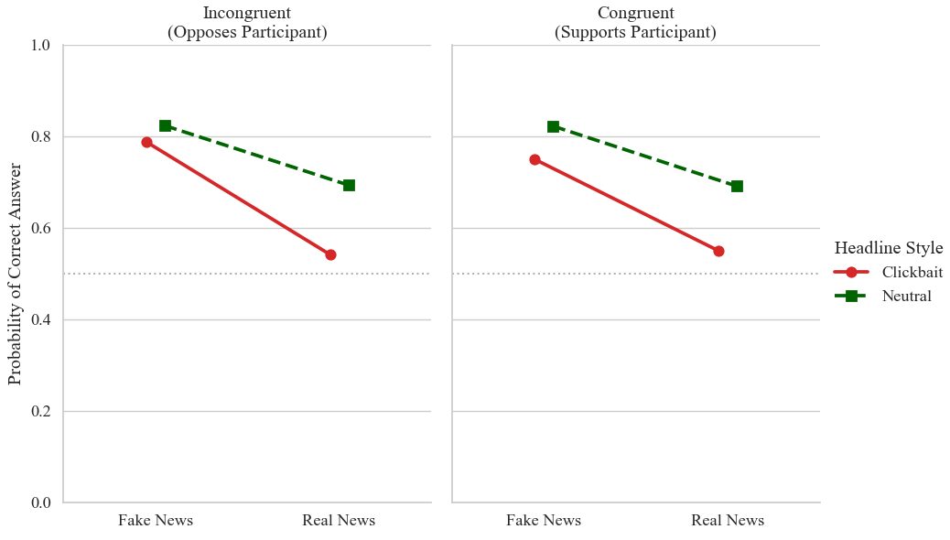
Accuracy result: Clickbait reduces accuracy and shifts truth-judgements towards congruence
Incongruent
(opposes judge)
Congruent
(supports judge)
1.0
0.9
0.6
Clickbait
Neutral
0.4
Random chance
0.2
0.0
False headlines
True headlines
False headlines
True headlines
Mixed-effects model: Predicted probability of correct classification

Slide 11
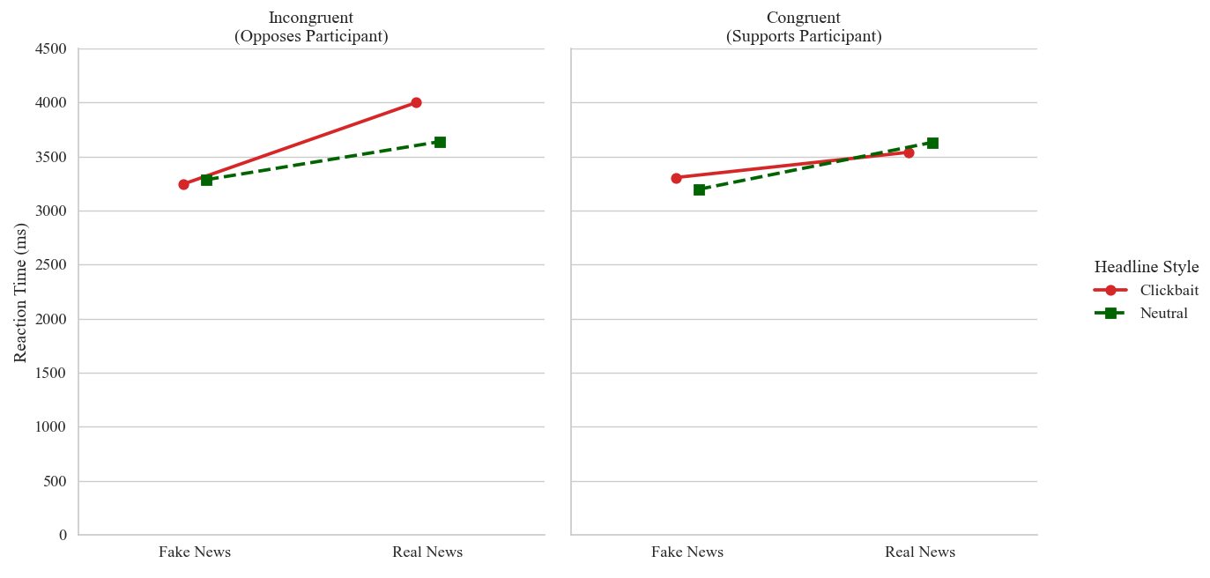
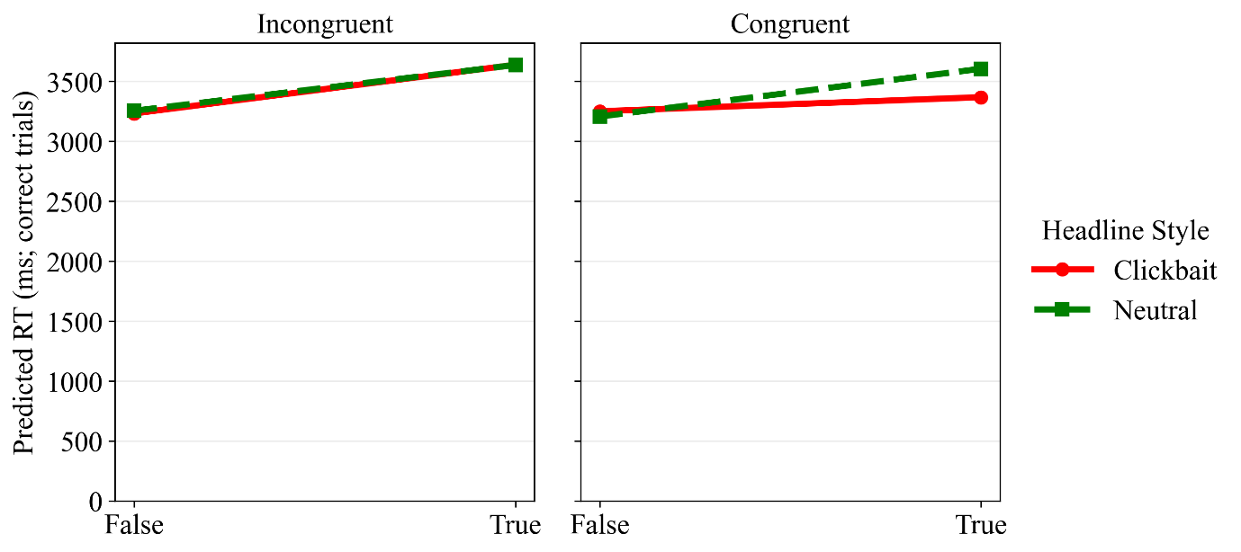
Correct-trial RTs: True endorsements are slower, but congruences reduces this
Incongruent
(opposes judge)
Congruent
(supports judge)
4000
3000
Clickbait
Neutral
2000
1000
0
False headlines
True headlines
False headlines
True headlines
Linear mixed model on log-RT: Predicted reaction times (ms) for correct classifications

Slide 12
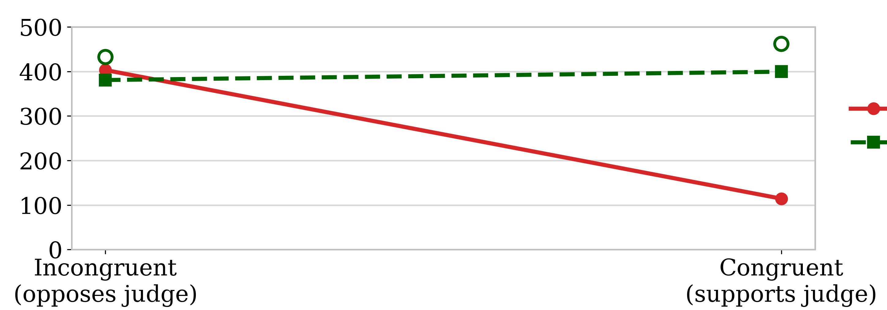
Correct-trial RTs: $Truth cost=RT(True, correct)−RT(False, correct)$
Incongruent
(opposes judge)
Congruent
(supports judge)
4000
3000
Clickbait
Neutral
Linear mixed model on log-RT: Predicted reaction times (ms) for correct classifications

Slide 13
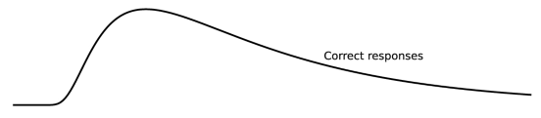




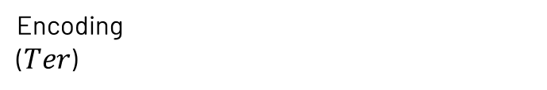
Hierarchical response-coded DDM: 5235 trials
Accept as true
Encoding
($Ter$)
Drift ($v$)
Time ($ms$)
Starting point ($z$)
Reject as false

Slide 14
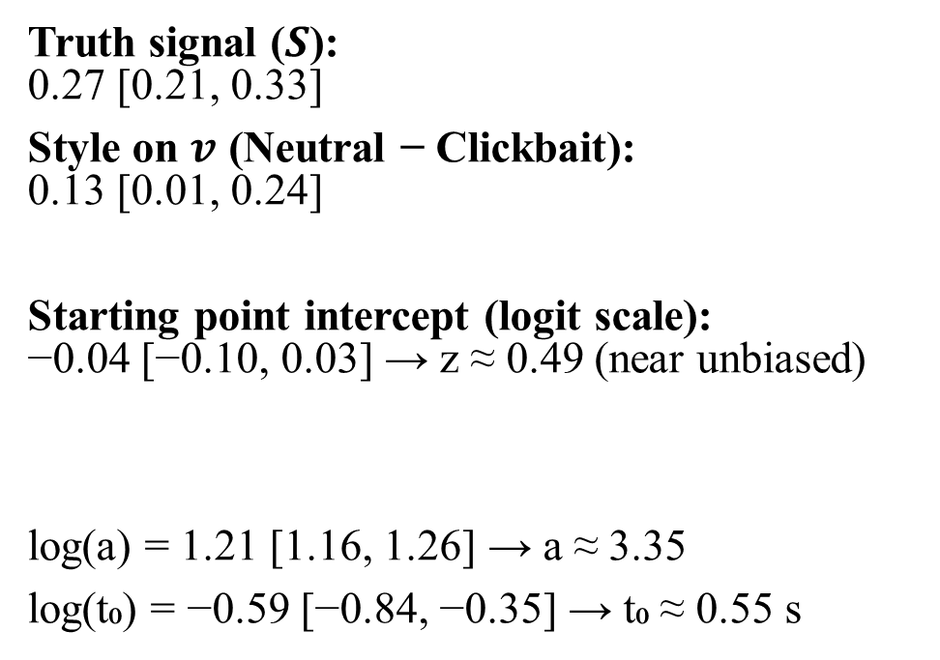


Hierarchical response-coded DDM: 5235 trials
Accept a true headline
Key estimates
Truth signal ($S$): 0.27 [0.21, 0.33]
Style on $v$ (Neutral − Clickbait): 0.13 [0.01, 0.24]
Starting point intercept (logit scale): −0.04 [−0.10, 0.03] → z ≈ 0.49 (near unbiased)
log(a) = 1.21 [1.16, 1.26] → a ≈ 3.35
log(t₀) = −0.59 [−0.84, −0.35] → t₀ ≈ 0.55 s
Encoding
($Ter$)
Drift ($v$) $=S∙v^{∗}$
$$S: +1 True, −1 False$$
Time ($ms$)
Starting point ($z$)
Reject a false headline

Slide 15
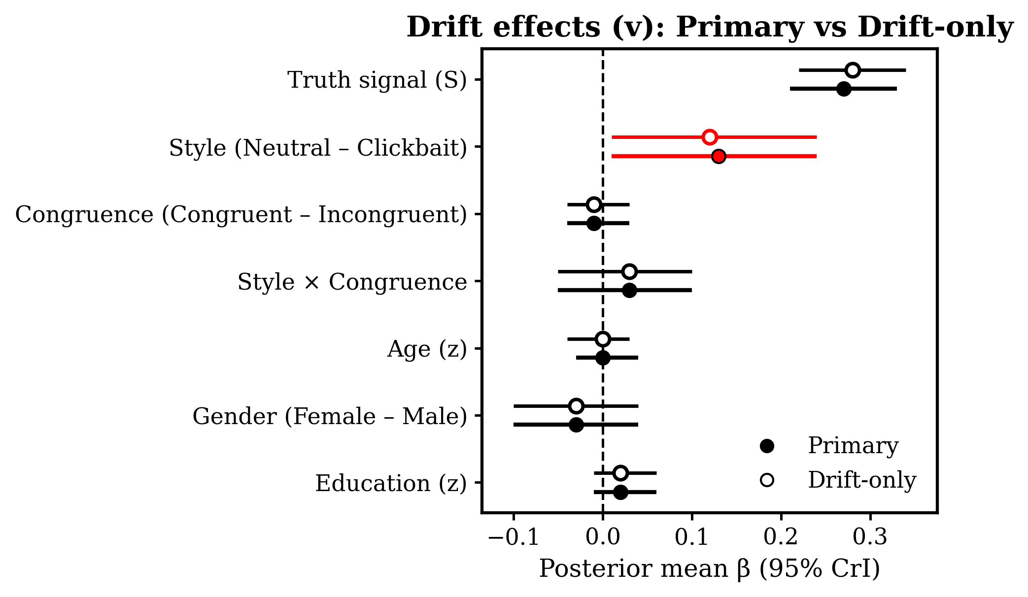
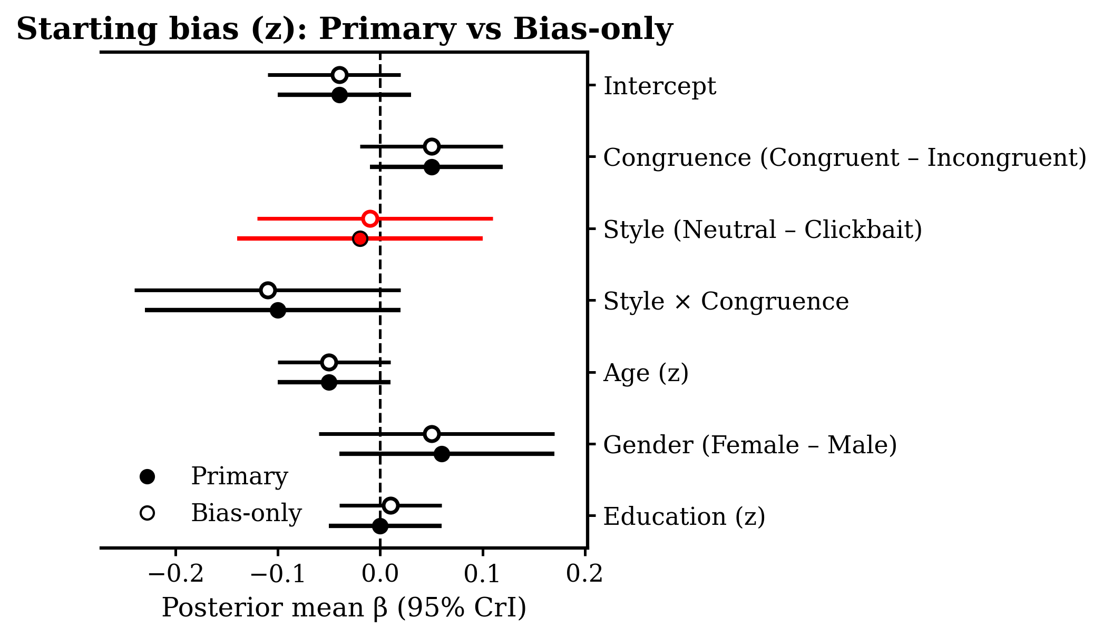
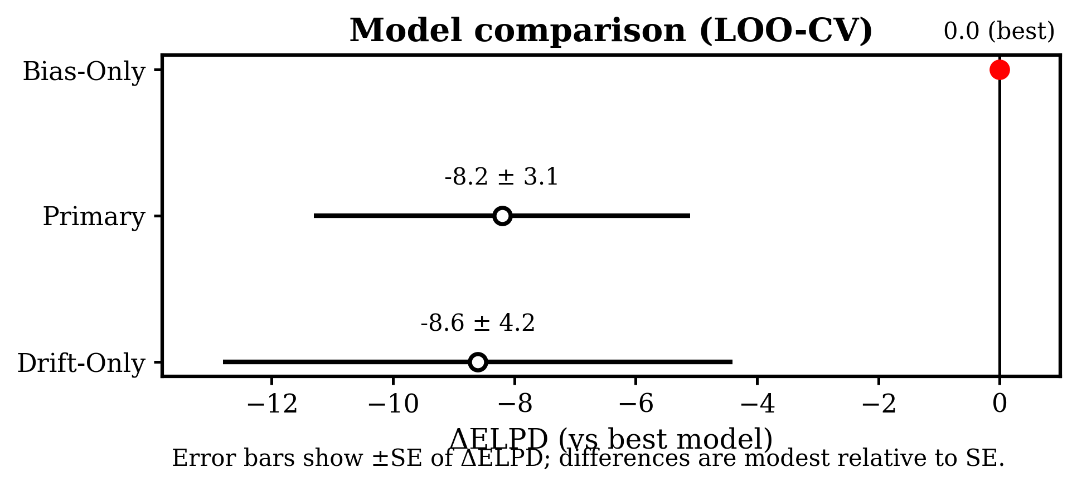
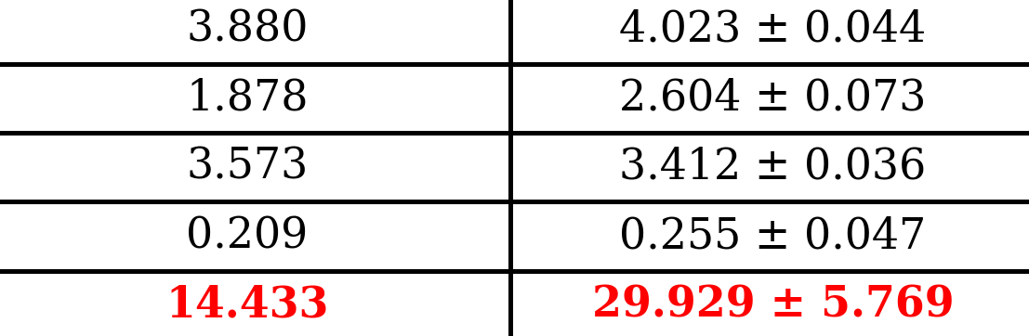

Hierarchical response-coded DDM: Headline style mostly changes the quality of evidence people draw on.
Observed
Predicted (mean $±$ SD)
Model comparison (LOO-CV)
Mean RT
SD RT
Median RT
Min RT
Max RT

