Slide 1
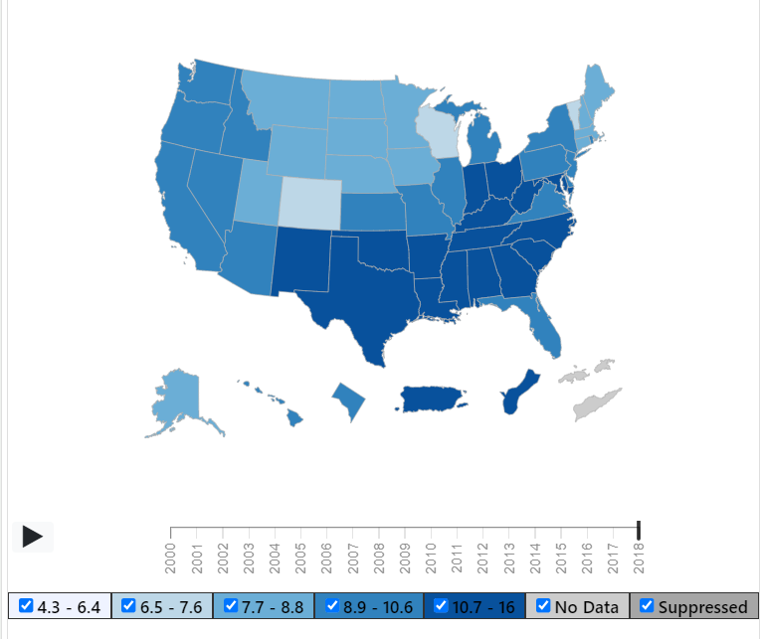
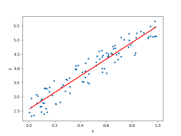
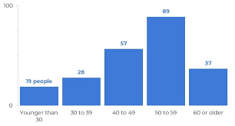
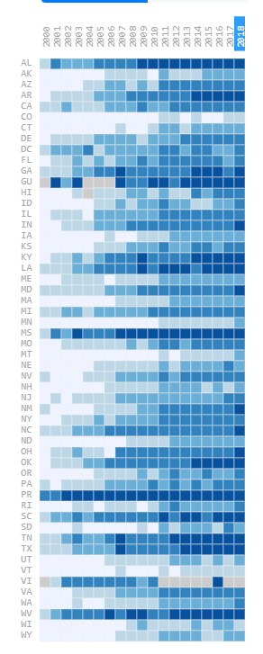
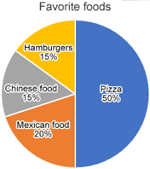
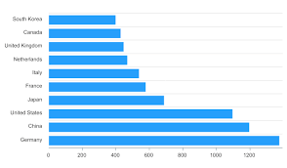
Diabetes vs. Fast-Food
Number of fast food restaurants in the united states: 196,839
National Number of Diabetes Cases: 34.2 MILLI9ON
Number of Observations in our sample: ~10,000
- Linear regression plot of fast food restaurants per state vs diabetes CASES PER STATE
- Vertical restaurant showing top 10 fast food restaurants
One map showing the states with the most cases of diabetes
Heat map showing the states that have the most fast food restaurants from sample
- Pie chart showing the different restaurants and their amounts in the U.S.
- Horizontal bar chart showing WHICH STATES HAVE THE HIGHEST NUMBER OF FAST FOOD RESTAURANTS

