Slide 1
Clickjacking & Prevention techniques
By Matt Langlois

Slide 2




whoami
&
@

Slide 3
Outline
Clickjacking
Definition
Exploitation Techniques
Preventing Clickjacking
Server side: The headers
Client Side: The framebusters
Demonstration

Slide 4
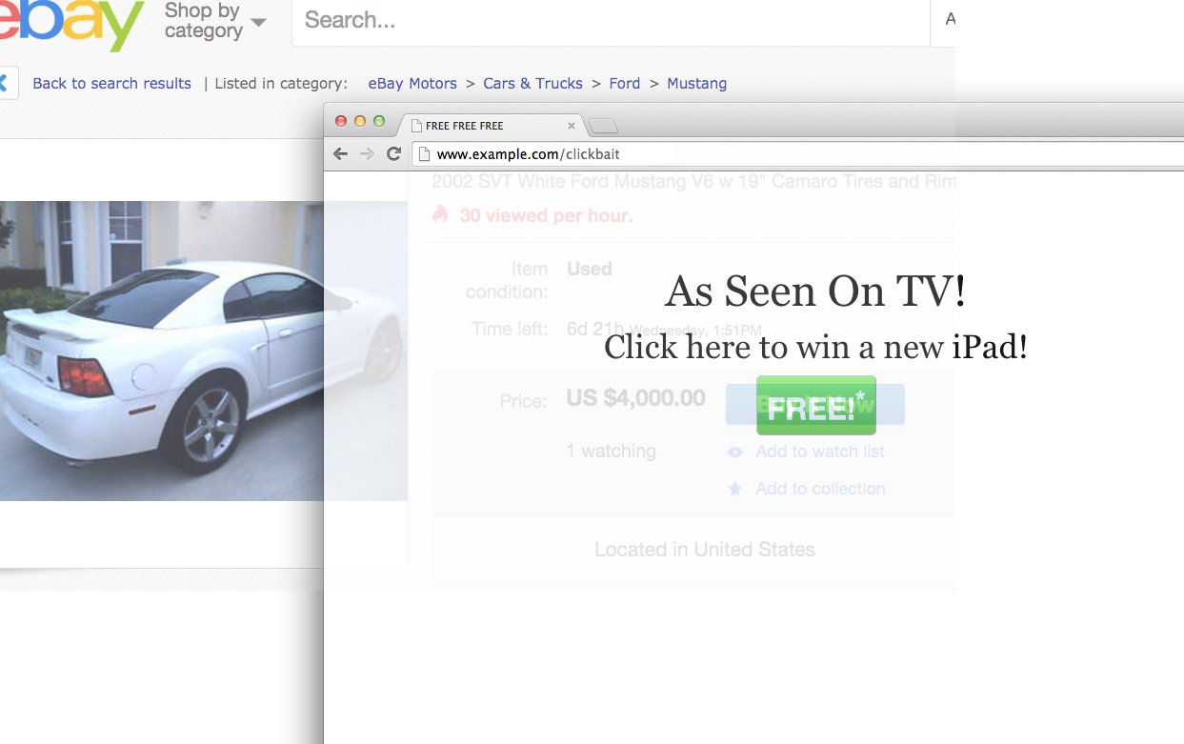
Clickjacking: What is it?
A UI “redress”
Tricking users into clicking something unintentionally
Typically abuses websites which you have a session on

Slide 5
Exploitation
At its core to clickjack the user must be persuaded to click something they didn’t intend to press
Multiple types:
Likejacking (most common) – Abusing a user’s session to gain likes/followers/retweets
Cursor jacking – Making the cursor appear a location, even though it is elsewhere
Password manager jacking – Tricking a password manager to reveal your password to the attacker (this actually happened with lastpass)

Slide 6
Prevent your site from being a target
The “X-Frame-Options” header to whitelist or deny framing
Prevents your website from being loaded into an iframe/frame
Supported in all major browsers for quite some time now (ie8 era)
Never “official” now deprecated in favor for CSP – however still reliable
“Content-Security-Policy” header
Frame-ancestors option to whitelist specific URI’s which can load your site into a frame
The XFO header takes priority
MUST BE AN HTTP RESPONSE HEADER, not a <meta> tag!
But I need to develop for < IE8! Oh you poor soul…

Slide 7
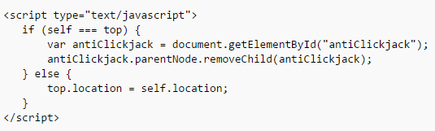
Legacy: Frame busting
For those of who must develop for out of date browsers:

Slide 8
I can’t just prevent framing, my site is famous!
Window.confirm() is your friend OR
Validate the user’s action outside of the current window
Don’t rely on just JavaScript to perform framebusting!

Slide 9
I can haz ur likes
Demo of a facebook vulnerability I found while building this talk… The issue has been reported to facebook by me and I have permission to demo this
Please let me steal your facebook likes at (click demo link once page loads):
https://shorten.ninja/clickjacking

Slide 10
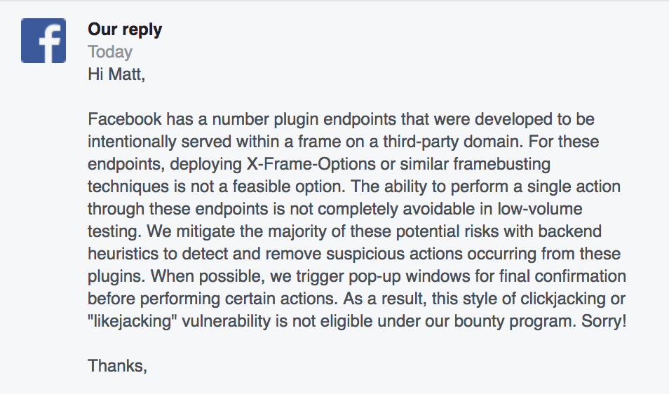
Facebook’s Response

Slide 11
Keep in touch!
Github: https://github.com/fletchto99
Twitter: @fletchto99
Further reading: https://shorten.ninja/clickjacking
Fun random website: https://pi.fletchto99.com
Oh and that uOComputerSecurity page which you’ve already liked ☺

