Slide 1
Signing your commits to github using GPG
By Matt Langlois

Slide 2




whoami
&
@

Slide 3
Outline
Why?
Badges!!!
Proving Identity
How?
How it works
Keybase (optional)
Generating Keys
Signing your first commit
Questions?

Slide 4

Badges!!!
Who doesn’t love this?!?!

Slide 5
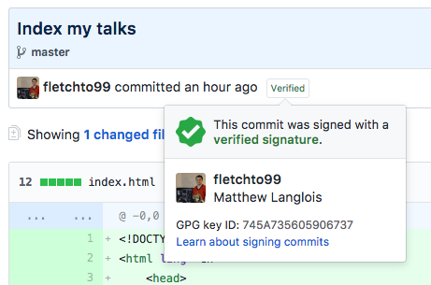
Badges!!!
Then you can also have these!!!

Slide 6
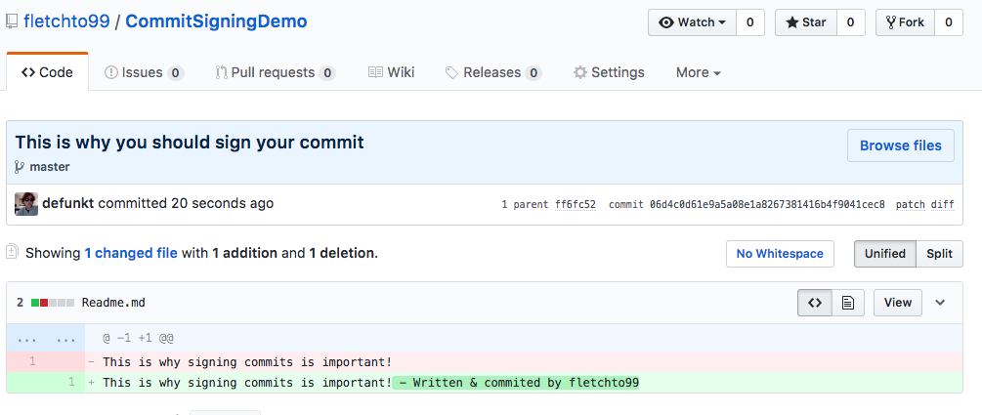
Prove your Identity

Slide 7
How it works
You set an email address in your gitconfig
You set an email address on github & verify it
You generate a GPG key locally with the verified email on github
You put the public key on github
You sign your commit using your private key
Github validates the signature using your public key & the commits email address

Slide 8
KeyBase (optional – recommended)
Register at https://Keybase.io
A place to store your proofs of identity online
Keybase has a CLI through homebrew `brew cask install keybase`
You’ll also need GPG – `brew install gpg`

Slide 9
Generating keys
First run `Keybase login`
Next run `Keybase pgp gen --multi`
Make sure the email entered matched a verified email address on your github account
(Optional) Upload encrypted private key to keybase

Slide 10

Using your new key
Use `gpg --list-secret-keys` to list the IDs of your keys
The output is the ID of your key which will be used to sign things

Slide 11
Using your new key - cont
Run `git config --global user.signingkey <secret key id>`
Run `git config --global commit.gpgsign true`

Slide 12
Final steps
Navigate to https://github.com/settings/keys
Press `New GPG key`
In your terminal run `keybase pgp export –q <key id>`
Copy everything that is output

Slide 13
Go commit & Push something!!
You are now a verified committer ☺

Slide 14
Questions/Live demo?

Slide 15
Keep in touch!
Github: https://github.com/fletchto99
Twitter: @fletchto99
Further reading:
Fun random website: https://pi.fletchto99.com

