Slide 1
Trends and Concepts in the Software Industry I
Jens Krueger, Juergen Mueller
Seminar
Summer Term 2012

Slide 2
Seminar goals
Elaborate potential for new programming approaches in the domain of enterprise software
Get hands on experience on a small business process
Compare different solutions and the impact of the taken design decisions
A simplified version of the procure-to-pay process serves as a basis for your implementations.

Slide 3
Scenario Introduction
The Procure-to-Pay business scenario covers all aspects of procuring items to stock
This includes activities from sales order, purchasing contract, material resource planning, purchase proposal, purchase request and order management, inbound logistics, inventory management and journal entries
Simplified process will be regarded in this seminar to allow focusing on implementation parts
First lets have a look onto the process from the customers point of view

Slide 4
Procurement triggered by Sales Demand on Customer Side
A sales representative creates a sales order. This indicates a customer demand and if this cannot be covered by the available stock, demand planning triggers the procurement of the item to stock.
The supply planner performs an MRP run. The system automatically creates a purchase proposal.
The supply planner reviews the purchase proposals and releases it.
The purchaser orders the goods according to the purchase request.
An inbound delivery is created once the goods arrived.
The supplier invoice is posted against the goods receipt.
Now let’s have a look at the process from suppliers side.

Slide 5
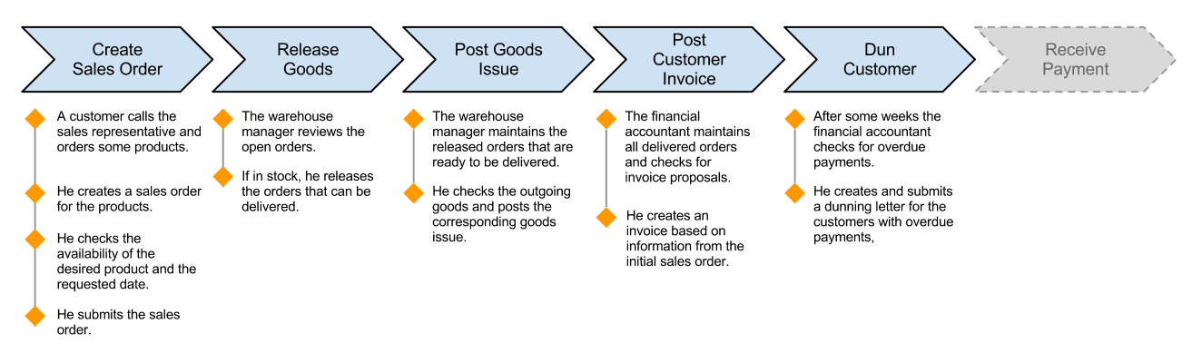
Procure to Pay Steps Overview
From the suppliers point of view, the procure-to-pay scenario consists of the following main steps:

Slide 6
Procure to Pay Scenario in BPMN

Slide 7
Procure to Pay Steps Overview
First step: Creation of a Sales Order

Slide 8
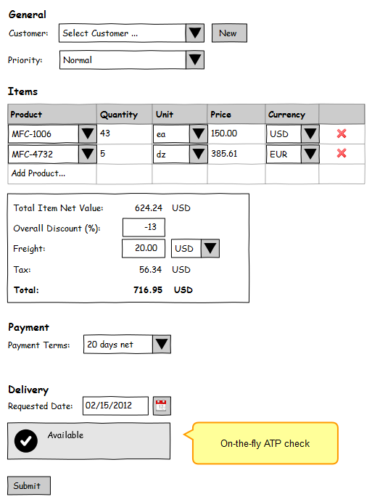
Create Sales Order
ATP Check
true / false for specific date OR
earliest possible shipment date
Facts to consider
all products and their quantities in current Sales Order
current stock
forecasting information
ATP checks are done on daily basis
only shipped orders result in a stock change
released orders still count to stock, but can‘t be used to fulfill ATP checks any longer
low priority orders that are not yet released shall be used to meet ATP checks of orders with higher priority

Slide 9
Create Sales Order
Do not consider
splitting of orders to fulfill parts earliest possible (like Amazon does)
affinity of certain orders or goods to specific warehouses for cost reduction

Slide 10
Create Sales Order
Examples for payment details
10 days 2% cash discount, 20 days net
If customer pays within the first 10 days, a 2% cash discount is given
Customer has a maximum of 20 days to pay after invoicing, after that period he can be dunned
before end of month 4%, before 15th next month 2%, before 15th in 2 months due net
If customer pays before end of the month the invoice was issued, a 4% cash discount is given
If customer pays next month and before 15th, a 2% cash discount is given
Customer has to pay before 15th in 2 months, otherwise dunning can be issued

Slide 11
Procure to Pay Steps Overview
Second step: Ordered Goods are released

Slide 12
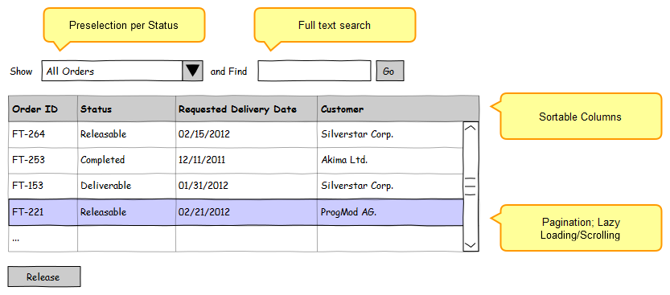
Release Ordered Goods
Releasing a Sales Order marks this Sales Order to be ready for delivery
A released Sales Order will appear in the “Outbound Logistics Workcenter” where the goods issue will be posted (next step)

Slide 13
Procure to Pay Steps Overview
Third step: Goods Issue is posted

Slide 14
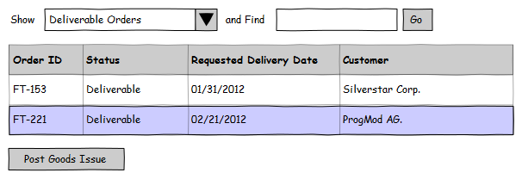
Post Goods Issue
Items of released sales orders are ready to be delivered to the customer
When the items leave the warehouse and are sent to the customer, a goods issue is posted

Slide 15
Procure to Pay Steps Overview
Fourth step: Customer Invoice is posted

Slide 16
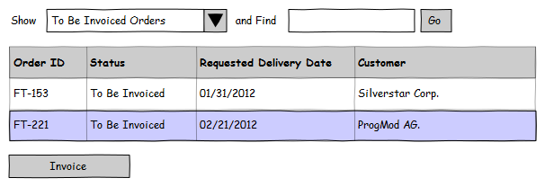
Post Customer Invoice
After posting the goods issue, the invoice for the corresponding sales order is sent to the customer

Slide 17
Procure to Pay Steps Overview
Fifth step: Dun customers if necessary

Slide 18
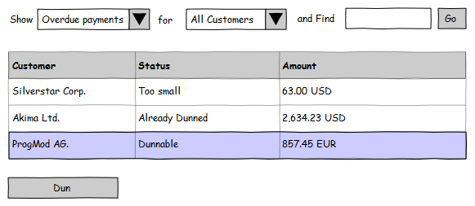
Dun Customer
Dunning
For the dunning view shown below, all dunning proposals are created on-the-fly
A dunning proposal comprises a company and the amount the company is overdue
the overdue amount can be
the total amount over all Sales Orders of that company
displayed separately for each Sales Order

Slide 19
Dun Customer
Overdue:
a payment is overdue when the net value of the payment terms has been exceeded
in the first example of "(1) Create Sales Order" the payment is overdue 20 days after the invoice was issued
in the second example the payment is overdue after 15th in 2 months after the invoice was issued

Slide 20
Procure to Pay Steps Overview
Fifth step: Dun customers if necessary

Slide 21
Dun Customer
For each sales order partial payments have to be regarded
table "PaymentReceipt" in database schema
the sum of all partial payments has to be deducted from the total invoice amount. The result is the dunning amount for this sales order.

Slide 22
Procure to Pay Steps Overview
Analytics is an overall task that should cover all process steps
Analytics

Slide 23
Analytics
Provides additional information about the performance of processes
Examples:
Average duration of the complete process (from the creation of a Sales Order until invoicing, covering all data grouped by productId)
Number of issued dunnings per product / customer
Amount of orders in each step
Average dwell time in each step

Slide 24
Data Schema

Slide 25
Data Schema explained
Main tables
Customer: Name, Address and Contact Information of customer
SalesOrder: Priority, Discount and Freight
Product: Name and RetailPrice
Order Fulfillment Tables
ATPResult: soonest delivery date, customer for the check
Forecast: Incoming and Outgoing quantities(belongs to product)
ReleasedSO: (belongs to SalesOrder)
Outbound Delivery: (belongs to ReleasedSO)
SOInvoice: (belongs to SalesOrder and Outbound Delivery)
PaymentReceipt: amount (belongs to SOInvoice)
Issued Dunning: amount (belongs to Customer)
Warehouse: name

Slide 26
Data Schema explained
Connection tables:
soprod: Connects SalesOrder and Product
Quantity, Currency and Price
prodwarehouse: Connects Product and Warehouse
Quantity
prodatp: Connects Product and ATPResult
Quantity
CREATE-Statements of the data schema will be provided
Data schema is not final and may be subject to changes if necessary

Slide 27
Your task
Implement the procure-to-pay process in a (group) individual way, choosing the languages, libraries and tools you want
The process serves as an example for an arbitrary business process, concentrate on how you implement it, not on possible real-life restrictions of this specific scenario
Focus on interesting aspects during the implementation
Examples for some aspects:
Where to implement the business logic (DB, client or splitted)?
How to realize analytics?
How does the application scale?
Where do you presume (or identify) your bottleneck?
How and to what extent could your implementation be reused, altered or adapted for other business processes?

