Slide 1

ODataERP
Stefan George, Felix Leupold
Trends and Concepts midterm presentation

Slide 2
Background
Protocol for querying and updating data via HTTP
MS released OData specification and SDKs
Competitor: GData by Google
Build on top of the AtomPub Protocol
REST design pattern

Slide 3
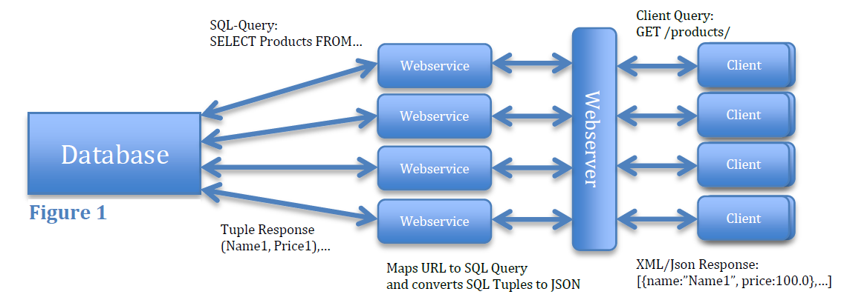
Motivation I

Slide 4
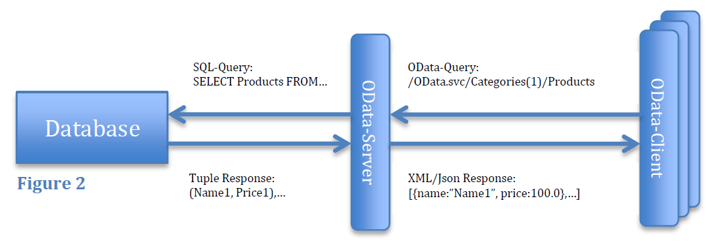
Motivation II

Slide 5
Features
Exposes data as Atom-Feed, JSON or Plain XML
Pros:
Standard syntax for all APIs
Expressive filter syntax: Categories?$filter=(CategoryID add 4) eq 8
Easy to integrate into Windows Apps
Cons:
Client has to make assumptions (version of protocol, metadata)
No operations on collections: Customers?$filter=Orders/Name eq 'Foo'
No aggregates: Customers?$filter=count(Orders) gt 4

Slide 6
REST vs. CRUD
OData based on REST but appropriate for CRUD
REST | (OData) CRUD
Stateless | Transactions across multiple requests
Smart data | Dump data
Service oriented | Data oriented

Slide 7
Libraries and Services available
Clients
WP7
Android
iOS
Sliverlight
.NET
JavaScript
Java
PHP
Ruby
Server:
.NET
Java
PHP
Live Services (selection):
Netflix
Open Government Data
TechEd
DBpedia
Ebay
Stack Overflow
…

Slide 8
OpenERP configuration
HTML5 Client
ODataJS
jQuery/UI
ASP.NET 3.0 Server Application
OData Provider
Microsoft SQL Server Compact (will be exchanged)

Slide 9
By Example: Read/GET
OData.read(
"ODataERP.svc/Customer?$filter=startswith(Name, '" + term + "')",
function (data) {
// response processing
});

Slide 10
By Example: Save/POST
OData.request({
requestUri: "ODataERP.svc/$batch",
method: "POST",
data: requestData
},
function (data) {}, //success
function (err) {}, // error
OData.batchHandler
);

Slide 11
var requestData = { __batchRequests: [{ __changeRequests:
[
{ requestUri: "SalesOrder", method: "POST", headers: { "Content-ID": "1" }, data: {
CustomerID: so.customer,
DeliveryDate: $("#order-delivery-date").datepicker("getDate"),
PaymentTerms: parseInt($("#order-payment-terms").val()),
Priority: parseInt($("#priority-selection").val())
}
}
]
}]
};
for (var i=0; i< so.products.length; i++) {
var requestObject = {
requestUri: "ProductForSalesOrder", method: "POST", data: {
Quantity: so.products[i].quantity,
ProductID: so.products[i].product.ID,
SalesOrderID: { __metadata: { uri: "$1"} }.ID
}
};
requestData.__batchRequests[0].__changeRequests.push(requestObject)
}

Slide 12
Security
Authorization (ODataERP.svc):
config.SetEntitySetAccessRule("*", EntitySetRights.All);
No authentication in OData
Authentication on a different layer (e.g. using OAuth)
No role specific authorization on attribute level
[IgnoreProperties(“SecretAttribute")]
.All
.AllRead
.AllWrite
.WriteDelete
…
Customer
SalesOrder
…

Slide 13
Conclusion
OData is great for exposing data for reading access
OData is great for small publishing apps
OData is for business processes
Notes:
Next Steps
Wie weit ist der Prozess implementiert

Slide 14
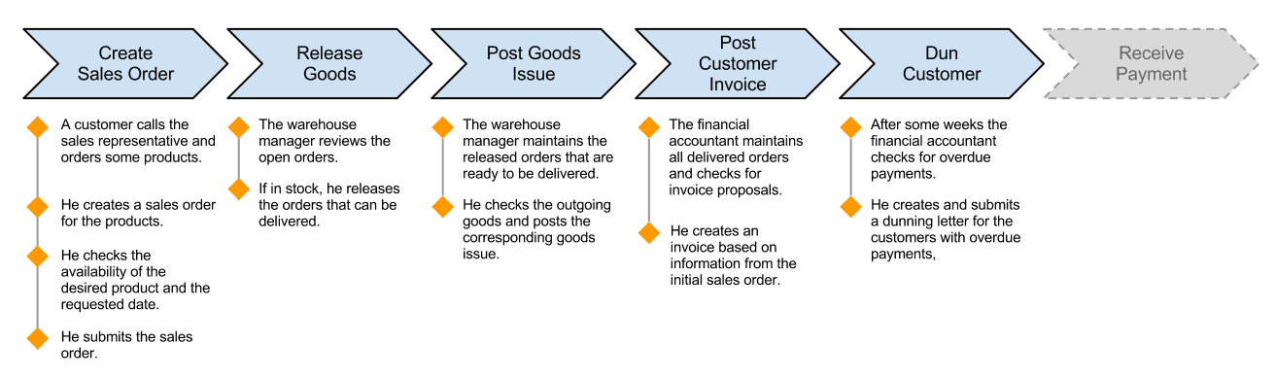
Status

Slide 15
Next Steps
Implement complete process
Evaluate OData
Find workarounds for analysis
Push logic in data base layer?

