Slide 1
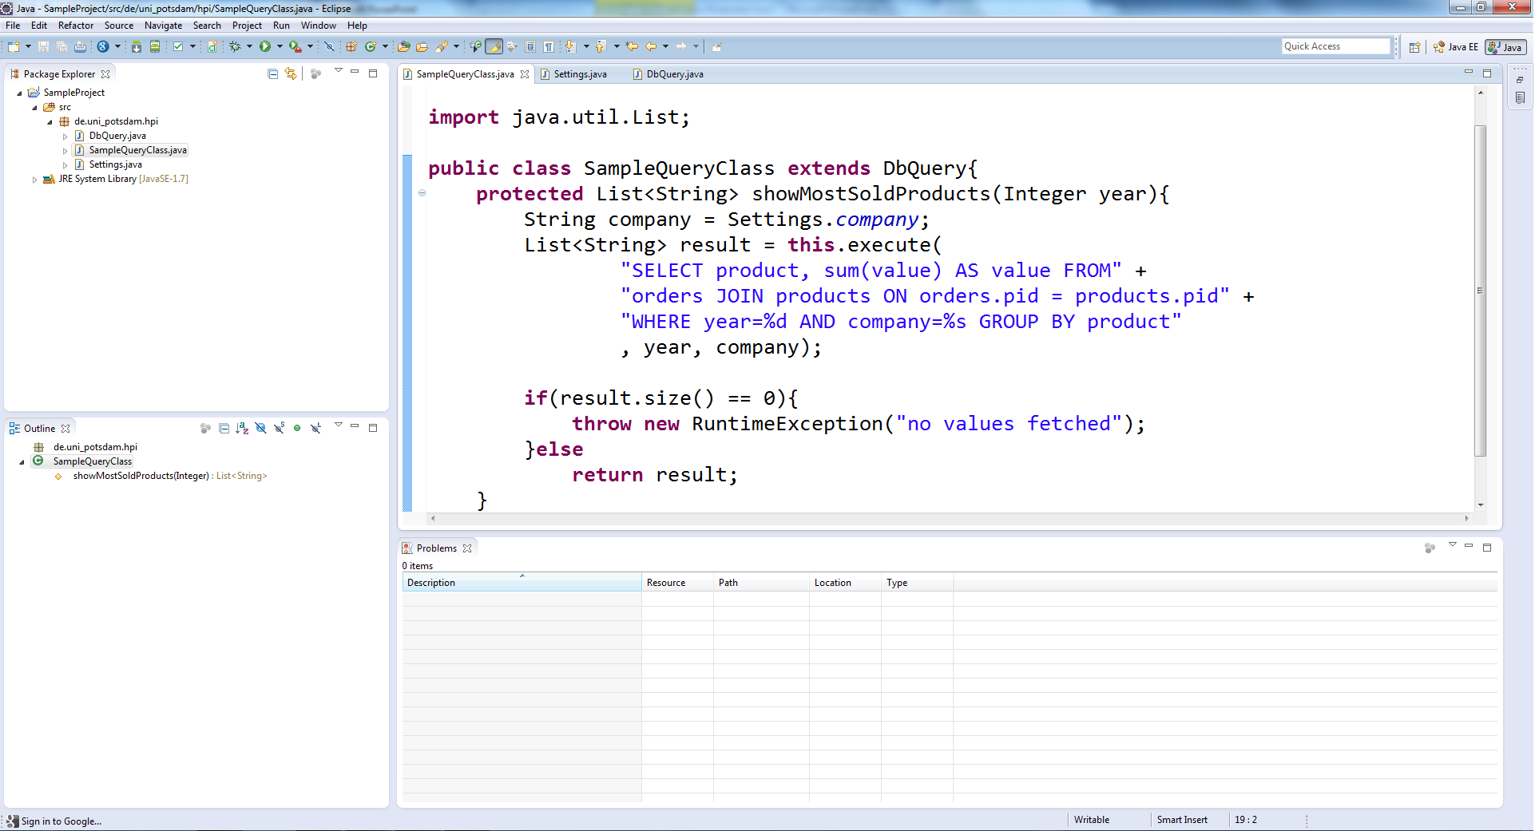
public class SampleQueryClass extends DbQuery{
protected List<String> showMostSoldProducts(Integer year){
List<String> result = this.execute(
"SELECT product, sum(value) AS value FROM" +
"orders JOIN products ON orders.pid = products.pid" +
"WHERE year=%d AND company=%s GROUP BY product",
year, Settings.company);
if(result.size() == 0){
throw new RuntimeException("no values fetched");
}else
return result;
}

Slide 2


public class SampleQueryClass extends DbQuery{
protected List<String> showMostSoldProducts(Integer year){
List<String> result = this.execute(
"SELECT product, sum(value) AS value FROM" +
"orders JOIN products ON orders.pid = products.pid" +
"WHERE year=%d AND company=%s GROUP BY product",
year, Settings.company);
if(result.size() == 0){
throw new RuntimeException("no values fetched");
}else
return result;
}
Context
Store1_Report2013
Store2_Report2013
Generated_Test
Store1_Forecast2014
Live-SQL (result: 4 million tuples fetched in 3.58 s)
product | value
Nutella | 100
Club Mate | 253
Chio Chips | 38

Slide 3
public class SampleQueryClass extends DbQuery{
protected List<String> showMostSoldProducts(Integer year){
List<String> result = this.execute(
"SELECT product, sum(value) AS value FROM" +
"orders JOIN products ON orders.pid = products.pid" +
"WHERE year=%d AND company=%s GROUP BY product",
year, Settings.company);
if(result.size() == 0){
throw new RuntimeException("no values fetched");
}else
return result;
}
Context
Store1_Report2013
Store2_Report2013
Generated_Test
Store1_Forecast2014
Live-SQL (orders: 8 billion tuples fetched in 5.8 s)
pid | company | amount | year
324854 | Foobar Inc. | 425 | 2013
976654 | HPI Ltd. | 250 | 2013
234578 | UP-Ventures | 3000 | 2013

Slide 4
public class SampleQueryClass extends DbQuery{
protected List<String> showMostSoldProducts(Integer year){
List<String> result = this.execute(
"SELECT product, sum(value) AS value FROM" +
"orders JOIN products ON orders.pid = products.pid" +
"WHERE year=%d AND company=%s GROUP BY product“ +,
“ORDER BY value LIMIT 100“, year, Settings.company);
if(result.size() == 0){
throw new RuntimeException("no values fetched");
}else
return result;
}
Context
Store1_Report2013
Store2_Report2013
Generated_Test
Store1_Forecast2014
result: 6 billion tuples fetched in 12.82 s
result: 100 tuples fetched in 0.12 s
product | value
Hohes C | 35
1-2-3 Frites | 126
Twix | 259
product | value
Twix | 259
1-2-3 Frites | 126
Club-Mate | 117

Slide 5
public class SampleQueryClass extends DbQuery{
protected List<String> showMostSoldProducts(Integer year){
List<String> result = this.execute(
"SELECT product, sum(value) AS value FROM" +
"orders JOIN products ON orders.pid = products.pid" +
"WHERE year=%d AND company=%s GROUP BY product“ +,
“ORDER BY value LIMIT 100“, year, Settings.company);
if(result.size() == 0){
throw new RuntimeException("no values fetched");
}else
return result;
}
2014
Context
Store1_Report2013
Store2_Report2013
Generated_Test
Store1_Forecast2014
Live-SQL (result: 0 tuples fetched in 0.01 s)
product | value

Slide 6
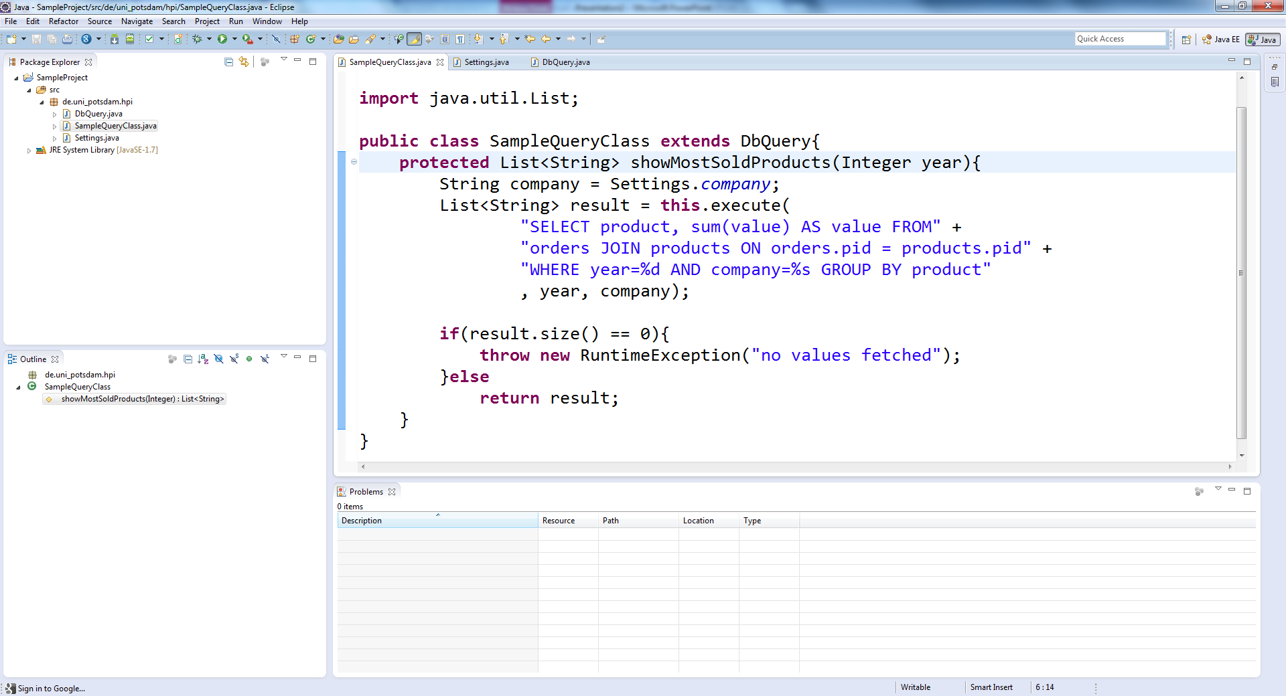
public class SampleQueryClass extends DbQuery{
protected List<String> showMostSoldProducts(Integer year){
List<String> result = this.execute(
"SELECT product, sum(value) AS value FROM" +
"orders JOIN products ON orders.pid = products.pid" +
"WHERE year=%d AND company=%s GROUP BY product",
year, Settings.company);
if(result.size() == 0){
throw new RuntimeException("no values fetched");
}else
return result;
}
Context
Store1_Report2013
Store2_Report2013
Generated_Test
Store1_Forecast2014
product | value

Slide 7
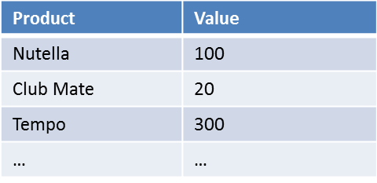
Context
Store1_Report2013
Store2_Report2013
Generated_Test
Store1_Forecast2014
#of tuples: 4m Fetch time: 10s

