Slide 1
Connect & Control
Build Your First Internet of Things (IoT) Application on Arm
Steinheim 01.08.2023

Slide 2
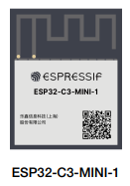
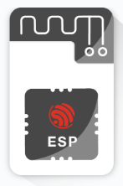
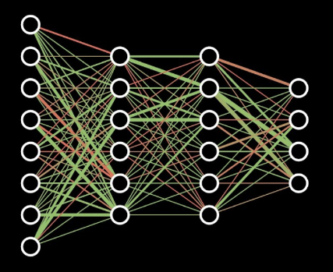
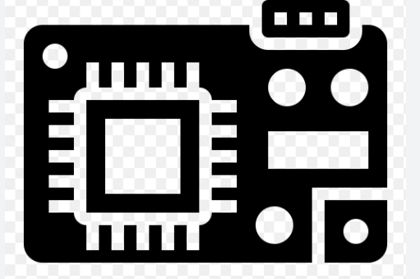

Slide 3
ESP32-C3 Series
ESP32-C3 family is an ultra-low-power MCU-based SoC solution that supports 2.4 GHz Wi-Fi and Bluetooth®
Low Energy (Bluetooth LE). With its state-of-the-art power and RF performance, this SoC is an ideal choice for a
wide variety of application scenarios relating to Internet of Things (IoT),
Two ‚level‘ of circuits:
SoC -> Module
Module -> PCB board

Slide 4
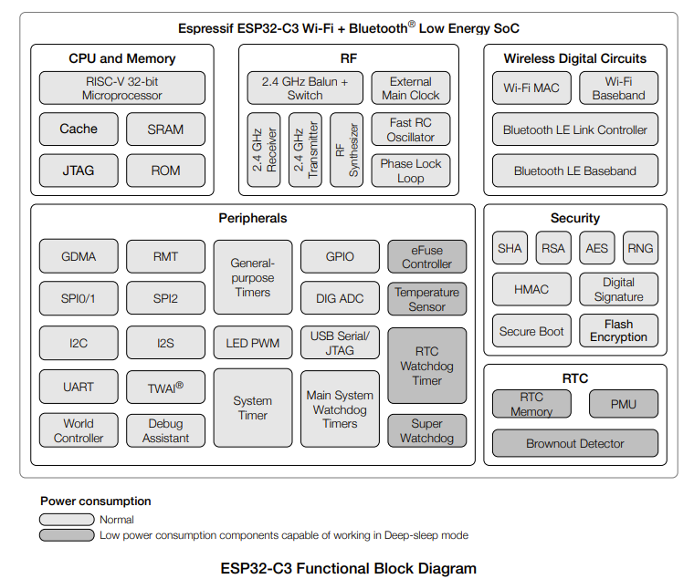
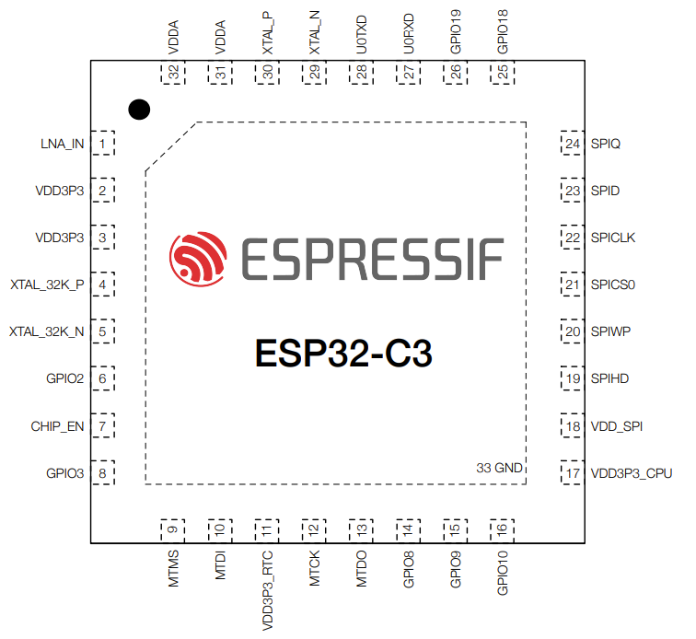
A little description about ESP32C3

Slide 5
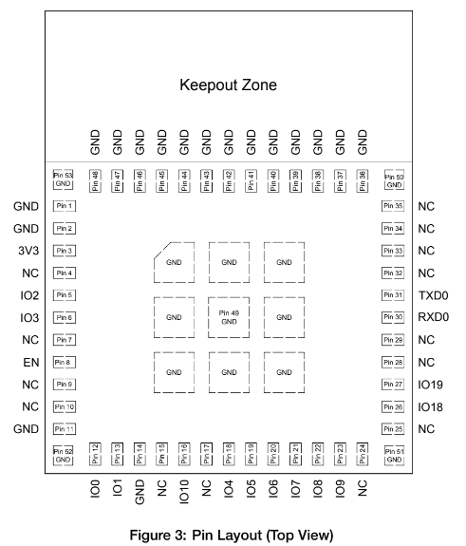
Then module ESP32C3/MINI
ESP32-C3-MINI-1 and ESP32-C3-MINI-1U are two general-purpose Wi-Fi and Bluetooth LE modules.

Slide 6
Arduino ESP32

Slide 7
Introduction
General vision of IoT topic in FLEX

Slide 8
Sensor & Basic Components

Slide 9
Voltage sensor
Current sensor
Power switch

Slide 10
Networks & Protocols

Slide 11
ESP-NOW
From local to cloud : gateway
ESP-NOW is a fast communication protocol that can be used to exchange small messages (up to 250 bytes) between ESP32 boards.

Slide 12
System Architecture

Slide 13
communication
Short-range technologies such as Bluetooth and ZigBee

Slide 14
System Standardisation

Slide 15
Cloud, Fog and Edge Computing

Slide 16
Gateway

Slide 17
architecture

Slide 19
Edge computing
Fog computing
cloud computing

Slide 21
Device Architecture

Slide 22
hardware platform

Slide 23
memory

Slide 24
sensor

Slide 25
Energy & Battery

Slide 26
Connectivity

Slide 27
Bluetooth

Slide 28
Zigbee

Slide 30
Internet & Cloud

Slide 31
A number of protocol enhancements have been developed over the years, primarily to improve the throughput performance of 802.11 networks. One such enhancement is 802.11n that makes use of twice as much bandwidth if needed, by bonding together two channels. It is also possible to employ a signal processing technique called MIMO, M-I-M-O to allow the simultaneous transmission of multiple data streams between two pairs and encode more bits of information per symbol to increase data rates. The overhead associated with contention and hedges is reduced through different frame aggregation techniques. With some, it is also possible to retransmit only a particular part of a message if it is affected by errors. This improves channel efficiency.
802.11ac adds new features to further enhance throughput performance. For instance, channels up to 160 megahertz can be used. Given the spectral width, only the five gigahertz band becomes suitable, and as such, 802.11ac are reserved for this band. Up to eight MIMO streams are supported, effectively multiplying the data rate eight times, and the new modulation schemes enable transmitting up to 16 bits per symbol. In addition, a new multi-user MIMO technique is adopted that allows an access point to transmit to multiple stations at the same time. This is called spatial multiplexing.

Slide 32
WLAN IEEE 802.11n

Slide 33
LPWAN

Slide 34
LoRaWAN

Slide 35
NB-IoT

Slide 36
Virtualisation

Slide 37
MQ Telemetry Transport

Slide 38
Constrained Application Protocol (CoAP)

Slide 39
Data Processing Pipelines

Slide 41
ESP32 Production Testing Guide

