Slide 1
Introduction to Binary Exploitation and Common Attacks

Slide 2
Introduction to Binary Exploitation and Common Attacks

Slide 3

SO DO U WANNA PWN?!

Slide 4

LET’s GO!

Slide 5
DISCLAIMER
We will:
Go more theoretical.
Talk about basic concepts as we can.

Slide 6
whoami
Mohamed Sayed (A.K.A Flex).
Working @ CyShield.
PWNing, Bug Hunt, RE, and Hardware in Night.

Slide 7
Agenda
Binary Exploitation Concepts
Binary
CPU Instructions
Registers
Memory Layout
System Calls & Privileges
What is Binary Exploitation (AKA Pwning)
Attacks:
Buffer Overflow Exploits
Heap Exploits
Format String
Mitigations
W^X (Write XOR Execute)
ASLR (Address Space Layout Randomization.
Stack Canary
How to start.

Slide 8
Binary Exploitation Concepts

Slide 9
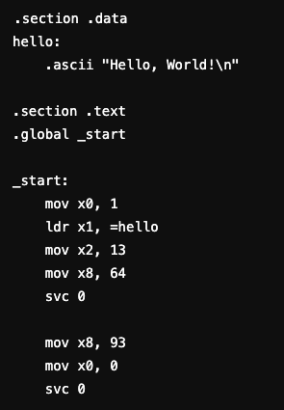
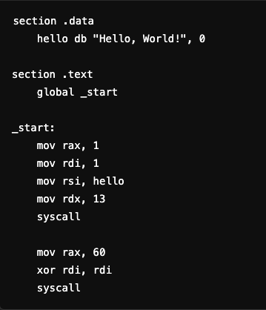
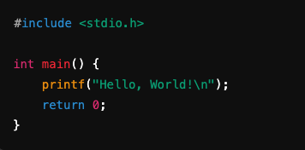
Binary

Slide 10
CPU Instructions
Notes:
Load, Store, Move, Syscall

Slide 11
CPU Instructions
Intel 64
ARM 64

Slide 12
Registers
Storage spaces inside the CPU.
Types
Instruction Pointer.
Stack Pointer.
General Purpose.
Registers in Hacking?!

Slide 13
Memory Layout
Stack
Temporary storage.
Data Pushed on the top and Popped from top too (Last-In-First-Out).
Stores Information, Functions calls, Quick Calculations.
Heap
Long-term and flexible storage.
Complex than the stack.
It is not LIFO.

Slide 14
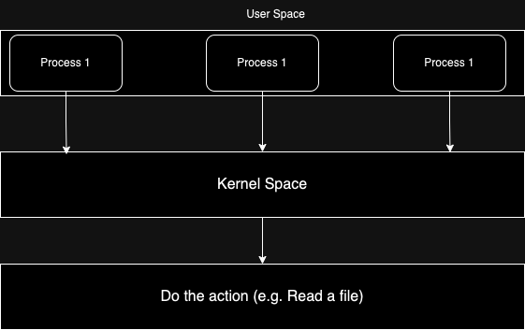
System Calls & Privileges
User Space.
Kernel Space (AKA Ring0).
System Calls.
Write
Read
Open
Exit

Slide 15
What is Binary Exploitation?

Slide 16
Attacks

Slide 17
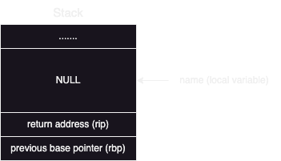
Buffer Overflow

Slide 18
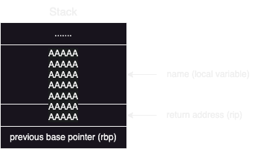
Buffer Overflow

Slide 19
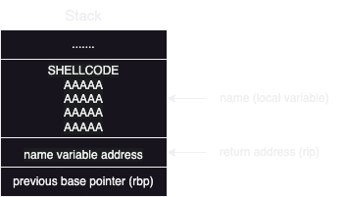
Buffer Overflow

Slide 20
Heap Exploits
Heap attacks is based on the used “libc”.
C Standard Library, core collection of functions and constants.
Uses chunks.

Slide 21
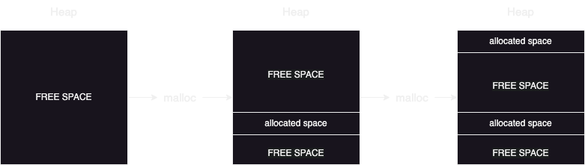
Heap Exploits

Slide 22
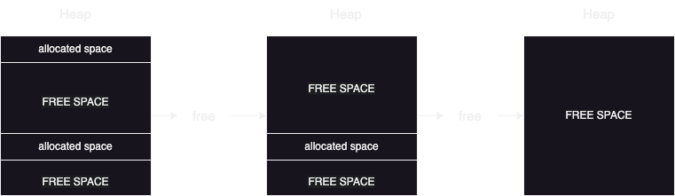
Heap Exploits

Slide 23
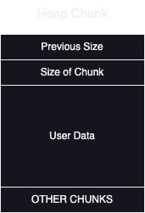
Heap Exploits

Slide 24
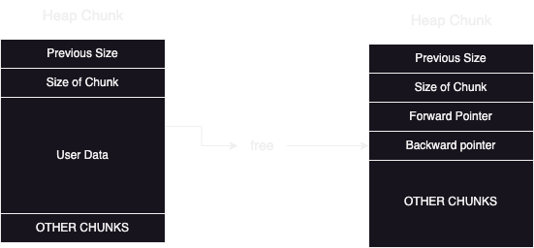
Heap Exploits

Slide 25
Format String
Way to control how data is formatted and displayed (e.g. printf).
How can we control a system with “%x” or “%n”.

Slide 26


Format String

Slide 27
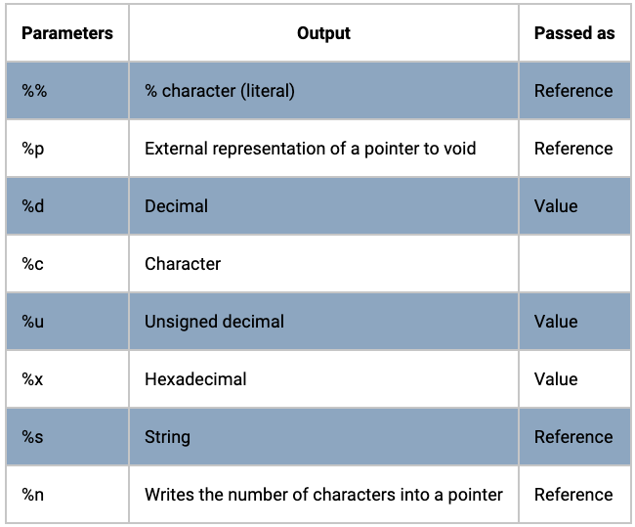
Format String
what can we use?!

Slide 28
Format String
We have Write-What-Where (WWW).

Slide 29
Mitigations

Slide 30
Write XOR Execute (W^X)

Slide 31
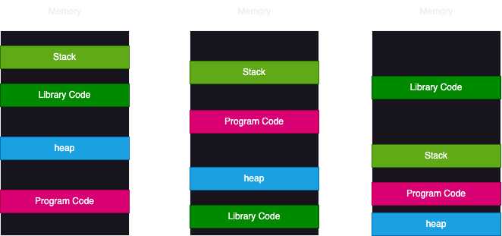
Address space layout randomization (ASLR)

Slide 32
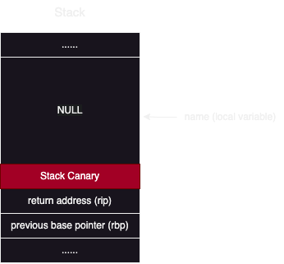
Stack Canary

Slide 33
How to start?!
pwn.college
CTFs (pwn, RE)
Hack

Slide 34
Q&A

Slide 35
Thanks

