Slide 1
Introduction to Cyber Security

Slide 2
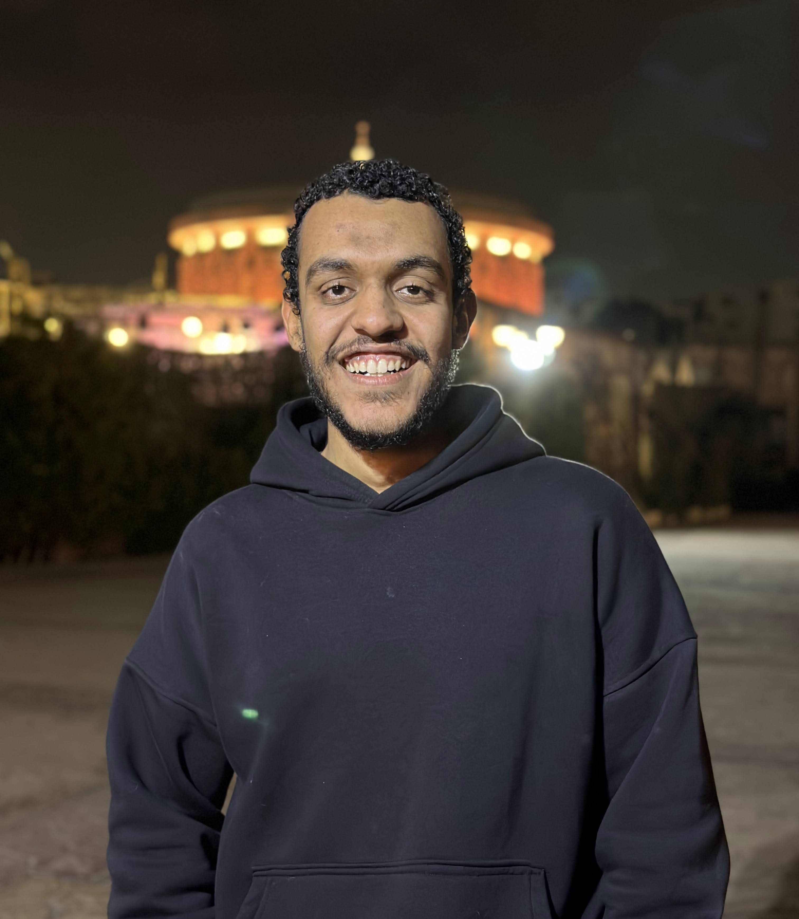
whoami
Mohamed Sayed A.K.A Flex
Senior Cyber Security Engineer @ Cyshield
CTF Player (trying to be)
IoT & Binary Exploitaiton lover (pwner)

Slide 3
Agenda
What is Cyber Security?
Security Concepts
Teams In Cyber Security
Building your CV
How to be good in Cyber Security?

Slide 4
What is Cyber Security?

Slide 5
Concepts
C.I.A
OWASP Top 10
Risk, Threat, Vulnerability

Slide 6

C.I.A

Slide 7
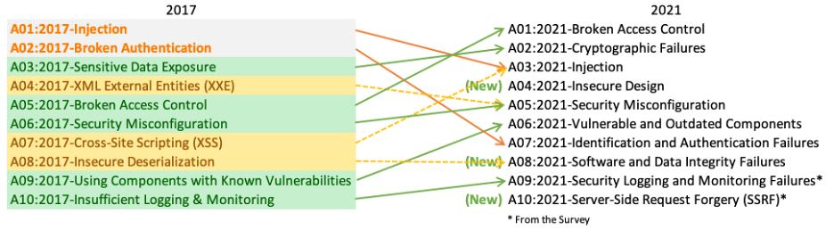
OWASP Top Ten

Slide 8
Risk, Threat, Vulnerability
Notes:
Risk: The potential for loss or damage when a threat exploits a vulnerability.
Threat: A possible danger that could exploit a vulnerability to cause harm.
Vulnerability: A weakness or flaw in a system that can be exploited by a threat to cause harm.

Slide 9
Teams

Slide 10
Red Team – Offensive
Application Pentest (Web, Mobile, Desktop)
Network Pentest
Secure Source Code Review
Binary Exploitation
IOT and Firmware Penetration Testing
DevSecOps

Slide 11
Web Application Security

Slide 12
Mobile Application Security

Slide 13
Desktop Application Security

Slide 14
Network Pentest

Slide 15
Secure Source Code Review

Slide 16
Binary Exploitation

Slide 17
IOT & Firmware Analysis

Slide 18
DevSecOps

Slide 19
Blue Team – Defense
Digital forensics and incident response (DFIR)
Security operations center
Threat Hunting
Threat Intelligence
Malware Analysis
Reverse Engineering

Slide 20
DFIR

Slide 21
SOC

Slide 22
Threat Hunting
Notes:
Search for risks the threats in the env without waiting an action happen in your env (avoid that there is an attack and u don’t know)

Slide 23
Threat Intelligence

Slide 24
Malware Analysis

Slide 25
Reverse Engineering

Slide 26
Building your CV

Slide 27
How to be good in Cyber Security
Time
Focus
Commitment
Avoid Distractions
Avoid learning loop

Slide 28
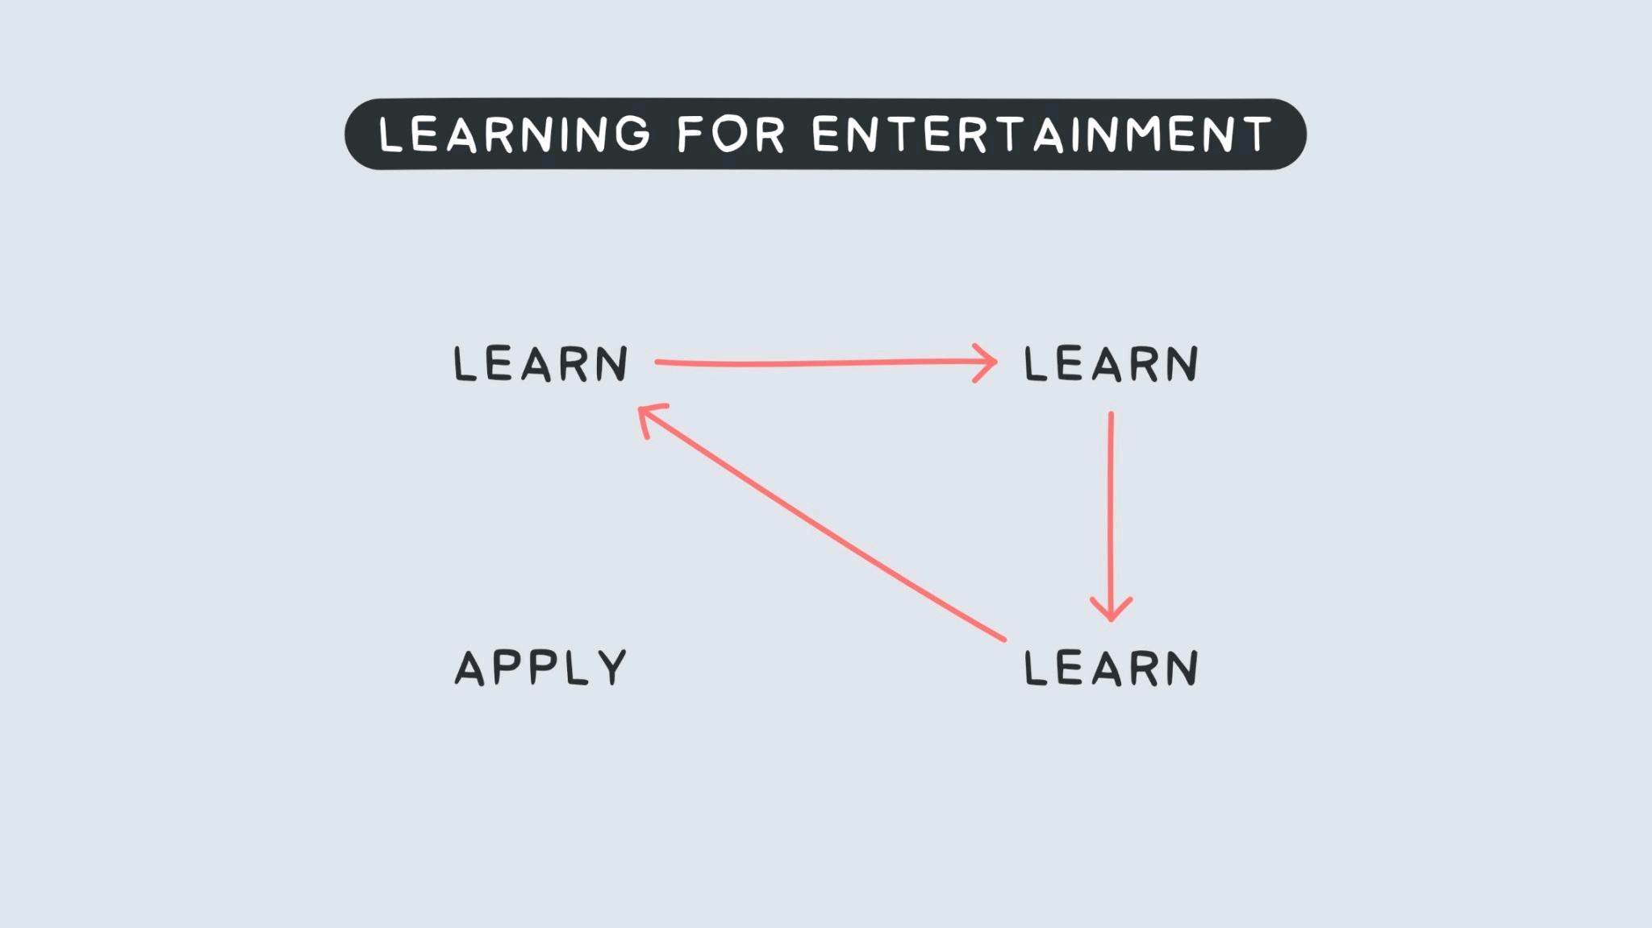

Slide 29
References
https://www.youtube.com/watch?v=i8rizLc4hc0 (So, You Wanna Do Security ?) by Mohamed Gamal
https://azeria-labs.com/the-importance-of-deep-work-the-30-hour-method-for-learning-a-new-skill/ (Deep work & 30-H Method)

Slide 30
Ask Me

Slide 31
Thank you

