Slide 1
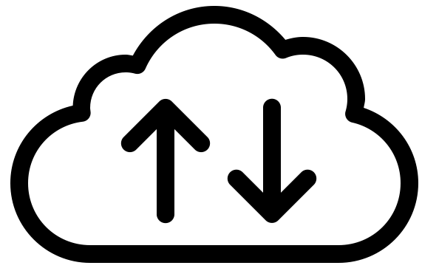
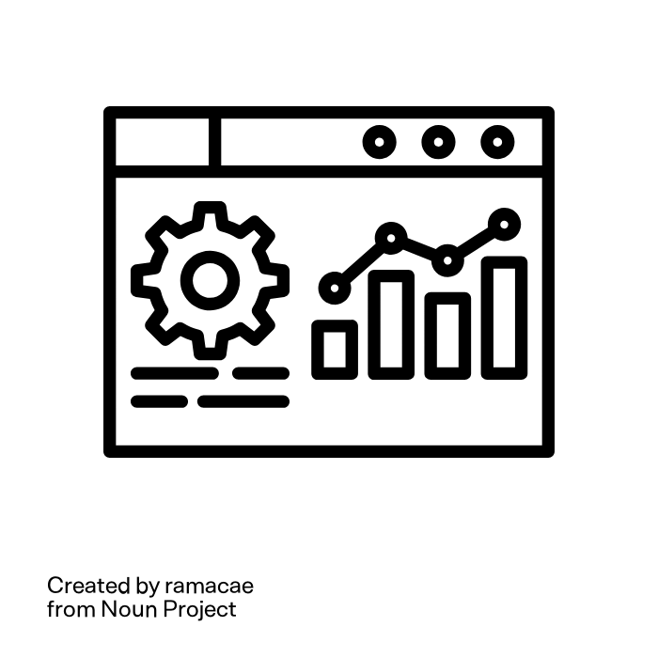
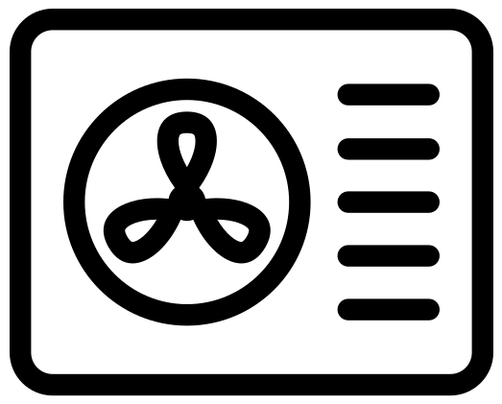

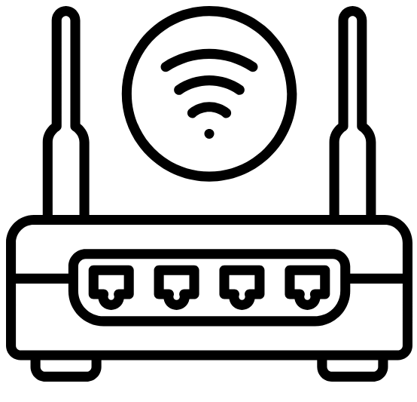
CEM
RM
WW
WAN
WW
=
WAN-WAN interaction
WL
WL
=
WAN-LAN interaction
Firewall/NAT
LL
=
LAN-LAN interaction
CEM
RM
LL
LAN

Slide 2
CEM
Server
RM
WW
WAN
Server
Client
WW
=
WAN-WAN interaction
WL
WL
=
WAN-LAN interaction
Firewall/NAT
LL
=
LAN-LAN interaction
CEM
Client
RM
LL
Server
Client
LAN

Slide 3
WAN
S2 application
Pairing Client
S2 application
Pairing Client
Pairing server
Pairing server
Pairing process pointing from initiator to responder
Proprietary connection between cloud representative and S2 node (out of scope)
WAN S2 pairing server (optional)
WAN S2 pairing server (optional)
Pairing server
Pairing server
Reverse pairing procedure based on long polling (LAN-LAN only)
LAN
S2 application
Pairing Client
S2 application
Pairing Client
Pairing server

Slide 4
WAN
S2 CEM application
Pairing Client
S2 RM application
Pairing Client
Pairing server
Pairing server
Pairing process pointing from initiator to responder
Proprietary connection between cloud representative and S2 node (out of scope)
WAN S2 pairing server (optional)
WAN S2 pairing server (optional)
Pairing server
Pairing server
Reverse pairing procedure based on long polling (LAN-LAN only)
LAN
S2 CEM application
Pairing Client
S2 RM application
Pairing Client
Pairing server

Slide 5
WAN
S2 application
Pairing Client
Pairing server
S2 application
Pairing server
Pairing Client
Pairing process pointing from initiator to responder
Proprietary connection between cloud representative and S2 node (out of scope)
WAN S2 pairing server (optional)
WAN S2 pairing server (optional)
Pairing server
Pairing server
Pairing process when an optional pairing server is used to represent a local LAN node in the WAN using a proprietary connection
LAN
S2 application
Pairing Client
S2 RM application
Reverse pairing procedure based on long polling (LAN-LAN only)
Pairing server
Pairing Client

Slide 6
WAN
Used by
Initiator Node
Used by
Responder Node
S2 Endpoint
Pairing Client
Pairing Server
S2 Endpoint
Pairing Server
Pairing Client
Pairing process pointing from initiator to responder
Proprietary connection between cloud representative and S2 node (out of scope)
WAN S2 pairing server (optional)
WAN S2 pairing server (optional)
Pairing Server
Pairing Server
Pairing process when an optional pairing server is used to represent a local LAN node in the WAN using a proprietary connection
LAN
S2 Endpoint
Pairing Client
S2 RM-only Endpoint
Reverse pairing procedure based on long polling (LAN-LAN only)
Pairing Server
Pairing Client

Slide 7
S2 application
Initiator Node
Responder Node
Endpoint (Pairing server/client)
Node 1 (Initiator / Responder)
HTTPS Client/Server
Node 2 (Initiator / Responder)

Slide 8
Initiator Node
Responder Node
S2 application
S2 application
Endpoint (Pairing server)
Endpoint (Pairing client)
Node 1 (Responder)
HTTPS Client
Node 1 (Initiator)
HTTPS Server
Node 2 (Responder)
Node 2 (Initiator)

Slide 9
Initiator Node
Responder Node
Node 1 (Responder)
Pairing Client
Node 1 (Initiator)
Pairing Server

Slide 10
WAN
S2 application
Pairing Client
Pairing server
S2 application
Pairing server
Pairing Client
Pairing process pointing from initiator to responder
Proprietary connection between cloud representative and S2 node (out of scope)
WAN S2 pairing server (optional)
WAN S2 pairing server (optional)
Pairing server
Pairing server
Reverse pairing procedure based on long polling (LAN-LAN only)
LAN
S2 application
Pairing Client
S2 RM application
Pairing server
Pairing Client

Slide 11
WAN
S2 application
Pairing Client
Pairing server
S2 application
Pairing server
Pairing Client
Pairing process pointing from initiator to responder
Reverse pairing procedure based on long polling (LAN-LAN only)
LAN
S2 application
Pairing Client
S2 RM application
Pairing server
Pairing Client

Slide 12
WAN
S2 application
Pairing Client
Pairing server
S2 application
Pairing server
Pairing Client
Pairing process pointing from initiator to responder
Proprietary connection between cloud representative and S2 node (out of scope)
WAN S2 pairing server (optional)
WAN S2 pairing server (optional)
Pairing server
Pairing server
Reverse pairing procedure based on long polling (LAN-LAN only)
LAN
S2 application
S2 RM application

