Slide 1

Analyzing international large-scale assessments using R 2024.05.16
Francis L. Huang / huangf@missouri.edu
Professor / Statistics, Measurement, and Evaluation in Education Program
Educational, School, and Counseling Psychology, University of Missouri
https://francish.net
@flhuang
Workshop @Education University of Hong Kong

Slide 2

NOTE: Current workshop is based on training we have been conducting at AERA for almost 10 years…
A focus on past workshops has been the use of HLM software
For today, our focus is on both understanding the concepts and using R to model results (not necessarily MLM)
NOTE: These slides are also available here: https://sites.google.com/view/hlmworkshop/
Rathbun, A., Huang, F., Meinck, S., Park, B., Ikoma, S., & Zhang, Y. (2024, April). Multilevel modeling with large-scale international datasets. Professional development course presented at the annual meeting of the American Educational Research Association, Philadelphia, PA.

Slide 3
Agenda
Short Background on ILSAs
Defining Characteristics of ILSAs

Slide 4








International studies across the lifespan Source: Rathbun et al. (2024)
Study |  | What’s Surveyed? | Who’s Surveyed? | When?
International Early Learning Study (IELS) |  | Emerging literacy skills Emerging numeracy skills Social and emotional skills Self-regulation | 5-year-olds | 2018
Progress in International Reading Literacy Study (PIRLS) |  | Informational and literary reading literacy Online informational reading literacy | 4th-graders | 2001, 2006, 2011, 2016, 2021
Trends in International Mathematics and Science Study (TIMSS) |  | Mathematics Science | 4th-graders 8th-graders | 1995, 1999, 2003, 2007, 2011, 2015, 2019, 2023
 |  | Advanced mathematics Physics | Advanced 12th-graders | 1995, 2008, 2015
International Computer and Information Literacy Study (ICILS) |  | Computer and information literacy | 8th-graders | 2013, 2018, 2023
International Civic and Citizenship Education Study (ICCS) |  | Civic and citizenship knowledge, attitudes, beliefs and behaviour | 8th-graders | 2009, 2016, 2022
Program for International Student Assessment (PISA) |  | Reading literacy Mathematics literacy Science literacy Problem solving Financial literacy | 15-year-olds | 2000, 2003, 2006, 2009, 2012, 2015, 2018, 2022, 2025
Teaching and Learning International Survey (TALIS) |  | Teachers’ teaching practices, and learning environments | Teachers in grades 7, 8, and 9 | 2008, 2013, 2018, 2024
Program for the International Assessment of Adult Competencies (PIAAC) |  | Literacy skills Numeracy skills Problem solving in a technology-rich environment | Adults ages 16-65 (16-74 in the U.S.) | 2012/2012, 2022/2023

Slide 5
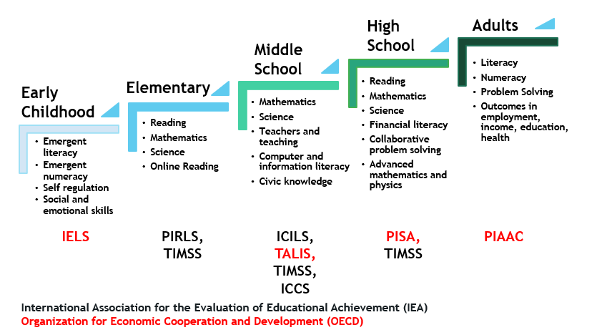
International studies across the lifespan Source: Rathbun et al. (2024)

Slide 6
Sponsorship and management
International Association for the Evaluation of Educational Achievement (IEA)
International contractor: TIMSS & PIRLS International Study Center at Boston College
Studies: PIRLS, TIMSS, ICILS, ICCS
https://www.youtube.com/watch?v=7lOpMHa02lc
Organization for Economic Cooperation and Development (OECD)
International contractor: PISA International Consortium (ETS, Westat, DIPF, Pearson)
Studies: PISA, PIAAC, TALIS, IELS
Source: Rathbun et al. (2024)

Slide 7
Different studies have different target populations…
PIRLS
4th-graders
TIMSS
4th- and 8th-graders
In TIMSS Advanced: Final year of secondary school
PISA
15-year-olds
Source: Rathbun et al. (2024)

Slide 8
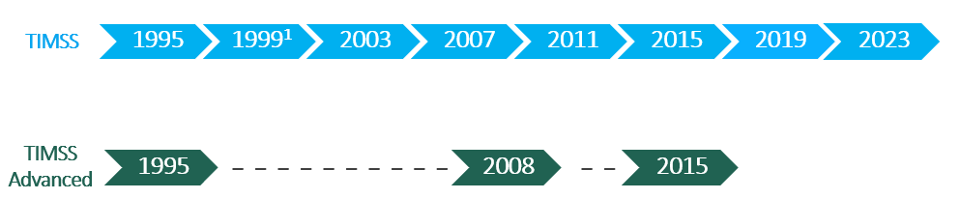
Content areas differ as well … for TIMSS
For the Trends in International Mathematics and Science Study (TIMSS)
TIMSS: Mathematics and science assessment at grades 4 and 8
TIMSS Advanced: Advanced mathematics and physics assessment in the final year of secondary school
¹Grade 8 only
Source: Rathbun et al. (2024)

Slide 9
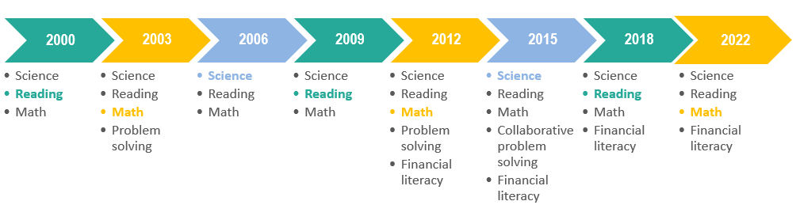
For the Program for International Student Assessment (PISA)…
In each cycle, one of the subject areas is the focal subject or major domain. The other two subject areas are minor domains. The graphic above shows the rotation of the subject areas since PISA 2000. The subject listed in bold font is the major domain for the cycle.
Source: Rathbun et al. (2024)

Slide 10
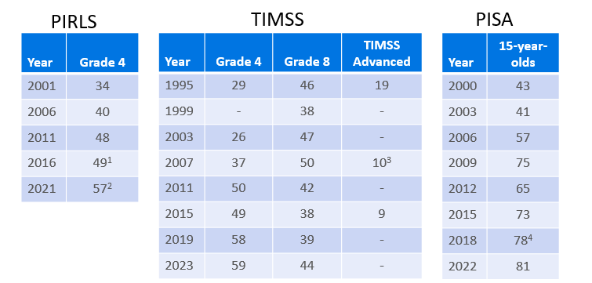
How many educational systems* participate in the studies?
¹ In 2016, 14 education systems participated in ePIRLS.
² In 2021, 26 education systems participated in digitalPIRLS. The United States administered the PIRLS 2021 assessment digitally, but reported results of its paper-bridge assessment.
³ TIMSS Advanced was administered in 2008.
⁴ Including Vietnam, which had no published results.
NOTE: The counts shown do not include benchmarking education systems that may have participated in the assessment (such as Canadian provinces and U.S. states) nor do they include countries that participated but not at the target grade level.
* Not necessarily countries
Source: Rathbun et al. (2024)

Slide 11
How many students and schools participate in each system?
Average sample size in each education system | PIRLS & TIMSS | TIMSS Advanced | PISA
Students | ~4,000 – 5,000 | ~2,000 – 4,000 | ~5,000 – 6,000
Schools | ~150 – 200 | ~100 – 200 | ~150 – 200
Source: Rathbun et al. (2024)

Slide 12
What other information is collected aside from the assessment portion?
Questionnaires (and example components):
Student
Home educational resources
Self-perceptions, beliefs, and attitudes about learning
Teacher
Attitudes/beliefs about teaching/learning
Teacher collaboration and professional development
School
School climate and safety
School resources and technology

Slide 13
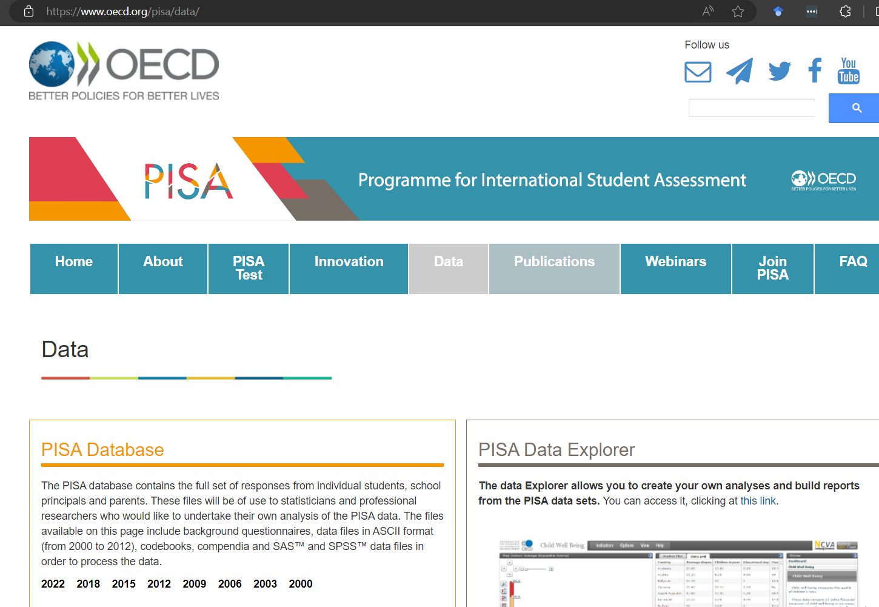
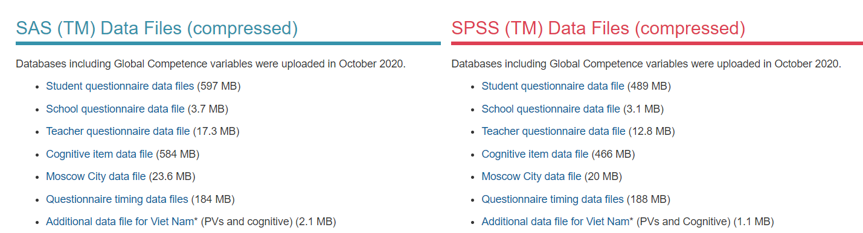
Where can I find the data (PISA)? (in different formats)

Slide 14
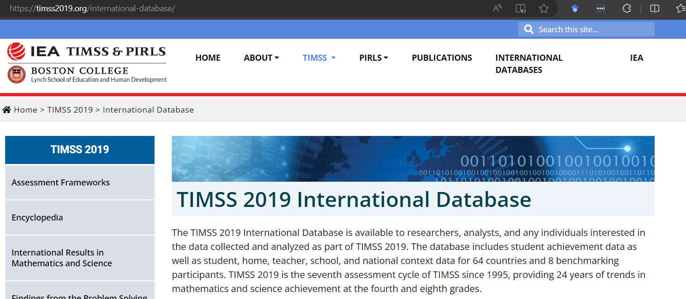
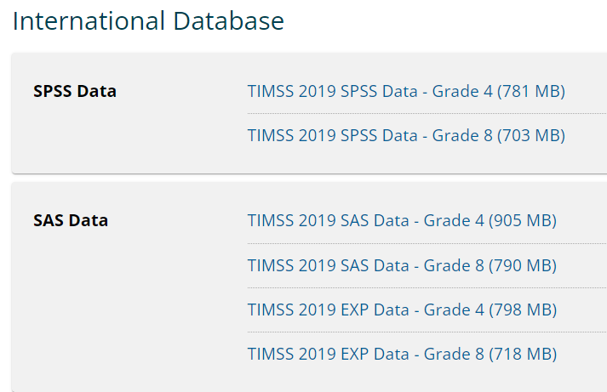
Where can I find the data (TIMSS)? (in different formats)

Slide 15
NOTE: depending on the assessment…
There may be different files: e.g., student, school, cognitive results, etc.
Need to merge data if interested in different aspects
Some data files (e.g., PISA) have the entire survey in one file for all educational systems
Need to have basic data management skills

Slide 16
Other resources that may be helpful…
Codebooks and almanacs: PIRLS and TIMSS
PISA codebooks and compendia
NCES International Data Explorer (IDE)
IEA International Database Analyzer (IDB Analyzer) (used with SAS or SPSS)
Merge module
Analysis module
EdSurvey Package for R Users
Source: Rathbun et al. (2024)

Slide 17
Agenda
Short Background on ILSAs
Defining Characteristics of ILSAs

Slide 18
What characteristics make ILSAs different from other large datasets?
The use of weights (these are common in nationally representative datasets)
The use of plausible values (not all surveys use this)

Slide 19
Why use weights?
We do not have a census where we get data from everyone
Why not?
Cost + logistics = too difficult and too expensive
We take a sample
We are not interested in the characteristics of the sample but want to generalize from the sample to the population

Slide 20
ILSAs use complex sampling designs
Multiple stages of sampling (reflect the hierarchical structure of the population)
Schools → Classrooms → Students (TIMSS)
Schools → Students (PISA)
Homogenous samples are selected (cluster sampling)
Selected with different sampling probabilities
Stratification is used

Slide 21
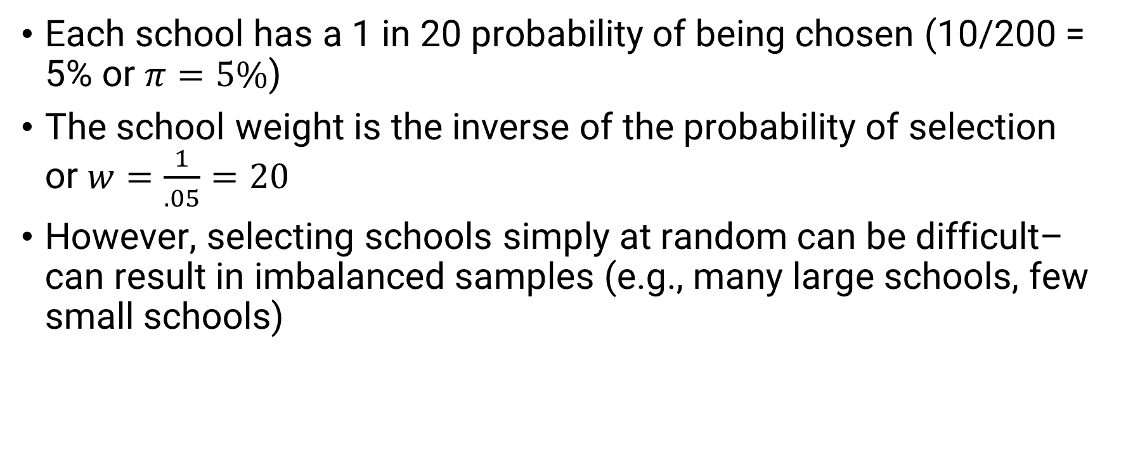
If we have a population of 200 schools and we select 10 schools at random (for example)…
Each school has a 1 in 20 probability of being chosen (10/200 = 5% or $π=5\%$)
The school weight is the inverse of the probability of selection or $w=\frac{1}{.05}=20$
However, selecting schools simply at random can be difficult– can result in imbalanced samples (e.g., many large schools, few small schools)

Slide 22
With ILSAs, schools, which represent the first stage of sampling, are selected probability proportional to size (PPS)
We often also use stratification as well to avoid imbalanced samples (e.g., private vs public schools)
If private schools represent 10% of the population of schools and there are 1000 schools in total, if we chose 150 schools– how many can we expect to sample?
Stratification (subdividing the sample prior to sample selection) can help ensure we get the necessary number of private schools
We may want to OVERSAMPLE certain types of schools so we can analyze subpopulations (e.g., we may want to get 50 private schools)

Slide 23
If we were to compute the proportion of private schools in our sample, we would get 33% (50 / 150)– when there were only 10% in reality!
 | N | N (%) | n | N (%) | Prob | Weight
Public | 9000 | 90% | 100 | 66% | .01 | 90
Private | 1000 | 10% | 50 | 33% | .05 | 20
TOTAL | 10,000 |  | 150
There may also be different nonresponse patterns (e.g., one type of school may be more likely to not participate)
Weights typically adjust for nonresponse: n_{sch} / (n_{sch} – n_{nresp})
Adj Schweight = Schweight x nonresponse adjustment

Slide 24
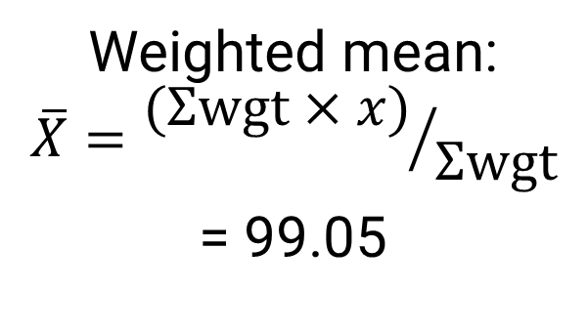

What if also the outcomes differed by group?
 | N | n | Prob | Weight | Score
Public (90%) | 9000 | 100 | .01 | 90 | 100
Private (10%) | 1000 | 50 | .05 | 20 | 90
TOTAL | 10,000 | 150
Unweighted mean:
$$\overline{X}={Σx}/n$$
= 96.64
Weighted mean:
$$\overline{X}={(Σwgt×x)}/{Σwgt}$$
= 99.05

Slide 25
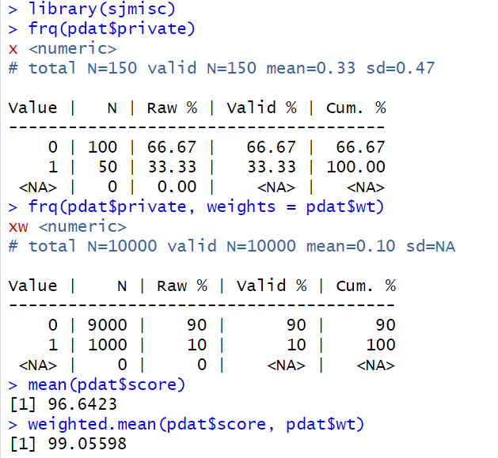
An example using data from the previous page and the sjmisc::frq function

Slide 26
The preceding example only discusses school weights…
However, within a school, a certain number of students (or a classroom) can also be sampled
There is also a student weight that should be considered
The probability of selection of the student in the school
If there are 250 eligible students in a school and 25 students are randomly selected, the chosen students had a 1/10 chance of being chosen
The selected students then have a weight of 10 each
That student weight also is subject to nonresponse (e.g., students refused to participate or was absent on the day of the assessment)
The total weight is sch_weight x stu_weight (incl. all adjustments)
Take note of how these are labelled depending on the dataset (e.g., in PISA, w_fstuwt is the total weight; in TIMSS, TOTWGT is the total weight)

Slide 27
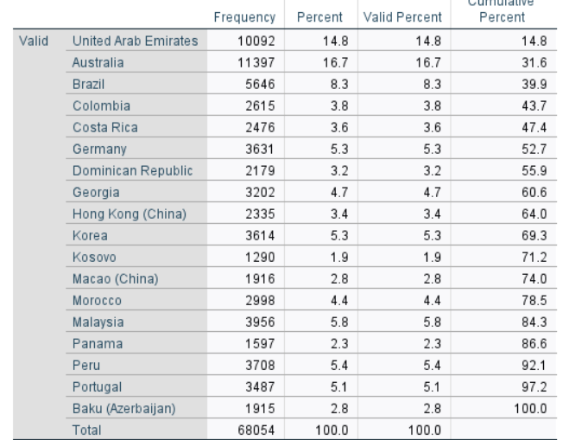
Also, new with PISA 2022, the first cycle to use teacher weighting…
Eighteen countries/economies participated in this (p. 8)
Have not explored the use of these weights yet…
https://www.oecd.org/pisa/data/pisa2022technicalreport/PISA-2022-Technical-Report-Ch-10-PISA-SurveyWeighting.pdf

Slide 28
For proportions and descriptives (as has been shown), easy to see that weights can make a difference
The use of weights has been debated more when used in a regression
However, they can make a difference
In addition, if using multilevel models, care must be taken to consider weights at the different levels as well

Slide 29
In addition to weights, we have to pay attention to clustering (e.g., students within classrooms/schools)
This affects our standard errors (SE)
Affects the precision of our estimates–a measure of sampling error
Since don’t have everyone (i.e., a census), we have some uncertainty about our estimate (i.e., the SE captures this)
If we ignore the clustering, we run the risk of higher Type I errors for higher level variables (violation of observation independence)
Can use multilevel modeling or cluster robust standard errors to account for this (discuss this more in the example)

Slide 30
A note about the test design in ILSAs
ILSA studies use many different items to estimate student achievement for specific domains/sub-domains
Items are allocated to item blocks
Item blocks are allocated to booklets
E.g., for TIMSS 2019:
Each item block appeared in 2 out of 14 booklets
Hence, each student completes one seventh of the full test
If a student completed the entire assessment, would take 10 hours→ instead, takes 90 minutes (Rutkowski et al., 2010)
Source: Rathbun et al. (2024)

Slide 31
Scaling: Item Response Theory (IRT)
Response to an item depends on the interaction between the “ability” of the respondent, and characteristics of the item
IRT allows us to summarize data across multiple items, even if/when different people take different items
IRT facilitates linking when dealing with rotated test forms
Source: Rathbun et al. (2024)c

Slide 32
Plausible values…
IRT estimates an ability distribution for each student using auxiliary variables (“conditioning”)
Student scores are sets of “Plausible Values”
Random draws are made from each student’s ability distribution
Each of these draws constitutes a “plausible value”
The variance between these plausible values reflects the measurement error associated with the test
Source: Rathbun et al. (2024)c

Slide 33
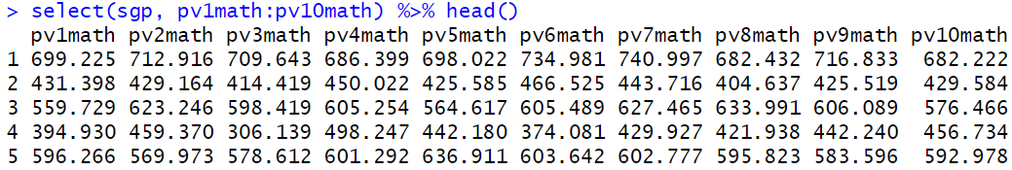
Depending on the ILSA, can have 5 (TIMSS) to 10 plausible values (PISA; 6 obs shown below)
For the final analysis, have to use all the PVs– do not choose just one!
NOTE the variability of the scores within a person
Average scores though are more similar
59-point difference
190-point difference!
566 to 569→ only a 3-point difference!

Slide 34
Plausible values are for…
Estimating population level outcomes
Not for individual level outcomes (e.g., who performed best in school ABC?)
Only for achievement related variables (e.g., math, reading, science)
This is a form of planned missing data

Slide 35
Plausible values should be combined appropriately when conducting any analysis
Combined using Rubin’s (2004) rules (a form of missing data)
Combining the point estimate is easy– just get the average value across all PVs
However, the standard errors require more work– this reflects measurement error
When you perform a regression, perform a regression m number of times (where m is the number of plausible values)
You will then have m results
The output must be combined properly

Slide 36
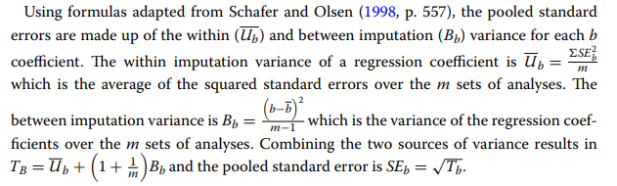
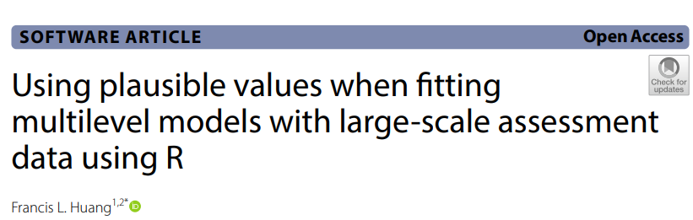
Combining PVs: Analysis are done m number of times

Slide 37
Summary
Use the sampling weights (if we want to generalize to the population)
Account for the clustering effect to get correct standard errors
Account for measurement errors by using all the plausible values (properly!) where appropriate

