Slide 1

Monitoring Real Time Flight Data With ADS-B
Frederick Herzog
Enhance IT
12.17.2020

Slide 2
ADS-B Use Cases
Tracking / monitoring Aircraft
Safety / situational awareness
Flight path / Airspace optimization and Management
Aircraft categorization and classification
Weather
Identification
Detecting Emergencies

Slide 3


Data Source
ADS-B Exchange
Monitor real time flights
Current Coordinates
Altitudes
ICAO’s
Ground and Vertical Speeds
AC Classifications
- www.adsbexchange.com

Slide 4
Producer Design
Localized data
User defined API calls
User arguments for Lat, Lon, Radial Distance, and Location
Updates every 30 seconds

Slide 5




TECHNOLOGY STACK

Slide 6
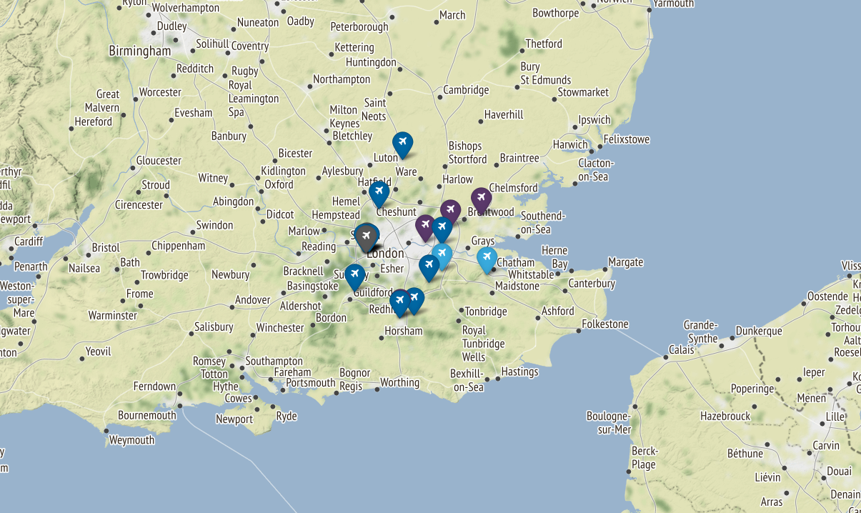
Example
Place your screenshot here
python3 producer.py --dist 25 --loc London

Slide 7
Consumer Design
Spark Dstream
Batch Processing
Hive storage
-- Data stored into an internal table in Hive and overwritten every 30 seconds.

Slide 8

The Data
ICAO (6 digit unique identifier)
AC Registration Number
Operator ICAO (Type designator) i.e. Southwest=SWA
Call Sign
Squawk (4 digit transp code) i.e. 7500 = Hijack code, 7600 = Radio Failure, 7700 = Emergency,
Altitude (ft.) (Standard Pressure)
gAltitude (ft.) (Adjusted for local air pressure)
Ground Speed (knots)
Vertical Speed (ft./min.)
Wake turbulence class -- 0, 1, 2, 0r 3 (size)
On Ground ?
Is Military ?
Track Angle (Across ground clockwise from 0 deg. N.)
Current Heading
Distance from central point
Coordinates
Timestamp

Slide 9

Live Demonstration

Slide 10
THANKS!
Any questions?
You can find me at:
frederick.herzog@enhanceit.us

Slide 11
Future Works
Real-time streaming
Geo-Json
MongoDB?
Graph Database? (Neo4j)
Real-time Visualization
Historical Data

