Slide 1
TRANSFORMERS

Slide 2
INTRODUCTION
TYPES
CONSTRUCTION AND WORKING
LOSSES
APPLICATION

Slide 3
INTRODUCTION
A Transformer is a static device that transfers electrical energy from one electrical circuit to another without change in frequency.
They are also used for increasing or decreasing the alternating voltages in electrical power applications.
A transformer has no internal moving parts, and it transfers energy from one circuit to another by electromagnetic induction

Slide 4
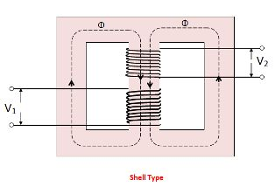
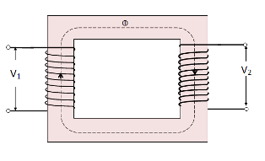
TYPES
On the basis of construction:
Core type Transformer
Shell type Transformer

Slide 5
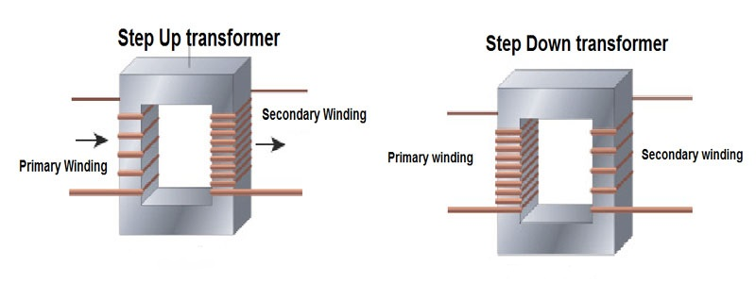
On the basis of purpose:
Step-Up Transformer
Step-Down Transformer

Slide 6
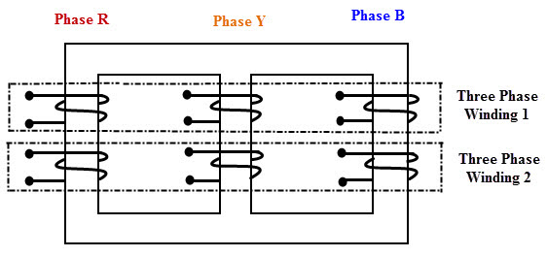
On the basis of the supply:
Single phase Transformer
Three phase Transformer

Slide 7
On the basis of cooling employed
Oil filled Self-Cooled Type:
Oil filled self cooled type uses small and medium-sized distribution transformers .The assembled windings and core of such transformers are mounted in a welded, oil-tight steel tanks provided with a steel cover. The tank is filled with purified, high quality insulating oil as soon as the core is put back at its proper place. The oil helps in transferring the heat from the core and the windings to the case from where it is radiated out to the surroundings.
Oil filled water cooled type:
This type is used for much more economic construction of large transformers as the above told self cooled method is very expensive. The same method is used here as well the windings and the core are immersed in the oil. The only difference is that a cooling coil is mounted near the surface of the oil, through which cold water keeps circulating .This water carries the heat from the device.
Air blast type:
This type is used for transformers that use voltages below 25.000 volts. The transformer is housed in a thin sheet metal box open at both ends through which air is blown from the bottom to the top.

Slide 8
Construction and Working

Slide 9
LOSSES IN A TRANSFORMER

