Slide 1
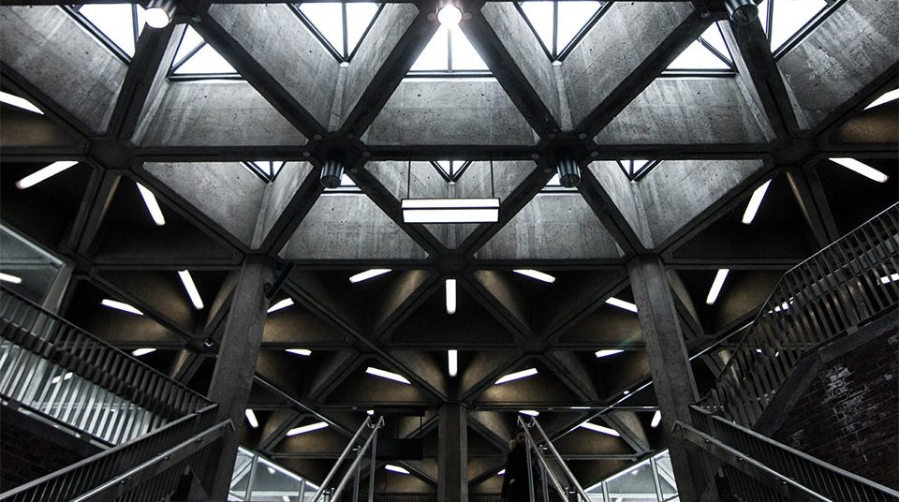
TRANSFORMERS

Slide 2


INDEX
Construct-oin Working
Types
Intro
Applications
Losses

Slide 3

INTRODUCTION
A Transformer is a static device that transfers electrical energy from one electrical circuit to another without change in frequency.
They are also used for increasing or decreasing the alternating voltages in electrical power applications.
A transformer has no internal moving parts, and it transfers energy from one circuit to another by electromagnetic induction

Slide 4
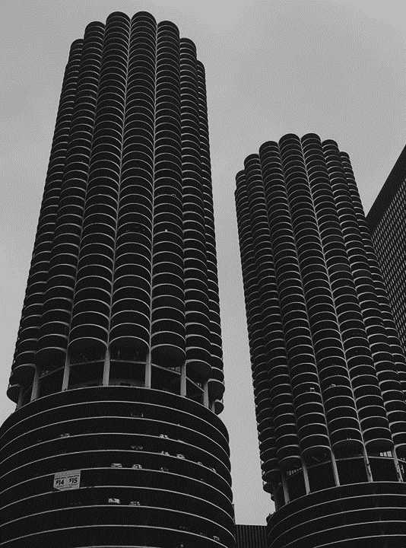
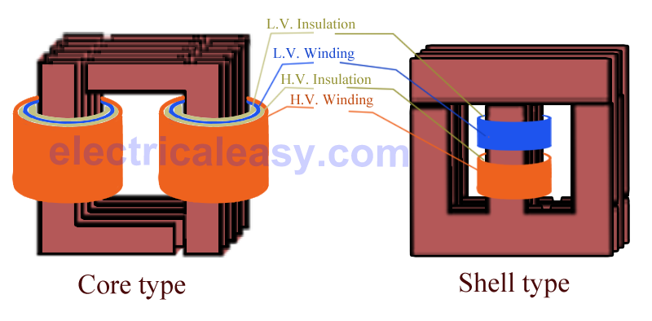
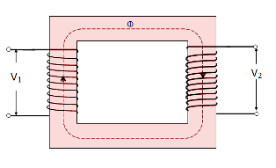
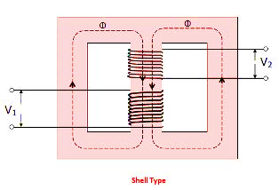
TYPES OF TRANSFORMERS
Core
Windings are cylindrical former wound.
The cylindrical coils have different layers and each layer is insulated from each other.
Shell
Coils are former wound and mounted in layers.
A shell type transformer may have simple rectangular form
Cons-truct-ion

Slide 5

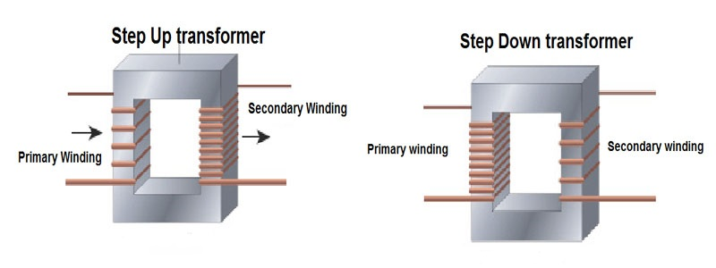
On the basis of purpose:
Step-Up
Step-Down

Slide 6
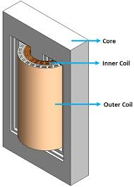
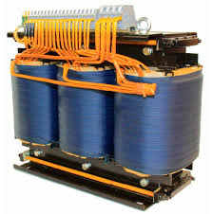
On the basis of SUPPLY:
Single Phase
A single-phase transformer is a type of power transformer that utilizes single phase alternating current.
Three Phase
A three-phase transformer is made of three sets of primary and secondary windings, each set wound around one leg of an iron core assembly.

Slide 7
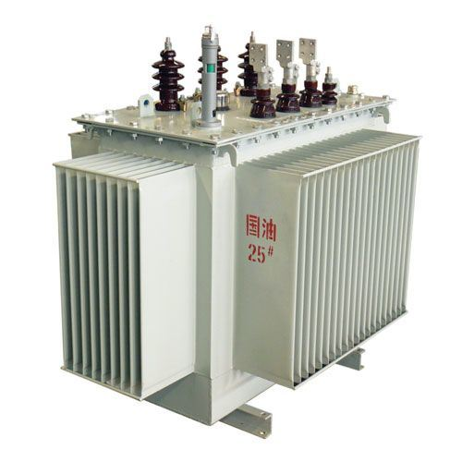
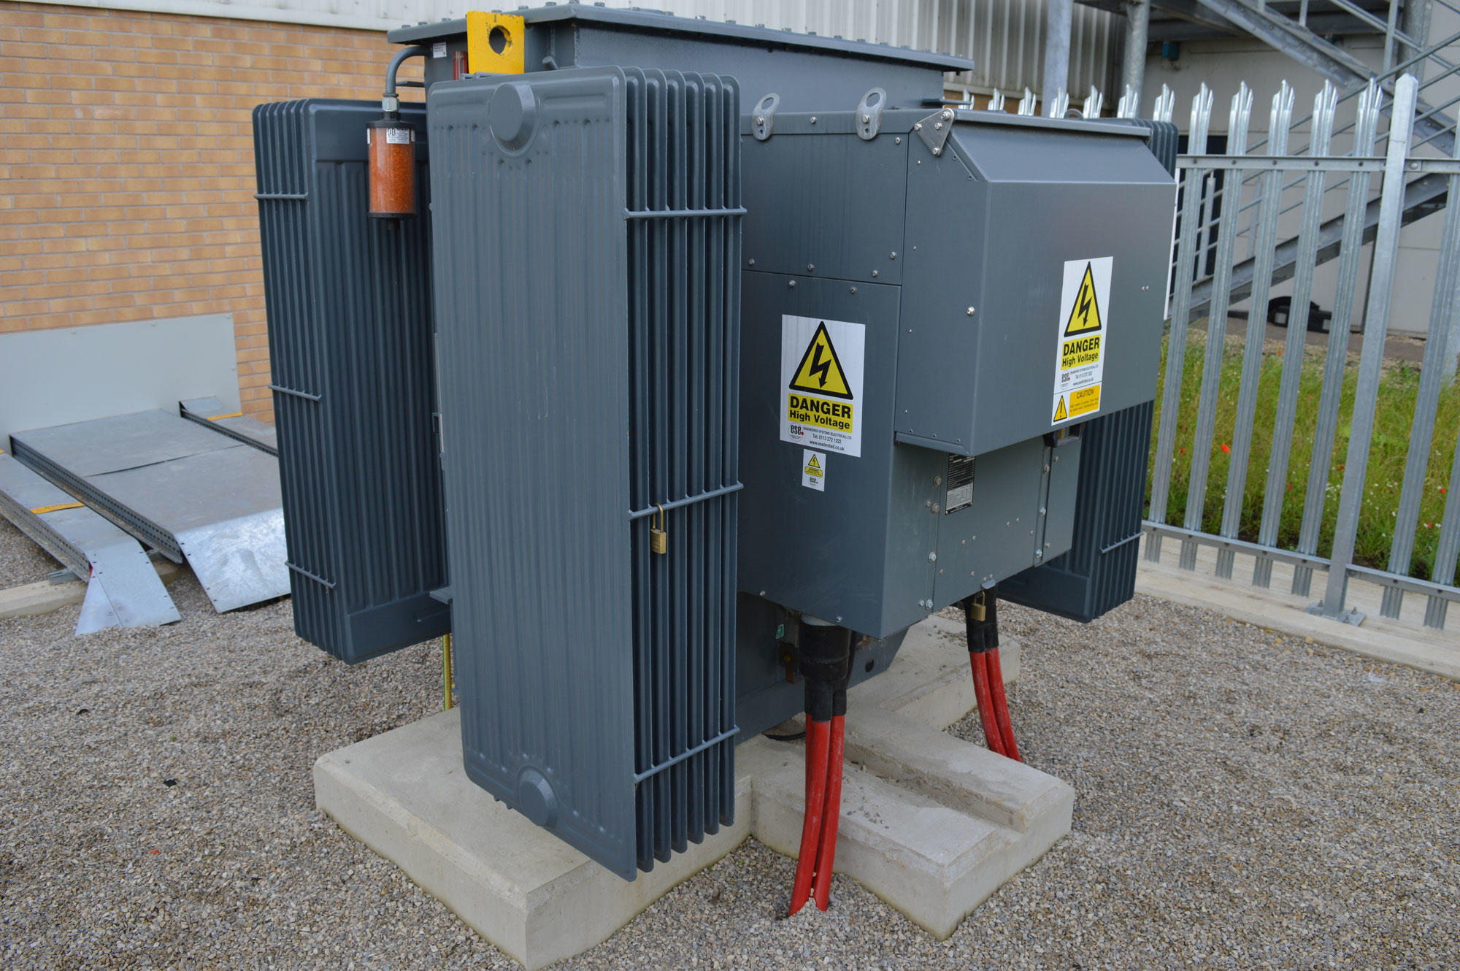
ON BASIS OF COOLING EMPLOYED
Airblast type
Water cooled type
Self cooled type

Slide 8
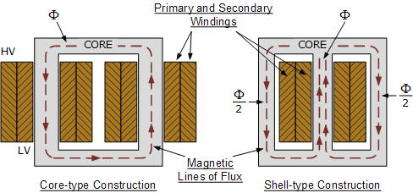
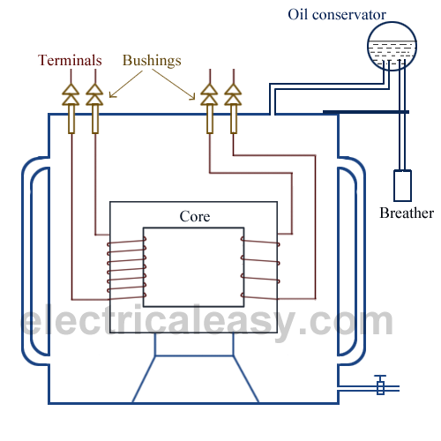
C O N S T R U C T I O N

Slide 9
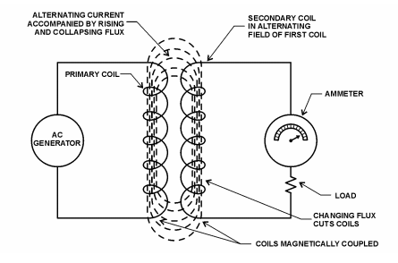
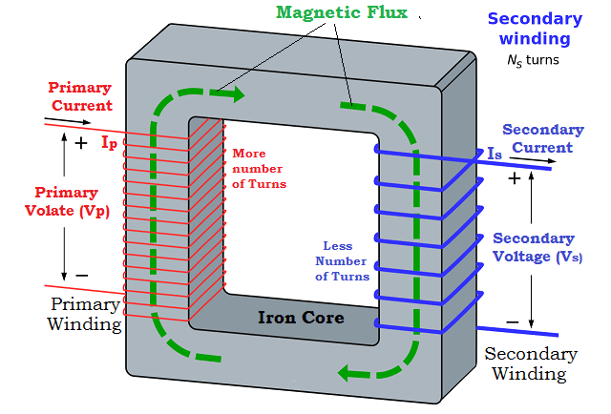
W O R K I N G

Slide 10

Title:
ENERGY LOSS
EDDY CURRENT
HYSTERESIS
WINDING JOULE
E N E R G Y L O S S E S

Slide 11

Title
Winding joule losses
Eddy current losses
Current flowing through a winding's conductor causes joule heating due to the resistance of the wire.
As frequency increases, skin effect and proximity effect causes the winding's resistance and, hence, losses to increase.
Eddy currents are induced in the conductive metal transformer core by the changing magnetic field, and this current flowing through the resistance of the iron dissipates energy as heat in the core.
The eddy current loss is a complex function of the square of supply frequency and inverse square of the material thickness.

Slide 12
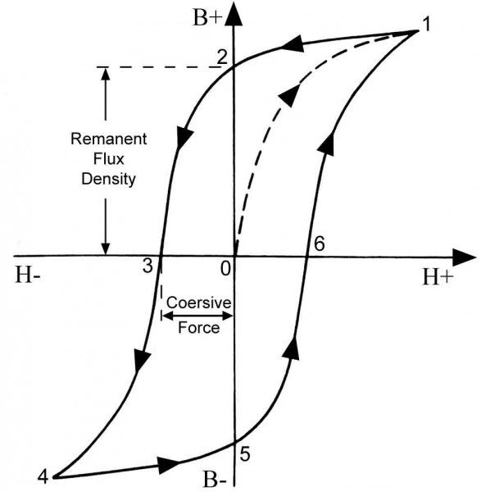
Hysteresis losses
Hysteresis loss is due to the reversal of magnetization of transformer core whenever it is subjected to alternating nature of magnetizing force.
Whenever the core is subjected to an alternating magnetic field, the domain present in the material will change their orientation after every half cycle.
The power consumed by the magnetic domains for changing the orientation after every half cycle is called Hysteresis loss.

Slide 13
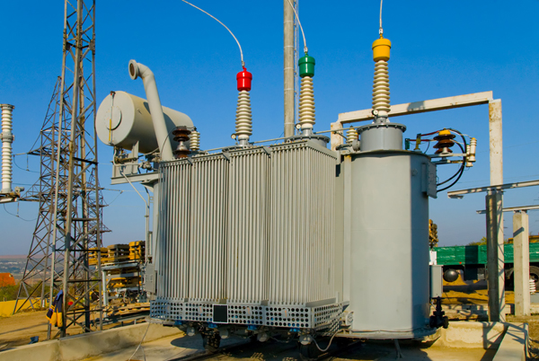
A p p l I c a t I o n s
In electric power transmission, transformers allow transmission of electric power at high voltages, which reduces the loss due to heating of the wires.
This allows generating plants to be located economically at a distance from electrical consumers.

Slide 14
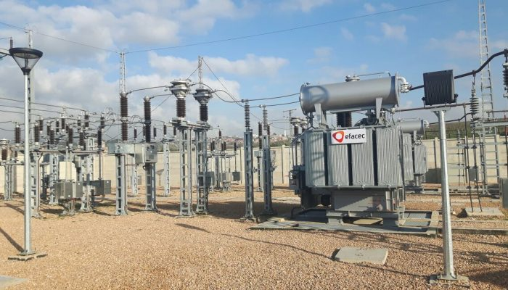
A P P L I C A T I O N S
Signal and audio transformers are used to couple stages of amplifiers and to match devices such as microphones and record players to the input of amplifiers.
A balloon transformer converts a signal that is referenced to ground to a signal that has balanced voltages to ground, such as between external cables and internal circuits.

Slide 15
T H A N K Y O U

