Slide 1
Second order liner homogenous recurrence relation
Defination:
A recurrence relation of the form c_{n}a_{n} + c_{n-1}a_{n-1} + c_{n-2}a_{n-2} = 0 ——> (1) is called a second order linear homogeneous recurrence relation with constant coefficients. Solution to this is in form a_{n} = ck^{n} where c, k!=0 Putting this in (1) c_{n}ck^{n} + c_{n-1}ck^{n-1} + c_{n-2}ck^{n-2} = 0 c_{n}k² + c_{n-1}k + c_{n-2} = 0 —–> (2) Thus, a_{n} = ck^{n} is solution of (1) if k satisfies quadratic equation (2). This equation is called characteristic equation for relation (1).

Slide 2
Real and Distinct roots
3 cases
Repeated Real Roots
Complex roots

Slide 3


Procedure to solve:
Given equation
Change the given equation $a_{n}$ into $r^{n}$
Divide by the lowest $a_{n}$
Quadric equation
Find the two roots r1 , r2
Solve

Slide 4
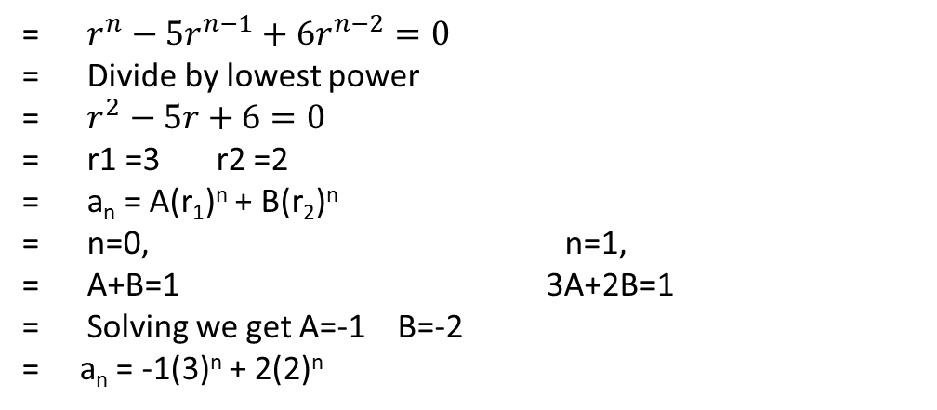

Case 1: If the two roots k₁, k₂ of equation are real and distinct then, we take a_{n} = A(k₁)^{n} + B(k₂)^{n}
as general solution of (1) where A and B are arbitrary real constants.
Problem :
a_{n} =5$a_{n−1}−6a_{n−2}$ where $a_{0}=1 a_{1}=1$
= $r^{n}−{5r}^{n−1}+{6r}^{n−2}=0$
= Divide by lowest power
= $r^{2}−5r+6=0$
= r1 =3 r2 =2
= a_{n} = A(r₁)^{n} + B(r₂)^{n}
= n=0, n=1,
= A+B=1 3A+2B=1
= Solving we get A=-1 B=-2
= a_{n} = -1(3)^{n} + 2(2)^{n}

Slide 5


Case 2: If the two roots k₁, k₂ of equation are real and equal, with k as common value then, we take a_{n} = (A + Bn)k^{n}
as general solution of (1) where A and B are arbitrary real constants.
Problem:
a_{n} =6$a_{n−1}−9a_{n−2}$ where $a_{0}=1 a_{1}=1$
Ans =
a_{n} = 1(3)^{n} + ${\text{(-2/}\text{3}\text{)}}_{n}$(3)^{n}

Slide 6
Case 3: If the two roots k₁ and k₂ of equation are complex then, k₁ and k₂ are complex conjugate of each other i.e k₁ = p + iq and k₂ = p – iq and we take a_{n} = r^{n}(Acosnθ + Bsinnθ)
as general solution of (1) where A and B are arbitrary complex constants, r = |k₁| = |k₂| = √p² + q² and θ = tan⁻¹(q/p).

