Slide 1
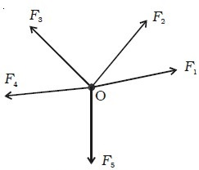
Coplanar Concurrent Forces
A force system is said to be Coplanar and Concurrent , if the lines of action of all the forces lie in one plane and intersect at a common point

Slide 2
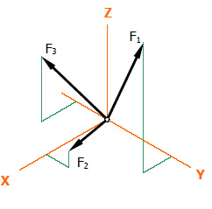
Non-coplanar Concurrent Forces
A force system is said to be Non-coplanar and Concurrent , if the lines of action of all the forces lie different plane and intersect at a common point

Slide 3
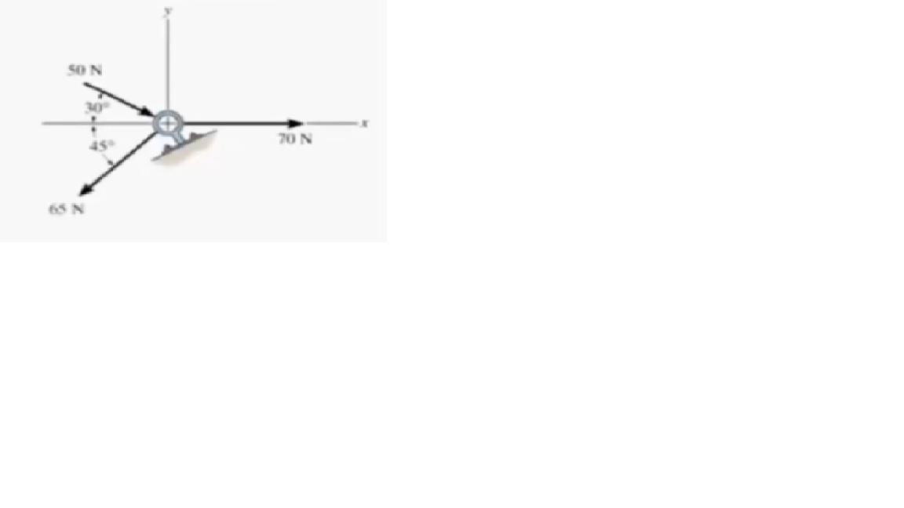
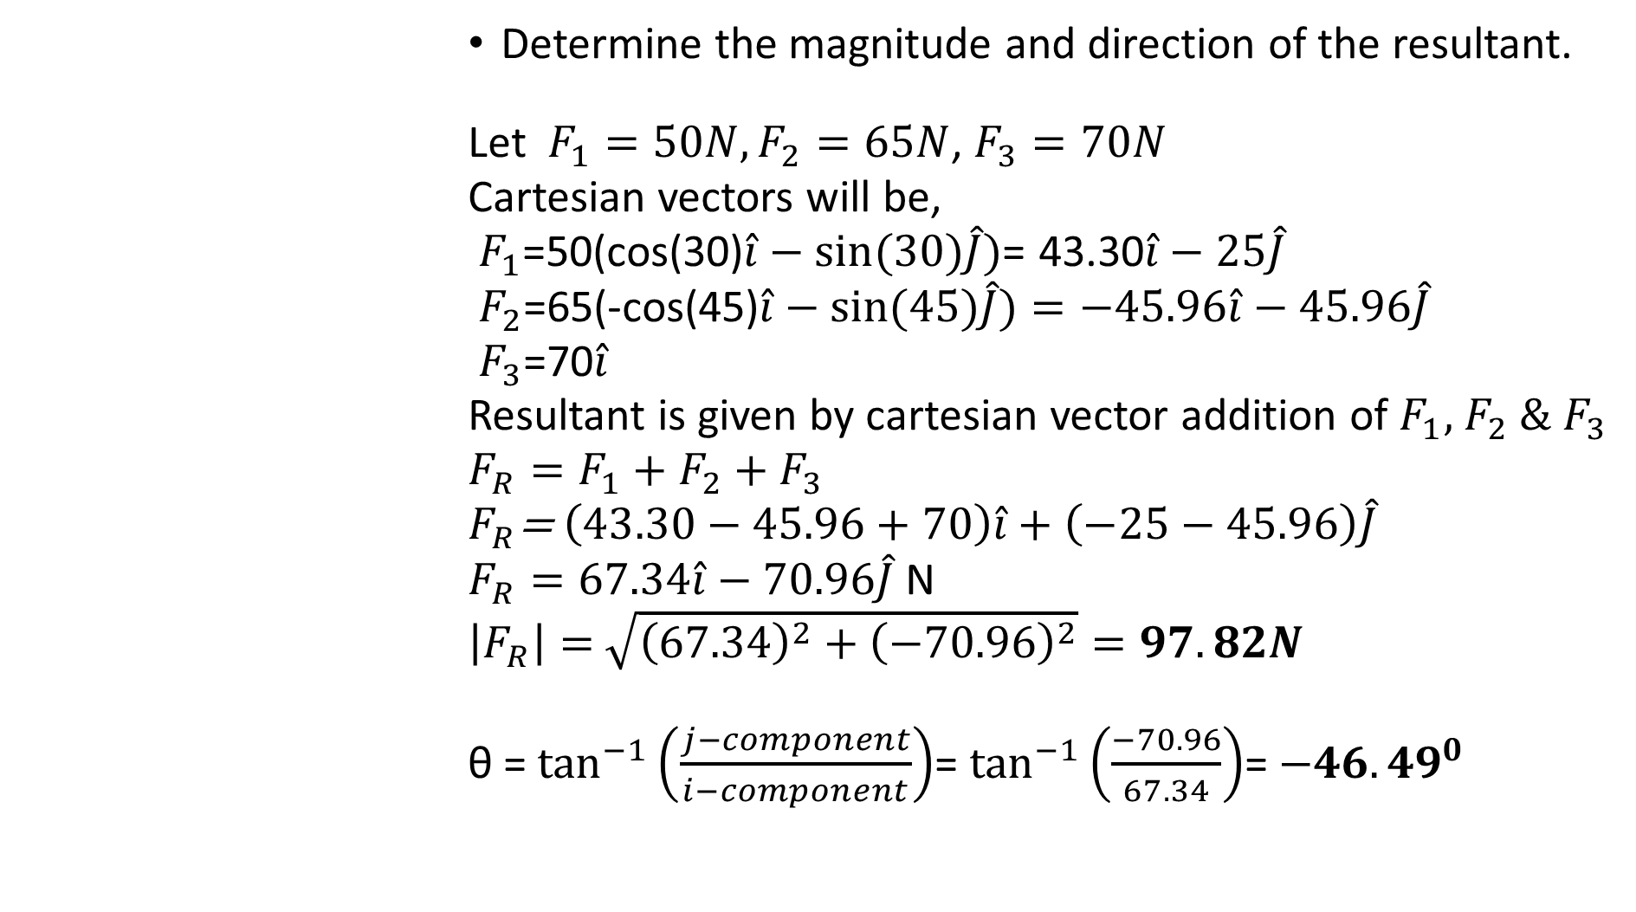
Determine the magnitude and direction of the resultant.
Let $F_{1}=50N,F_{2}=65N$, $F_{3}=70N$
Cartesian vectors will be,
$F_{1}$=50(cos(30)$\hat{i}−sin⁡(30)\hat{J})$= 43.30$\hat{i}−25\hat{J}$
$F_{2}$=65(-cos(45)$\hat{i}−sin⁡(45)\hat{J})=$ $−45.96\hat{i}−45.96\hat{J}$
$F_{3}$=70$\hat{i}$
Resultant is given by cartesian vector addition of $F_{1},$ $F_{2} \&$ $F_{3}$
$F_{R}=F_{1}+F_{2}+$ $F_{3}$
$F_{R}$= $\left(43.30−45.96+70\right)\hat{i}+\left(−25−45.96\right)\hat{J}$
$F_{R}=67.34\hat{i}−70.96\hat{J}$ N
$\left|F_{R}\right|=$ $\sqrt{{\left(67.34\right)}^{2}+{\left(−70.96\right)}^{2}}=97.82N$
θ = $\tan^{−1}\left(\frac{j−component}{i−component}\right)$= $\tan^{−1}\left(\frac{−70.96}{67.34}\right)$= ${−46.49}^{0}$

Slide 4
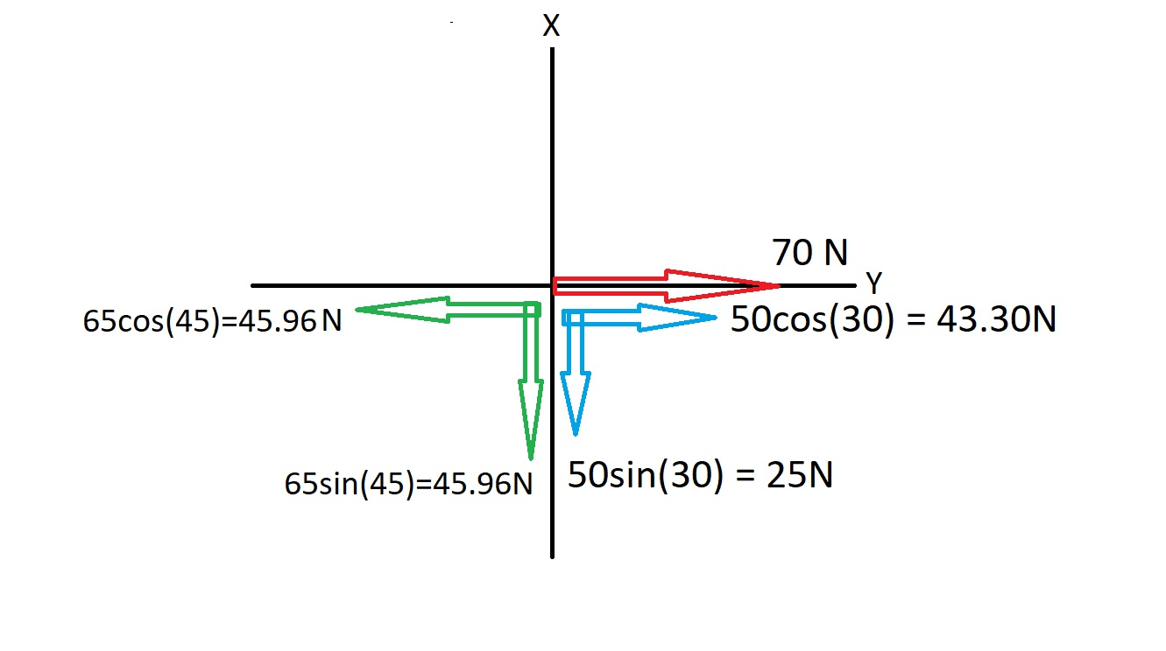

∑ $F_{x}=43.30+70−45.96=67.34N$
∑ $F_{Y}=−25−45.96=−70.96N$
$F_{R}=$ $\sqrt{{\left(\text{∑ }F_{x}\right)}^{2}+{\left(\text{∑ }F_{Y}\right)}^{2}}= \sqrt{{\left(\text{67.34}\right)}^{2}+{\left(\text{-70.96}\right)}^{2}}=97.82N$
θ = $\tan^{−1}\left(\frac{\text{∑ }F_{Y}}{\text{∑ }F_{x}}\right)$= $\tan^{−1}\left(\frac{−70.96}{67.34}\right)$= ${−46.49}^{0}$

Slide 5
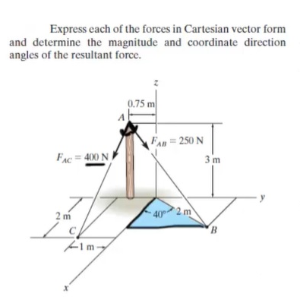
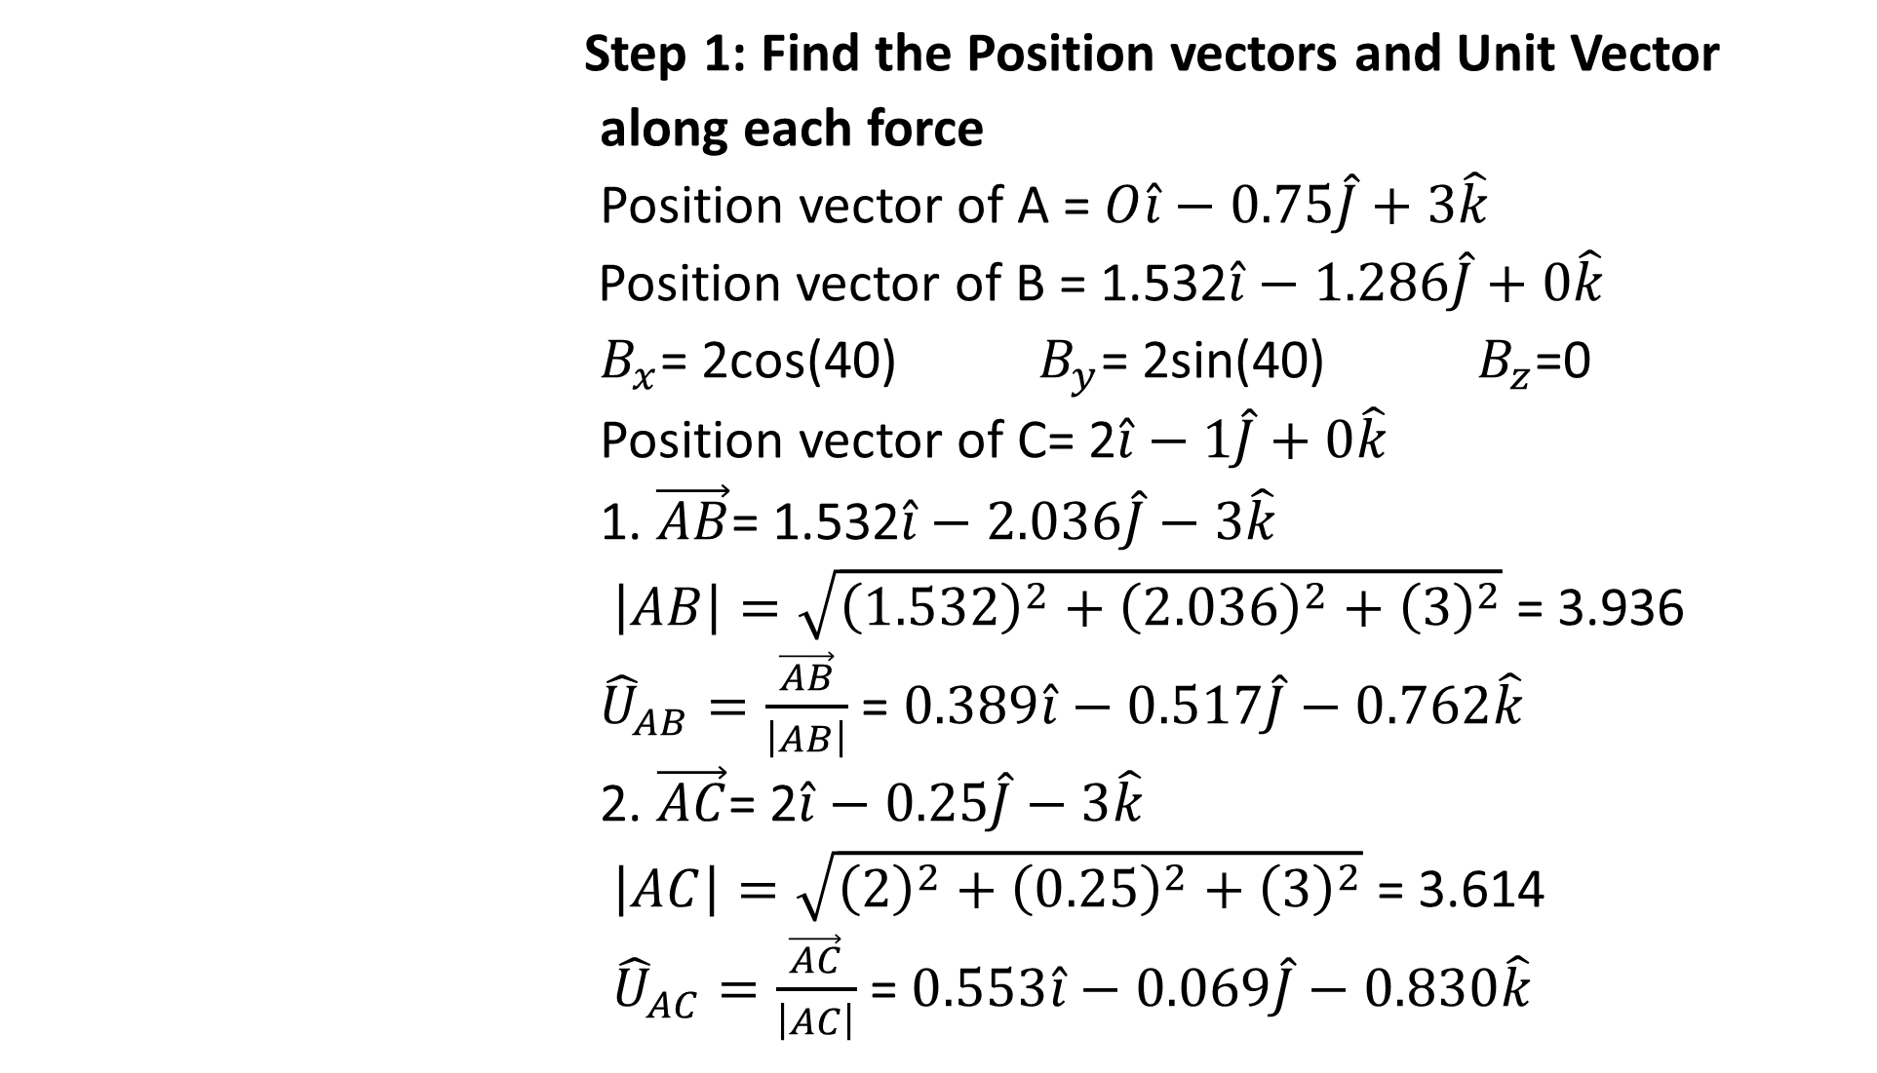
Step 1: Find the Position vectors and Unit Vector
along each force
Position vector of A =$O\hat{i}−0.75\hat{J}+3\hat{k}$
Position vector of B = 1.532$\hat{i}−1.286\hat{J}+0\hat{k}$
$B_{x}$= 2cos(40) $B_{y}$= 2sin(40) $B_{z}$=0
Position vector of C= 2$\hat{i}−1\hat{J}+0\hat{k}$
1. $\vec{AB}$= 1.532$\hat{i}−2.036\hat{J}−3\hat{k}$
$\left|AB\right|=\sqrt{{\left(1.532\right)}^{2}+{\left(2.036\right)}^{2}+{\left(3\right)}^{2}}$ = 3.936
${\hat{U}}_{AB}=\frac{\vec{AB}}{\left|AB\right|}$ = $0.389\hat{i}−0.517\hat{J}−0.762\hat{k}$
2. $\vec{AC}$= 2$\hat{i}−0.25\hat{J}−3\hat{k}$
$\left|AC\right|=\sqrt{{\left(2\right)}^{2}+{\left(0.25\right)}^{2}+{\left(3\right)}^{2}}$ = 3.614
${\hat{U}}_{AC}=\frac{\vec{AC}}{\left|AC\right|}$ = $0.553\hat{i}−0.069\hat{J}−0.830\hat{k}$

Slide 6
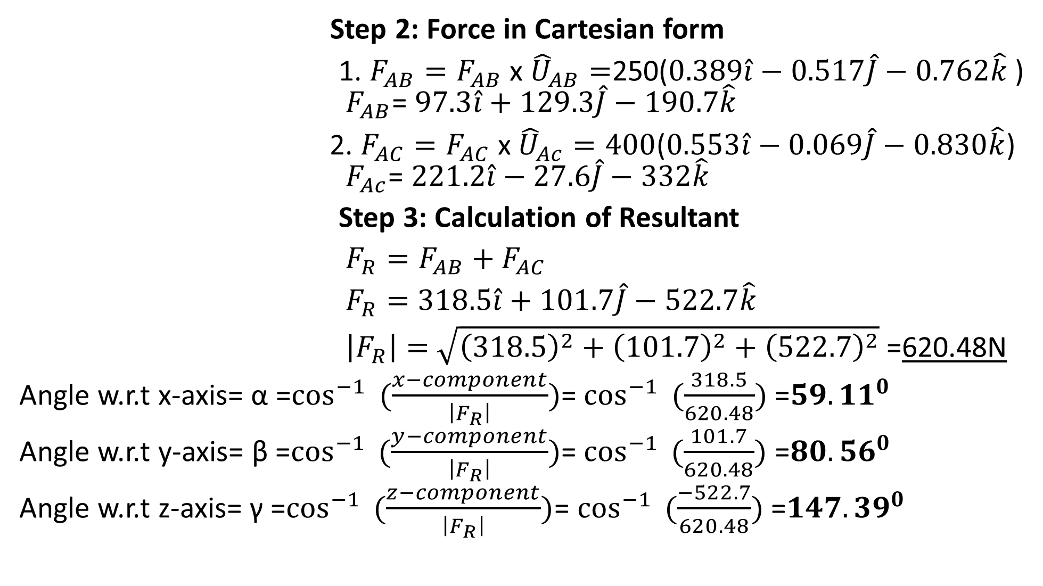
Step 2: Force in Cartesian form
1. $F_{AB}=F_{AB}$ x ${\hat{U}}_{AB}=$250($0.389\hat{i}−0.517\hat{J}−0.762\hat{k}$) $F_{AB}$= $97.3\hat{i}+129.3\hat{J}−190.7\hat{k}$
2. $F_{AC}=F_{AC}$ x ${\hat{U}}_{Ac}=400$($0.553\hat{i}−0.069\hat{J}−0.830\hat{k}$) $F_{Ac}$= $221.2\hat{i}−27.6\hat{J}−332\hat{k}$
Step 3: Calculation of Resultant
$F_{R}=F_{AB}+F_{AC}$
$F_{R}=$ $318.5\hat{i}+101.7\hat{J}−522.7\hat{k}$
$\left|F_{R}\right|=$ $\sqrt{{\left(318.5\right)}^{2}+{\left(101.7\right)}^{2}+{\left(522.7\right)}^{2}}$ =620.48N
Angle w.r.t x-axis= α =$\cos^{−1}{ (\frac{x−component}{\left|F_{R}\right|})}$= $\cos^{−1}{ (\frac{318.5}{620.48})}$ =${59.11}^{0}$
Angle w.r.t y-axis= β =$\cos^{−1}{ (\frac{y−component}{\left|F_{R}\right|})}$= $\cos^{−1}{ (\frac{101.7}{620.48})}$ =${80.56}^{0}$
Angle w.r.t z-axis= γ =$\cos^{−1}{ (\frac{z−component}{\left|F_{R}\right|})}$= $\cos^{−1}{ (\frac{−522.7}{620.48})}$ =${147.39}^{0}$

