Slide 1

MBDCPS
Project 1
Group 24

Slide 2
Task 2
Positive roll change
Negative pitch change
Positive Yaw change
The unit of the accelerometer: m/s^2
When standing on table: It reads [0 0 1]^T.
When upside down: It reads [0 0 -1]^T.
When free fall: It reads [0 0 0]^T
Freefall rotate: It will read [0 0 0]^T
Freefall upside down: It will read [0 0 0]^T

Slide 3
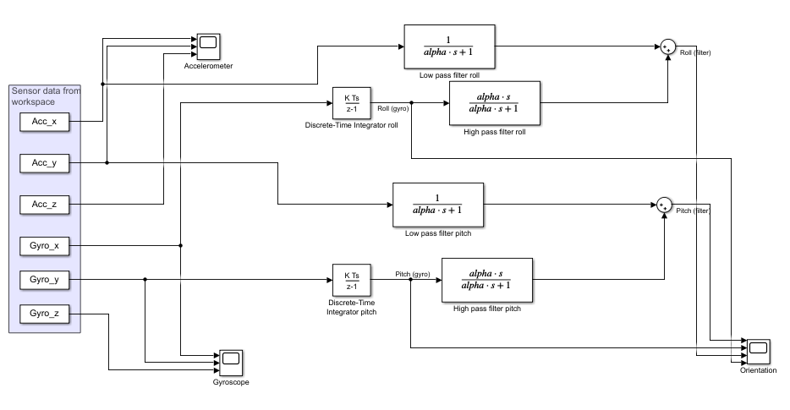
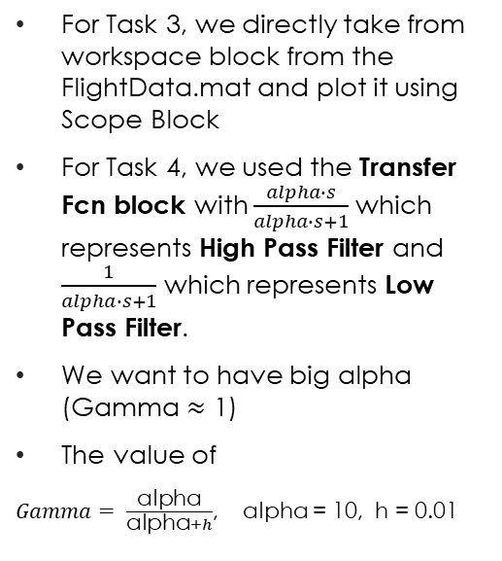
Simulink Structure
For Task 3, we directly take from workspace block from the FlightData.mat and plot it using Scope Block
For Task 4, we used the Transfer Fcn block with $\frac{alpha∙s}{alpha∙s+1}$ which represents High Pass Filter and $\frac{1}{alpha∙s+1}$ which represents Low Pass Filter.
We want to have big alpha (Gamma $≈$ 1)
The value of
$Gamma= \frac{\text{alpha}}{\text{alpha}+h}$, alpha = 10, h = 0.01
Figure 1. Simulink Block Structure

Slide 4
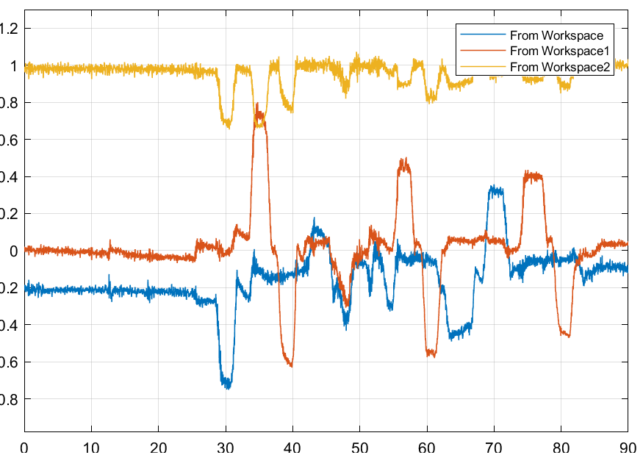
Accelerometer Data Plot (Task 3)
The following showed us the result from the scope
Blue indicates x-direction
Red indicates y-direction
Yellow indicates z-direction
Figure 2. Simulink Block Structure and Resulting Acceleration Plot

Slide 5
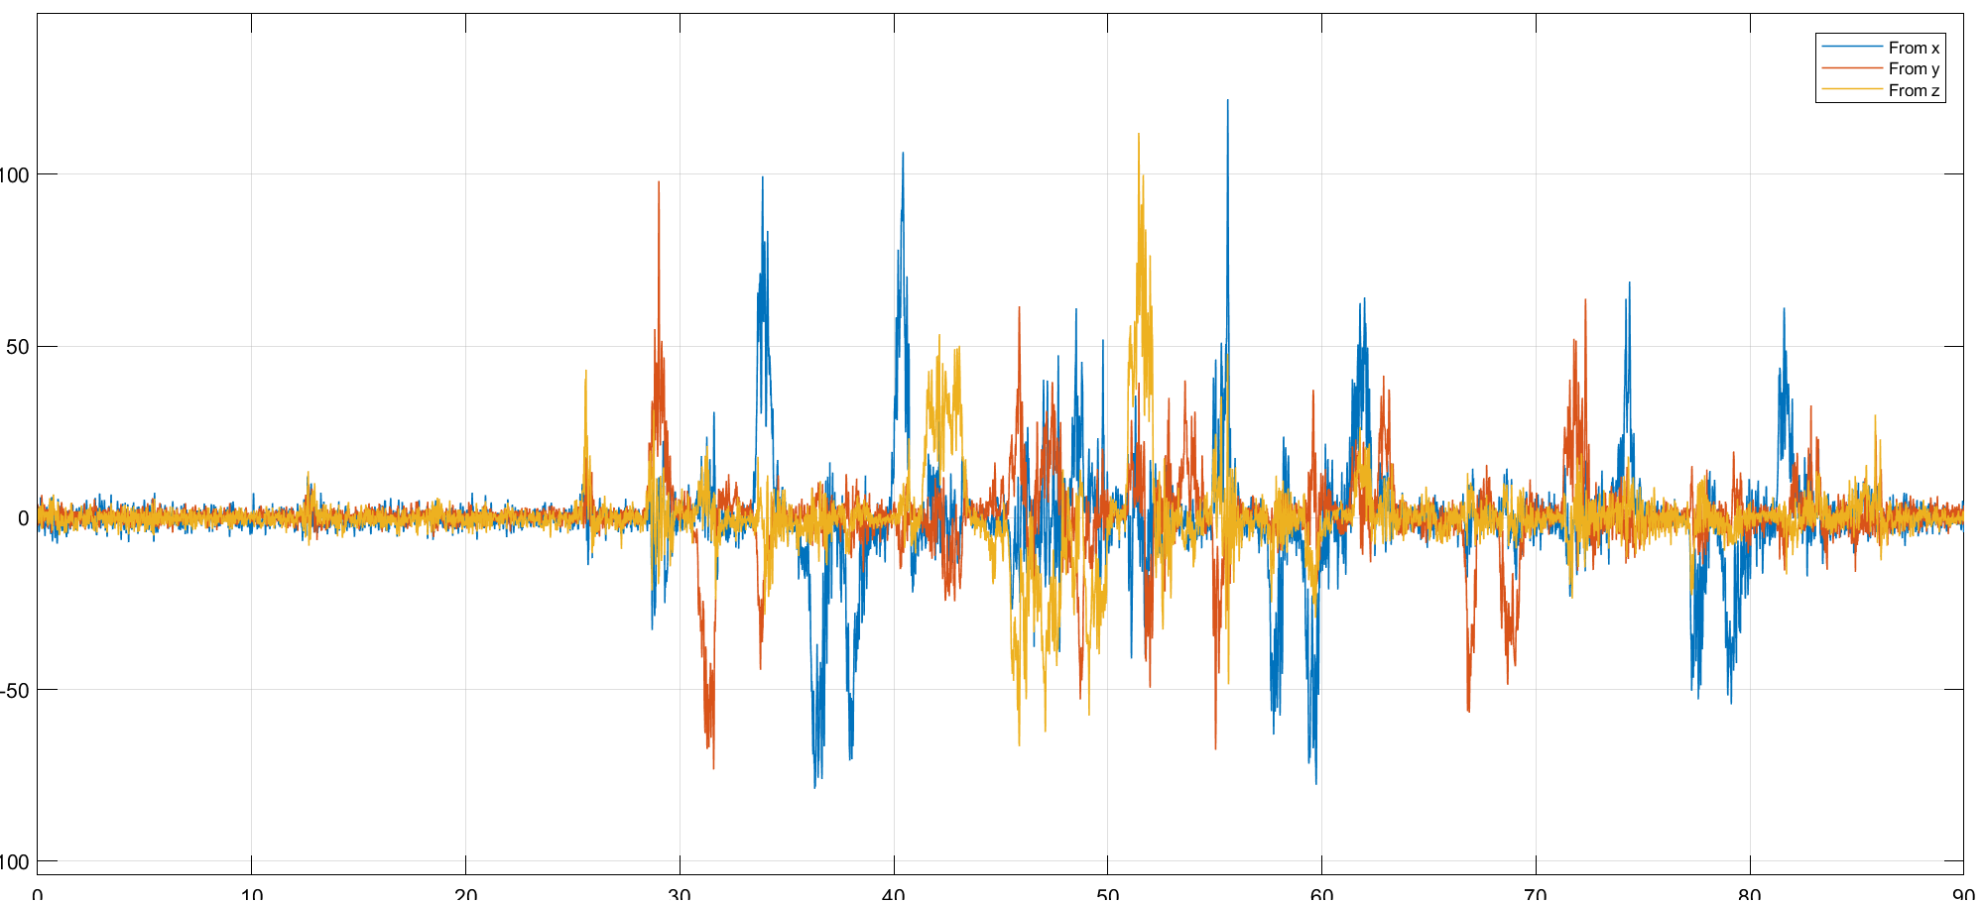
Gyro Data Plot (Task 3)
The following showed us the result from the scope
Blue indicates x-direction (Roll rate)
Red indicates y-direction (Pitch rate)
Yellow indicates z-direction (Yaw Velocity)
Figure 3. Simulink Block Structure and Resulting Rotational Velocity Plot

Slide 6
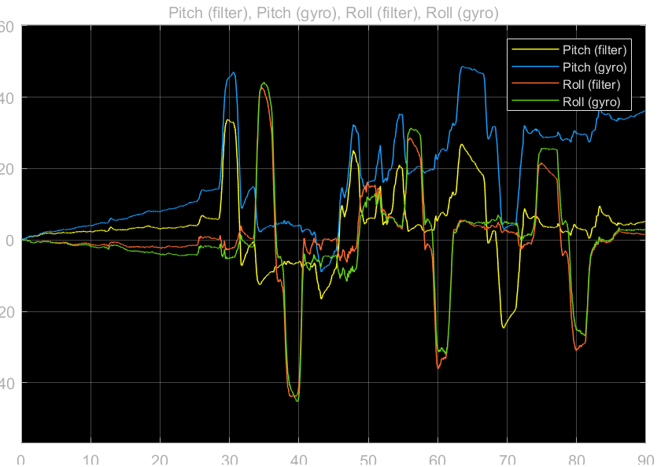
Filtered Roll Result Comparison (Task 4 & 5)
Roll: the gyro and the filter seems to follow each other. No big difference.
Pitch: the gyro result is drifting away, which is a result by integration of small errors, this one is not stable. But the filter is.
Figure 4. Roll Result from Integrated Gyro data
Figure 5. Roll and Pitch Result from Complementary Filter

Slide 7
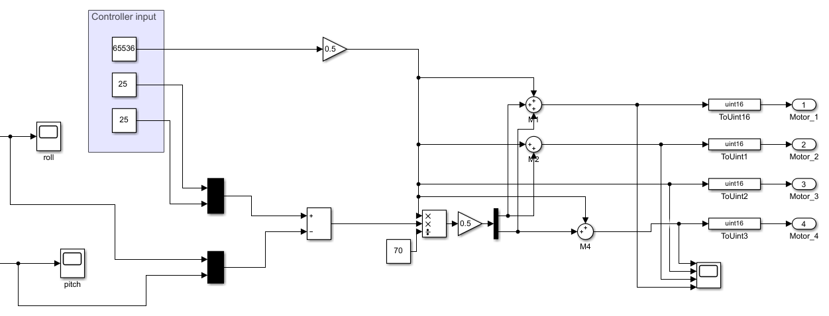
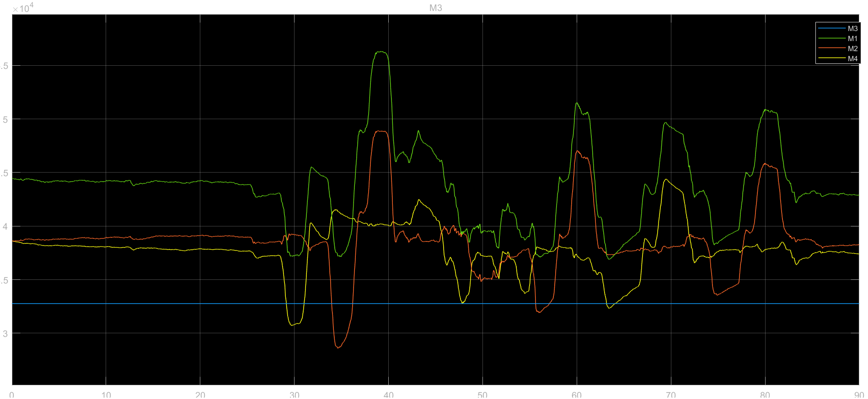
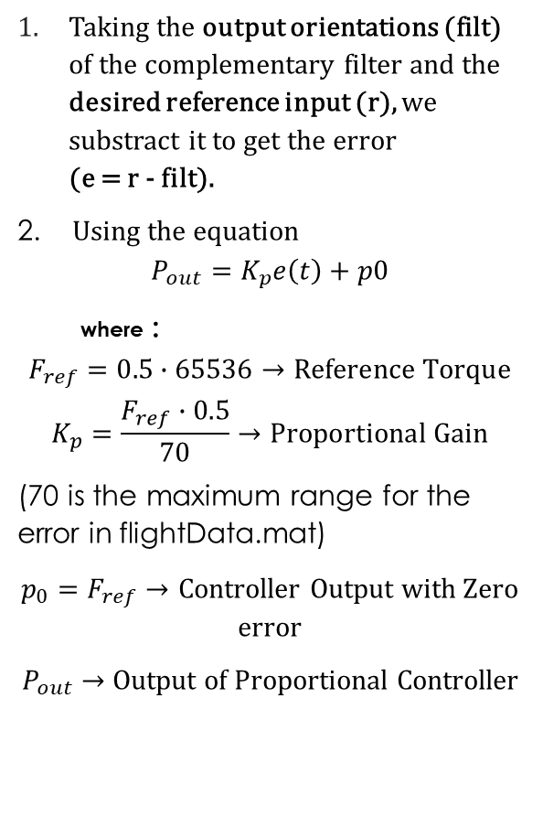
P- Controller (Task 6)
Taking the output orientations (filt) of the complementary filter and the desired reference input (r), we substract it to get the error (e = r - filt).
2. Using the equation
$$P_{out}=K_{p}e\left(t\right)+p0$$
where :
$$F_{ref}=0.5∙65536→Reference Torque$$
$$K_{p}=\frac{F_{ref}∙0.5}{70}→Proportional Gain$$
(70 is the maximum range for the error in flightData.mat)
$p_{0}=F_{ref}→$ Controller Output with Zero error
$P_{out}$ $→$ Output of Proportional Controller
1
2
Figure. P-Controller Structure
Figure. Control Output for each Motors (M1,M2,M3,M4)

