Slide 1
Release the TURTLES A Pure Tcl Interface to Dynamic Proc Tracing Tcl Conference 2019 Michael Yantosca FlightAware
7 November 2019

Slide 2


Outline
Introduction
Design and Implementation
Experiments
Conclusions
Future Work

Slide 3
Introduction
TURTLES
Tcl Universal Recursive Trace Log Execution Scrutinizer
captures dynamic call record information
limited to immediate caller/callee relationship
records inclusive time in proc
fork-safe (to a point)
probably not thread-safe
for now

Slide 4
Introduction
Motivation
Multi-Machine HyperFeed (MMHF) project
Extensive refactoring of codebase in progress for…
Performance
Modularity
Legibility
Maintainability
Étude in Tcl introspection
Self-professed Tcl neophyte
Wanted an immersive project to dive headfirst into the language

Slide 5
Introduction
Available tools
Cmdtrace
Comprehensive logging of commands
Verbose output
Tcl Dissassemble
Potentially useful for static analysis
Need dynamic analysis to measure execution timings

Slide 6
Design and Implementation
Package Organization
Initialization
Collection
Finalization
Analysis

Slide 7
Design and Implementation: Package Organization
::turtles
all the things

Slide 8
Design and Implementation: Package Organization
::turtles::persistence
mechanisms for saving trace artifacts
alias for ::turtles::persistence::mt or ::turtles::persistence::ev
::turtles::persistence::base
common persistence functionality
::turtles::persistence::mt
multi-threaded persistence scheduling
::turtles::persistence::ev
Tcl event loop persistence scheduling

Slide 9
Design and Implementation: Package Organization
::turtles::bale
clustering based on GHS minimum spanning tree
incomplete (more on that later)
::turtles::kmm
k-machine model simulation
also incomplete
cluster.tcl
standalone Tcl script
functioning proc clustering based on BFS flooding

Slide 10
Design and Implementation: Package Organization
::turtles::hashing
hashing helper functions for proc identification
::turtles::options
convenience functions for processing command-line options

Slide 11
Design and Implementation: Package Organization
::turtles::test::integration::mt
integration tests for multi-threaded persistence scheduling
::turtles::test::integration::ev
integration tests for Tcl event loop persistence scheduling
::turtles::test::integration::postmortem
helper functions for validating post-mortem final storage contents

Slide 12
Design and Implementation: Package Organization
Documentation
conference paper
Github README
doxygen comments throughout codebase
make docs
doxygen not required to build and install library
Installation
make install
see README and Makefile for more details

Slide 13
Design and Implementation: Initialization
package require turtles
::turtles::release_the_turtles ::argv
It really is that simple.
But you can choose some non-default parameters.
You can even supply a variable name other than ::argv.
Recommendations
Place this before any imports on packages you want to measure.
i.e., as early as possible

Slide 14
Design and Implementation: Parameterization
Parameters
-enabled
-commitMode (staged|direct)
-scheduleMode (mt|ev)
-intervalMillis <ms>
-dbPath <path>
-dbPrefix <string>
-debug
Specified on command-line
Between +TURTLES … -TURTLES brackets
Destructively consumed to avoid interfering with regular command-line args

Slide 15
Design and Implementation: Persistence Tables
proc_ids
Field | Type | Description
proc_id | INT | hash of proc_name
proc_name | TEXT UNIQUE | fully-qualified, original name of proc
time_defined | INT | time of proc definition in UNIX epoch µs
call_pts
Field | Type | Description
caller_id | INT | hash of caller proc name
callee_id | INT | hash of callee proc name
trace_id | INT | unique identifier distinguishing specific calls from caller to callee
time_enter | INT | time of entry into the callee in UNIX epoch µs
time_leave | INT | time of exit from the callee in UNIX epoch µs

Slide 16

Design and Implementation: Identifiers
Proc ID
Rabin-Karp rolling hash on string $S$
$p=M8=231−1$
$a=M7=219−1$
$h\left(0\right)=0$
$h\left(i\right)=(h\left(i−1\right)a+\text{ord}(S\left[i\right])) \text{mod} p$
Trace ID
Rabin-Karp rolling hash of the following parameters in order:
[thread ID, stack level, caller ID, source line number, callee ID]
replace $S$ from the proc ID formula with the integer list above

Slide 17
Design and Implementation: Auto-Instrumentation
Bootstrapping with proc
proc a {} {
return [b]
}
…
proc b {} {
return 0
}
proc
::turtles::on_proc_define_add_trace
(leave)
::a
::b
::turtles::on_proc_enter
(enter)
::turtles::on_proc_enter
(enter)
::turtles::on_proc_leave
(leave)
::turtles::on_proc_leave
(leave)

Slide 18



Design and Implementation: Collection
proc do_it {} {
…
}
…
do_it
::do_it
Recorder
Stage 0
::turtles::on_proc_enter
(enter)
$$(α,β, γ, t0)$$
::turtles::on_proc_leave
(leave)
$$(α,β, γ, t1)$$
$$α=\text{caller} \text{ID}$$
$$β=\text{callee} \text{ID}$$
$$γ=\text{trace} \text{ID}$$
$$t0=\text{entry} \text{time}$$
$$t1=\text{exit} \text{time}$$

Slide 19
Design and Implementation: Finalization
::turtles::capture_the_turtles
That’s it.

Slide 20
Design and Implementation: Finalization
Scheduler
Recorder
Stage 0
Stage 1
Zzz…

Slide 21
Design and Implementation: Finalization
Scheduler
Recorder
Stage 0
Stage 1
Zzz…

Slide 22
Design and Implementation: Finalization
Scheduler
Recorder
Stage 0
Stage 1
Zzz…

Slide 23
Design and Implementation: Post-Mortem Views
calls_by_callee
Field | Type | Description
callee_name | TEXT UNIQUE | fully-qualified, original name of callee
calls | TEXT UNIQUE | total number of invocations of callee
total_exec_micros | INT | total time spent in callee (µs)
avg_exec_micros | INT | average time spent in callee (µs)
calls_by_caller_callee
Field | Type | Description
caller_name | TEXT UNIQUE | fully-qualified, original name of caller
callee_name | TEXT UNIQUE | fully-qualified, original name of callee
calls | INT | total number of invocations of callee by caller
total_exec_micros | INT | total time spent in callee (µs)
avg_exec_micros | INT | average time spent in callee (µs)
unused_calls
Field | Type | Description
callee_name | TEXT UNIQUE | fully-qualified, original name of callee never invoked

Slide 24
Design and Implementation: Analysis
Clustering Procs
initially attempted w/ Gallagher-Humblet-Spira (GHS) minimum spanning tree
k-machine model implemented in Tcl threads
overkill
development was progressing glacially (weeks)
switched to simple breadth-first-search (BFS) flooding approach
implemented in a day (or two)
turns out to be sufficiently fast for the datasets collected

Slide 25
Design and Implementation: BFS Flooding (Directed)
::b0
::a0
::b2
::a2
::b1
::a1
::c

Slide 26
Design and Implementation: BFS Flooding (Undirected)
::b0
::a0
::b2
::a2
::b1
::a1
::c

Slide 27
Experiments
Test Suite
basic cases
standalone proc
nested procs
fork boundary cases
Slowbird
console application that continuously reads TSV data and provides message statistics
FlightAware onboarding exercise
Multi-Machine HyperFeed (MMHF)
service that manages multiple forked children
children continuously read TSV data

Slide 28
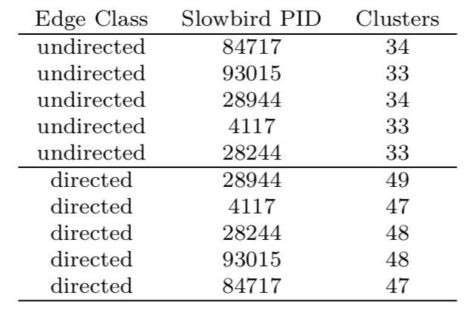
Experiments: Slowbird Cluster Sizes

Slide 29
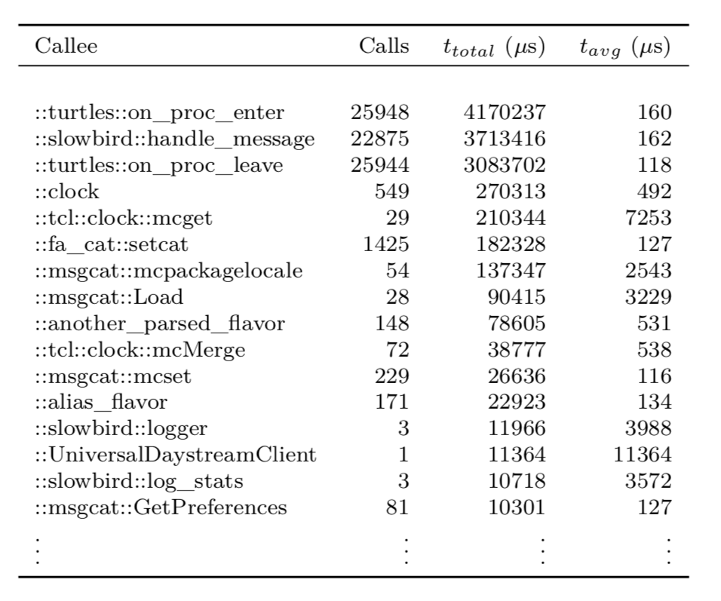
Experiments: Slowbird Execution Timings

Slide 30
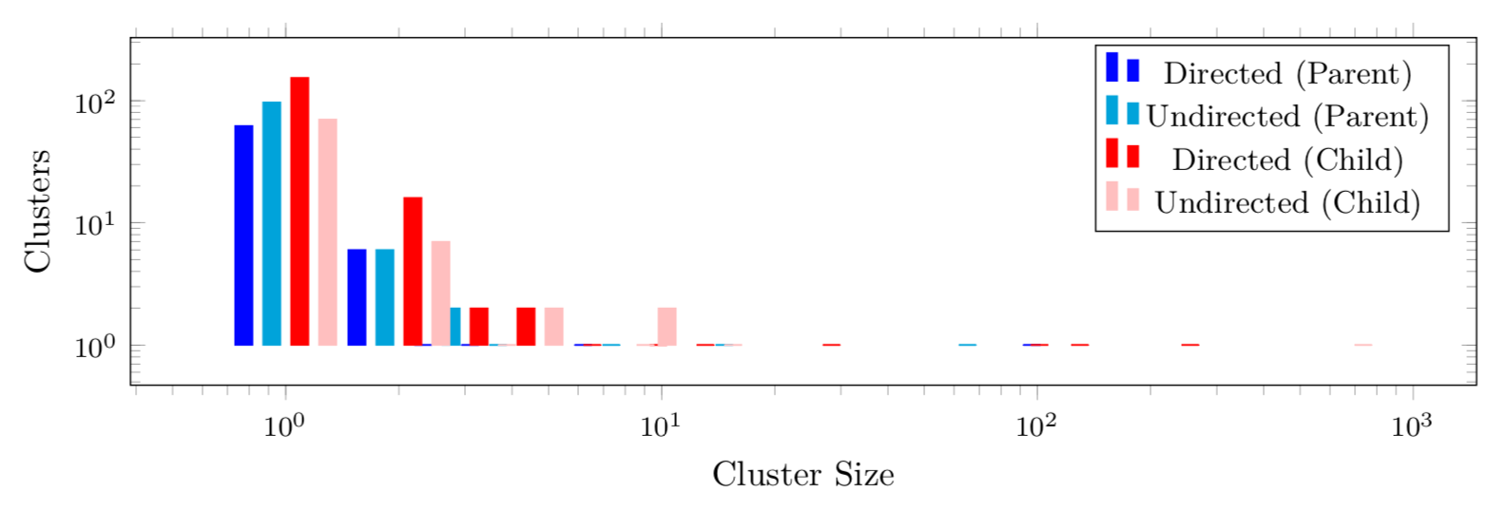
Experiments: MMHF Cluster Size Distribution

Slide 31
Experiments: Unused Procs
Slowbird
Sample run = 779
MMHF
Sample parent = 6324
Sample child = 5581

Slide 32
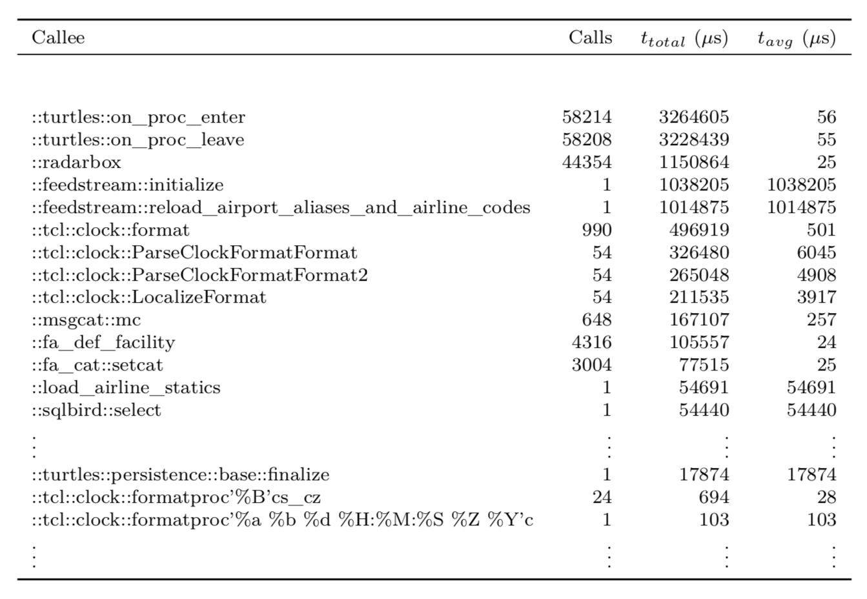
Experiments: MMHF Parent Execution Timings

Slide 33
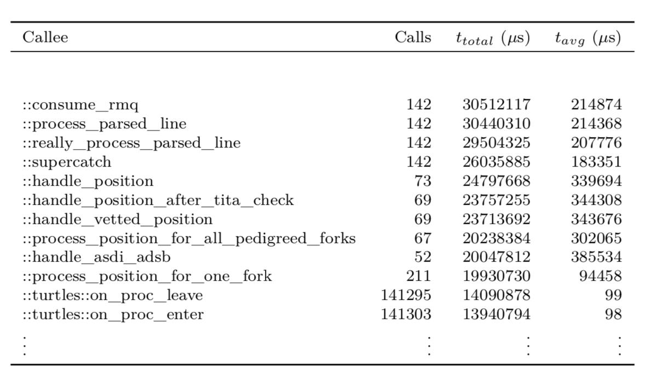
Experiments: MMHF Child Execution Timings

Slide 34
Conclusions
Simplest is often best.
Premature optimization can significantly lower overall development velocity.
Measure performance as you go to avoid getting trapped.
Iterative improvements!
Frameworks don’t always translate (well) across platforms.
e.g., OpenMPI processes →Tcl threads
Play to the strengths of the tools at hand.
a.k.a., How I Learned to Stop Worrying and Love the String.
currying by composition

Slide 35
Conclusions
OS Support
Signal trapping
Issues when using multiple threads
MacOSX support needs improvement
Forking
Scripting runtime lockdowns
EIAS
String escaping can get tedious and hard to track.
E.g., sending snippets across threads
Dictionary comparison
Documentation
More complex example code for non-trivial cases would be welcome.

Slide 36
Conclusions
Introspection
Trace handlers survive fork boundaries.
Information regarding program state is plentiful.
Interpreter isolation
Pro: easier to reason about behavior vs. shared state
Con: cross-thread communication via snippets can be expensive
Boilerplate copy-pasta in MT scenaros

Slide 37
Caveats
Collection on multiple threads is not tested.
It will probably induce contention.
There is a window of potential collection loss over fork boundaries.
It’s small, but it is there.
The TURTLES library induces quite a bit of overhead when enabled.
Be sure to disable for production.

Slide 38
Future Work
Performance improvements
Replace thread messages with shared channels
May need to drop down to C for hash functions
Τrace IDs
Add IDs based on descent path to encapsulate full call stack
Every root level call is assigned a unique ID which all subcalls inherit.
Extension
PostgreSQL support
Variable usage tracking
Retroactive proc/variable inclusion
Full multi-threaded support
implicit loading on ::thread::create?

Slide 39
Repos
TURTLES
https://www.github.com/flightaware/turtles
ghs-coco
actual working implementation of GHS with OpenMPI/C++
inspiration for attempts with ::turtles::bale and ::turtles::kmm
https://www.github.com/myantosca/ghs-coco

Slide 40
Q&A
Any questions?

