Slide 1
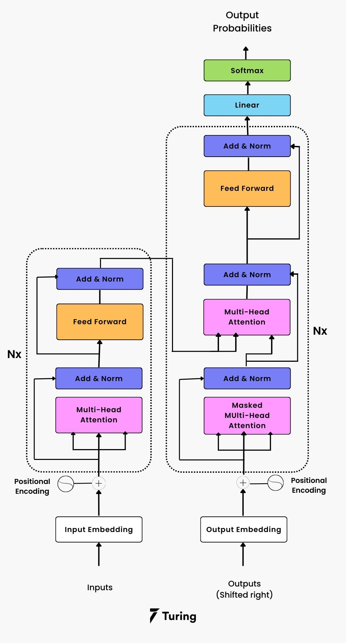
Decoder
Encoder

Slide 2






Self-Attention
Hidden Size
Hidden Size
Sequence Length
$$W^{key}$$
$$Key$$
$$W^{query}$$
$$W^{value}$$
Sequence Length
X
$$Query$$
$$Value$$

Slide 3






Self-Attention
$$Query$$
$${Key}^{T}$$
Sequence Length
$$Softmax(\frac{Score}{\sqrt{d_{k}}})$$
$$Prob$$
Sequence Length
X
Sequence Length
Hidden Size
$$Score$$
$$Prob$$
Hidden Size
Hidden Size
Sequence Length
X
$$Value$$
Sequence Length
$$Z$$

Slide 4





Multi-Attention: Context Projection
Hidden Size
Hidden Size
Hidden Size
Hidden Size
Sequence Length
X
$$Z_{head1}$$
$$Z_{head2}$$
$$Z_{headn}$$
$$Z_{multi−head}$$
$$W^{Context Projection}$$

Slide 5


Add & Layer Normalization
Hidden Size
Sequence Length
Hidden Size
$$Input Sequence$$
Layer Normalization
+
Sequence Length
Sequence Length
$$Z_{multi−head}$$

Slide 6




Feed-Forward
Linear Layer 1
$$W^{Linear}≈2\sim 5 Hidden Size$$
Hidden Size
$$W^{Linear}$$
Sequence Length
X
Gelu / Relu / Relu6..
Sequence Length
Linear Layer 2
Hidden Size
$$W^{Linear}$$
Hidden Size
Sequence Length
Sequence Length
Layer Normalization
X
+
$${Output}_{encoder}$$

Slide 7
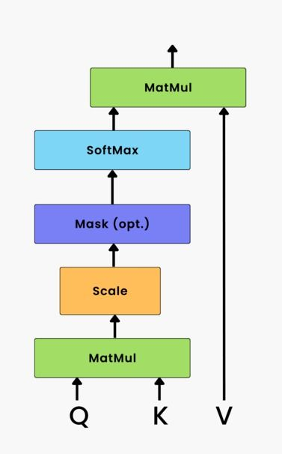



Decoder
$$Masked Score$$
$$Mask$$
·
Sequence Length
Sequence Length
$$Score$$

