Slide 1
Software Quality in Data Science
Implementing data science solutions have to tackle many of the same challenges that traditional software development and engineering has to.
Messy, complicated, untestable and unreadable code is universal!

Slide 2
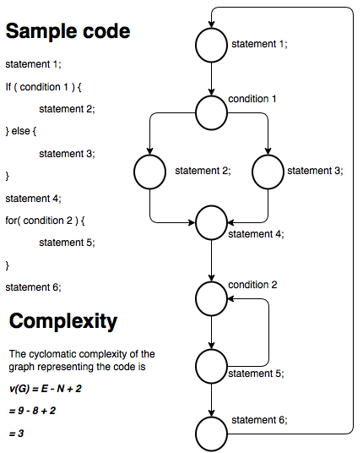
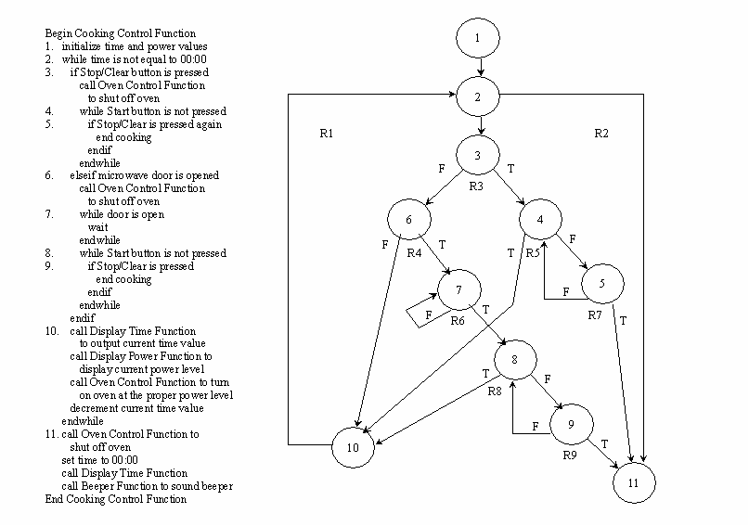

Slide 3
Things to do or discuss
Code review and common code repositories
If your colleague actually understands it – there is hope!
Not for «passing a review test», but to have a professional discussion
Always use pull requests, or merge requests (on GitLab)
Write unit tests
If you can test your code, it is also documented
If you can test your code, it is probably more modular
If you can test your code – it might contain fewer errors
Modularize your code
There is a separate function in there, just look for it!
There is a piece of data that perhaps is too scattered in your code.
Don’t write a function that does not fit on the screen (unless you have a very large screen!) ☺
Communication! There is a lot to discuss and talk about. But how and where, when we are distributed?

