Slide 1
CSC3423 – Bio-computing L02 – Genetic Algorithms
Jaume Bacardit
Jaume.bacardit@newcastle.ac.uk

Slide 2
Outline
Bio-inspired motivation
Historical notes
A simple genetic algorithm
More focus in each stage of the cycle
Advanced topics
Applications

Slide 3
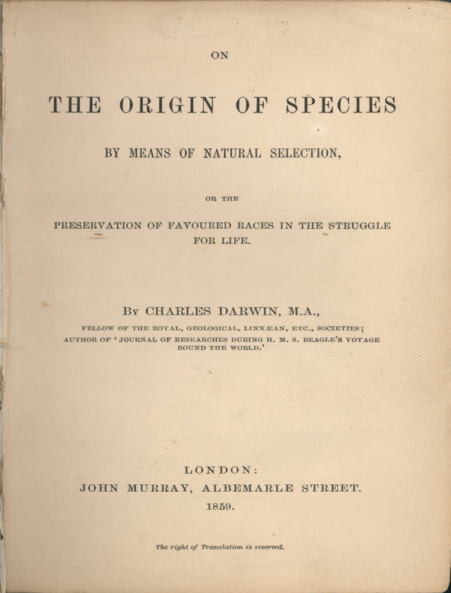
Biological inspirations
Darwin’s Natural selection
“principle by which each slight variation [of a trait], if useful, is preserved”
Individuals that are better adapted to the environment have more chances of reproducing
Their traits are inherited by the later generations

Slide 4
Biological inspirations
Genetics → How solutions are represented, and how information is passed from parents to off-spring
Our genetic code (the blueprints that specify all the functioning of a living organism) is structured in chromosomes, formed by DNA. Each chromosome is divided in functional units called genes
During reproduction the chromosomes from the parents are mixed (picking half the chromosomes of one parent, half from the other) to create off-spring → crossover
In the process leading to reproduction the chromosomes are copied. This copy is not always perfect → mutation

Slide 5
Historical notes
Researchers started tinkering with computer algorithms mimicking evolution since the 50s
In Berlin, Ingo Rechenberg and Hans-Paul Schwefel → evolution strategies
In California, Larry Fogel → evolutionary programming
And In Michigan, John Holland → Genetic Algorithms
These algorithms shared many traits, but these communities didn’t really talk much to each other until the 90s → evolutionary computation

Slide 6
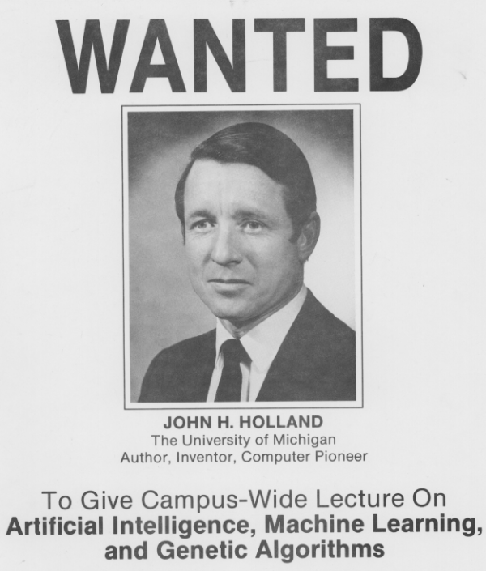
John Holland
Highly interdisciplinary researcher that had the broad aim of building complex adaptive systems as models of cognition
Mixing AI, Biology and Phycology (and others)
Most people date the GA algorithm based on his seminal book “Adaptation in Natural and Artificial Systems” from 75
Although the name GA does not appear there, but appears in the PhD thesis of his student Ken de Jong
And the most classic book on GAs “Genetic Algorithms in Search, Optimization and Machine Learning” was written by another of Holland’s PhD students, David Goldberg

Slide 7
A simple genetic algorithm
A genetic algorithm iteratively refines a pool of solutions (called population)
This iterative refinement process follows a specific cycle that is inspired in the natural evolution
There is some selection
There is the mixing of solutions via two stages called crossover and mutation
Initialisation
Population A
Evaluation
Population B
Mutation
Selection
Population D
Population C
Crossover

Slide 8
Population
Possible solutions of the problem
Typically a vector of elements called chromosome
Each subpart of an individual is called gene
A classic GA uses a binary representation (more later)
Initial population is created at random
Chromosome
For i from 1 to pop_size
For j in 1 to chromosome_size
If rand_real(0,1)<0.5
Individual[i]->gene[j]=1
Else
Individual[i]->gene[j]=0
EndIf
EndFor
EndFor
0
1
0
0
1
0
Genes
rand_real(0,1) → generate a continuous number in [0,1)

Slide 9
Evaluation
Giving a goodness value to each individual in the population
Uses a fitness formula/objective function, as we discussed last lecture.
For i from 1 to pop_size
fitness[I] = fitnessFunction(Individual[i])
EndFor

Slide 10
Selection
Process that rewards good individuals
Good individuals will survive, and get more than one copy in the next population. Bad individuals will disappear
Classic selection algorithm is called “Roulette Wheel Selection”
Imagine you construct a giant wheel where each individual got a segment of size proportional to its fitness value
You spin the wheel as many times as individuals you want to select
Individual with larger segment sizes (larger fitness) will have more opportunities of being selected

Slide 11
Roulette Wheel selection
total_fitness=0
Allocate vector acum of pop_size size
For i from 1 to pop_size
total_fitness+=fitness[i]
acum[i] = total_fitness
EndFor
For i from 1 to pop_size
slice_point = rand_real(0,total_fitness)
For j from 1 to pop_size
if(slice_point<acum[j])
Copy individual j to new population
break
endif
EndFor
EndFor
Individual | Fitness
Ind1 | 10
Ind2 | 30
Ind3 | 20
Ind4 | 15
4 random numbers between 0 and 75:
42.11, 5.64, 67.23, 51.84
Selected individuals: 3, 1, 4, 3
Notice something?
Acum | Fitness
Ind1 | 10
Ind2 | 40
Ind3 | 60
Ind4 | 75
Total_fitness | 75

Slide 12
Crossover
Exchanging subparts of the solutions
The crossover stage will take two individuals from the population (parents) and with certain probability Pc will generate two offspring
1-point crossover
Parent1=-1
For i in 1 to pop_size
If(rand_real(0,1)<Pc
If(Parent1==-1)
Parent1=i
Else
(Offspring1,Offspring2) = Crossover(population[parent1],population[i])
Add Offspring1 and Offspring2 to new population
parent1=-1
EndIf
Else
Add population[i] to new population
EndIf
EndFor
If(parent1!==-1)
Add population[parent1] to new population
Function Crossover(individual1,individual2)
cutPoint=rand_int(0,chromosome_size)
Copy genes before cutPoint from individual 1 to offspring 1
Copy genes before cutPoint from individual 2 to offspring 2
Copy genes after cutPoint from individual 1 to offspring 2
Copy genes after cutPoint from individual 2 to offspring 1
return (offspring1,offspring2)
Rand_int(n,m) → generate an integer number in [n,m]
Pc = probability of crossover

Slide 13
Mutation
Making a subtle change to one gene
Flipping from 0 to 1 or from 1 to 0 with probability Pm
For I in 1 to pop_size
For J in 1 to chromosome_size
If(rand_real(0,1)<Pm)
If(individual[i]->gene[j]==1)
individual[i]->gene[j]=0
Else
individual[i]->gene[j]=1
EndIf
EndIf
EndFor
EndFor
Pm = probability of mutation

Slide 14
A simple genetic algorithm: overview
Population = Initialise_Population()
Iteration = 0
While Iteration<Num_Iterations
Evaluate(Population)
Population = Selection(Population)
Population = Crossover(Population)
Population = Mutation(Population)
Iteration++
Best = Get_Best_Individual(Population)
return Best
Three parameters that need to be adjusted:
Number of iterations
Probability of Crossover
Probability of Mutation

Slide 15
A simple example
We will use a very simple to use Java EC framework called jenetics
The problem we are going to “solve” is called OneMax, and its fitness function consists in summing all bits set to 1
Hence the optimal solution is 111111…111, and the maximum fitness is the chromosome size
pop_size=100, chromosome_size=100
The code is available at http://homepages.cs.ncl.ac.uk/jaume.bacardit/CSC3423/SimpleGA/

Slide 16
Using jenetics
This is a taster of the practical on 8/10
Jenetics the set up of a GA with very few lines of code
Essentially all that needs to be defined is
Define a class that implements the fitness function
Define the number of genes in the individual and the type (integer, double) of each gene
Define the set of operators (and their parameters) that the GA will use

Slide 17
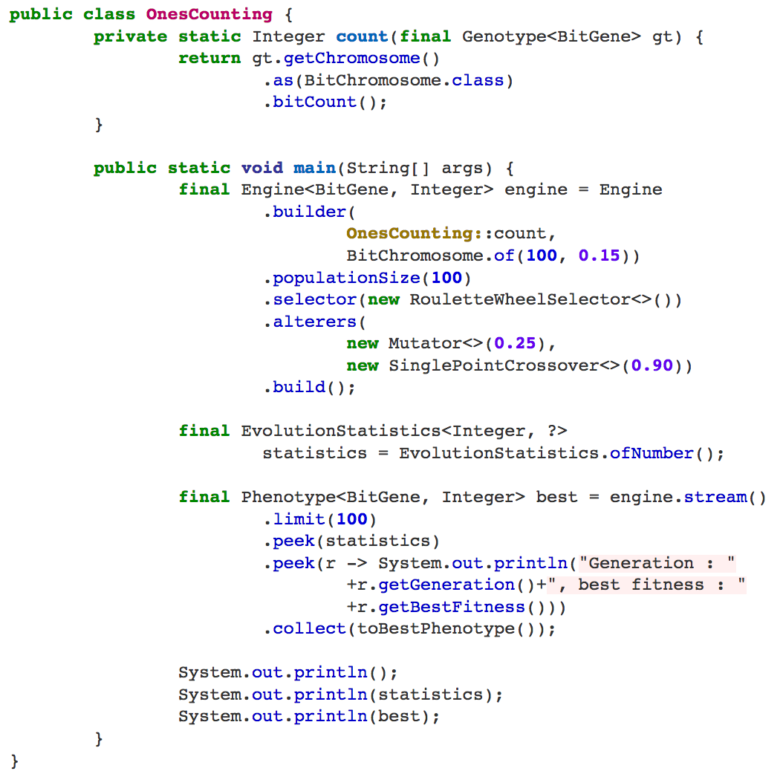
The code (relevant bits)

Slide 18
Compiling and running the code (from the command line)
javac -classpath jenetics-4.2.0.jar OnesCounting.java
java -cp jenetics-4.2.0.jar:. OnesCounting
To compile this code from e.g. Eclipse, you need to tell it to load the jenetics jar library

Slide 19
Running the code
Generation : 1, best fitness : 48
Generation : 2, best fitness : 49
Generation : 3, best fitness : 51
Generation : 4, best fitness : 57
.
.
.
Generation : 98, best fitness : 69
Generation : 99, best fitness : 70
Generation : 100, best fitness : 69
+---------------------------------------------------------------------------+
| Population statistics |
+---------------------------------------------------------------------------+
| Age: max=13; mean=0.693100; var=1.264039 |
| Fitness: |
| min = 8.000000000000 |
| max = 70.000000000000 |
| mean = 51.130300000000 |
| var = 51.503672277228 |
| std = 7.176605902321 |
+---------------------------------------------------------------------------+
[00001101|00011100|00111111|01101101|00011111|11011111|01111111|11110111|10011010|10111111|11010110|11110101|01101110] --> 70

Slide 20
How the population is adapting?
Although here I am only showing the fitness of the best individual, the whole population is improving, but not only that, but all individuals are slowly becoming similar. This is called convergence

Slide 21
Questions?

