Slide 1
CSC3423 – Biologically-inspired computing L02 – Genetic Algorithms
Jaume Bacardit
Jaume.bacardit@newcastle.ac.uk

Slide 2
Outline
A simple genetic algorithm
Genetic Algorithm Example
More focus in each stage of the cycle
Parallel Genetic Algorithms
Applications

Slide 3
A simple genetic algorithm
A genetic algorithm iteratively refines a pool of solutions (called population)
This iterative refinement process follows a specific cycle that is inspired in the natural evolution
There is some selection
There is the mixing of solutions via two stages called crossover and mutation
Initialisation
Population A
Evaluation
Population B
Mutation
Selection
Population D
Population C
Crossover

Slide 4
Let’s add a few more things to the GA cycle
Representations
Selection
Crossover
Mutation policies
Replacement

Slide 5
Representation
Instead of bits, why not using integers or real numbers?
Crossover
Keeping as it is. Works well if you have a large chromosome → large number of cut-points, and more potential variability
Rather than just mix-and-match (which keeps all original values of the genes), we can blend the values of the parent’s genes, using special crossover operators for continuous representations. E.g. BLX-α operator
http://onlinelibrary.wiley.com/doi/10.1002/int.10091/abstract
Mutation
Adding/subtracting a certain offset from the current value
Offset
offset = rnd(0,1)*max_offset
Sign = random + or –
newValue = currentValue + offset * sign
clip newValue if it overlaps with the limits of the variable
Current value

Slide 6
Selection
Tournament selection
tournament_size = parameter of system
For I in 1 to pop_size
tournament = Select tournament_size individuals from population at random
Add to new population the individual from tournament with higher fitness
EndFor
Sampling strategy is very important for stability of algorithm
Sampling without replacement is more stable
You cannot pick twice the same individual (unless the whole population has been sampled)

Slide 7
Selection
Roulette-wheel belongs to a class of selection methods called ‘fitness-proportionate selection’
The chances of being selected are derived from how good is an individual’s fitness in relation to the whole population
If all individuals have similar fitness (such as the case of late iterations of the GA cycle), selection becomes close to random
Tournament is a rank-based method
If individual A competes with B and fitness(A)> fitness(B), A is always going to win
Tournament selection is said to have a more stable selection pressure

Slide 8
Presenting experimental results
In the next few slides you will see a few plots, similar to the one on lecture 1, about the performance of the Genetic Algorithm
I’m going to show exactly how they are generated as this is information that will be useful for the practical
What I’m showing is my way of generating and plotting the data, not the only way ☺
Basically I use the tools I know that will get the task done quick.

Slide 9
Presenting results. Step 1: repetitions
A genetic algorithm is a stochastic algorithm
This means that it depends on (pseudo) random numbers for its functioning
That does not mean that the algorithm is random!
Different runs can generate different results
A good practice is to repeat the same experiments multiple times and average the results
In the GA community the magic number of repetitions is 30
Using the example and code from lecture one, the following shell script would run it 30 times and extract the best fitness of each iteration
$ for i in `seq 1 30`; do java -cp jenetics-4.2.0.jar:. OnesCounting | grep ^Generation | cut -d\ -f3,7 | sed s/,//g; done > data-RWS.txt
$ cat data-RWS.txt
1 41
2 48
3 54
4 54
5 59
6 59
7 58
.
.
.
996 67
997 67
998 67
999 67
1000 67
1 41
2 48
3 57
4 60
5 59
.
.
.
994 65
995 69
996 69
997 64
998 68
999 68
1000 65
The next step would be to find the average best fitness of each iteration across the 30 repetitions

Slide 10
Presenting results. Step 2: averaging the repetitions
import sys
import numpy as np
valueLists = {}
for line in sys.stdin:
values = [int(i) for i in line.split(" ")]
if not values[0] in valueLists:
valueLists[values[0]]=[]
valueLists[values[0]].append(values[1])
for it in sorted(valueLists.iterkeys()):
print "{0},{1}".format(it,np.mean(valueLists[it]))
$ echo Iteration,AveBestFitness,SelectionMethod > evol-Selection.csv
$ cat data-RWS.txt | python2.7 mergeIterations.py | sed s/$/,RWS/g >> evol-Selection.csv
$ cat evol-Selection.csv
Iteration,AveBestFitness,SelectionMethod
1,44.6333333333,RWS
2,49.3333333333,RWS
3,53.2,RWS
4,55.7666666667,RWS
5,57.5,RWS
6,58.9,RWS
7,60.6,RWS
8,60.6,RWS
9,61.3666666667,RWS
.
.
.
991,65.3,RWS
992,65.1666666667,RWS
993,64.5666666667,RWS
994,64.0666666667,RWS
995,64.8333333333,RWS
996,64.4333333333,RWS
997,64.6333333333,RWS
998,64.6333333333,RWS
999,64.9666666667,RWS
1000,64.4,RWS
The next step would be to run the GA with tournament selection and 30 repetitions, average the results and append them to the same evol-Selection.csv file

Slide 11
Presenting results. Step 3: plotting the data
To plot the data I am using an open source statistical program (and programming language) called R
Specifically, I’m using a plotting library called ggplot
From the comman line you simply type ‘R’ and you get an interactive prompt. You can start to type commands straight away
data=read.csv("evol-Selection.csv")
library(ggplot2)
pdf("evol-Selection.pdf")
ggplot(data,aes(Iteration,AveBestFitness,colour=SelectionMethod))+geom_line()+ theme(legend.position="top")
dev.off()

Slide 12
Impact of selection algorithms

Slide 13
Crossover
2-point crossover
uniform crossover
In uniform crossover we decide, gene by gene, from which parent we get it

Slide 14
Crossover probability
However, this problem is very simple, as it is just question of recombining blocks of size 1
When a crossover operation can cut a block of genes that should be treated together, it can potentially be harmful

Slide 15
Mutation
Rather than specifying a gene-wise Pm, specify an individual-wise Pm
For I in 1 to pop_size
If rand_real(0,1)<Pm
pos = rand_int(1,chromosome_size)
mutate(individual[i]->gene[pos])
EndIf
EndFor

Slide 16
Mutation probability
Mutation is meant to be a subtle change
When applied too often it does more harm than good
Not applying it at all is also bad
Still, remember what this is a simple problem, typically a Pm of 0.1 would be too high already

Slide 17
Replacement
So far we have considered that the offspring population (crossover+mutation) totally replaces parent population
Generational Genetic Algorithm
What if we make sure that the best individual from the previous generation survives?
Elitism
Steady-state genetic algorithm
No off-spring population
Selection chooses 2 parents
Offspring are created by crossover and then mutation
They are inserted back directly into the parents population by replacing the two individuals with worst fitness

Slide 18
Elitism
With roulette-wheel selection
With tournament selection

Slide 19
Ensuring a proper evolutionary process
In rough terms, a GA is said to learn well when two forces are balanced: Exploration vs Exploitation
Exploration: Directing the population towards new parts of the solution space
Exploitation: Directing the population towards the parts of the solution space that look most promising (based on fitness)
Too much exploitation, and the population may converge to sub-obtimal solutions (premature convergence).
If the population is too similar, cross-over is not an effective exploration operator anymore, and mutation is too slow
Too much exploration, and we risk
Slowing down too much the evolutionary process
If their probabilities are too high, crossover and mutation may do more harm than good

Slide 20
Parallel Genetic Algorithms
Genetic Algorithms have always had the bad reputation for being slow
But they have huge room for speeding up.
Given that they are a population-based algorithm, there is a lot of implicit parallelism!
For many years parallel GAs have been studied

Slide 21
Parallel programming in a nutshell
Your program is not sequential. Several tasks may be running at the same time
In the same machine or in different machines
Crucial aspects
Load balancing: all CPUs involved should be busy most of the time
Communication:
Sending data between CPUs
Synchronisation: idle CPUs waiting for other to finish their task
A good parallel program has to find the balance between all these aspects

Slide 22
Master-Slave model
Two types of nodes: 1 master and multiple slaves
GA cycle is run in the master node
Slaves compute the fitness computations
These are the most computationally consuming part of the algorithm
Hence, it makes sense to parallelise this part of the algorithm, especially for DM
This model also fits very well the type of parallelism of a GPU
https://link.springer.com/book/10.1007/978-3-642-37959-8
Master
Population
Fitness values
Slave 1
Slave 2
Slave n

Slide 23
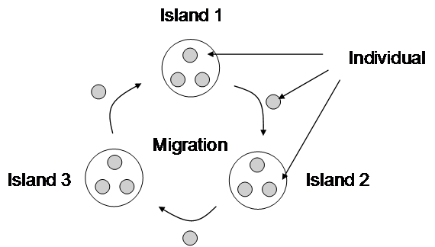
Island model
Population is divided across nodes
Each node runs the whole GA cycle
With certain probability, individuals will migrate from one island to another
This is not a pure parallelisation
It changes how the algorithms behaves → Can change the results
Image taken from http://www.intechopen.com/books/image-processing/fast-evolutionary-image-processing-using-multi-gpus

Slide 24
Applications of Genetic Algorithms
Machine Learning (in a few lectures)
Optimisation
Evolutionary art
Games

Slide 25

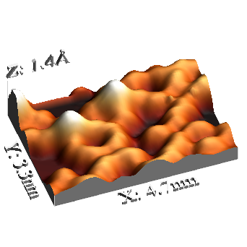
Optimising a Scanning Probe Microscopy
i
i_{t} ∝ exp(−2kd)
G
Z
Scanning tip
A
X
V
Y
Sample surface
http://www2.fz-juelich.de/ibn/index.php?index=1021
Axis under direct (piezo) control
The tunnel current i_{t} is highly dependant on the tip-sample distance, d. This current can be maintained with a feedback loop, G, that actively controls the tip-sample distance.
Notes:
A Scanning tunneling microscope maps the topographical and/or electronic surface features by scanning an atomically sharp tip within nm’s of the surface
Important to give the basics of what we are doing
In air STM of HOPG
This is a simulation of how a human operator might optimise the tip and feedback loop
UHV STM bit different Gross Boland Crustance Gisseible all dip the tip to prepair it
Come onto different HOPG surface images later
IMPORTANT the image is the convolution between the tipand the smaple surface, if you know the surface then the unknow, which is the tip can be calcualted
Details for the movie:
http://www2.fz-juelich.de/ibn/index.php?index=1021
With the SEM it is possible to measure overview scans at various magnifications and to image relatively large areas of the sample (up to about 2 x 2 mm²). The SEM images are then used to select certain parts of the sample for the STM-analysis. All this is done under ultrahigh vacuum conditions. The electron gun and the secondary electron detector (SED) of the SEM are arranged perpendicular to each other so that the STM-tip causes a shading of secondary electrons coming from the part of the sample which is opposite to the SED. This tip shadow is important for the positioning of the tip relative to the sample. Thus the SEM is very helpful for the tip approach to the sample and for the selection of the sample area to be analyzed with STM. Beyond that it is possible to investigate the quality of the tip and the sample preparation with the SEM. More details can be found here: Rev. Sci. Instrum. 72, 3546 (2001).

Slide 26
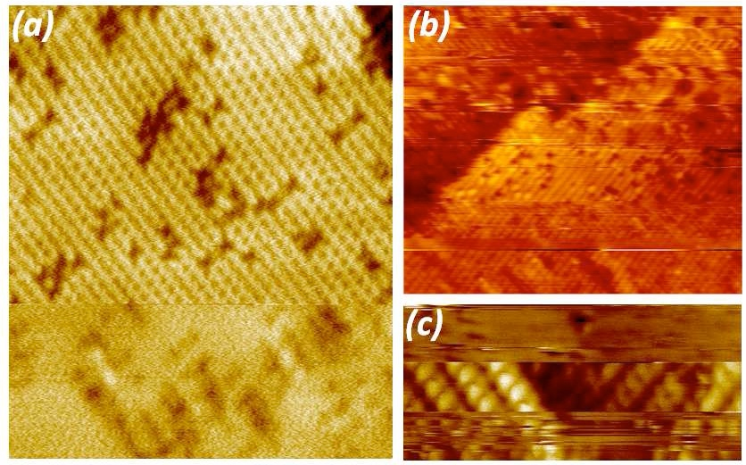
(Un)Stable and (Un)defined Tip States
Imaging problems, spontaneous tip changes

Slide 27
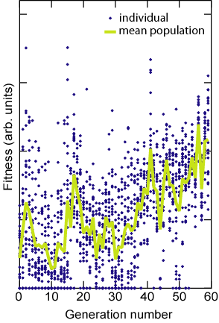

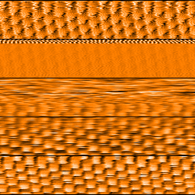

Optimising the microscope parameters with a GA
Starting image
GA
V
i
G
V
i
G
V
i
G
V
i
G
V
i
G
Machine Optimised
Fitness function: similarity between the image generated by the parameters of the individual and a target image
Automated probe microscopy via evolutionary optimisation at the atomic scale. R. Woolley, J. Sterling, A. Radocea, N. Krasnogor and P. Moriarty. Applied Physical Letters

Slide 28
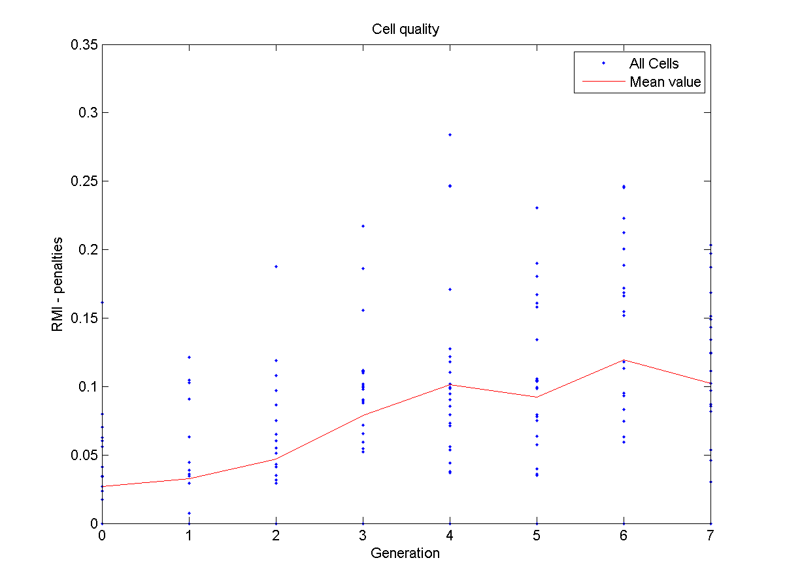
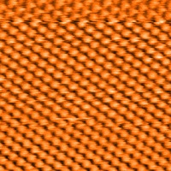
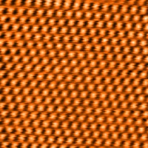
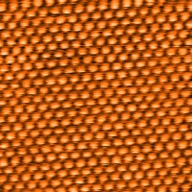
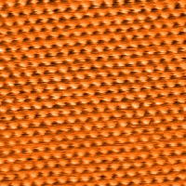
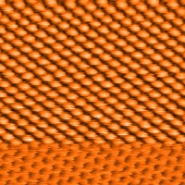
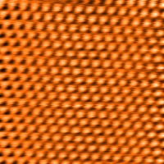
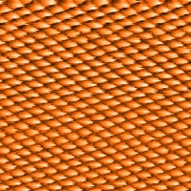
How Does it Compares to an Expert Operator?
Microscopist | Ave. RMI | Change in RMI/min
i-SPM | 0.20 | 7.1
Human | 0.09 | 2.6
Silver Medal in the THE 2012 “HUMIES” AWARDS FOR HUMAN-COMPETITIVE RESULTS PRODUCED BY GENETIC AND EVOLUTIONARY COMPUTATION.

Slide 29

Evolutionary Music
Replicating musical instruments & generate variations
Generating derivations of a piece of music
Composing music from scratch
Jam sessions
http://link.springer.com/book/10.1007/978-1-84628-600-1

Slide 30
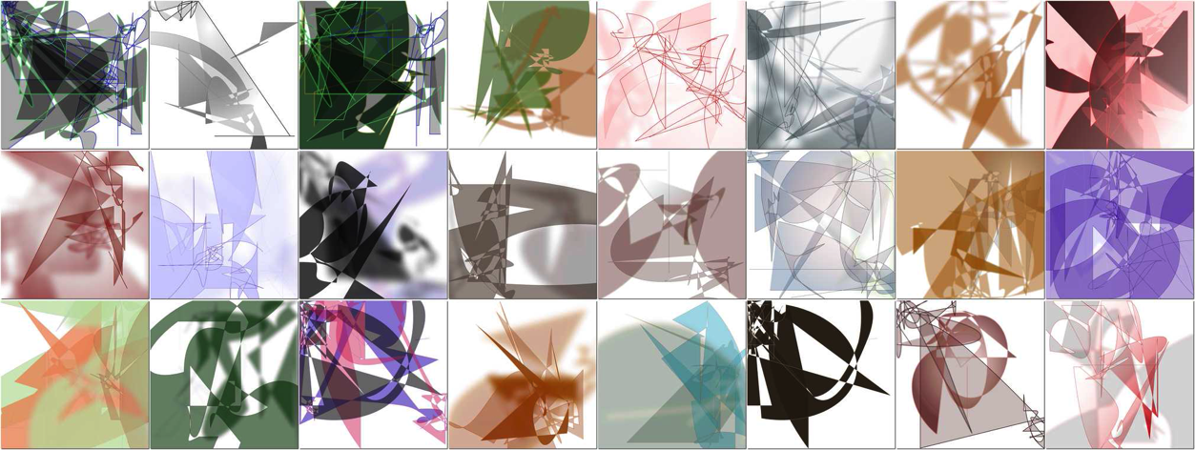
Evolutionary art
Evolving art with scalable vector graphics
http://dl.acm.org/citation.cfm?doid=2001576.2001635
Representation involves a set of polygons & shapes
Fitness functions based on colour gradients following a normal distribution / global contrast factor

Slide 31
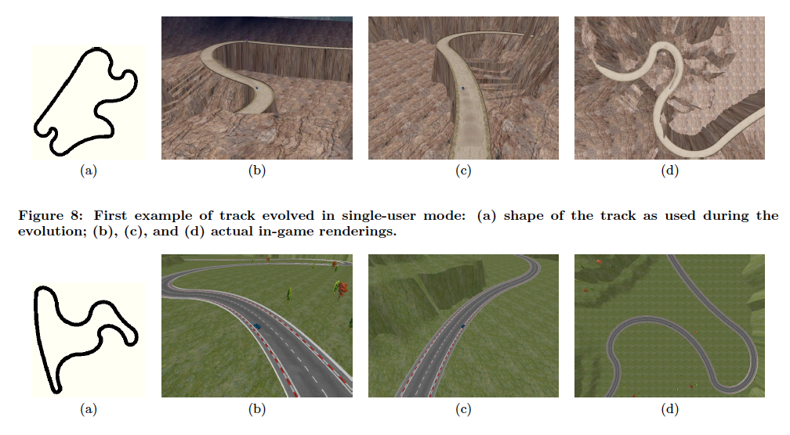
Generating content for videogames
Generating racing circuits
http://dl.acm.org/citation.cfm?doid=2001576.2001631
Rendered using the TORCS simulator (more later)
Interactive genetic algorithm → humans evaluate solutions
Interesting implication: consistency between evaluations of the same or different users. See https://dl.acm.org/citation.cfm?id=1068228

Slide 32
Generating controllers for racing cars
For the last few years there has been a competition on the EC community about simulated car racing
Many evolutionary methods used (sometimes mixed with NN and other algorithms)
Using a simulator called TORCS
Performs & renders simulation
Provides API to give lots of sensors and actuators
http://ieeexplore.ieee.org/stamp/stamp.jsp?tp=&arnumber=5654649
https://www.youtube.com/watch?v=IR9x-IDX9Eg
https://www.youtube.com/watch?v=RyxCjMZvijI

Slide 33
References
What is an Evolutionary Algorithm?, Chapter 2 of “Introduction to Evolutionary Computing” by Eiben & Smith
The Design of Innovation, by David E. Goldberg
Contains theoretical models that explain how genetic algorithms work and how to adjust them properly
Volume 2 of the “Handbook of Natural Computing”
Proceedings of the GECCO conference (main conference in the EC field). Lots of papers of theory and applications
http://www.informatik.uni-trier.de/~Ley/db/conf/gecco/index.html

Slide 34
Questions?

