Slide 1
CSC3423 – Biologically-inspired Computing L03 – Description of coursework 1
Jaume Bacardit
Jaume.bacardit@newcastle.ac.uk

Slide 2
Coursework 1
To use (suitable) biologically-inspired computing for a particular optimisation task.
You will be provided with the (Java) source code of the use of two bio-inspired algorithms for a specific continuous optimisation benchmark (more later)
Genetic Algorithm
Particle Swarm Optimisation
You have to
Tune both algorithms (choice of operators and parameters) to improve their performance at the provided task
Critically assess and compare the performance of the two methods.

Slide 3
The optimisation code
Available in Blackbord from Learning Materials > Assessment > CW1.zip
1 java class for the GA case
CW1_GA.java
3 java classes for the Particle Swarm Optimisation case
CW1_PSO.java
MyFitnessFunction.java
MyParticle.java
Configuration files for each case
And the jar files of the two libraries for GA and PSO
The practicals for this week and next will be dedicated to explain in detail the code (and how to use it) of these two cases
$ unzip -v CW1.zip
Archive: CW1.zip
jenetics-4.2.0.jar
jswarm-pso_2_08.jar
CW1_GA.java
CW1_PSO.java
MyFitnessFunction.java
MyParticle.java
CW1_GA.class
CW1_PSO.class
MyFitnessFunction.class
MyParticle.class
GA.config
PSO.config

Slide 4
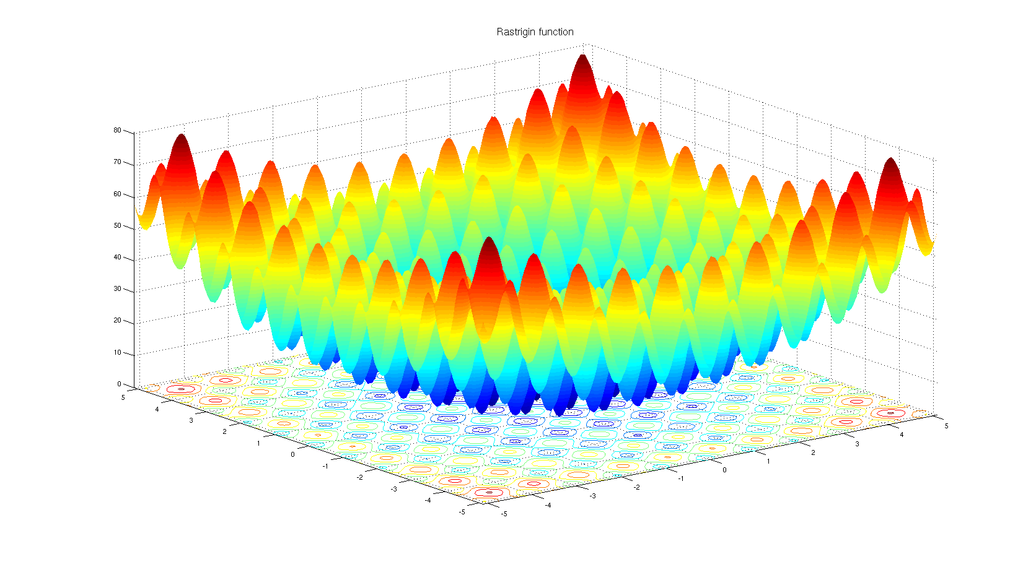
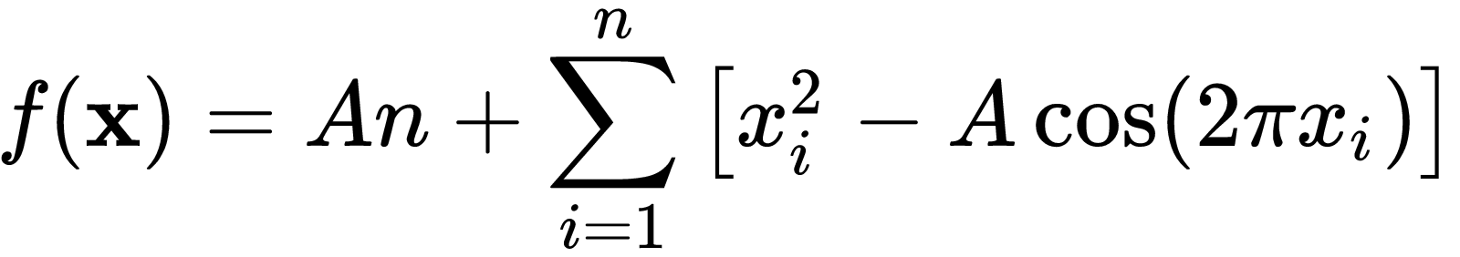
The optimisation challenge
Rastringin function
https://en.wikipedia.org/wiki/Rastrigin_function
Classic problem in continuous optimisation (where the solution is formed by real numbers)
Minimisation function (lower is better)
A = 10 and n = 10. All x_{i} are defined from -5.12 to +5.12
Optimal solution at 0 (but you should not know that)
Shape of the function for the 2D version of the problem

Slide 5
Fitness calculations budget
If you run the provided code as is you will see that both the GA and the PSO solutions are parametrised to call 1M times the fitness function (1000 individuals x 1000 iterations)
Scenario 1: budget of 1M evaluations
Scenario 2: budget of 10K evaluations
You need to tune the two methods for both scenarios

Slide 6
Marking criteria
Write a report where you explain how you have tuned the two provided algorithms (GA and PSO) to improve their performance in the two fitness formula budget scenarios
You have to carefully and systematically report the performance of both algorithms (e.g. best solutions found, running time, number of iterations needed to converge to a good solution vs to the best solution) and critically compare them.
This assignment will comprise 25% of the total marks of the module.
Marks will be awarded for:
Description of the two nature-inspired algorithms: 15 marks
Description of the algorithm calibration process for scenario 1: 15 marks
Description of the algorithm calibration process for scenario 2: 15 marks
Detailed reporting of algorithm performance: 15 marks
Critical comparison between the two algorithms: 20 marks
Figures: 10 marks
Writing: 10 marks
The report has a word limit of 2000 words
Preliminary deadline: 9th of November (check NESS for the official deadline)

Slide 7
Questions?

