Slide 1
Fliks
App Description
Samsung Smart TV (Tizen) — package FliksMedia
CP name: Clément Delestre

Slide 2
Revision History
Version | Date | Description | Author
1.0 | 2026.08.03 | First submission of Fliks 2.0.0 | Clément Delestre

Slide 3
Contents
• What the app is, and what it needs to run
• UI Structure
• Usage Scenario (server pairing and log-in)
• Menu & function description
• Key policy
• How to change languages

Slide 4
What Fliks is
Read this first: the app cannot be tested without a server.
• Fliks plays the video files a user already owns. It is the TV client of a self-hosted media server the user runs at home.
• The app ships no content of its own and no catalogue: everything shown comes from the server the user pairs with. There is no purchase, no subscription and no in-app payment.
• On first launch the app therefore asks for a server address, then for an account on that server.
• A public test server is provided for validation — credentials on the next slide.
• Video is played with the Samsung AVPlay API (HLS, fMP4 and TS); the server converts the file on the fly when the TV cannot decode the original.

Slide 5
UI Structure
Depth navigation. Every screen is reached with the D-pad.
• 1st depth — Server setup (first launch only): enter the server address
– 2nd depth — User picker: pick an account, or "Enter another user"
– 3rd depth — Log in: username + password
• 1st depth — Home: Libraries, Continue watching, Recently added
– 2nd depth — Library (e.g. Movies): grid, Suggestions, Genres, Collections, Likes
– 3rd depth — Media detail: synopsis, cast, file information, Play / Resume
– 4th depth — Player: full-screen playback, audio and subtitle tracks, quality
– 3rd depth — Series detail: seasons and episodes → 4th depth Player
• 1st depth — Sidebar: Home, Search, My profile, Playlists, History, Requests, Activity, Calendar
– 2nd depth — Search: results by title, person or genre → Media detail
– 2nd depth — My profile / Settings: display, playback, languages, account

Slide 6
Usage Scenario
Log-in flow, as the template requires. No payment step exists.
• Step 1 — Launch the app. On a first launch the "Server" screen is shown.
• Step 2 — Enter the test server address with the on-screen keyboard:
• Step 3 — The user picker appears ("Who's watching?"). Select the test account:
• Step 4 — Enter its password:
• Step 5 — Home is shown. Move focus with the D-pad, press ENTER to open a title.
• Step 6 — On the media detail screen, press ENTER on "Play" to start playback.
• Step 7 — During playback: LEFT/RIGHT seek, ENTER pauses and resumes, RETURN goes back to the detail screen.
• Step 8 — RETURN from Home closes the app (Fliks is not a game app, so no exit pop-up is shown); EXIT closes it as well and returns to broadcasting.
Test account for validation
Server address: fliks-demo.delestre.me
User: user-demo Password: user-demo

Slide 7
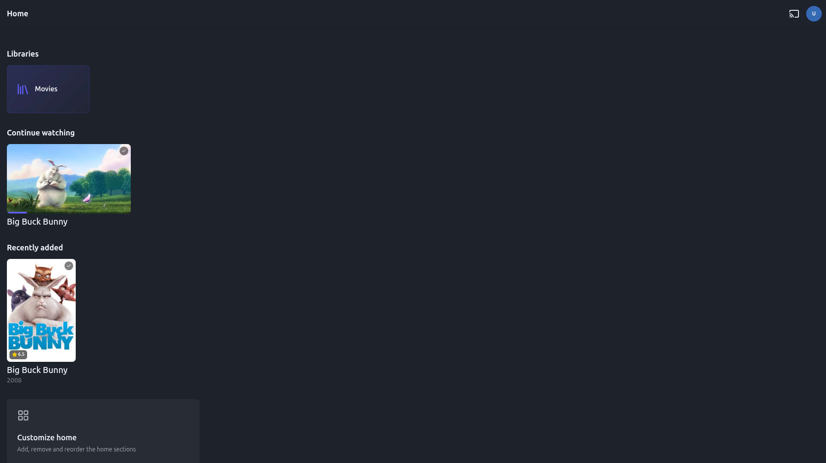
Menu & function description — Home
Home
• Libraries the account can see, "Continue watching" with the resume position of every unfinished title, and "Recently added".
• Focus moves with UP/DOWN between rows and LEFT/RIGHT inside a row; ENTER opens the focused title.

Slide 8
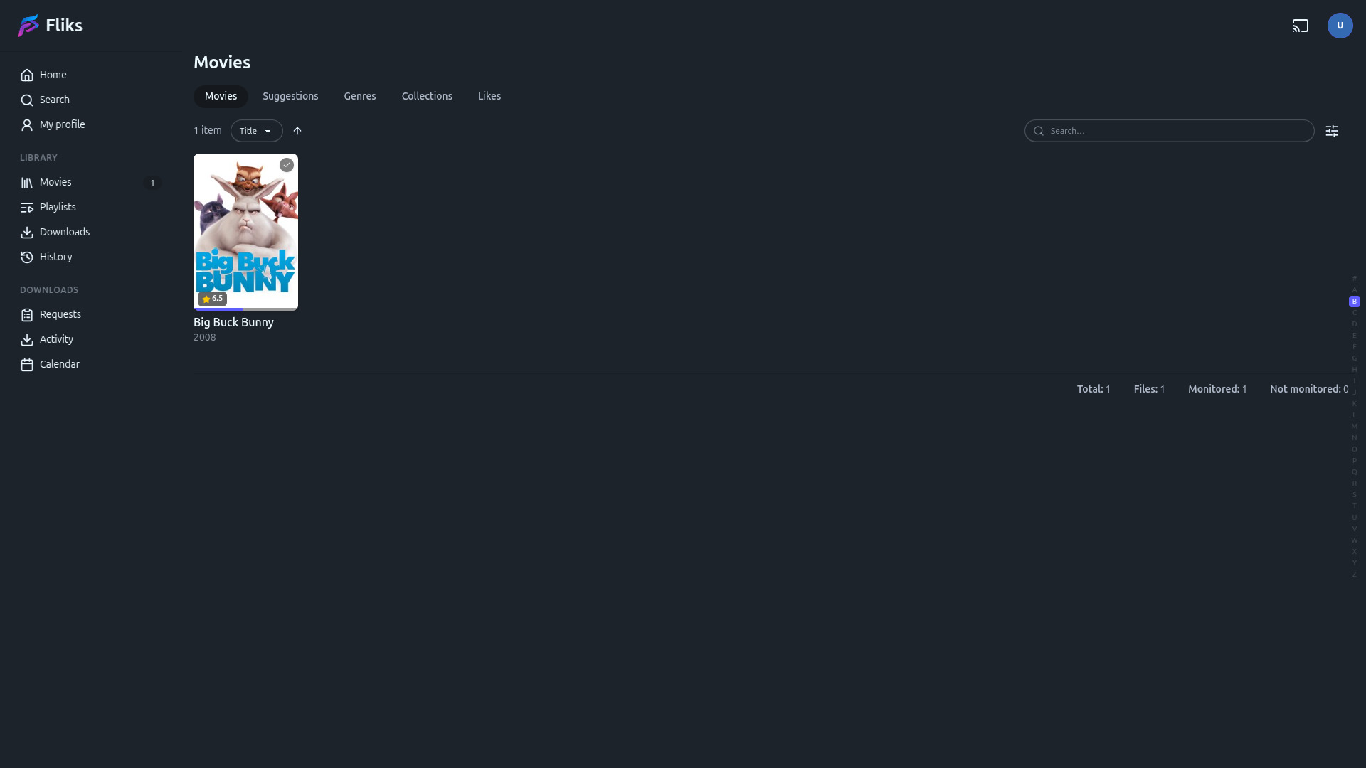
Menu & function description — Library and navigation menu
Library and navigation menu
• The left menu reaches Home, Search, the libraries, Playlists, Downloads, History, Requests, Activity and Calendar.
• A library lists its titles as a poster grid, with sorting and the Suggestions, Genres, Collections and Likes tabs.

Slide 9
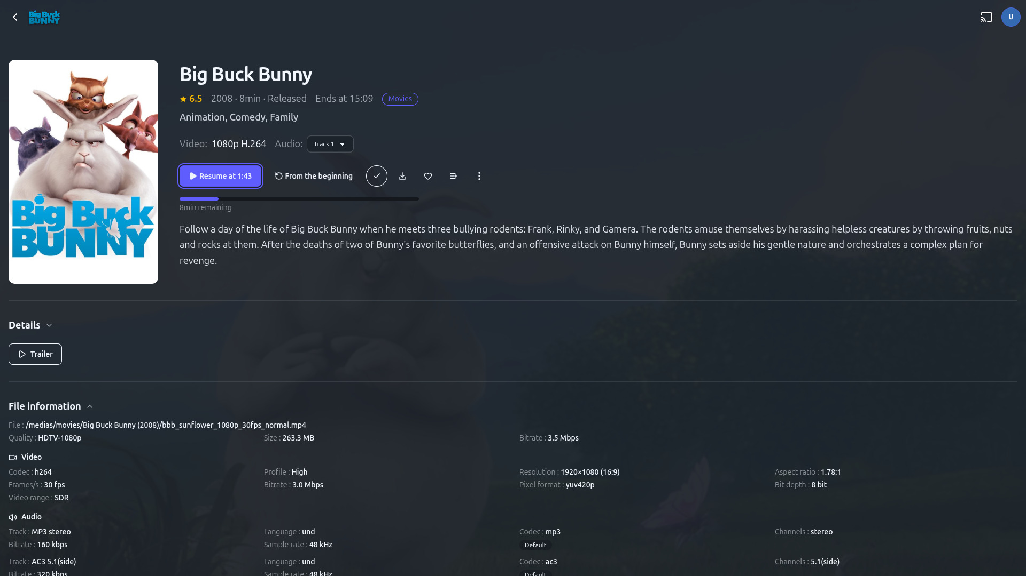
Menu & function description — Media detail
Media detail
• Poster, rating, year, runtime, genres and synopsis, plus the audio and subtitle tracks found in the file.
• "Resume" continues at the stored position, "From the beginning" restarts. "File information" shows the real codecs, bitrate and resolution.

Slide 10
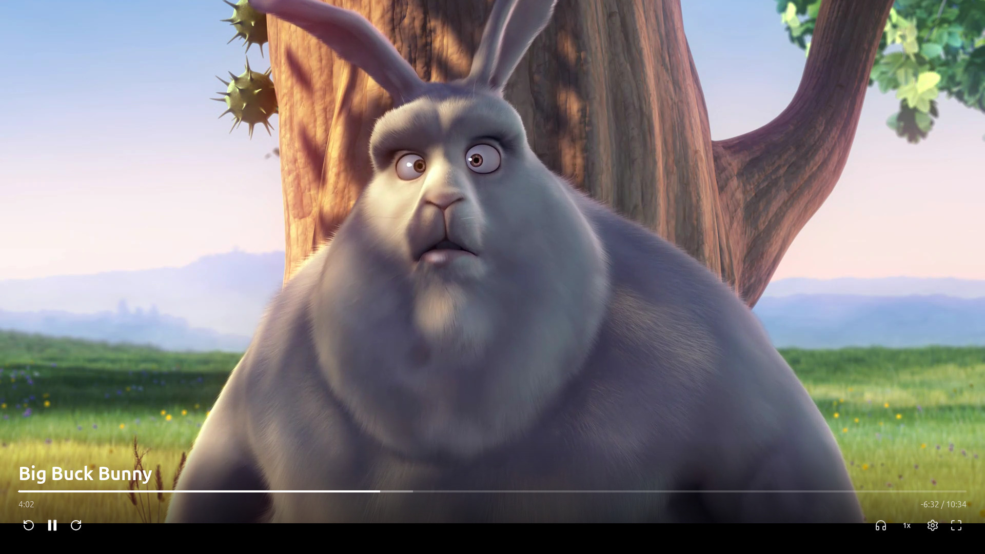
Menu & function description — Player
Player
• Full-screen playback through the Samsung AVPlay API. The bar shows the elapsed and total time and the buffered range.
• Controls: play/pause, skip back and forward, subtitle track, audio track, and playback settings (quality, speed).

Slide 11
Key Policy
Every key below is handled by the app; the rest is left to the TV.
Button | Action | Remarks
UP / DOWN | Move focus between rows, menu items and form fields
LEFT / RIGHT | Move focus inside a row. During playback: seek backward / forward
ENTER | Activate the focused item. On the player: pause and resume
RETURN | Close the topmost overlay, then go back one depth. At the top level: close the app (tizen.application.exit) | Samsung Mandatory
EXIT | Close the app and return to broadcasting | Samsung Mandatory
Ch. Up/Down | N/R
Colour buttons | N/R

Slide 12
How to change languages
Items | Contents
Supported languages | English, French, Spanish, German, Italian and Portuguese.
Default behaviour | The app follows the TV OSD language. With the TV set to one of the six languages, the whole UI is shown in it; any other setting falls back to English.
How to check | Change the TV OSD language (Settings > General > System Manager > Language) and relaunch the app — or override it in the app itself: My profile > Display > Language.
Media titles and synopses | Served by the user's own server in its metadata language; independent of the UI language above.

