Slide 1
Driver 2015
Kernel for Pricision

Slide 2
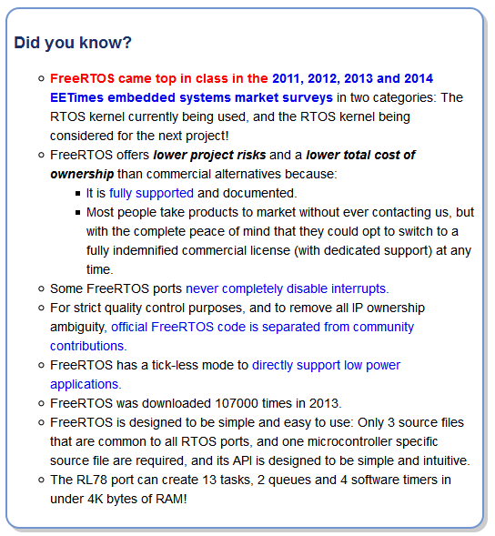

RTOS
V8.2.0
Why choose FreeRTOS?
"It's probably safe to say at this point that FreeRTOS goes through more 'peer-review' than any other RTOS available on the planet. I have used it in several projects - one of which was a multiprocessor environment that used more than 64 processors and needed to run for months reliably. The RTOS core performed well. Take FreeRTOS for a spin." - John Westmoreland

