Slide 1
Introduction
Computer Organization (CS220)
Semester 2022-23-II
Urbi Chatterjee
CSE, IIT Kanpur

Slide 2
Eight Great Ideas in Computer Architecture
Design of Moore’s Law
Use Abstraction to Simplify Design
Make the Common Case Fast
Performance via Parallelism
Performance via Pipelining
Performance via Prediction
Hierarchy of Memories
Dependability via Redundancy

Slide 3
Below Your Program
Operating System: interfaces between a user’s program and the hardware
and provides a variety of services and supervisory functions.
Application Software
System Software
Hardware
Compilers: The translation of a program written
in a high-level language, such as C, C, Java, or Visual Basic into instructions
that the hardware can execute.

Slide 4
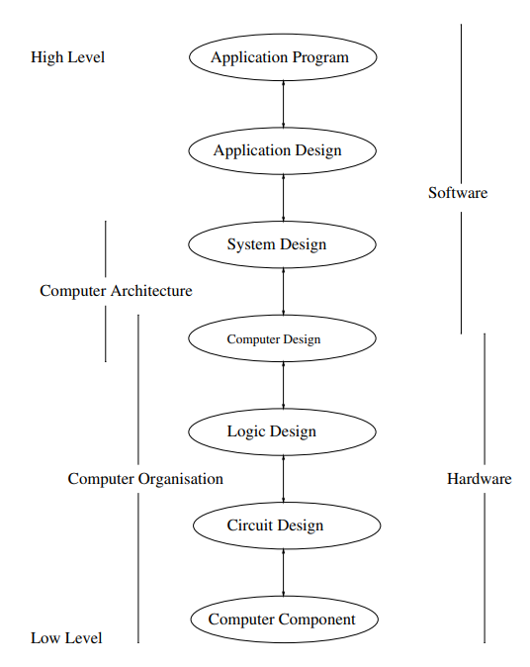
Computer Architecture Vs. Computer organization
how it does it
what the computer does
functional behaviour: As a programmer, you can view architecture as a series of instructions, addressing modes, and registers.
structural relationship: The implementation of the architecture is called organization.
For designing a computer, organization is decided after its architecture.
For designing a computer, its architecture is fixed first.

Slide 5
Example
Compiler
int p,q,r;
scanf(“%d,%d”, &p, &q);
r=p+q;
printf(“%d”,r);
IN PORTA
STR P
IN PORTA
STR Q
LDA P
ADD Q
STA R
OUT PORTB
Accumulator!
Assembler
Operating System
Input-Output Handling
Memory Allocation
Process Separation
01001010101010
11111110101010
01010101010100
11111111111100

Slide 6
From a High-Level Language to the Language of Hardware
Assembly Language Program
Binary Machine Language Program
factorial(int):
push rbp
mov rbp, rsp
mov DWORD PTR [rbp-20], edi
mov DWORD PTR [rbp-8], 1
mov DWORD PTR [rbp-4], 1
jmp .L2
.L3:
mov eax, DWORD PTR [rbp-8]
imul eax, DWORD PTR [rbp-4]
mov DWORD PTR [rbp-8], eax
add DWORD PTR [rbp-4], 1
.L2:
mov eax, DWORD PTR [rbp-4]
cmp eax, DWORD PTR [rbp-20]
jle .L3
mov eax, DWORD PTR [rbp-8]
pop rbp
ret
High-level Language
Program (in C)
00000000101000100000000100011000
00000000100000100001000000100001
10001101111000100000000000000000
10001110000100100000000000000100
10101110000100100000000000000000
10101101111000100000000000000100
00000011111000000000000000001000
….
int factorial(int num) {
int i;
int a=1;
for (i=1;i<=num; i++)
{
a=a*i;
}
return a;
}
Compiler
Assembler

Slide 7
What a computer must have
IN PORTA
STR P MOV R1,P
IN PORTA
STR Q ADD R1
LDA P
ADD Q
STA R
OUT PORTB
CPU
MEMORY
I/O DEVICES

Slide 8
How the CPU looks like
FLAGS
IR
ACC
R1
PC
R2
DECODE
SP
R3
DR
ALU
R4
DR: Data Register
ACC: Accumulator
IR: Instruction Register
PC: Program Counter
SP: Stack Pointer
ALU: Arithmetic Logic Unit
CPU: Central Processing Unit
TIMING & CONTROL

Slide 9
INTERCONNECTION
ADDRESS BUS
CPU
DATA BUS
CONTROL SIGNAL
MEMORY
I/O DEVICES
RD and WR

Slide 10
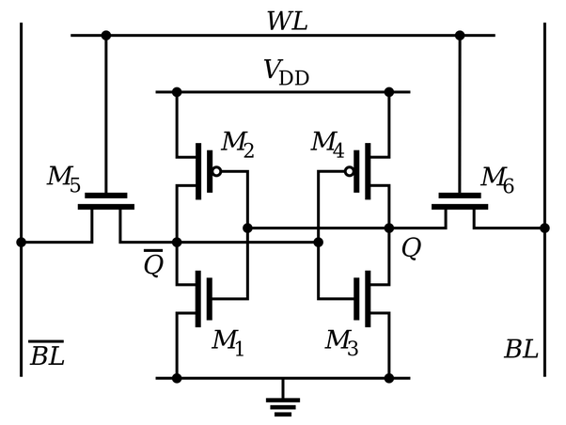
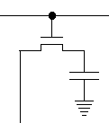
MEMORY
Secondary Memory
Main Memory
Cache Memory
Fastest
Costliest
Slowest
Cheapest

Slide 11
Some basic Information about the Course
Class Timing: Wed, Thurs, Fri: 11.00-12.00
Lab Timing: Mon (Group 1) and Wed (Group 2)
Batch 1: 14.00 to 15.30
Batch 2 : 15.30 to 17.00
For practicing in home, you can use IVERILOG compiler. In lab, we will be using Xiling ISE Tool.
Iverilog Links:
http://iverilog.icarus.com/
https://bleyer.org/icarus/
No need to install ISE in laptop.
9th and 11th January Lab will be held on KD101. in these classes, we will learn more about Verilog, how to run a code and testbench in iverilog and there will be no assignment.
From 16th January, we will have the lab session in CSE labs in KD 1st and 2nd floor.
FCH: https://urbiism.wixsite.com/urbi1989/teaching

Slide 12
Evaluation:
Quiz 15%
Lab Assignments 20%
Mid Sem 30%
End Sem 35%
Quiz Schedule: • Quiz 1: 3rd Feb, 2023. The quiz will be taken in regular class time.
• Quiz 2: 17th March, 2023. The quiz will be taken in regular class time.
Books:
1. D. A. Patterson and J. L. Hennessy. Computer Organization and Design: The Hardware/Software Interface. Elsevier India/Morgan Kaufmann publishers, 5th edition (also known as the MIPS edition).
2. P. P. Chu. FPGA Prototyping by Verilog Examples: Xilinx SPARTAN-3 Version. Wiley publication.
3. S. Palnitkar. Verilog HDL: A Guide to Digital Design and Synthesis. Pearson India publishers.

Slide 13
Teaching Assistants
Mayuresh Diwakar Shandilya 21111041 mayuresh@cse.iitk.ac.in
Nimit Jain 21111045 nimitj@cse.iitk.ac.in
Piyush Gangle 21111046 piyushg@cse.iitk.ac.in
Prajwal Pradiprao Thakare 21111047 prajwalt@cse.iitk.ac.in
Srujana Sabbani 22111083 srujanasabbani@cse.iitk.ac.in
Aditya Dhaulakhandi 22211401 adityad22@iitk.ac.in
Neelofar Hassan 21211263 neelofar@cse.iitk.ac.in
Suraj Mandal 22111276 surajmandal@cse.iitk.ac.in

Slide 14
Thank you.

