Slide 1
MODULE 3: The Basics of Logic Design
Computer Organization (CS220)
Semester 2021-22-II
Urbi Chatterjee
CSE, IIT Kanpur

Slide 2
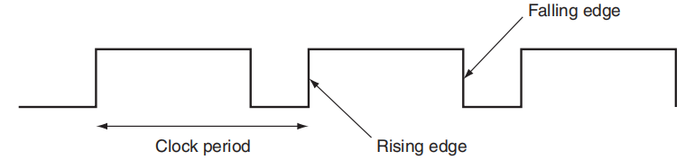
Sequential Logic
Clocks are needed in sequential logic to decide when an element that contains state should be updated.
A clock is a free-running signal with a fixed cycle time; the clock frequency is the inverse of the cycle time. The clock period is the time for one full cycle.
Edge-Triggered Clocking: all state changes occur on a clock edge.
Clocking Methodology: The approach used to determine when data is valid and stable relative to the clock.
In an edge-triggered methodology, either the rising edge or the falling edge of the clock is active and causes state changes to occur.
The clock edge acts as a sampling signal, causing the value of the data input to a state element to be sampled and stored in the state element.

Slide 3
Synchronous system
State Element 1
Combinational Logic
State Element 2
The signals that are written into state elements must be valid when the active clock edge occurs.
A signal is valid if it is stable (i.e., not changing), and the value will not change again until the inputs change.
Since combinational circuits cannot have feedback, if the inputs to a combinational logic unit are not changed, the outputs will eventually become valid.

Slide 4
Synchronous system
The state elements, whose outputs change only after the clock edge, provide valid inputs to the combinational logic block.
To ensure that the values written into the state elements on the active clock edge are valid, the clock must have a long enough period so that all the signals in the combinational logic block stabilize, and then the clock edge samples those values for storage in the state elements.
This constraint sets a lower bound on the length of the clock period, which must be long enough for all state element inputs to be valid.

Slide 5
State Element 1
Combinational Logic
An edge-triggered methodology allows a state element to be read and written in the same clock cycle without creating a race that could lead to undetermined data values.

Slide 6
Flip-Flops and Latches
Latch: A memory element in which the output is equal to the value of the stored state inside the element and the state is changed whenever the appropriate inputs change
and the clock is asserted.
Flip-Flop: A memory element for which the output is equal to the value of the stored state
inside the element and for which the internal state is changed only on a clock edge.

Slide 7
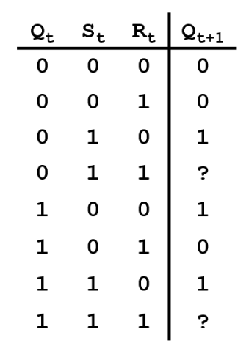
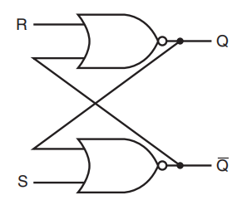
Memory Elements: Flip-Flops, Latches, and Registers
S-R latch: simplest unclocked memory elements.
The outputs represent the value of the stored state and its complement.
When neither S nor R are asserted, the cross-coupled NOR gates act as inverters and store the previous values of the outputs.

Slide 8
D flip-flop
D Latch
D Latch
D
Q(t)
Q(t)
D
Q(t)’
Q(t)’

Slide 9
Register File
A register file consists of a set of registers.
Can be read and written by supplying a register number to be accessed.
Main element of the datapath.
Read and Write Ports
Write Enable Port
Read Register and Write data ports
Reading is combinational, writing is sequential.

Slide 10
Register File
5
32
Read 1
Data 1
32
5
Data 2
Read 2
5
RegWrite
32
WriteData
WriteReg

Slide 11
module registerFile (Read1, Read2, WriteReg, WriteData, RegWrite, Data1, Data2, clock);
input [4:0] Read1, Read2, WriteReg;
input [31:0] WriteData;
input RegWrite, clock;
output [31:0] Data1, Data2;
reg [31:0] RF [31:0];
assign Data1= RF[Read1];
assign Data2= RF[Read2];
always@(posedge clock)
begin
if (RegWrite)
RF[WriteReg] <=WriteData;
else
RF[WriteReg]<=RF[WriteReg];
end
endmodule

Slide 12
4 Bit PIPO Register
D1
D FlipFlip
D2
D FlipFlip
D3
D FlipFlip
D4
D FlipFlip
D
q
D
q
D
q
D
q
Q1
Q2
Q3
Q4

Slide 13
32 bits
5
Reg0
Read 1
Reg1
32
32*1 MUX
Data 1
…
5
Read 2
32
…
32*1 MUX
Data 2
Read Operation
Reg31

Slide 14
5
D
Reg0
WriteReg
0
clk
D
clk
Reg1
5
1
RegWrite
5*32 Decoder
Write Operation
WriteData
D
31
clk
Reg31
32

Slide 15
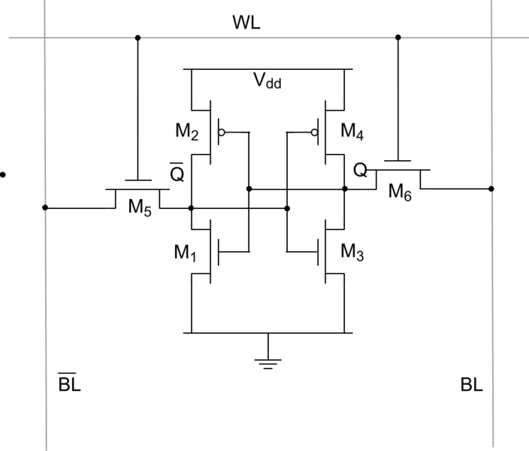
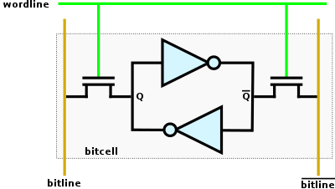
SRAM Cell
A typical SRAM cell is made up of six MOSFETs
Often called a 6T SRAM cell
Each bit in the cell is stored on four transistors (M1, M2, M3, M4).
They form two cross-coupled inverters.
This storage cell has two stable states which are used to denote 0 and 1
Two additional access transistors serve to control the access to a storage cell during read and write operations.

Slide 16
static random access memories (SRAMs)
The memory arrays with a single access port that can provide either a read or a write.
An SRAM chip has a specific configuration in terms of:
number of addressable locations : height
bits of each addressable location : width
Address Line, Chip Select, Output Enable, Write Enable, Data In, Data Out
To initiate a read or write access, the Chip select signal must be made active.
For reads, we must also activate the Output enable signal that controls whether or not the datum selected by the address is actually driven on the pins.
The Output enable is useful for connecting multiple memories to a single-output bus.
Output enable is used to determine which memory drives the bus.
For writes, we must supply the data to be written and the address, as well as signals to cause the write to occur.
When both the Write enable and Chip select are true, the data on the data input lines is written into the cell specified by the address.

Slide 17
Bit LINE and TRI-STATE BUFFER
For large memories, such 64K*1 SRAM, 64K*1 multiplexer is not practical.
Bit Line: shared output line where multiple memory cells in the memory array can assert.
To allow multiple sources to drive a single line, a three-state buffer (or tristate buffer) is used.
A three-state buffer has two inputs—a data signal and an Output enable—and a single output, which is in one of three states: asserted, deasserted, or high impedance.
The output of a tristate buffer is equal to the data input signal, either asserted or deasserted, if the Output enable is asserted, and is otherwise in a high-impedance state that allows another three-state buffer whose Output enable is asserted to determine the value of a shared output.

Slide 18
DYNAMIC RANDOM ACCESS MEMORY
Data is stored as a charge in a capacitor.
Single transistor to access the charge either to read or to write.
Denser and Cheaper: DRAMs use only a single transistor per bit of storage whereas SRAMs take 4-6 Transistors per bit.
Charges in DRAM can not be stored indefinitely, where in SRAM the value stored in a cell is kept on a pair of inverting gates.
Refreshed periodically. Hence the term DYNAMIC.

Slide 19
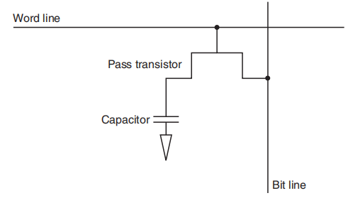
Credit: D. A. Patterson and J. L. Hennessy. Computer Organization and Design: The Hardware/Software Interface. Elsevier India/Morgan Kaufmann publishers, 5th edition

Slide 20
HOW DRAM WORKS
PASS TRANSISTOR: Acts as a switch.
Allows read/write from the capacitor.
When the signal on the word line is high, the switch is closed, connecting the capacitor to the bit line.
Write Operation: the value to be written is placed on the bit line.
Value is a 1: the capacitor will be charged.
Value is a 0: the capacitor will be discharged.

Slide 21
HOW DRAM WORKS
Read Operation: DRAM must detect small charge stored in the capacitor.
the bit line is charged to the voltage that is halfway between the low and high voltage.
Next word line is activated.
The charge on the capacitor is read out onto the bit line.
Bit line moves slightly toward the high or low direction.
The charge is detected by a sense amplifier.

Slide 22
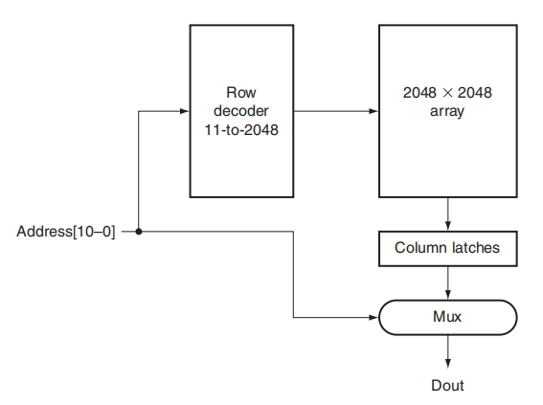
RAS : Row Access Strobe
CAS : Column Access Strobe
Credit: D. A. Patterson and J. L. Hennessy. Computer Organization and Design: The Hardware/Software Interface. Elsevier India/Morgan Kaufmann publishers, 5th edition

Slide 23
MEMORY ACCESS
Two-level decoder
The same address lines are used for both the row and column address
RAS : Row Access Strobe
CAS : Column Access Strobe
The row access chooses one of a number of rows and activates the corresponding word line.
The contents of all the columns in the active row are then stored in a set of latches.
Th e column access then selects the data from the column latches.
Refresh is performed by reading the columns into the column latches and writing back the same. Thus, an entire row is refreshed in one cycle.

