Slide 1
MODULE 3:The Basics of Logic Design
Computer Organization (CS220)
Semester 2022-23-II
Urbi Chatterjee
CSE, IIT Kanpur

Slide 2
Gates, Truth Tables, and Logic Equations
Modern digital computers
Signals
Asserted
Deasserted
Logic Blocks
Combinational: A logic system whose blocks do not contain memory and hence compute the same output given the same input.
Sequential: A group of logic elements that contain memory and hence whose value depends on the inputs as well as the current contents of the memory.

Slide 3
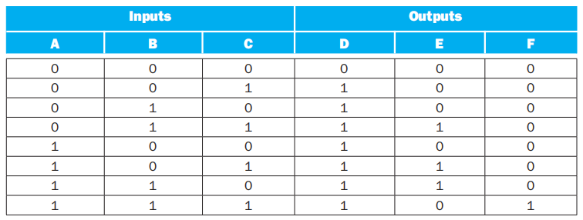
Representation of LOGIC BLOCKS: TRUTH TABLE
Truth Tables can be used to describe any combinational logic function. Each entry specifies the value of all the outputs for that particular input combination.

Slide 4
Representation of LOGIC BLOCKS: LOGIC EQUaTIONS
 | 00 | 01 | 11 | 10
0 | 0 | 1 | 1 | 1
1 | 1 | 1 | 1 | 1
D=A+B+C
 | 00 | 01 | 11 | 10
0 | 0 | 0 | 1 | 0
1 | 0 | 1 | 0 | 1
E=A’.B.C+A.B’.C+A.B.C’
 | 00 | 01 | 11 | 10
0 | 0 | 0 | 0 | 0
1 | 0 | 0 | 1 | 0
F=A.B.C

Slide 5
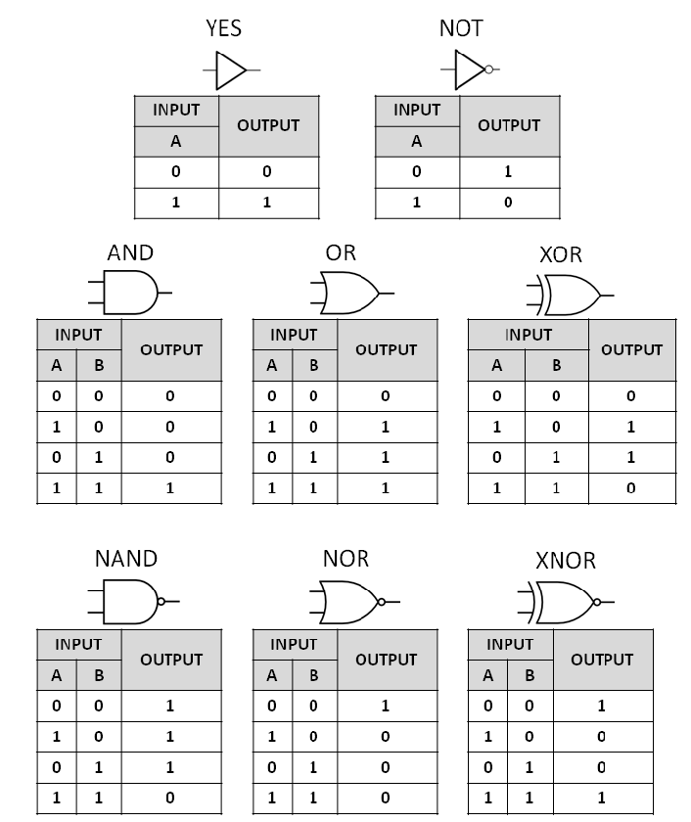
LOGIC GATES

Slide 6
2-to-4 DECODER
2-to-4 DECODER
Y3
A1
Y2
A0
Y1
E
Y0

Slide 7
Enable | INPUTS |  | OUTPUTS
E | A1 | A0 | Y3 | Y2 | Y1 | Y0
0 | x | x | 0 | 0 | 0 | 0
1 | 0 | 0 | 0 | 0 | 0 | 1
1 | 0 | 1 | 0 | 0 | 1 | 0
1 | 1 | 0 | 0 | 1 | 0 | 0
1 | 1 | 1 | 1 | 0 | 0 | 0
Y3=E.A1.A0
Y2=E.A1.A0′
Y1=E.A1′.A0
Y0=E.A1′.A0′

Slide 8
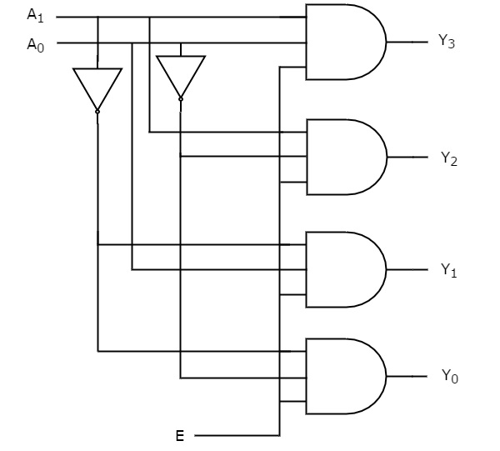
Can we design a 3-to-8 decoder using 2-to-4 decoders?
Check yourself!

Slide 9
Full Adder
FULL ADDER
A
S
B
C_{out}
C_{in}

Slide 10
A | B | C_{in} | S | C_{out}
0 | 0 | 0 | 0 | 0
0 | 0 | 1 | 1 | 0
0 | 1 | 0 | 1 | 0
0 | 1 | 1 | 0 | 1
1 | 0 | 0 | 1 | 0
1 | 0 | 1 | 0 | 1
1 | 1 | 0 | 0 | 1
1 | 1 | 1 | 1 | 1

Slide 11
 | 00 | 01 | 11 | 10
0 | 0 | 1 | 0 | 1
1 | 1 | 0 | 1 | 0
Sum of Products
(It gives HIGH-1 output.)
S=A’.B’.C_{in}+ A’.B.C’_{in}+ A.B’.C’_{in}+A.B.C_{in}
S=(A+B+C’_{in}). (A+B’+C’_{in}). (A’+B+C_{in}).(A’+B’+C’_{in})
 | 00 | 01 | 11 | 10
0 | 0 | 0 | 0 | 1
1 | 0 | 1 | 1 | 1
Products of Sums
(It gives LOW-0 output.)
C_{out}=A’.B.C_{in}+ A.B’.C_{in}+ A.B.C’_{in}+A.B.C_{in}
C_{out}=(A+B’+C’_{in}). (A’+B+C_{in}). (A’+B’+C_{in}).(A’+B’+C’_{in})

Slide 12
programmable logic array and Two Level Logic
sum-of-products representation
A PLA has a set of inputs and corresponding input complements (which can be implemented with a set of inverters), and two stages of logic.
The first stage is an array of AND gates that form a set of product terms (sometimes called minterms); each product term can consist of any of the inputs or their complements.
The second stage is an array of OR gates, each of which forms a logical sum of any number of the product terms.

Slide 13
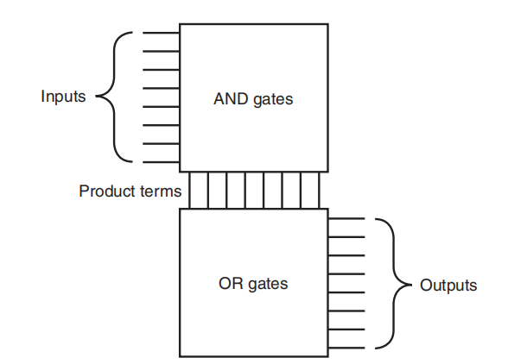
programmable logic array and Two Level Logic

Slide 14
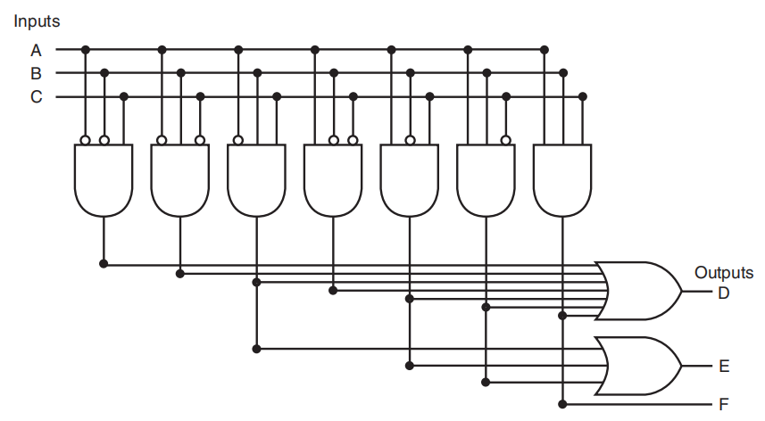
EXAMPLE

Slide 15
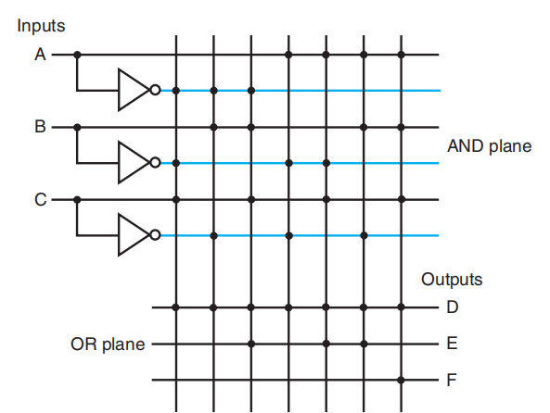

Slide 16
read-only memory (ROM)
A ROM is called a memory because it has a set of locations that can be read; however, the contents of these locations are fi xed, usually at the time the ROM is manufactured.
Programmable ROMs (PROMs) , Erasable PROMs (EPROMs)
A ROM has a set of input address lines and a set of outputs.
The number of Addressable entries in the ROM determines the number of address lines.
If the ROM contains 2^{m} addressable entries, called the height, then there are m input lines.
The number of bits in each addressable entry is equal to the number of output bits and is sometimes called the width of the ROM.
The total number of bits in the ROM is equal to the height times the width. The height and width are collectively referred to as the shape of the ROM.

Slide 17
EXAMPLE: ROM for 2-to-4 Decoder
0 | 0 | 0 | 1
0 | 0 | 1 | 0
0 | 1 | 0 | 0
1 | 0 | 0 | 0

